Slide 1
1.1 Scientific method
Miss Martel
Free Powerpoint Templates

Slide 2
The Scientific Method
With your partner try and remember as many of the parts of the scientific method as you can.
Write them down on your note book.

Slide 3
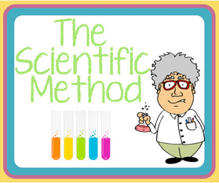
The Scientific Method
The scientific method is a way to ask and answer scientific questions by making observations and doing science experiments.
The steps of the scientific method includes:

Slide 4
The Scientific Method
Ask a Testable Question
Research
Develop a Hypothesis
Plan the Investigation
Experiment
Record Data and Observations
Write a Procedure
List the Materials
Analyze
Data
Draw a Conclusion

Slide 5
Problem/Question

The problem or question must be testable – can be answered by doing an experiment
Opinion questions or questions that can be answered by looking on the internet are not good scientific questions.

Slide 6
Research

Write down/use all the information that you already know about the topic.
Do research on the topic you are investigating to understand the basics.
Research is important because it helps form a hypothesis.
Notes:
Write down all information you already know
Do research in books on the topic you are investigating
Ask experts on the subject you are researching
If you find an answer to your problem/question you do not need to move on

Slide 7
Hypothesis
Using your background research and current knowledge, make an educated guess that answers your question.
A hypothesis is a simple statement that expresses what you think will happen.
“If ___(cause)______, then __(effect)_____.”

Slide 8
Investigation, Materials, Procedure and Experiment
Plan the Investigation
When the hypothesis is formed, follow the instructions of how the experiment will be carried out.
List the Materials
List all the materials used
Write a Procedure
Write down the steps you did to perform the experiment. The steps must be clear so that another person can reproduce the same experiment.
Experiment
Perform the experiment to test the hypothesis

Slide 9
Observations
Describe any observations you made during the experiment. Include all information that could have affected your results such as errors or unexpected surprises.
The observations should be collected by using all 5 senses: sight, smell, touch, taste and sound

Slide 10
Forming a Conclusion
Analyze the data you collected and summarize the results, this is called a conclusion
Use your analysis to answer your original question.
Do the results of your experiment support or oppose your original hypothesis?

Slide 11
How to Write a Conclusion
Restate the hypothesis of your experiment
Indicate if the results accept or reject the hypothesis
Explain your results

Slide 12
Look at these 2 sets of animal tracks.
List 3 observations and draw a conclusion for Frame 1

Slide 13
Now what do you think?
List 3 observations and draw a conclusion for Frame 2

Slide 14
What about now?
With more data and observations, you can draw a more accurate conclusion!
List 3 observations and draw a conclusion for Frame 3

Slide 15
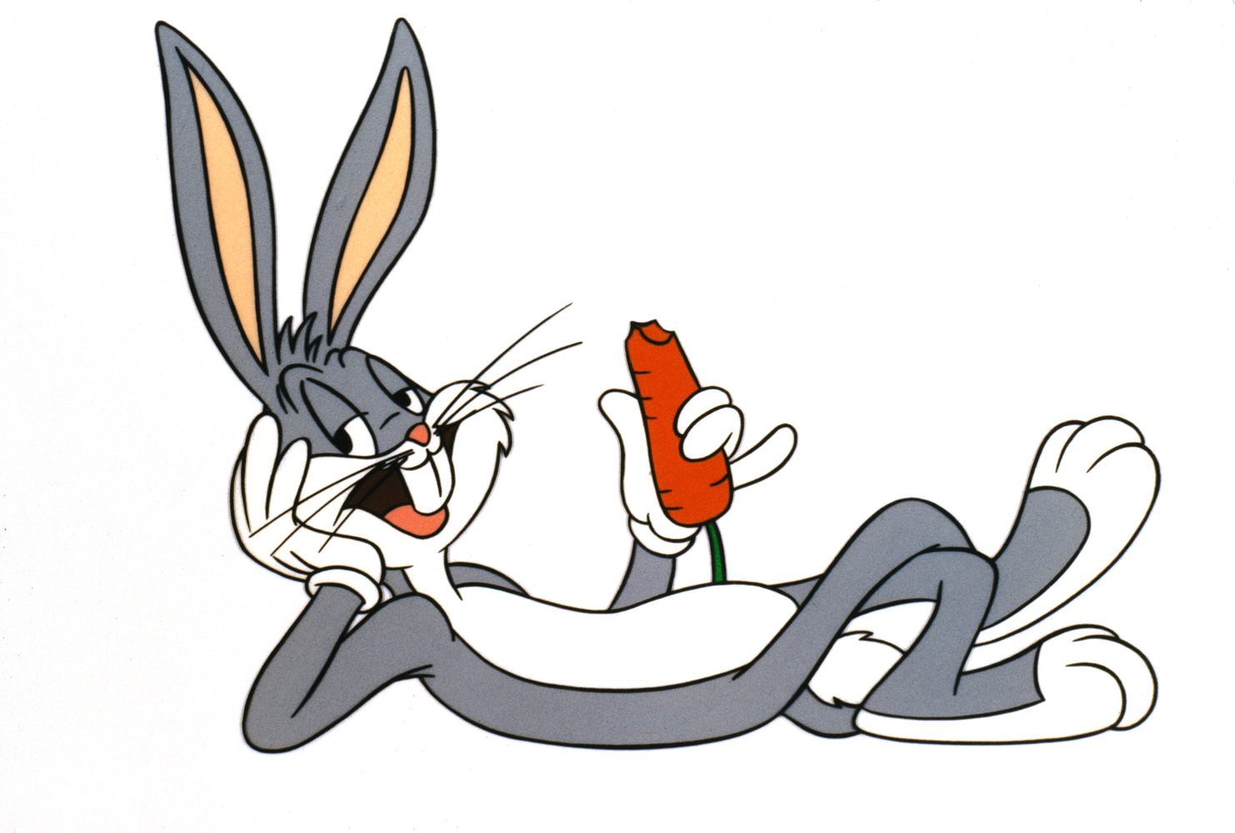
That’s all Folks!

Slide 16
Practicing how to write a proper lab
Read over the lab hand out very carefully!

