Slide 1
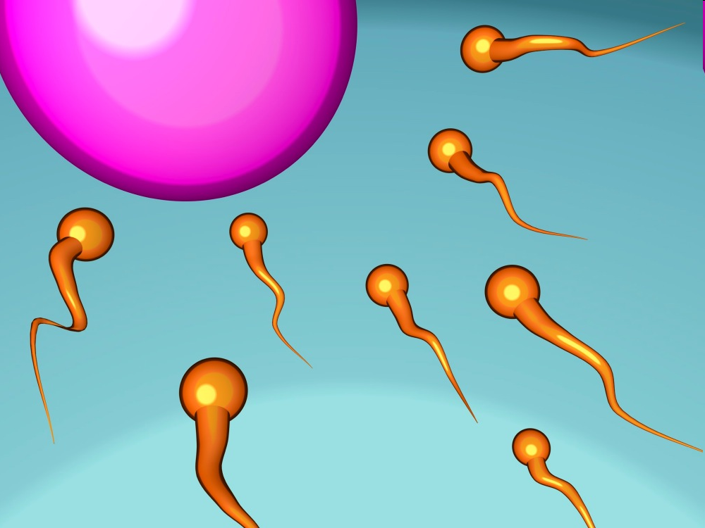
6.1 Meiosis
www.onacd.ca

Slide 2
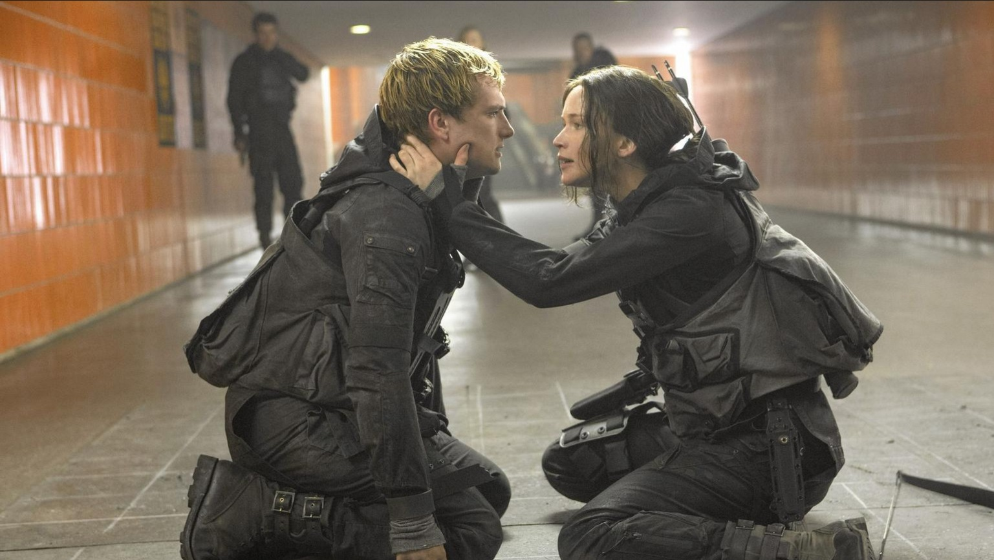
Sexual Reproduction
Have you ever wondered why everyone in our class looks different?
The answer is that all of us have been produced by sexual reproduction
Unlike asexual reproduction, sexual reproduction requires two parents
Sexual reproduction produces offspring that are genetically different from each other

Slide 3
Sexual Reproduction
Why is sexual reproduction important?
Think Pair Share

Slide 4
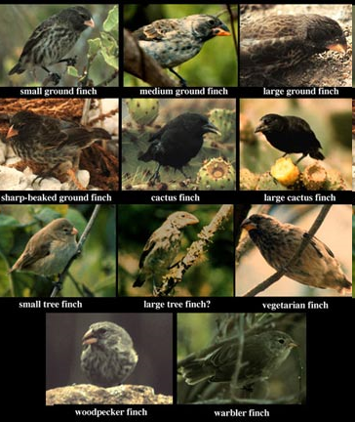
Sexual reproduction
Variation or inherited genetic differences in a species, is called genetic diversity
Genetic diversity occurs because sexual reproduction randomly sorts DNA
Organisms receive a combination of genes from their parents
Therefore, one organism may gain an advantage over another organism of the same species

Slide 5
Sexual reproduction
Do you think sexual reproduction or asexual reproduction cause evolution?

Slide 6
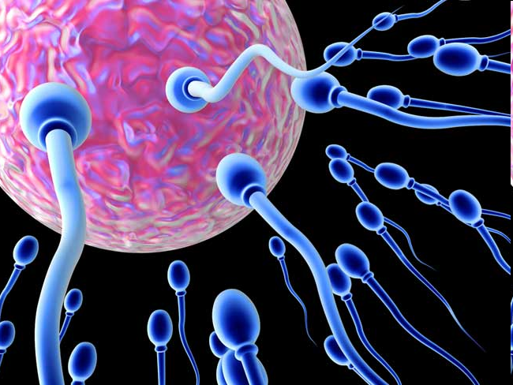
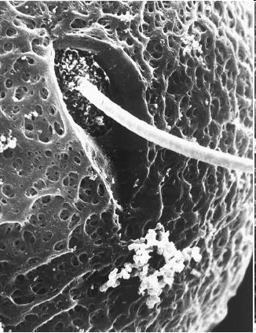
Gametes
Remember that we have 2 pairs of chromosomes. When an organism has 2 pairs of chromosomes it is referred to as a diploid (2n)
As a result, our chromosome number is referred to as the diploid number
Each set of chromosomes that we receive from our parents is referred to as the haploid number (n)

Slide 7
Gametes
Species | Haploid (n) | Diploid (2n)
Humans
Fruit fly | 4
Monkeys |  | 48
peanut | 20
23
46
8
24
40

Slide 8
Gametes
Haploid chromosomes are carried in gametes, which are specialized cells that are needed for reproduction
In animals, male gametes are called sperm cells and female gametes are called egg cells

Slide 9
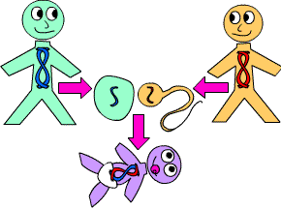
Fertilization
Fertilization occurs when a sperm cell penetrates an egg cell
The genetic information from male and female gametes combine

Slide 10
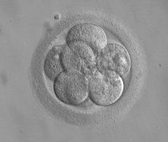
Fertilization
The combination of these two haploid cells results in a diploid cell (2n) called a zygote
A zygote is the initial cell formed when two gamete cells are joined together
The zygote then undergoes mitosis and cell division and becomes an embryo

Slide 11
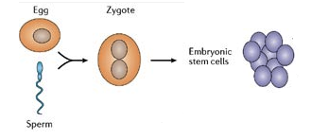
Fertilization
Haploid (n)
Haploid (n)
Diploid (2n)
Draw the process of an egg being fertilized and be coming a zygote and then into a embryo.
Answer the two questions on your handout.

Slide 12
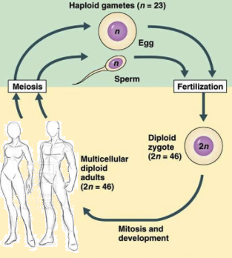
Fertilization

Slide 13
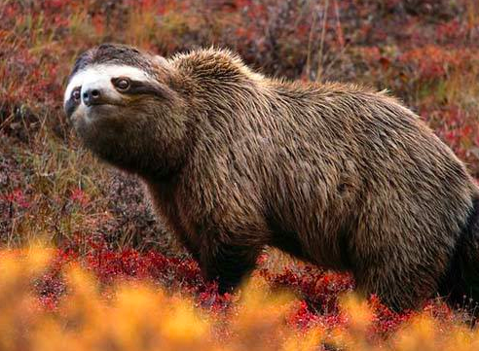
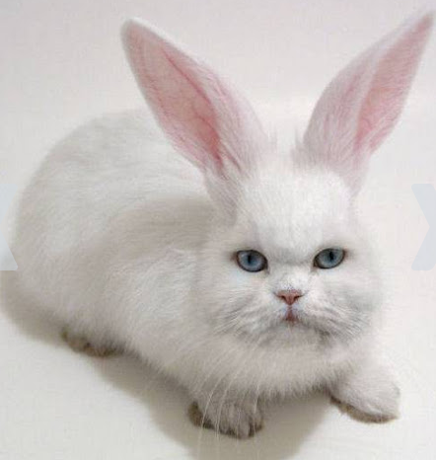
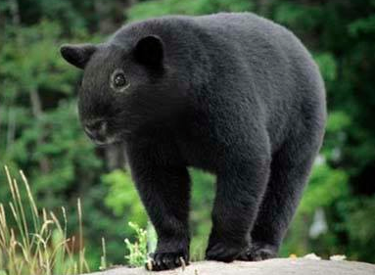
Genetic Diversity?

Slide 14
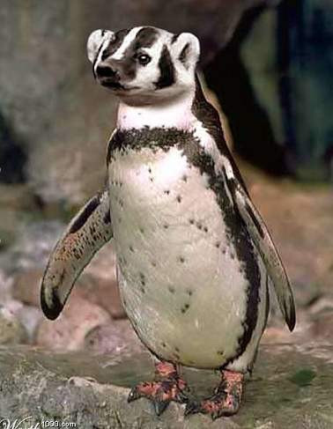
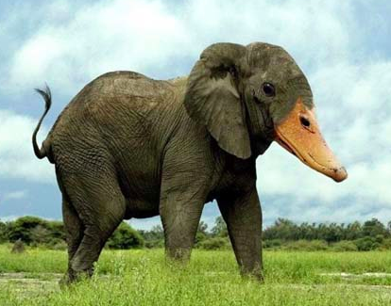
Genetic Diversity?

Slide 15
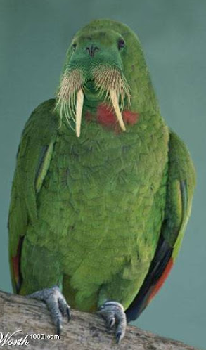
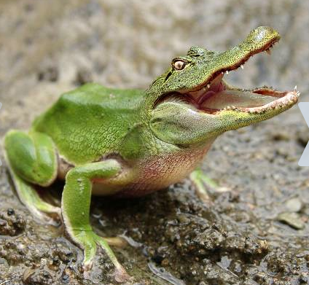
Genetic Diversity?

Slide 16
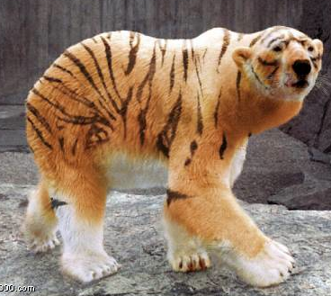
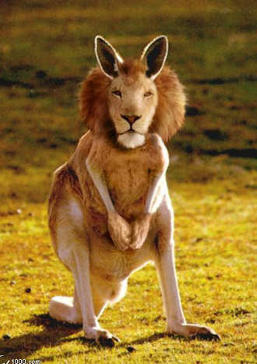
Genetic Diversity?

Slide 17
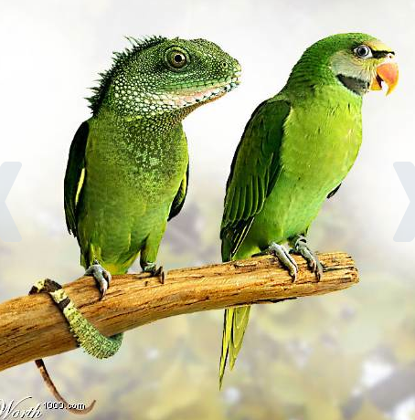
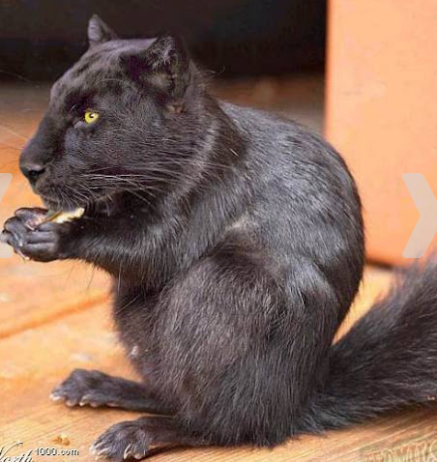
Genetic Diversity?

Slide 18
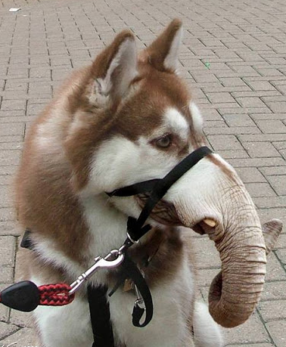
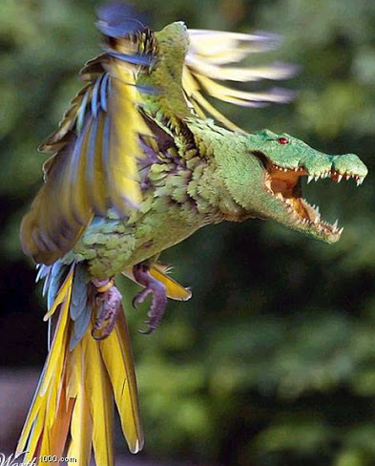
Genetic Diversity?

