Slide 1
1.1 Safety in the
Science Lab
Miss Martel

Slide 2
HOMEWORK CHECK
Please bring out your signed outline forms
Binders will be check next Thursday

Slide 3
Safety Symbols
Through out Canada, there are symbols on chemicals to warn people about the dangers.
They often use WHMIS Symbols: WHMIS stands for: Workplace Hazardous Materials Information System

Slide 4
WHMIS
Guess what the symbols mean! You can work with the partner beside you.

Slide 5
WHMIS
Compressed gas
Corrosive
Flammable
Reactive
Oxidizer
Biohazard

Slide 6
WHMIS
Poisonous
Toxic
Each group take a bottle and see what symbols they have. Fill in the chart on page 2 on your handout.

Slide 7
Compressed gas

Slide 8
Reactive

Slide 9
Working in the Science Classroom
What is the first thing to be done if there is any hazard or injury in the lab?
Are eating or drinking permitted in the science classroom?
Tell the teacher
No, unless the drink is in a bottle

Slide 10
Working with Fire
When using an open
flame, long hair must
be _________.
When do you use the fire extinguisher?
How far away from the fire are you when using the extinguisher?
tied back
On a small fire, not on a person
About 2.5 meters away

Slide 11
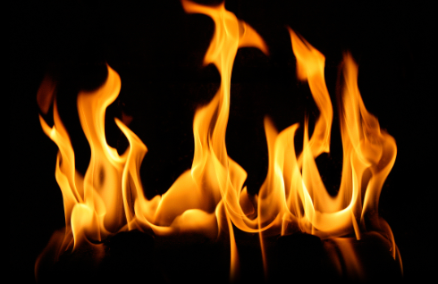
Working with Fire
Why do you avoid spraying it on a person?
If a person is on fire, what do you try to get them to do?
Could cause blindness, suffocate a person, since they cannot breathe
STOP, DROP, and ROLL

Slide 12

Fire Triangle – Fuel, heat and oxygen are all required for a fire to start

Slide 13
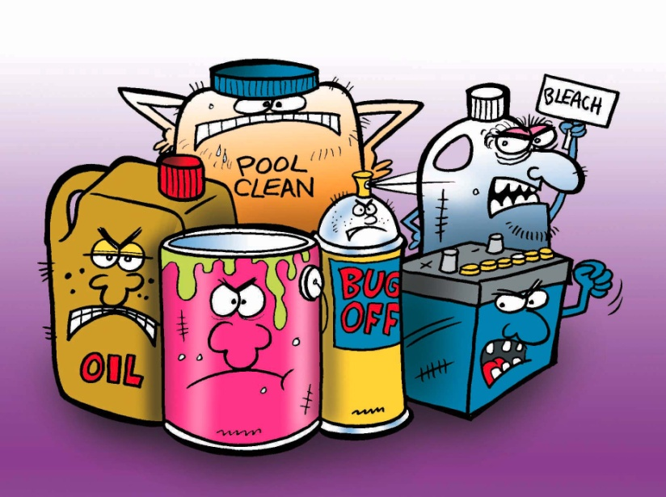
Working with Chemicals
How do you safely smell a chemical?
Why is it not recommended that a chemical be returned to its original container?
Waft (fan the smell)
It contaminates the contents that are left in the container

Slide 14
Working with Chemicals
What water temperature is used to rinse the skin if you spill a chemical on yourself? Why?
Is washing with soap recommended for all chemical spills to the skin?
With cold water, since it slows down the chemical reaction
No, we do not know if the chemical will react with the soap

Slide 15
Working with Chemicals
How do you dispose of chemicals at the end of a lab?
If you break glassware what should you do?
As directed by the teacher, since it depends on the chemical
Sweep it up with a broom, put it in
the broken glass container
Notes:
Stopped here for 9B.

Slide 16
1.1 Safety continues
Homework check
Course evaluation
First page of urban legends
Binders?

Slide 17
Warm up
On a separate sheet of paper
What does WHMIS stand for?
What is this symbol?
Why don’t you spray a person with a fire extinguisher? What should they do if they are on fire?

Slide 18
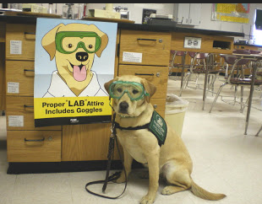
Appropriate
Lab Attire
What does it mean to be
dressed appropriately for
a lab?
Why is wearing contact lenses not permitted during a lab?
Wear lab coat and goggles,
sometimes gloves
Chemicals could stick to contacts

Slide 19
Appropriate
Lab Attire
Other than contact lenses, what else
should you avoid wearing?
Open toed shoes and
loose fitting clothes

Slide 20
Emergency
Procedures
When do you use the eyewash
bottle?
How do you use the eyewash bottle properly?
Where is the emergency shower? When do you use the emergency shower?
Chemicals get in your eyes
Keep eyes open, rinse
Boys washroom, 5th floor. When
chemicals spill on a large area of the body.

Slide 21
Emergency
Procedures
How do you use the shower properly?
When do you use the first aid kit?
What precautions are taken when helping someone who is bleeding?
Where do you go to find the FA Attendant?
Put the entire affected body part under water
Small, minor cuts or scratches
Always wear gloves
Office or PE Department

Slide 23
NEXT CLASS: SAFETY QUIZ
SYMBOLS AND THE QUESTIONS WE WENT OVER
OUT OF 18 POINTS
MUST GET 86% OR HIGHER.
If not you will redo after school or lunch time

