Slide 1
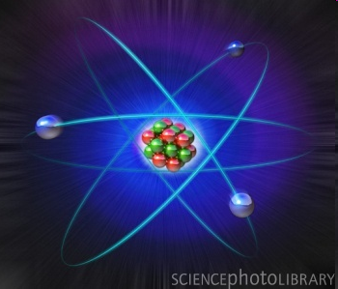
1.3 Atomic Theory
www.onacd.ca

Slide 2
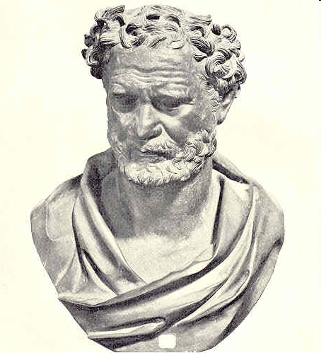
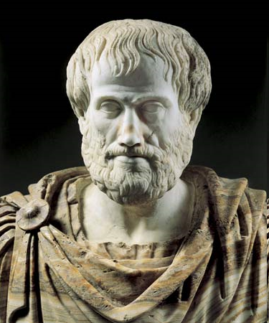
Atomic Theory through the Ages
400 B.C. – Democritus thought that matter could not be divided indefinitely
350 B.C – Aristotle states that all matter is made up of four elements: Earth, Air, Fire, and Water.
Aristotle is very, very wrong but his ideas persisted for 2000 years!!

Slide 3
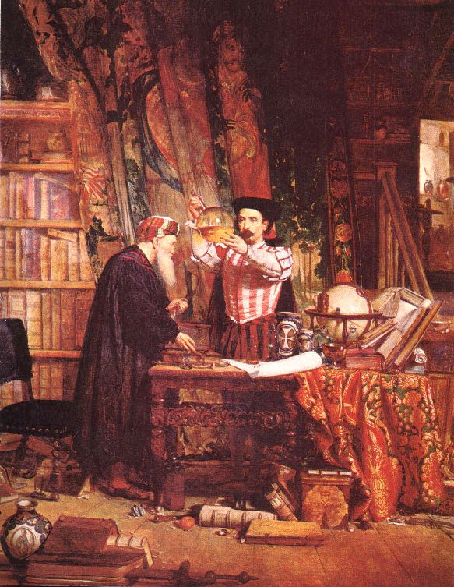
Alchemist
Middle ages – Alchemy
started
Alchemists experimented with matter
Tried to turn common metals into gold, for over 1000 years they tried.

Slide 4
John Dalton
1800 –Dalton conducts experiments and studied gases in the Earth’s atmosphere.
He proposed the theory of the atom.
Look on p.30 in textbook and fill in four main points on p.2 in notes

Slide 5
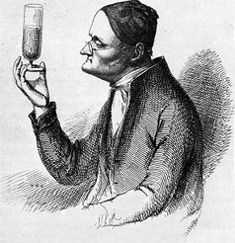
All matter is made of small particles called atoms.
Atoms cannot be created, destroyed, or divided into smaller particles. (partially untrue now, as we discovered!)
All atoms of the same element are identical in mass and size, but they are different in mass and size from the atoms of other elements.
Compounds are created when atoms of different elements link together in definite proportions.

Slide 6
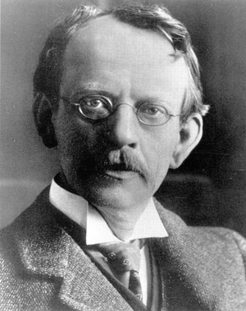
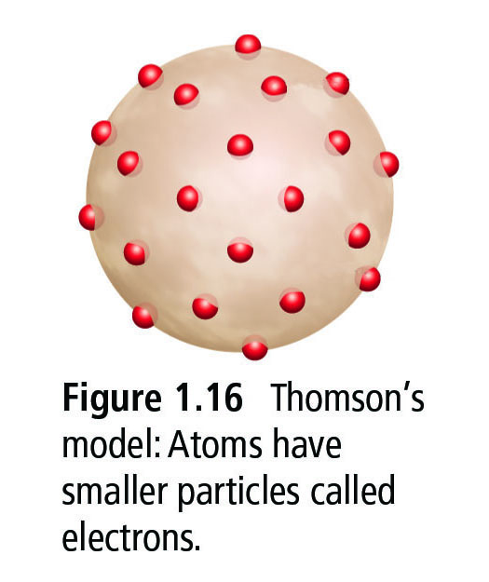
Atomic Theory through the Ages
1900 – JJ Thomson discovers that when materials are rubbed, they can develop a charge difference. He proposes his “Plum Pudding” model
Atoms, which are positively charged, contain negatively charged particles (later called electrons)
They are stuck in the atom
Draw his model of the atom

Slide 7
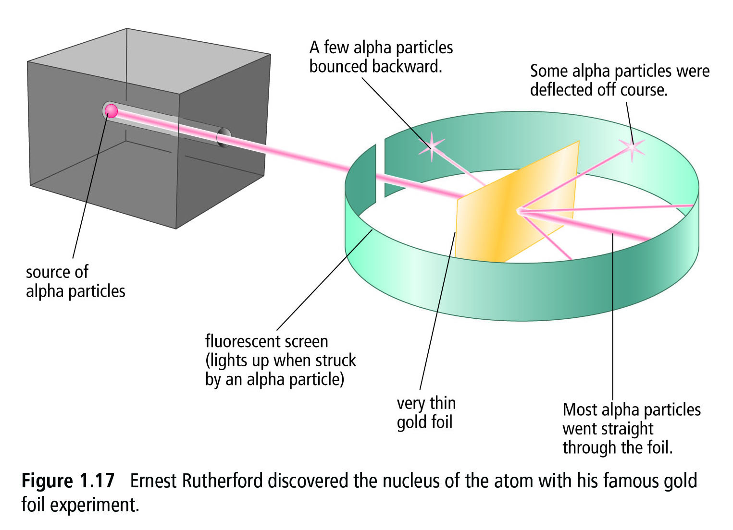
Atomic Theory through the Ages
1910 – Rutherford conducts alpha particle experiment
Phet simulation

Slide 8
Atomic Theory through the Ages
Run simulation and hand out magnets.
Try putting the south and south pole together. What happens?
Try putting the north and north pole ends together. What happens?
What happens when you put North and South end together?

Slide 9
Atomic Theory through the Ages
1. When you turned on the alpha gun, what did you notice?
2. What was the difference with the plum pudding model?
3. What do you think the difference is? Why does this happen?

Slide 10
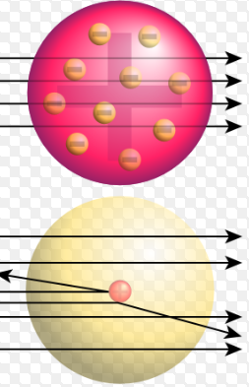
Atomic Theory through the Ages
1910 – Rutherford’s alpha particle experiment proves that:
Atoms are mostly empty space
Negative electrons orbit around a positive nucleus

Slide 11
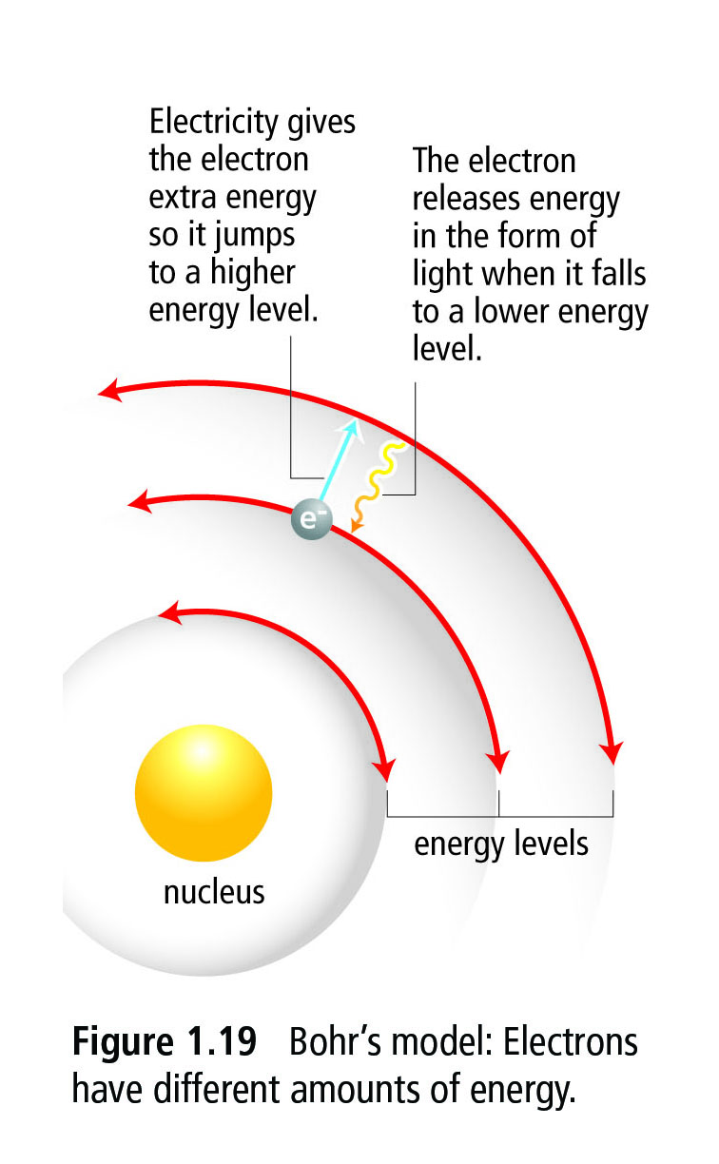
Atomic Theory through the Ages
1913 – Studied the light given off when he passes electricity through hydrogen gas
Niels Bohr proposes the Bohr Model in which electrons orbit the nucleus in specific energy “levels” or “shells”

Slide 12
Moving towards Modern Chemistry
Niels Bohr proposes the Bohr Model in which electrons orbit the nucleus in specific energy “levels” or “shells”
This meant that each electron has a particular amount of energy.
Example: Neon light

Slide 13
Emission Spectra
How are they formed?
Before:
electrons
He

Slide 14
Emission Spectra
How are they formed?
Before:
He

Slide 15
Emission Spectra
How are they formed?
Before:
He

Slide 16
Emission Spectra
How are they formed?
Before:
He

Slide 17
Emission Spectra
How are they formed?
After:
Electron is
“EXCITED”
He

Slide 18
Emission Spectra
How are they formed?
The result:
He

Slide 19
Emission Spectra
How are they formed?
The result:
He

Slide 20
Emission Spectra
How are they formed?
The result:
He

Slide 21
Emission Spectra
How are they formed?
The result:
Loses energy
as
light of a specific wavelength colour
He

Slide 22
Emission Spectra
How are they formed?
The result:
Loses energy
as
light of a specific wavelength colour
He

Slide 23
Emission Spectra
How are they formed?
The result:
Loses energy
as
light of a specific wavelength colour
He

Slide 24
Emission Spectra
How are they formed?
The result:
Loses energy
as
light of a specific wavelength colour
He
EMISSION
of
Light

Slide 25
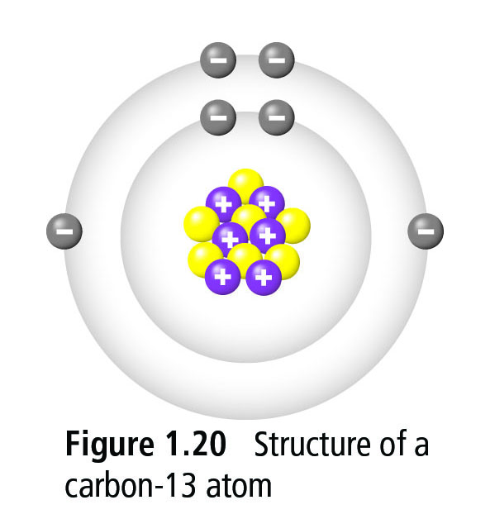
Modern Atomic Theory
Read page 32-33 in textbook
Fill in page 5 of handout

Slide 26
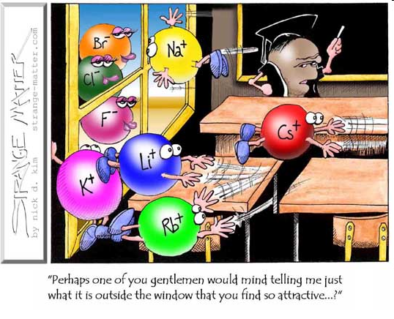
Fun Fact of the Day!
There is a whole lot of empty space in the atom! If the nucleus of a carbon atom was represented by a grape placed at centre ice of Rogers Arena, then the entire stadium would represent the volume occupied by electrons!

Slide 27
Modern Atomic Theory
Protons and Neutrons are held tightly together at the centre of the atom in a region called the Nucleus
Electrons exist around the Nucleus in shells or energy levels
The region occupied by Electrons makes up most of the volume of the atom

Slide 28
Modern Atomic Theory
Subatomic particles are the particles that make up an atom
Protons are subatomic particles with a 1+ (positive) electric charge
Neutrons are subatomic particles that do not have an electric charge
Electrons are subatomic particles with a 1- (negative) electric charge

Slide 29
Modern Atomic Theory
The region occupied by Electrons is actually a massive volume compared to the nucleus
A neutral atom has the same number of Protons and Electrons. Since a Proton counts as 1+ electric charge and a Electron counts as 1- electric charge, the charges add up to zero, making the atom neutral

Slide 30
Atomic Theory through the Ages
With one partner discuss the following people and what their ideas were about the atom
Aristotle
JJ Thompson
Rutherford
John Dalton
I will be asking students who they were!

Slide 31
Homework
Fill out 1.3 Worksheet

