Slide 1
Mitosis & Meiosis
Ms. Martel

Slide 2
The Key Roles of Cell Division
The ability of organisms to produce more of their own kind best distinguishes living things from nonliving matter.
The continuity of life is based on the reproduction of cells, or cell division.
Cell division plays several important roles in life:
1) The division of one prokaryotic cell reproduces an entire organism.
2) Cell division enables multicellular eukaryotes to develop from a single cell.
3) Renewal, repair, and replacing cells that die from normal wear and tear.

Slide 3
12.1 – MOST CELL DIVISION RESULTS IN GENETIALLY IDENTICAL DAUGHTER CELLS
Cellular Organization of the Genetic Material
A cell’s genetic information is called the genome.
A typical human cell has approximately 2 meters of DNA, a length about 250,000 times greater than the cell’s diameter.
In order for a cell to divide, all of the DNA must be copied.
The replication and distribution of so much DNA is manageable because the DNA molecules are packaged into chromosomes.

Slide 4
The DNA molecule carries several hundred to a few thousand genes.
Genes code for proteins.
Together, the entire complex of DNA and proteins that is the building material of chromosomes is referred to as chromatin.
Every eukaryotic species, has a characteristic number of chromosomes.
The nuclei of human somatic cells (all body cells except the reproductive cells) contains 46 chromosomes made up of two sets of 23.
Reproductive cells, or gametes – sperm and eggs – have half as many chromosomes as somatic cells. Or one set of 23 chromosomes in humans.

Slide 5
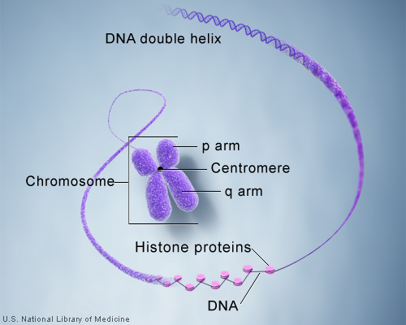

Slide 6
Distribution of Chromosomes During Eukaryotic Cell Division
The image here shows one chromosome in a eukaryotic cell before duplication.
Normally it would be a long, thin chromatin fiber containing one DNA molecule and associated proteins

Slide 7
Once duplicated, a chromosome consists of two sister chromatids connected along their entire lengths by sister chromatid cohesion.
Each chromatid contains a copy of the DNA molecule

Slide 8
Molecular and mechanical processes separate the sister chromatids into two chromosomes and distribute them to two daughter cells.

Slide 9
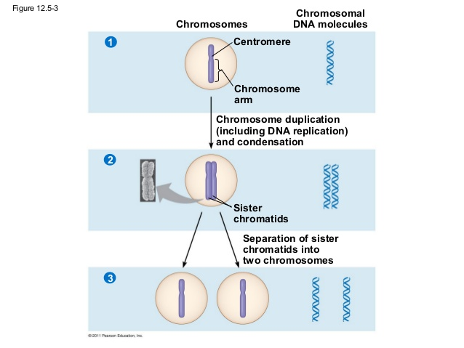
Mitosis, the division of the genetic material in the nucleus, is usually followed immediately by cytokinesis, the division of cytoplasm.

Slide 10
12.2 – THE MITOTIC PHASE ALTERNATES WITH INTERPHASE IN THE CELL CYCLE
Phases of the Cell Cycle
Mitosis is just one part of the cell cycle.
The mitotic phase, which includes both mitosis, and cytokinesis, is usually the shortest part of the cell cycle.
Interphase accounts for about %90 of the cell cycle.
During interphase, a cell that is about to divide grows and copies its chromosomes in preparation for cell division.

Slide 11
Interphase can be divided into subphases:
G1 phase – first gap
S phase – synthesis
G2 phase – second gap
Chromosomes are duplicated only during the S phase.

Slide 12
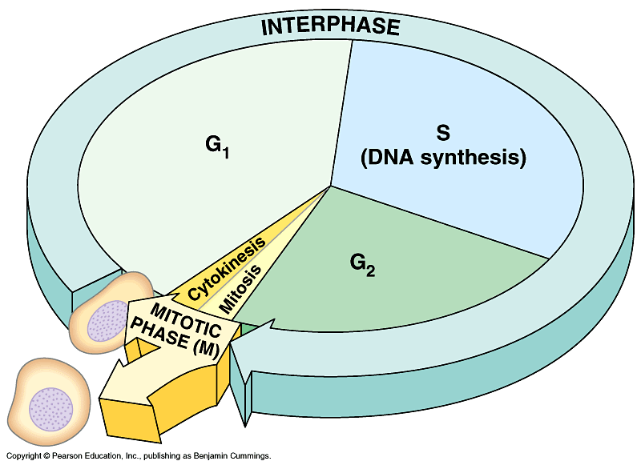
Mitosis is conventionally broken down into five stages: prophase, prometaphase, metaphase, anaphase, and telophase.
Overlapping with the latter stages of mitosis, cytokinesis completes the mitotic phase.

Slide 13
G2 of Interphase
A nuclear envelope encloses the nucleus.
Two centromeres have formed by duplication of a single centrosome. Centrosomes organize the microtubules of the spindle. Each centrosome contains two centrioles.
Chromosomes, duplicated during S phase, cannot be seen individually because they have not yet condensed.

Slide 14
Prophase
The chromatin fibers become more tightly coiled, condensing into discrete chromosomes
Each duplicated chromosome appears as two identical sister chromatids joined at their centromere.
Mitotic spindle begins to form. It is composed of centrosomes and microtubules. Radial arrays of shorter microtubules that extend from the centrosomes are called asters.
Centrosomes move away from each other.

Slide 15
Prometaphase
The nuclear envelope fragments.
Microtubules extending from centrosome, invade nuclear area.
Chromosomes are even more condensed.
Chromatids of each chromosome now has kinetochore at centromere
Some microtubules attach to kinetochores, and jerk chromosomes back and fourth.

Slide 16
Metaphase
Centromeres are now at opposite poles.
Chromosomes convene at metaphase plate, a plane that is equidistant between the spindle’s two poles.
For each chromosome, the kinetochores of the sister chromatids are attached to kinetochore microtubules coming from opposite poles.

Slide 17
Anaphase
Begins when cohesion proteins are cleaved. Sister chromatids part, each becoming chromosomes.
Daughter chromosomes move towards opposite ends of the cell.
Cell elongates as nonkinetochore microtubules lengthen.
By the end of anaphase, the two ends of the cell have equivalent – and complete – collections of chromosomes.

Slide 18
Telophase
Two daughter nuceli form in cell. Nuclear envelopes arise from fragments of parent cell’s nuclear envelope.
Chromosomes become less condensed.
Any remaining spindle microtubules are depolymerized.
Mitosis, the division of one nucleus into two identical nuclei, is now complete.

Slide 19
Cytokinesis
The division of the cytoplasm, is usually well under way by late telophase, so the two daughter cells appear shortly after the end of mitosis.
In animal cells, cytokinesis involves the formation of a cleavage furrow, which pinches the cell in two.

Slide 20
The Mitotic Spindle: A Closer Look
Many of the events of mitosis depend on the mitotic spindle, which begins to form in the cytoplasm during prophase.
This structure consists of fibers made of microtubules and associated proteins.
In animal cells, the assembly of spindle microtubules starts at the centrosome.
A subcellular region containing material that functions throughout the cell cycle to organize the cell’s microtubules.

Slide 21
Binary Fission in Bacteria
Binary fission refers to the process of asexual reproduction of bacteria and single-celled eukaryotes.
In bacteria, most genes are carried on a single bacterial chromosome that consists of circular DNA.
In some bacteria, cell division is initiated when the DNA begins to replicate at a specific place on the chromosome called the origin of replication, producing two origins.
While the chromosome replicates, the cell elongates
Once complete, the plasma membrane pinches inwards, dividing the bacteria into two daughter cells.

Slide 22
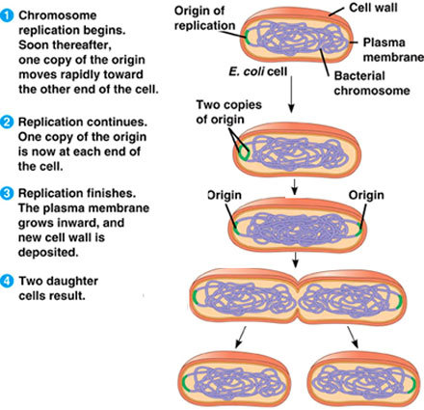

Slide 23
12.3 – THE EUKARYOTIC CELL CYCLE IS REGULATED BY A MOLECULAR CONTROL SYSTEM
The timing and rate of a cell division in different parts of an organism are crucial to normal growth, development, and maintenance.
The frequency of cell division varies with the type of cell.
Ex) human skin cells divide frequently throughout life. However, nerve and muscle cells do not divide in a mature human.
These differences result from regulation at the molecular level

Slide 24
Evidence for Cytoplasmic Signals
In the early 1970’s, experiments were conducted to determine if the cell cycle was driven by signaling molecules in the cytoplasm.
Two cells in different phases of the cell cycle were fused to form a single cell with two nuclei.
If one of the cells was in the S phase, and the other in G1, the G1 immediately entered into the S phase.
Furthermore, if a cell undergoing mitosis was fused with another cell in any stage of its cell cycle, the second immediately entered mitosis.

Slide 25
The Cell Cycle Control System
This control system is a cyclically operating set of molecules in the cell that both triggers and coordinates key events in the cell cycle.
The cell cycle is regulated by certain checkpoints by both internal and external signals.
A checkpoint in the cell cycle is a control point where stop and go-ahead signals can regulate the cycle.
Many signals registered at checkpoints come from cellular surveillance mechanisms inside the cell.

Slide 26
Three major checkpoints are found in the G1, G2, and M phases.
For many cells, the G1 checkpoint, “restriction point”, seems to be the most important. If it does not receive the go ahead signal at that point, it will switch into a nondividing stage called the G0 phase.

Slide 27
The Cell Cycle Clock: Cyclins and Cyclin-Dependent Kinases
Rhythmic fluctuations in the abundance and activity of cell cycle control molecules pace the sequential events of the cell cycle.
These molecules are mainly proteins of two types: protein kinases and cyclins.

Slide 28
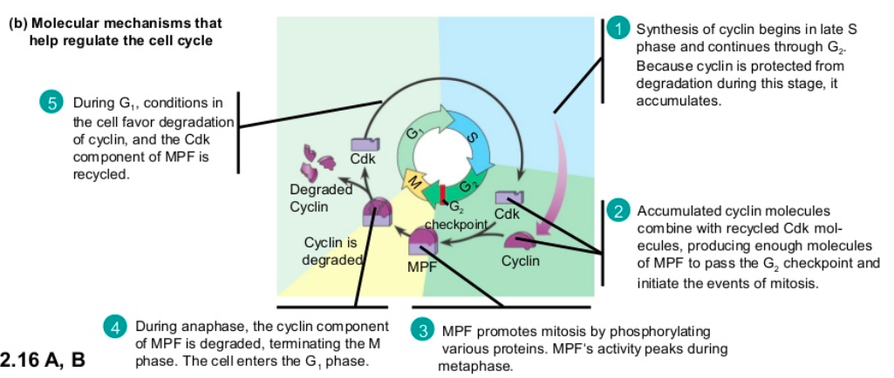

Slide 29
Stop and Go Signs: Internal & External Signals at the Checkpoints
INTERNAL
Anaphase does not begin until all the chromosomes are attached to the spindle at the metaphase plate.
Only then do the appropriate regulatory protein complexes become activated. This ensures cells do not end up with missing or extra chromosomes.

Slide 30
EXTERNAL
1) Growth factor for example, is a protein that is released by certain cells to stimulate other cells to divide.
2) Density-dependent inhibition is a phenomenon in which crowded cells stop dividing.
If dividing cells come into contact with neighboring cells or a border they will stop dividing.
3) Most animal cells exhibit anchorage dependence.
In order to divide they must be attached to a substratum.

Slide 31
Loss of Cell Cycle Controls in Cancer Cells
Cancer cells do not heed the normal signals that regulate the cell cycle.
They divide excessively and invade other tissues.
If unchecked they can kill the organism.
Cancer cells in culture do not stop dividing when growth factors are depleted.
Cancer cells can go on dividing indefinitely in culture if they are given a continual supply of nutrients.
Cancer cells also evade normal controls that trigger a cell to undergo apoptosis when something is wrong.
Ex) when an irreparable mistake has occurred during DNA replication

Slide 32
Family Photos!!! ☺
Show the person (people) at your table a family photo.
Have them identify similarities and differences between you and your parents and you and your siblings.
Why is there variation in the first place?
How are we different from our parents and siblings?

Slide 33
Meiosis and Sexual Life Cycles
The transmission of traits from one generation to the next is called inheritance or heredity.

Slide 34
However, sons and daughters are not identical copies of either parent or of their siblings.
Along with inherited similarity, there is also variation.
But what are the biological mechanisms leading to the hereditary similarity and variation that we call a “family resemblance”?

Slide 35
Genetics is the scientific study of heredity and hereditary variation.
In the upcoming sections, you will learn about genetics at multiple levels, from organisms to cells to molecules.
We begin our study of genetics in this chapter by examining how chromosomes pass from parents to offspring in sexually reproducing organisms.
The process of meiosis and fertilization maintain a species’ chromosome count during the sexual life cycle

Slide 36
13.1 – OFFSPRING ACQUIRE GENES FROM PARENTS BY INHERITING CHROMOSOMES
Inheritance of Genes
Parents endow their offspring with coded information in the form of hereditary units called genes.
Our genes program the specific traits that emerge as we develop from fertilized eggs into adults.
Most genes program cells to synthesize specific enzymes and other proteins, whose actions produces an organisms inherited traits.

Slide 37
In animals and plants, reproductive cells called gametes transmit genes from one generation to the next.
During fertilization, male and female gametes unite, passing on genes of both parents to offspring.
A genes specific location along the length of a chromosome is called the gene’s locus.

Slide 38
Comparison of Asexual and Sexual Reproduction
In asexual reproduction, a single individual is the sole parent and passes copies of all its genes to its offspring.
An individual that reproduces asexually gives rise to a clone.
Genetic differences occasionally arise in asexually reproducing organisms due to mutations.
In sexual reproduction, two parents give rise to offspring that have unique combinations of genes.
Offspring’s of sexual reproduction vary genetically from their siblings and parents.

Slide 39
13.2 FERTILIZATION AND MEIOSIS ALTERNATE IN SEXUAL LIFE CYCLES
A life cycle is the generation-to-generation sequence of stages in the reproductive history of an organisms, from conception to production of its own offspring.

Slide 40
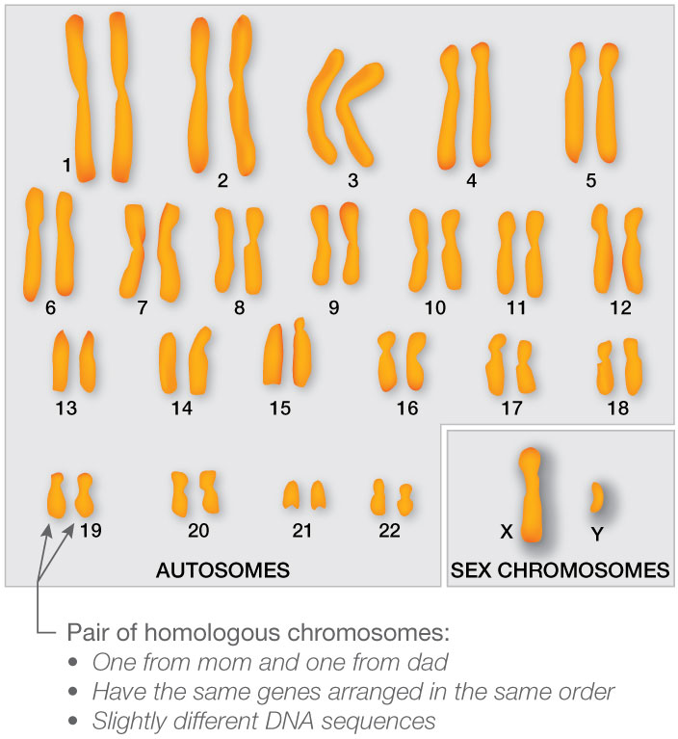
Sets of Chromosomes in Human Cells
Humans have 23 pairs, or 46 chromosomes.
Karyotypes show chromosomes in their pairs arranged by length.
The two chromosomes composing a pair have the same length, centromere position, and staining pattern.
AKA: homologous chromosomes

Slide 41
Both chromosomes of each pair carry genes controlling the same inherited characters.
The two distinct chromosomes (X and Y) are important exceptions to the general pattern of homologous chromosomes.
These are the human sex chromosomes.
The other chromosomes are called autosomes.

Slide 42
The number of chromosomes in a single set is represented by n.
Any cell with two chromosome sets is called a diploid cell and has a diploid number of chromosomes, abbreviated 2n.
For humans the diploid number is 46 (2n = 46), the number of chromosomes in our somatic cells.
Unlike somatic cells, gametes contain a single set of chromosomes, AKA haploid cells.
Each has a haploid number of chromosomes (n).
For humans, the haploid number is 23 (n= 23).

Slide 43
Behaviour of Chromosome Sets in the Human Life Cycle
Fertilization is the union of gametes, culminating in the fusion of their nuclei.
The resulting fertilized egg or zygote, is diploid because it contains two haploid sets of chromosomes.
Both chromosome sets in the zygote and all the genes they carry are passed with precision to the somatic cells.
The only cells of the human body not produced by mitosis are the gametes.

Slide 44
Gamete formation involves a type of cell division called meiosis.
In animals, meiosis occurs only in germ cells, which are in the ovaries and testes.

Slide 45
13.3 – MEIOSIS REDUCES THE NUMBER OF CHROMOSOME SETS FROM DIPLOID TO HAPLOID
Many of the steps in meiosis closely resemble corresponding steps in mitosis.
Meiosis, like mitosis, is preceded by the duplication of chromosomes.
However, this single duplication is followed by two consecutive cell divisions called meiosis I and meiosis II.
This results in four daughter cells.

Slide 46
Meiosis I: Separates Homologous Chromosomes

Slide 47
Prophase I
During early Prophase I
Chromosomes begin to condense
Paired homologues become physically connected to each other along their lengths. AKA: synapsis
Crossing over, a genetic rearrangement between non-sister chromatids involving the exchange of segments of DNA molecules, occurs here.

Slide 48
During mid Prophase I
Synapsis has ended and the chromosomes have moved apart slightly.
Homologous pairs have X-shaped regions called chiasmata.
Exists where a crossover has occurred.
Centrosome movement, spindle formation, and nuclear envelope breakdown occur

Slide 49
During late Prophase I
Microtubules from one pole or the other attach to the two kinetochores.
The homologous pairs then move towards the metaphase plate.

Slide 50
Metaphase I
Pairs of homologous chromosomes are now arranged at the metaphase plate.
Both chromatids of one homolog are attached to kinetochore microtubules from one pole;
Those of other homolog are attached to microtubules at opposite pole.

Slide 51
Anaphase I
Breakdown of proteins responsible for sister chromatid cohesion allows homologs to separate.
Homologs move toward opposite poles guided by spindle apparatus.
Sister chromatid cohesion persists at the centromere, causing chromatids to move as a unit towards the same pole.

Slide 52
Telophase I & Cytokinesis
In telophase I, each half of the cell has a complete haploid set of duplicated chromosomes.
Each chromosome is composed of two sister chromatids.
Cytokinesis usually occurs simultaneously with telophase I, forming two haploid daughter cells.
In animal cells, cleavage furrow forms.
No chromosome duplication occurs between meiosis I & II.

Slide 53
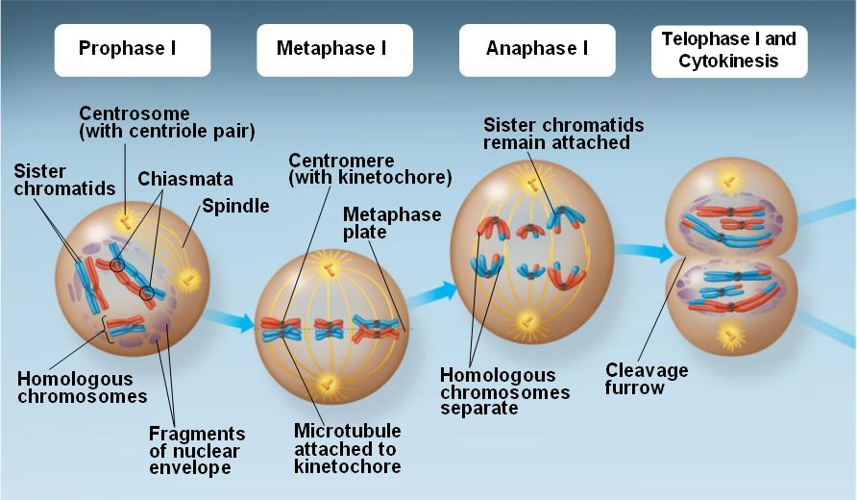

Slide 54
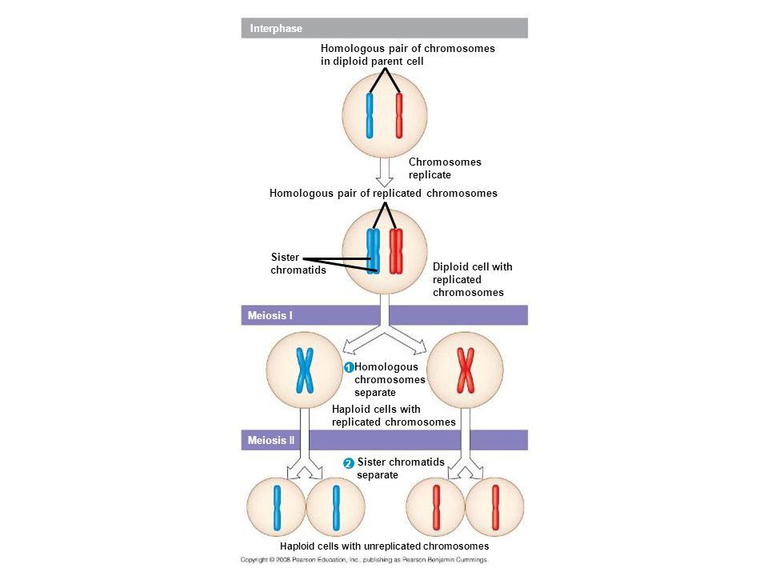
Meiosis II: Separates Sister Chromatids

Slide 55
Prophase II
A spindle apparatus forms
In late prophase II chromosomes, each still composed of two chromatids associated at the centromere, move toward the metaphase II plate

Slide 56
Metaphase II
The chromosomes are positioned at the metaphase plate.
Because of crossing over in meiosis I, the two sister chromatids are not genetically identical.
The kinetochores of sister chromatids are attached to microtubules extending from opposite poles.

Slide 57
Anaphase II
Breakdown of proteins holding the sister chromatids together at the centromere allows chromatids to separate.
The chromatids move toward opposite poles as individual chromosomes.

Slide 58
Telophase II and Cytokinesis
Nuclei form, the chromosomes begin decondensing, and cytokinesis occurs.
Meiotic division of one parent cell produces four daughter cells, each with a haploid set of chromosomes.
Four daughter cells are genetically distinct from one another, and from parent cell.

Slide 59
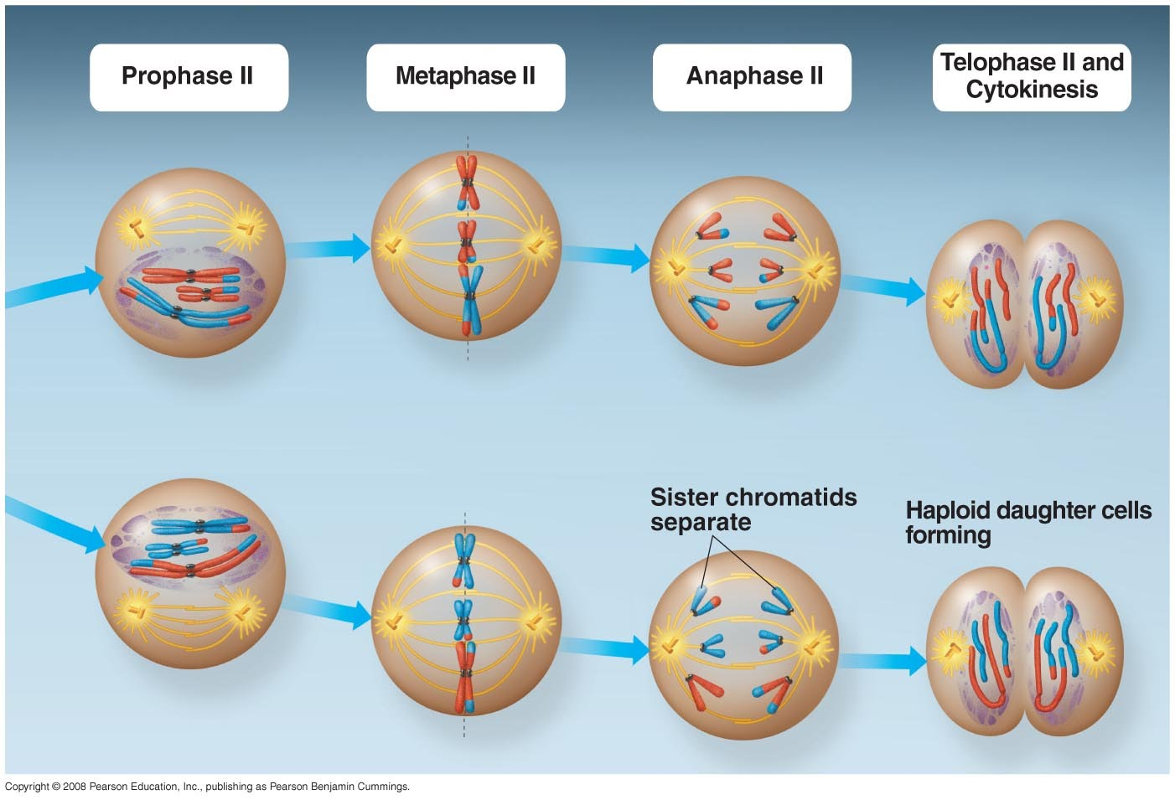

Slide 60
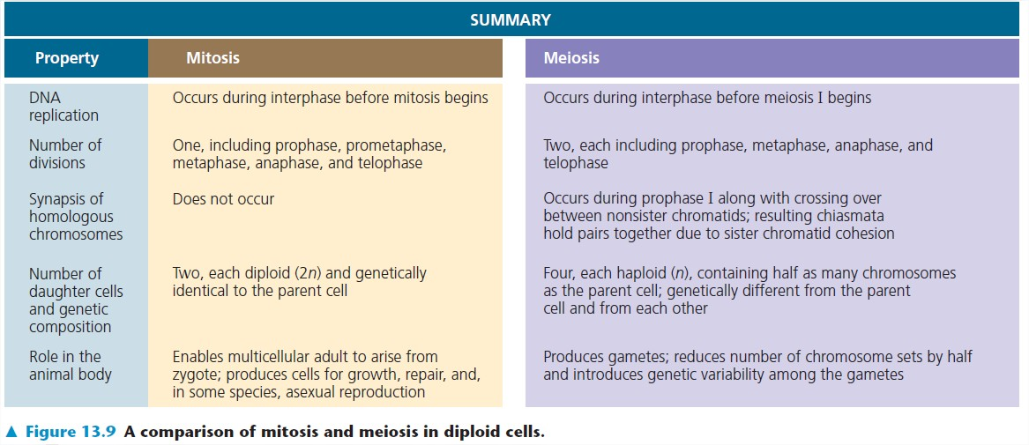
A Comparison of Mitosis and Meiosis

Slide 61
A Comparison of Mitosis and Meiosis
Basically, meiosis reduces the number of chromosome sets from two (diploid) to one (haploid), whereas mitosis conserves the number of chromosome sets
Three events unique to meiosis occur during meiosis I:
1. Synapsis and crossing over
2. Homologous pairs at the metaphase plate.
3. Separation of homologs.

Slide 62
13.4 – GENETIC VARIATION PRODUCED IN SEXUAL LIFE CYCLES CONTRIBUTES TO EVOLUTION
Mutations are the original source of genetic diversity.
These changes in an organism’s DNA create the different versions of genes known as alleles.
Reshuffling of the alleles during sexual reproduction produces the variation that results in a unique combination of traits.

Slide 63
Origins of Genetic Variation Among Offspring
In species that reproduce sexually, the behaviour of chromosomes during meiosis and fertilization is responsible for most of the variation that arises in each generation.
There are three mechanisms that contribute to genetic variation: independent assortment of chromosomes, crossing over, and random fertilization.

Slide 64
1. Independent Assortment of Chromosomes
This is the random orientation of pairs of homologous chromosomes at metaphase of meiosis I.
Each pair may orient with either its maternal or paternal homolog, the orientation is random.
The first meiotic division results in each pair sorting its maternal and paternal homologs into daughter cells independently of every other pair.

Slide 65
2. Crossing Over
Crossing over produces recombinant chromosomes, which combine DNA inherited from each parent.
Begins very early in prophase I, as homologs pair up gene by gene.
In crossing over, homolog portions of two nonsister chromatids trade places.

Slide 66
3. Random Fertilization
The random nature of fertilization adds to the genetic variation arising from meiosis.
In humans, each male and female gamete represents one of about 8.4 million (2^23) possible chromosome combinations due to independent assortment.
Crossing over adds even more variation
Each zygote has a unique genetic identity

Slide 67
The Evolutionary Significance of Genetic Variation Within Populations
Natural selection results in the accumulation of genetic variations favored by the environment.
Sexual reproduction contributes to the genetic variation in a population, which originated from mutations.

