Slide 1
Lymphatic and Immune System
Ms. Martel

Slide 2
The Lymphatic System
The lymphatic system consists of lymphatic vessels and the lymphatic organs.
This system has three main functions contributing to homeostasis:
1) taking excess fluid and returning it to the blood stream
2) lacteals absorb fats from the digestive tract and transport them to the bloodstream
3) helps defend the body against disease

Slide 3
Lymphatic Vessels
These vessels form a one-way system that begins with lymphatic capillaries.
Lymphatic capillaries take up excess tissue fluid which is made up of mostly water, and also contains solutes derived from plasma and cellular products secreted by cells.
This fluid is called lymph.

Slide 4
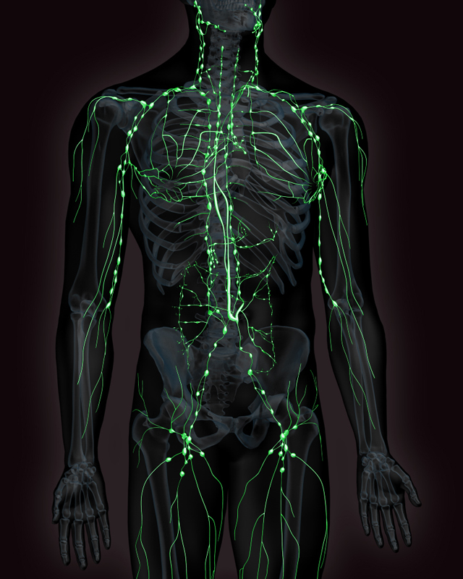
The lymphatic capillaries join to form the lymphatic vessels before entering either the thoracic duct or the right lymphatic duct.

Slide 5
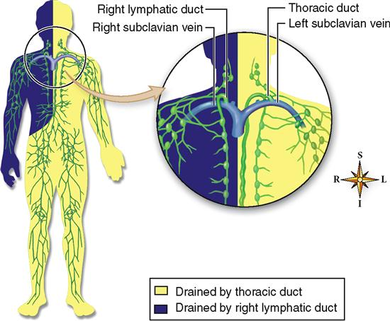
The right lymphatic duct returns lymph from the right arm, right side of the head and neck back to the right subclavian vein.
The thoracic duct drains the rest of the lymphatic fluid into the left subclavian vein

Slide 6
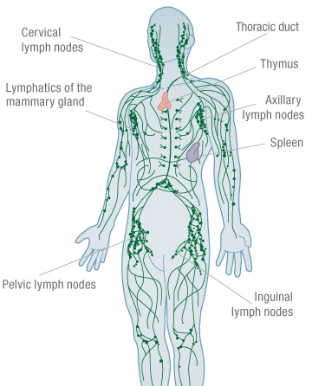
Larger lymphatic vessels have valves.
The movement of lymph is dependent upon skeletal muscle contraction.
Lymph forced through lymphatic vessels as a result of muscular compression is prevented from back-flowing by valves.

Slide 7
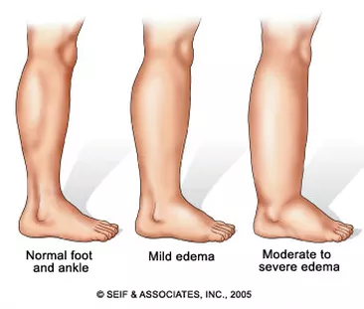
Edema is localized swelling caused by the accumulation of tissue fluid that has not been collected by lymphatic vessels.
Edema can lead to tissue damage and eventual death.
Fat absorption and defense function of the lymphatic system are equally important.
Unfortunately, cancer cells sometimes enter lymphatic vessels and move to other regions of the body undetected causing secondary tumors.

Slide 8
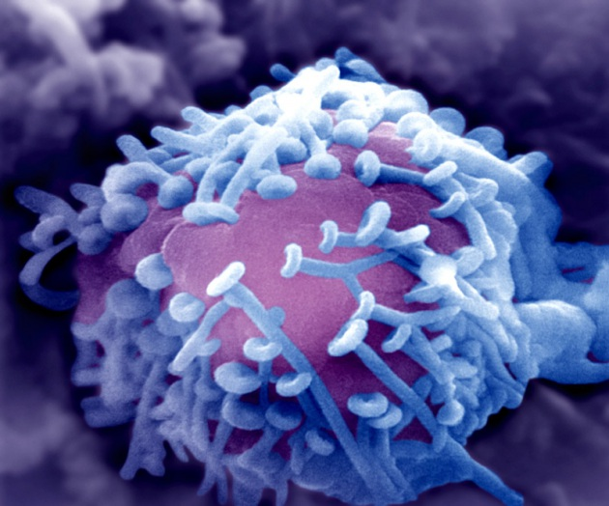
Lymphatic Organs
These organs contain a large number of lymphocytes.
Lymphocytes are a type of white blood cell (WBC) that exist as B lymphocytes (B cells) and T lymphocytes (T cells).
They are produced and mature in the primary lymphatic organs: red bone marrow and the thymus.

Slide 9
Primary Lymphatic Organs
Red bone marrow is the site of stem cells that produce blood cells.
In a child most bones have red bone marrow.
In adults it is present only in skull, sternum, ribs, clavicle, pelvis, and vertebrae.
Bone marrow is not only the source of B lymphocytes, but also where they mature.
T lymphocytes mature in the thymus.

Slide 10
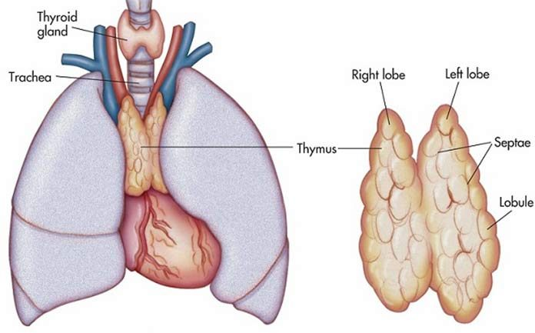
Thymus gland is located in the thoracic cavity between the trachea and sternum above the heart.
Immature T lymphocytes migrate from bone marrow through the bloodstream to the thymus, where they mature
Thymus gland produces thymosin, which aids in maturing T cells.

Slide 11
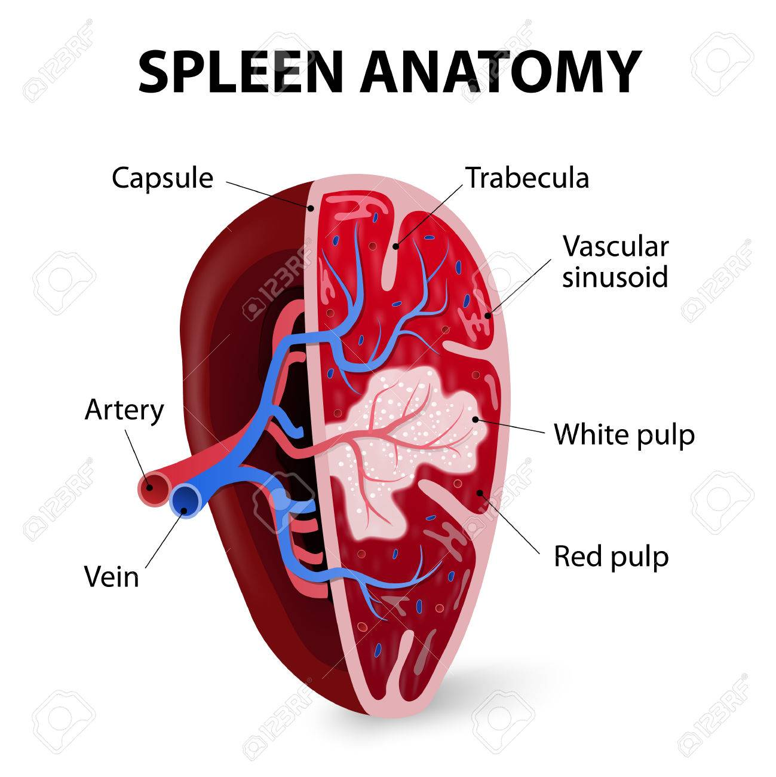
Secondary Lymphatic Organs
The spleen is red pulp that filters the blood.
It consists of blood vessels and sinuses where macrophages remove old and defective blood cells.
Lymphocytes cleanse the blood of foreign particles.
The spleen’s outer capsule is relatively thin, and an infection or blow can cause it to burst.
A person without a spleen is often more susceptible to infection.

Slide 12
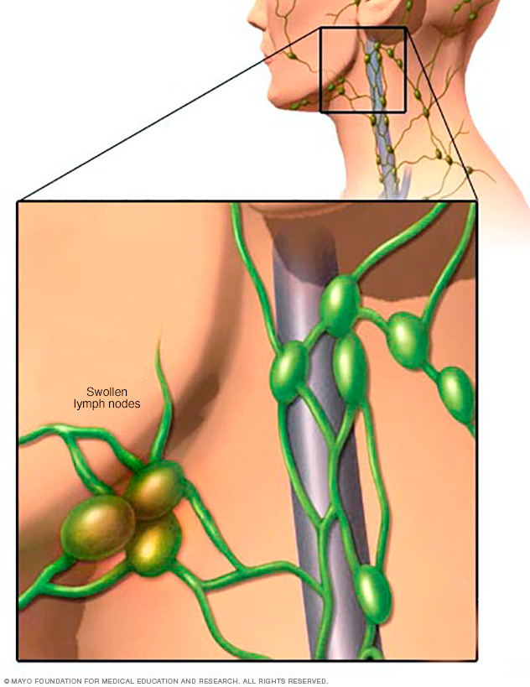
Lymph nodes cleanse lymph.
They are packed with B lymphocytes and contain a sinus.
As lymph courses through sinuses, it is filtered by macrophages, which engulf pathogens.
T cells are also present here, fight infections, and attack cancer cells.

Slide 13
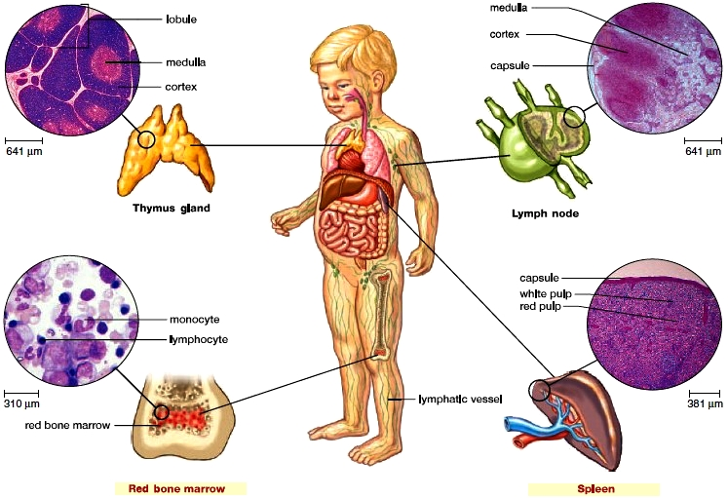

Slide 14
Nonspecific and Specific Defenses
Immunity is the body’s capability to repel foreign substances, pathogens, and cancer cells.
Nonspecific immunity indiscriminately repels pathogens, while specific immunity requires a certain antigen be present.
An antigen is any molecule that stimulates the immune system.

Slide 15
Nonspecific Defenses
There are four types of nonspecific defenses effective against many pathogens:
Barriers to entry
Inflammatory reaction
Natural killer cells
Protective proteins

Slide 16
Skin and mucous membranes lining the respiratory, digestive, and urinary tracts serve as mechanical barriers.
Oil gland secretions contain chemicals that weaken or kill bacteria on the skin
The upper respiratory tract is lined by ciliated cells that sweep mucous and trapped particles up into the throat, where they can be swallowed or coughed out.
The stomach acid has an acidic pH, which prevents bacteria growth.
Our bodies also have natural bacteria in the intestine and vagina to prevent outside pathogens from residing there.

Slide 17
Inflammatory Reaction
This reaction occurs when tissue is damaged by a physical or chemical agent.
An inflamed area has four outward signs:
Redness
Heat
Swelling
Pain
All of these signs are due to capillary changes in the damaged area.
Histamine and mast cells are chemical mediators that cause the capillaries to dilate and become more permeable.

Slide 18
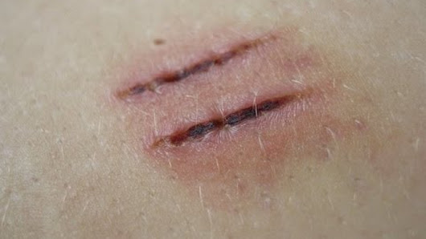
Excess blood flow causes the skin to redden and become warm.
Proteins and fluids escape the tissue, resulting in swelling.
The swollen area stimulates free nerve endings, causing pain sensations.

Slide 19
Migration of neutrophils and monocytes happen during this time.
These cells are amoeboid and can change shape to squeeze through capillary walls to enter the tissue fluid.
Also present are dendritic cells and macrophages that devour pathogens.
Once destroyed, these cells and waste become pus.
The inflammatory reaction can be accompanied by the blood clotting cascade, and activation of T lymphocytes to mount a specific defense.

Slide 21
Natural Killer Cells
Natural Killer Cells (NK) are large granular lymphocytes that kill virus-infected cells and tumour cells by cell-to-cell contact.
Our cells have “self” proteins on the surface that bind to receptors on NK cells.
Virus infected cells and tumour cells sometimes lose their “self” proteins.
NK cell will kill these cells if they come into contact with them.

Slide 22
Protective Proteins
The complement system is composed of a number of blood plasma proteins.
It “complements” certain immune responses.
This system can amplify the inflammatory response.
Other complement proteins join to form a membrane attack complex that produces holes in the surface of bacteria and viruses.

Slide 23
Specific Defenses
Specific defenses take five to seven days to become fully activated.
They rely primarily on the action of lymphocytes, either B cells or T cells.
B cells give rise to plasma cells, which produce antibodies
T cells differentiate into either helper T cells, or cytotoxic T cells.

Slide 24
B Cells and Antibody-Mediated Immunity
A B cell is activated in a lymph node or spleen when it’s receptor (BCR) binds to a specific antigen.
It will then divide by mitosis many times to make clones of itself. Mostly plasma cells.
The clonal selection theory states that an antigen selects, then binds to the BCR of only one type of B or T cell.
Once the threat of infection has passed, plasma cells present undergo apoptosis.
Defense by B cells is called antibody-mediated immunity.

Slide 25
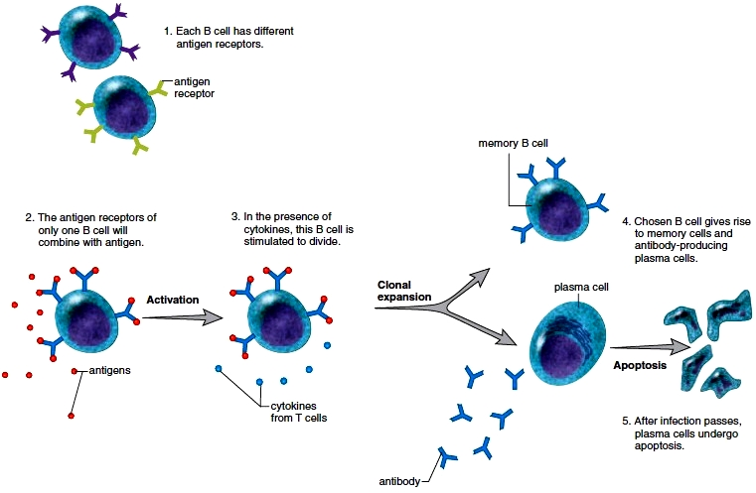

Slide 26
Characteristics of B Cells
Antibody-mediated immunity against pathogens
Produced and mature in bone marrow
Reside in lymph nodes and spleen, circulate in blood and lymph.
Directly recognize antigen and then undergo clonal selection
Clonal expansion produces antibody-secreting plasma cells as well as memory B cells.

Slide 27
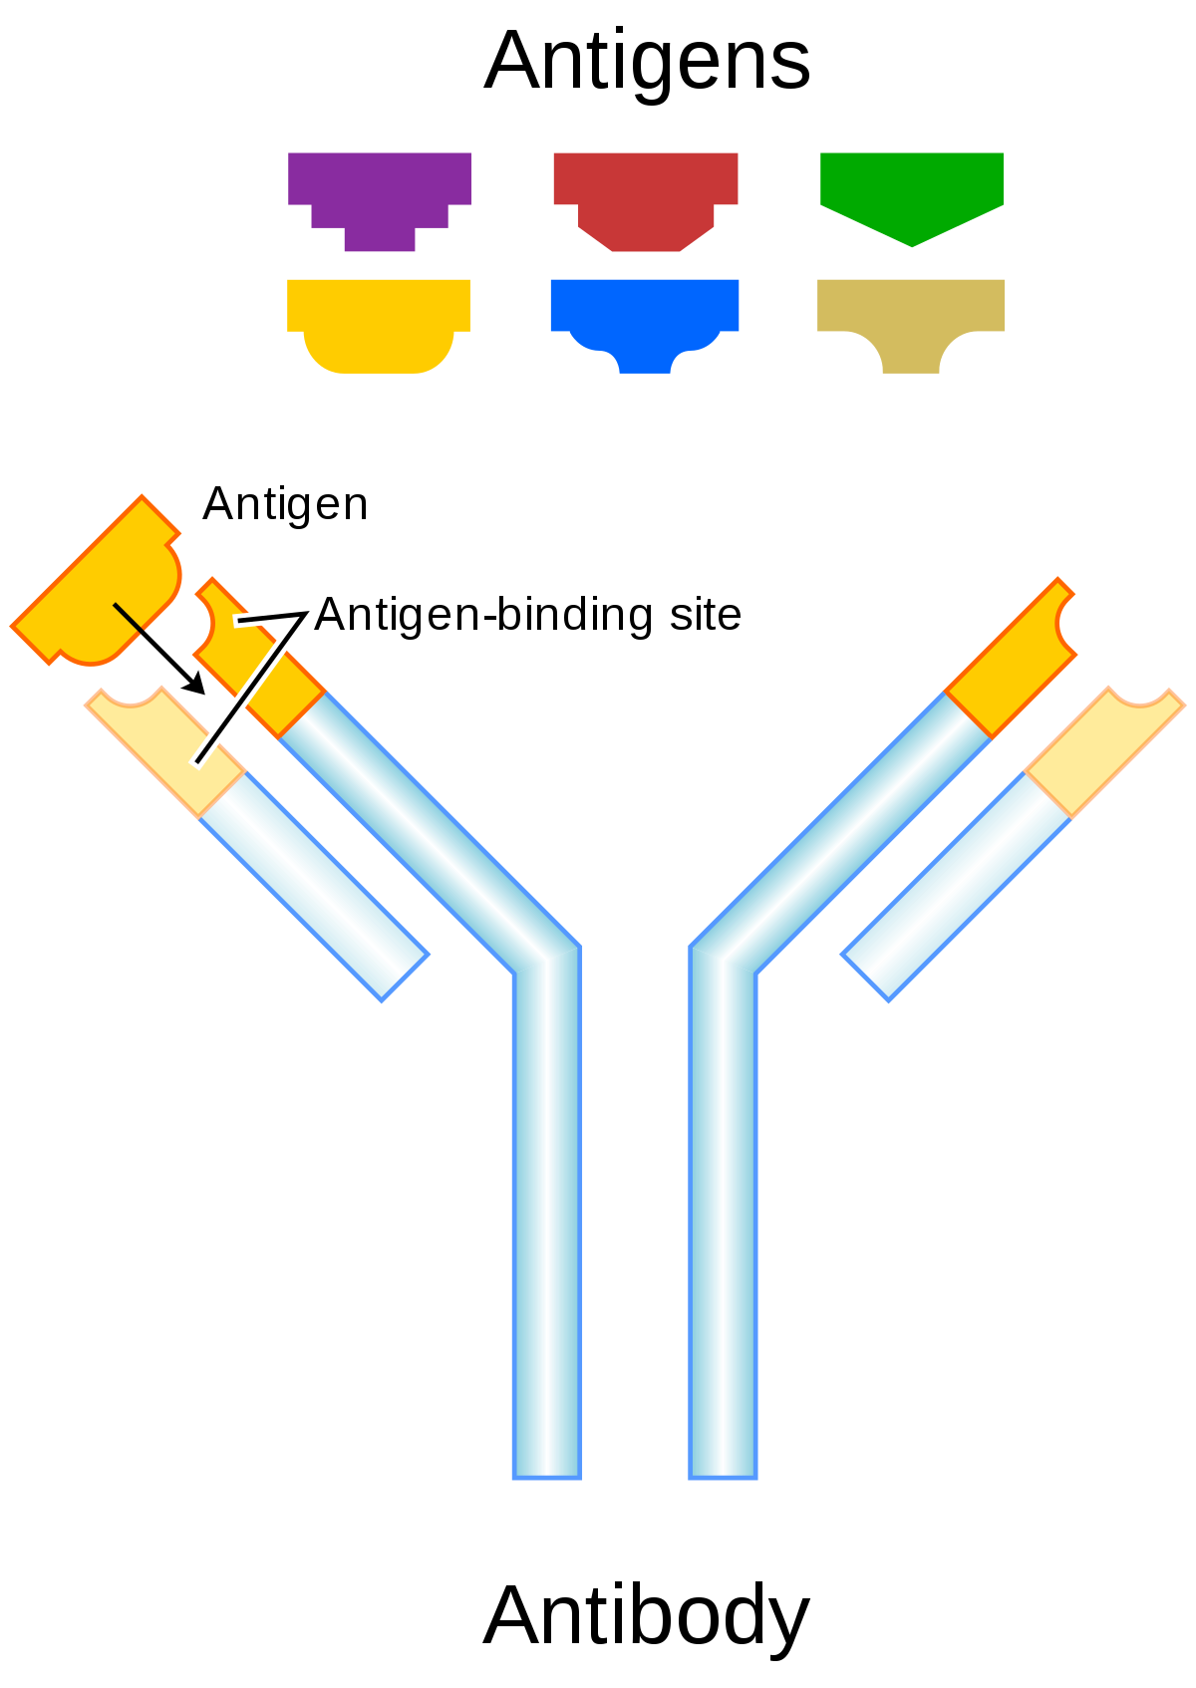
Structure of an Antibody
Antibodies are also called immunoglobulins (IgGs)
Typically Y-shaped with two arms.
The variable regions are the tips and form antigen-binding sites, which are specific for a particular antigen.
Antibodies mark antigens for destruction

Slide 28
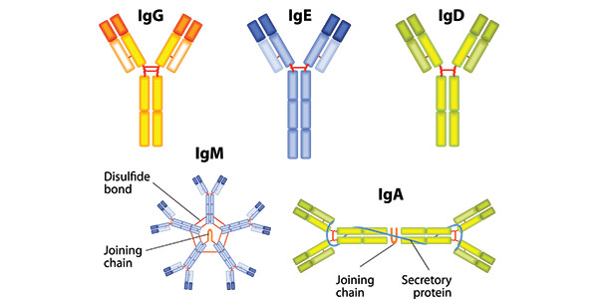
Types of Antibodies
There are five different classes of immunoglobulins (IgGs).
IgG antibodies are the major type in the blood, lymph, and tissue fluid. They bind to pathogens and their toxins.
IgM’s are found in circulation, they are the largest antibody. They activate the complement system and clump RBC’s

Slide 29
IgA’s are the main antibody in secretions such as saliva or milk. Prevent pathogens from attaching to epithelial cells in digestive and respiratory tract.
IgD’s are found on the surface of immature B cells. Signify readiness of B cell.
IgE’s are found as antigen receptors on basophils in blood and on mast cells in tissues. Responsible for immediate allergic response.

Slide 30
T Cells and Cell-Mediated Immunity
T cell’s have a receptor (TCR), however, they are unable to recognize an antigen without help.
It must be displayed to them by an antigen-presenting cell (APC).
APC’s present a piece of the pathogen to an MHC (major histocompatibility complex).
This complex will bind to a TCR and undergo a clonal expansion.

Slide 31
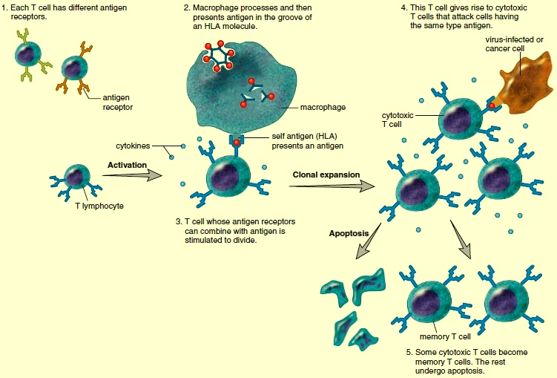

Slide 32
There are two classes of MHC proteins.
If an APC displays an antigen matching a MHC I protein,
The activated T cell will form cytotoxic T cells, which attack and kill virus infected cells and tumour cells.
If an APC displays an antigen matching a MHC II protein,
The activated T cell will form helper T cells, which release chemicals to regulate the immune response

Slide 33
Types of T cells
Cytotoxic T cells have vacuoles containing enzymes called granzymes.
These enzymes perforate the plasma membrane forming a pore.
Granzymes are released into the core and cause the cell to undergo apoptosis.
Helper T cells regulate immunity by releasing cytokines, the chemicals that enhance the response of all types of immune cells.
B cells cannot be activate without T cell help.
HIV infects helper T cells, inactivating the immune response making those infected more susceptible to opportunistic infections.

Slide 34
Characteristics of T Cells
Cell-mediated immunity against virus-infected cells and cancer cells
Produced in bone marrow, mature in thymus
Antigen must be presented in groove of an MHC molecule
Cytotoxic T cells destroy nonself protein-bearing cells.
Helper T cells secrete cytokines that control the immune response.

Slide 35
Induced Immunity
Immunity occurs naturally through infection or is brought about artificially by medicine.
Two types of immunity are active and passive.
Active immunity – the individual alone produces antibodies against an antigen.
Passive immunity – the individual is given prepared antibodies via an injection

Slide 36
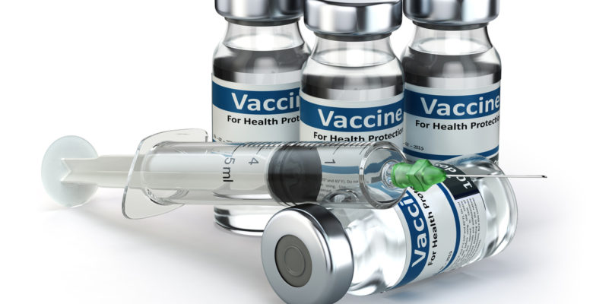
Active Immunity
Sometimes develops naturally after a person is infected by a pathogen.
Immunization involves the use of vaccines.
Traditionally vaccines are the pathogens themselves that have been treated so they are no longer virulent.
Active immunity is dependent upon the presence of memory B and T cells in the body.
Usually long lasting, may require a booster.

Slide 37
Passive Immunity
This occurs when an individual is given prepared antibodies.
Since these are not produced by the individual, it is temporary.
IgG’s cross the placenta, and IgG’s and IgA’s are secreted into breast milk, giving a baby temporary immunity.
It can provide protection when an individual is in immediate danger of succumbing to an infectious disease as well.

Slide 38
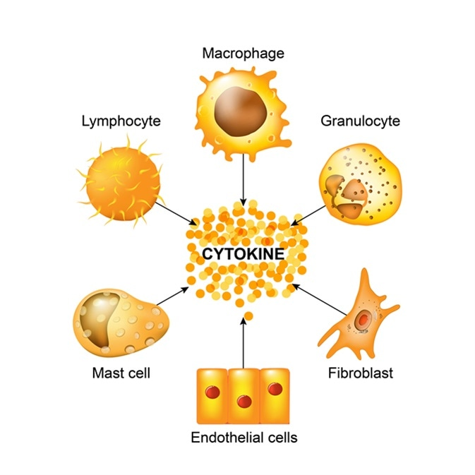
Cytokines and Immunity
Cytokines are signaling molecules produced by T lymphocytes, macrophages, and other cells.
They regulate WBC formation and/or function.
They are being researched as possible therapies for those with either cancer or AIDS.

Slide 39
Monoclonal Antibodies
Every plasma cell derived from the same B cell secretes antibodies against a specific antigen.
These are monoclonal antibodies.
At present they are used for quick and certain diagnosis of various conditions.

Slide 40
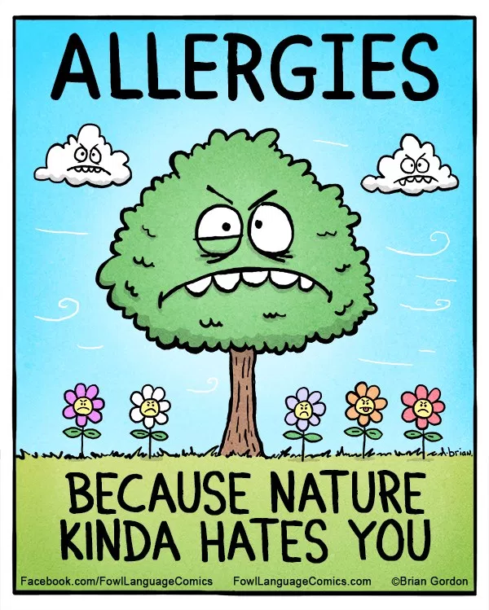
Immunity Side Effects
Sometimes the immune system responds in a way that harms the body.
Eg) allergy development, incompatible blood type, tissue rejection, or autoimmune diseases.

Slide 41
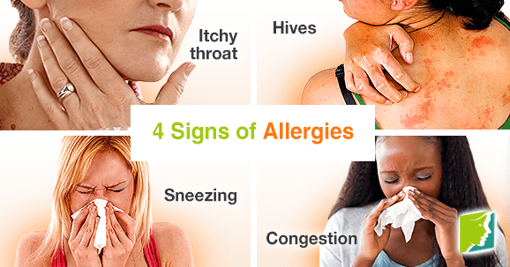
Allergies
Allergies are hypersensitivities to substances such as food or animal hair that would not ordinarily harm the body.
The response to these antigens, called allergens, usually include some degree of tissue damage.

Slide 42
Immediate allergic response can occur within seconds of contact with the antigen.
Caused by antibodies IgE.
When an allergen attaches to the antibody on mast cells, they release histamine to bring about allergic symptoms.
Examples are asthma and hay fever.

Slide 43
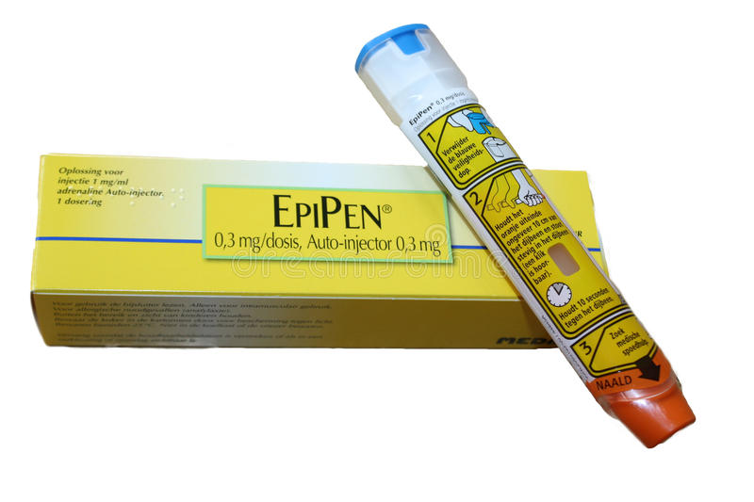
Anaphylactic shock is an immediate allergic response that occurs because the allergen has entered the blood stream.
Characterized by a sudden and life-threatening drop in blood pressure due to increased permeability of the capillaries by histamine.
People with allergies produce 10x more IgE than those people without allergies.

Slide 44
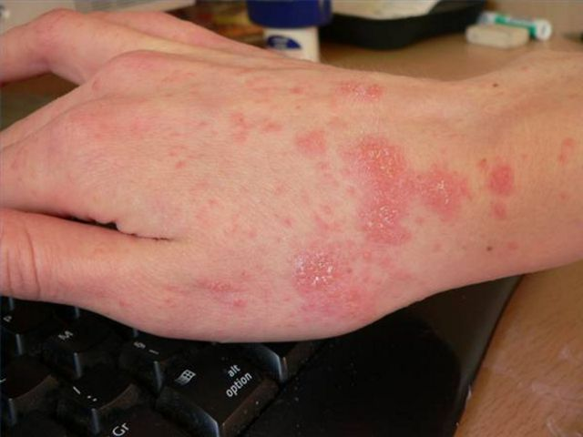
A delayed allergic response is initiated by memory T cells at the site of allergen contact in the body.
The response is regulated by the cytokines secreted by both T cells and macrophages.
Examples of this are tuberculosis, and contact dermatitis meaning poison ivy and jewelry.

Slide 45
Tissue Rejection
Certain organs, such as skin, the heart, and kidneys could be transplanted easily from one person to another if the body did not attempt to reject them.
The transplant recipients immune system recognizes that the tissue is not “self”.
Cytotoxic T cells respond by causing disintegration of transplanted tissue.
Rejection is controlled by careful selection of the organ and administering immunosuppressive drugs.

Slide 46
Disease of the Immune System
When a person has an autoimmune disease, cytotoxic T cells or antibodies mistakenly attack the body’s own cells.
Myasthenia gravis: neuromuscular junctions do not work properly, muscle weakness results
Multiple sclerosis: the myelin sheath of nerve fibers breaks down, and this causes various neuromuscular disorders.
Systemic lupus erythematosus: has various symptoms prior to death due to kidney damage.
Rheumatoid arthritis: when the joints are affected.

