Slide 1
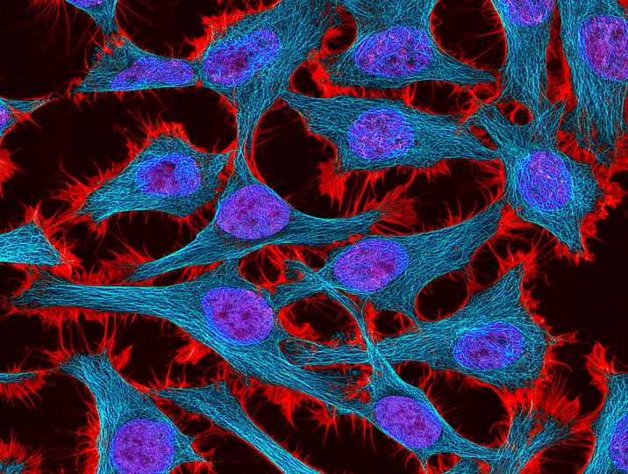
Cells review
Miss Martel

Slide 2
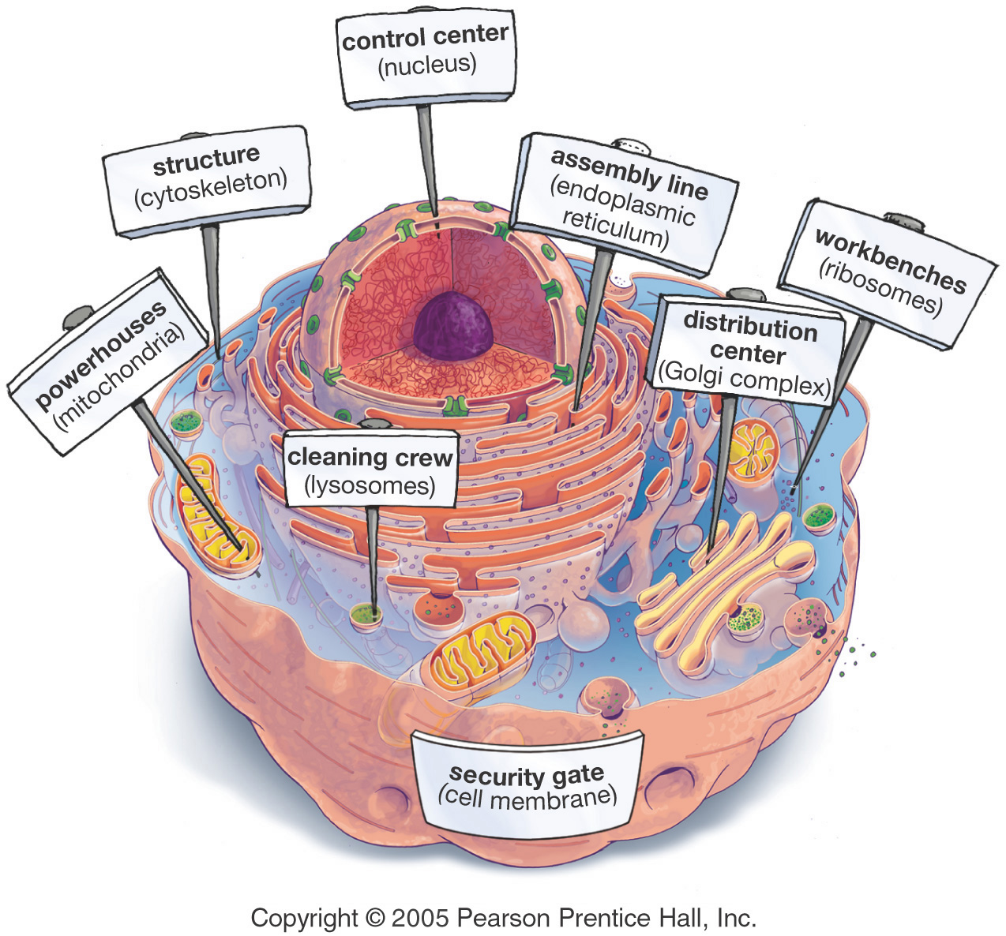
Organelles
Special structures that perform necessary functions of the cell
Notes:
Tiny organs. Just like organs in your body you need them to function properly or else it will DIE.

Slide 3
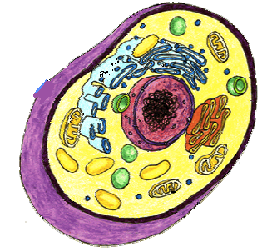
Nucleus
• Controls the cell ( the brain)
• Found in both plants and animal cells
• Large, oval shape
• Contains genetic
Information (DNA)

Slide 4
Cell Membrane
• Surrounds the outside of the cell in both animal and plant cells
• Provides cell with: protection, control of movement of materials in/out of cell, and support

Slide 5
Cytoplasm
• Found in both animal and plant cells
• Clear, thick, jelly-like material
• Supports and protects organelles

Slide 6
Ribosomes
• Found in both animal and plant cells
• Can be attached to the Endoplasmic Membrane or free floating in cytoplasm
• Makes proteins

Slide 7
Endoplasmic Reticulum
• Found in both animal and plant cells
• Network of tubes
• Transports proteins throughout the cell

Slide 8
Vesicle
• Found in plant and animal cells
• Little sacs that carry/transports things where they need to go. Waste outside, or proteins to golgi body

Slide 9
Golgi Body
• Found in both animal and plant cells
• Processes and packages proteins

Slide 10
Vacuoles
• Found in both animal and plant cells
In plants a large central one
In animals many little ones
• Fluid filled sacs
• Stores food, water and
waste

Slide 11
Mitochondrion
• Found in both animal and plant cells
• Known as powerhouse of the cell
It acts like digestive system,
takes in nutrients and breaks
It down into energy cell can
use

Slide 12
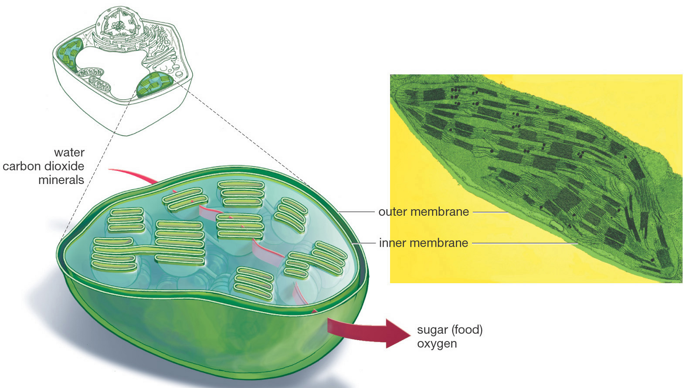
Chloroplasts
• Found in plant cells only
• Green because of chlorophyll
• Uses energy from the sun to make food for plant

Slide 13
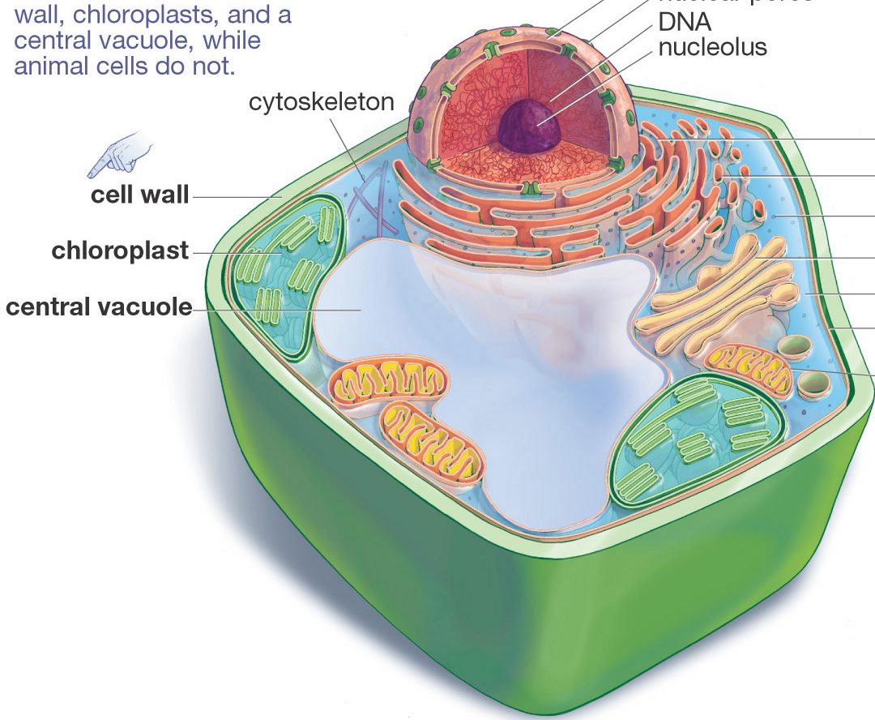
Cell wall
• Found in plant cells only
• Provides support and protection for cell
• It is rigid, strong and stiff

Slide 14
OVERVIEW
Ribosomes - makes proteins
ER - transports proteins
Golgi Body-packages proteins
Notes:
Importance of proteins. Relate it to food labels. Relate it to diseases like diabetes and Tay Sachs. Make sure they know vegetarians still need a protein source.
Memorization technique - ER like the show where they are constantly transporting people.

Slide 15
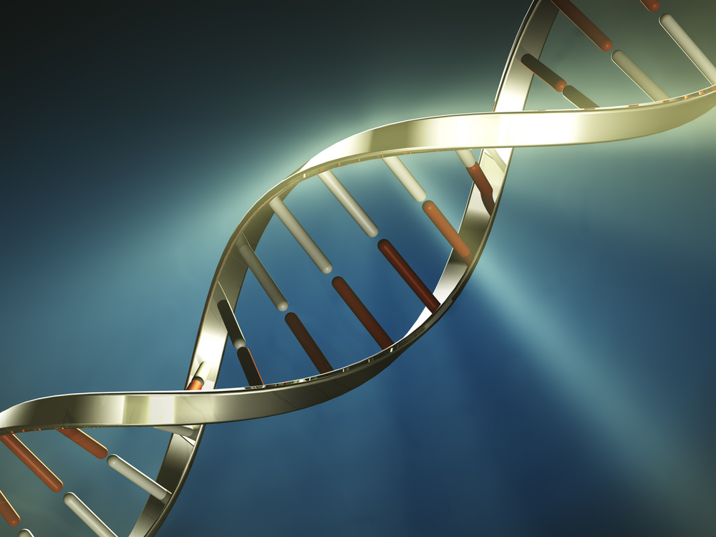
4.1 DNA & Protein Synthesis
www.onacd.ca

Slide 16
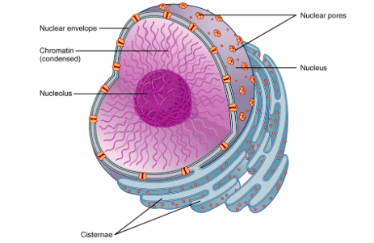
The Nucleus – Control center
The nucleus is the control center of the cell
It contains the master set of instructions for a cell
It determines what the cell will become, how it will
function, when it
will grow and
divide, and when
it will die

Slide 17
DNA – The Molecule of Life
The instructions are carried out in deoxyribonucleic acid (DNA)
DNA is the genetic blueprint of life.
Within every living cell, chromosomes can be found that contain the DNA and genes that govern the cell.

Slide 18
Structure of DNA
DNA has 2 strands. Each strand is made up of a series of sugar and phosphate molecules which are chemically bonded to nitrogenous bases. These bases bond to each other to hold the strands together.
When the 2 strands are joined together they form a spiraling ladder, also known as a double helix.

Slide 19
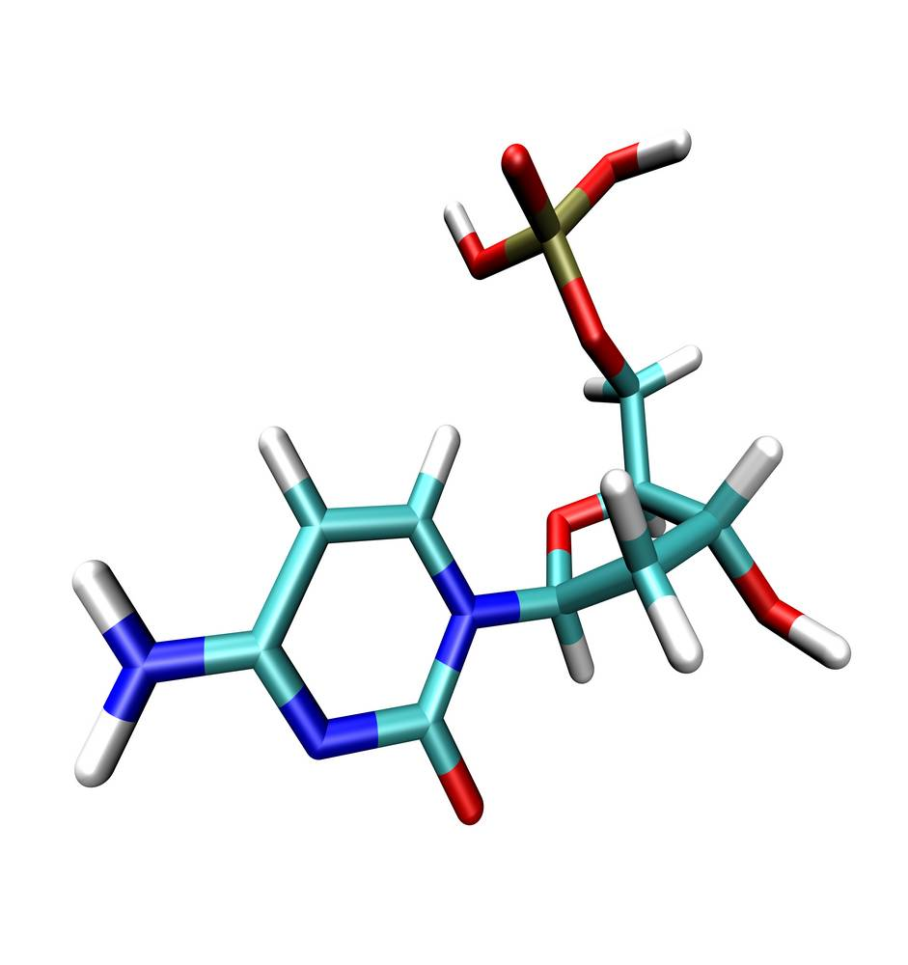
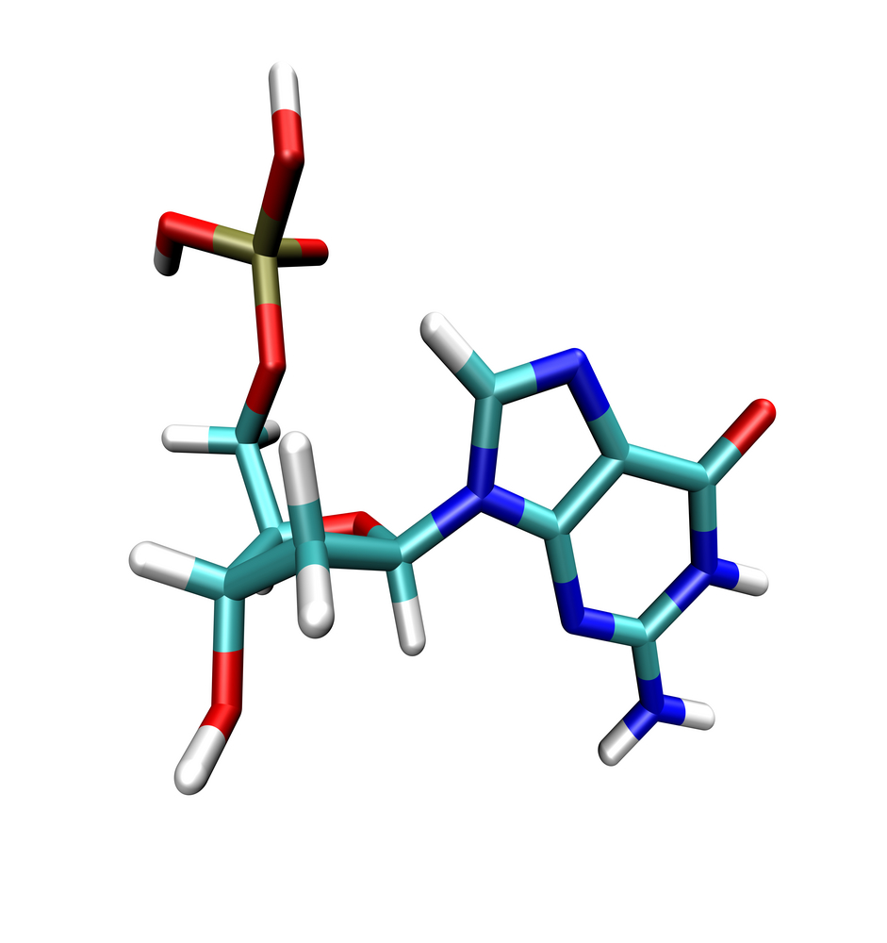
Nitrogenous Bases
There are four types of nitrogenous bases in the DNA ladder;
Adenine (A)
Thymine (T)
Guanine (G)
Cytosine (C)
The order that these bases matter and determine our DNA.
Note: Adenine will only pair up with Thymine and Guanine will only pair up with Cytosine (which is called complementary base pairing)
Above: Adenine and Thymine
Below: Guanine and Cytosine
Write the correct pairs on your sheet.

Slide 20
A nucleotide has one sugar
Phosphate backbone and
one base

Slide 21
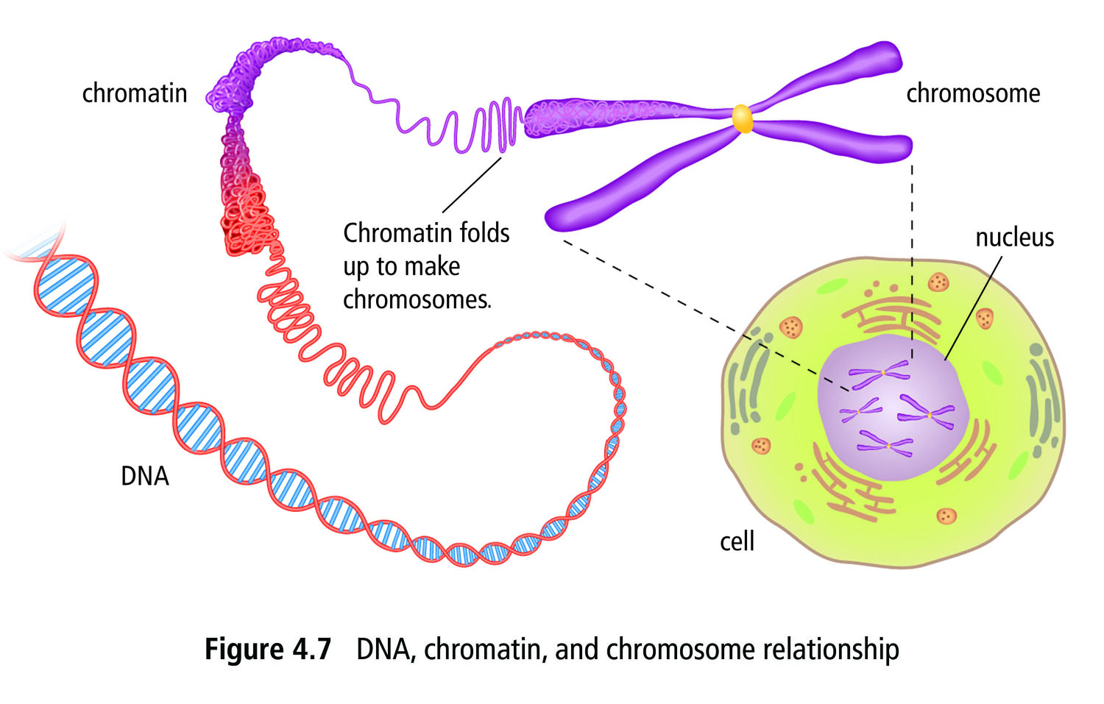
Chromatin
DNA and protein is found in chromatin
Chromatin is tightly wound up DNA strands.
When the cell is ready to divide becomes compact an X-shaped structure called a chromosome.

Slide 22
Chromosomes
Every organism has characteristic number of chromosomes
Most human cells have 46 chromosomes arranged in 23 pairs
23 from your mother, 23 from your father
The 23rd chromosome determines sex in humans. Males have XY and females have XX

Slide 23
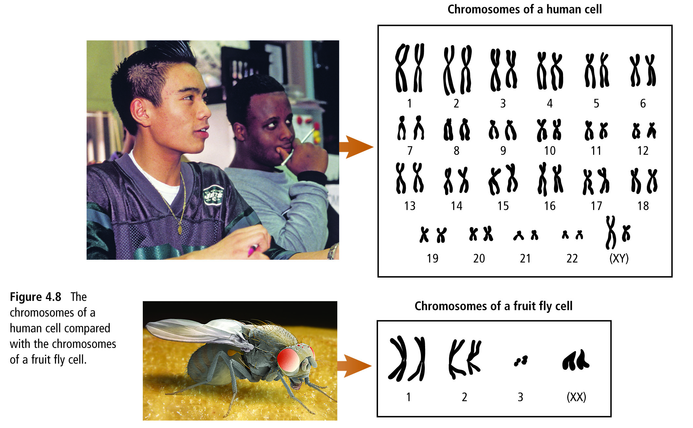
Chromosomes

Slide 24
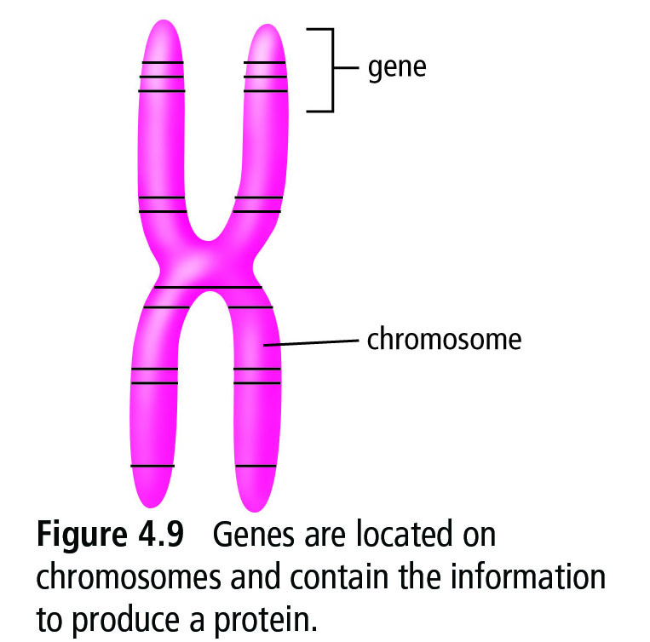
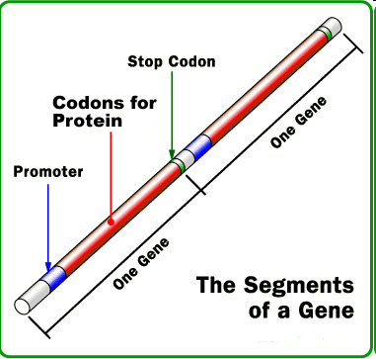
Genes
Chromosomes contains small segments of DNA called genes
Genes store information to make a specific proteins
Each of your body cells contain the exact same genetic information
Genes make specific proteins, so cells are specialized to produce specific proteins
Remember, genes are made up of DNA!
Genes vary in size from hundreds to thousands of bases

Slide 25
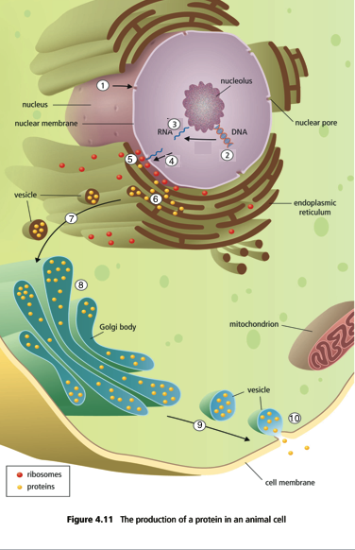
Protein Synthesis
The nucleus receives a chemical signal to make a certain protein
The DNA within the nucleus will unzip and unwind
The DNA message for that protein is copied into ribonucleic acid (RNA). This type of RNA is called messenger RNA or mRNA
The RNA (mRNA) leaves the nucleus through a nuclear pore

Slide 26
Protein Synthesis
5. The RNA message is delivered to the ribosome. At the ribosome, the RNA message will translate into a specific protein (tRNA)
6. The new protein enters the endoplasmic reticulum
7. A vesicle forms off the end of the endoplasmic reticulum and carries the protein to the Golgi Body
8. The Golgi repackages the protein for transport out of the cell

Slide 27
Protein Synthesis
9. A vesicle forms off the end of the Golgi to carry the protein to the cell membrane
10. The vesicle attaches to the cell membrane, and its protein contents are released out of the cell

Slide 28
Fun Fact of the Day!
We have discovered a genetic mutation in animals and humans that prevents the body from making a protein called myostatin. Myostatin is responsible for slowing or stopping muscles growth. Organisms with this mutation experience uncontrollable muscle growth!

Slide 29
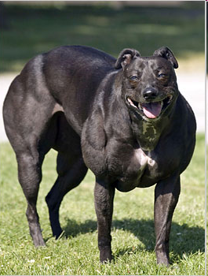
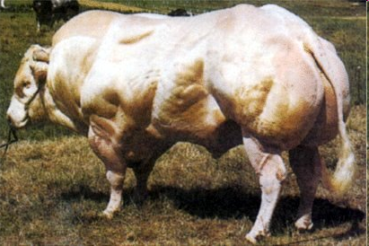
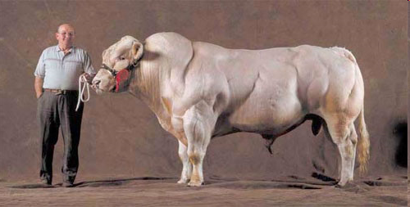
Fun Fact of the Day!

Slide 30
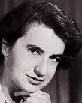
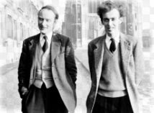
Who discovered DNA structure?

Slide 31
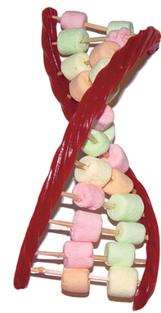
Edible DNA

Slide 32
Protein Synthesis Concept Map/Drawing
In groups of 4, you are going to draw a labeled diagram of how a protein is made. (Steps of protein synthesis)
You can use your notes to help guide you through the process. MAKE SURE TO LABEL EVERYTHING!!!
Once you’re finished you will present your findings to Ms. Martel as a group.

Slide 33
Group 3
Noah
Khrista
Neva
Felicia
Akash
Group 1
Ethan
Hania
Victor
Aanchal
Group 2
Damjan
Asha
Matteo
Rose
Group 5
Shariq
Abby
Luke
Terrence
Amanda
Group 4 Emiliano
Myka
Ali
Jin
Group 6
Kyle
Esbeidi
John
Colby

Slide 34
Group 1
Harjap
Ihsaan
Merisa
Sukmani
Group 2
Yuvi
Nikola
Minal
Mackenzie
Group 3
Franco
Hector
Rebecca
Luisa
Saroj
Group 4 Brandyn
Vlad
Alicia
Aliyah
Group 5
Jeremy
Xavier
Caylea
Coral
Jolin
Group 6
Maggie
Alesha
Karina
Sehaj
Group 7
Dylan
Asal
Natasha
Amisha

