Slide 1
Cellular Respiration
Ms. Martel

Slide 2
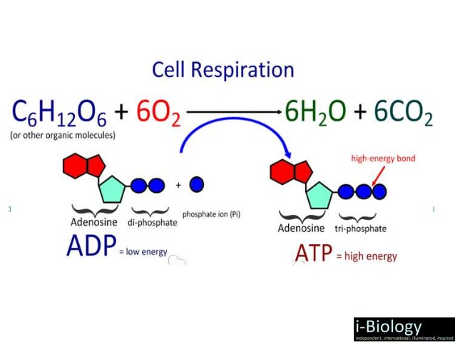
OVERVIEW OF CELLULAR RESPIRATION
Cellular respiration is the release of energy from glucose, the use of this energy is to synthesize ATP molecules.
It’s an aerobic process that requires oxygen (O2) and give off carbon dioxide (CO2)

Slide 3
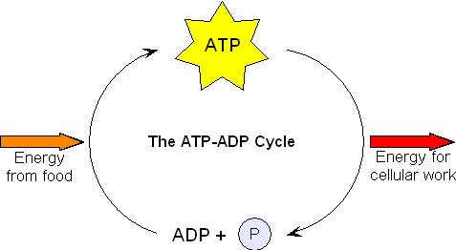
The energy released during the breakdown of glucose is used to form ATP.
The breakdown of one glucose molecule results in the production of 30-32 ATP molecules.

Slide 4
Oxidation & Reduction
Oxidation reaction: occurs when an atom or molecule loses an electron.
Reduction reaction: occurs when an atom or molecule gains an electron.
An electron that is lost by one atom or molecule must combine with another atom or molecule.
Therefore, oxidation and reduction reactions always happen at the same time.
These reactions are called redox reactions.

Slide 5
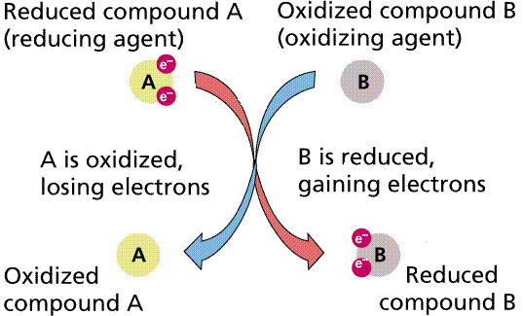
In the figure below, molecule A is oxidized, molecule B is reduced.
Molecule A is the reducing agent because it donates its electrons.
Molecule B is the oxidizing agent because it accepts the electrons.

Slide 6
NAD+ and FAD
Cellular respiration involves many individual reactions, catalyzed by it’s own enzyme.
Some of these enzymes use the coenzyme NAD+ as an electron carrier.
Coenzymes help an enzyme do its job and may participate in the reaction.

Slide 7
NAD+ receives two electrons, glucose is oxidized

Slide 8
FAD is another coenzyme used as an electron carrier.
When FAD accepts two electrons and H+ ions, FADH2 results.
NAD+ and FAD pick up electrons at specific enzymatic reactions in the cytoplasm or matrix of the mitochondria.
They carry the electrons to an electron transport chain in the cristae of the mitochondria, where they drop them off.
NAD+ and FAD then repeat the cycle.

Slide 9
Phases of Cellular Respiration
Cellular respiration involves four phases:
1) Glycolysis – outside mitochondria, no oxygen required: anaerobic.
2) Preparatory Reaction – inside mitochondria, requires oxygen: aerobic
3) Citric Acid Cycle – inside mitochondria, requires oxygen: aerobic
4) Electron Transport Chain – inside mitochondria, requires oxygen: aerobic

Slide 10
Glycolysis: the breakdown of glucose to two molecules of pyruvate, a C3 molecule.
Two molecules of ATP are required during this process, however, 4 ATP are produced.
NET gain of 2 ATP.
Preparatory reaction: pyruvate is oxidized to a C2 acetyl group carried by CoA, and CO2 is removed.
This reaction happens twice per glucose molecule.

Slide 11
The citric acid cycle: series of oxidation reactions that give off CO2, and produce 1 ATP.
The citric acid turns twice because of the two acetyl CoA’s.
Two ATP molecules are produced here.

Slide 12
The electron transport chain is a series of membrane bound carriers that pass electrons from one carrier to another.
High-energy electrons enter the chain, and low-energy electrons leave it.
The energy lost when going from the high energy to low energy state.
During this phase 26-28 ATP molecules are produced, depending on conditions and cell types.

Slide 14
In cellular respiration, the low-energy electrons are finally received by O2, which then combines with H+, and becomes water.
Pyruvate is a pivotal metabolite in cellular respiration.
If oxygen is not available fermentation occurs in the cytoplasm.
During fermentation, pyruvate is reduced to lactate, or CO2 and alcohol.

Slide 15
OUTSIDE THE MITOCHONDRIA: GLYCOLYSIS
Glycolysis most likely evolved before the citric acid cycle and the electron transport chain (ETC), because it occurs universally in all organisms and does not require oxygen.

Slide 16
Energy-Investment Steps
As glycolysis begins, two ATP are used to activate glucose, and the molecule that results splits into two C3 molecules: G3P.

Slide 17
Energy-Harvesting Steps
Oxidation of G3P occurs by the removal of hydrogen atoms.
The hydrogen atoms are picked up by NAD+ and NADH + H+ results.
Later, NADH will pass electrons onto the ETC.
Oxidation of G3P and subsequent substrates result in four high-energy phosphate groups, which are used to synthesize ATP.
Subtracting the two ATP that were used to get started, glycolysis yields a net gain of 2 ATP

Slide 18
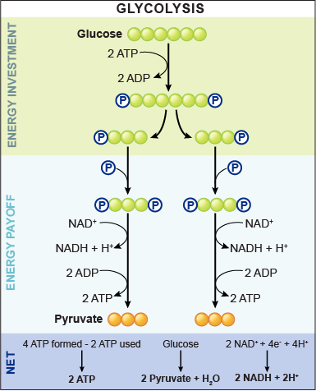

Slide 19
OUTSIDE THE MITOCHONDRIA: FERMENTATION
If oxygen is limited cells may use anaerobic pathways, such as fermentation.
In animal cells, pyruvate formed by glycolysis accepts two hydrogen ions and two electrons and is reduced to lactate.
In other organisms, alcohol is produced instead.

Slide 20
Advantages & Disadvantages of Fermentation
Fermentation is essential to humans. It provides a rapid burst of ATP, which our muscles require when working vigorously over a short period of time.
However, lactate is toxic to cells. When it builds up, it changes the pH causing our muscle cells to burn.

Slide 21
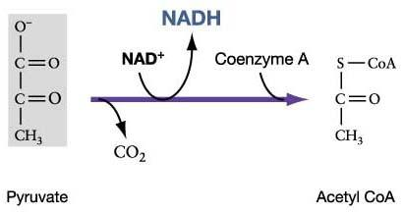
INSIDE THE MITOCHONDRIA
Preparatory Reaction
This occurs in the matrix of the mitochondria.
This reaction produces the molecule that can enter the citric acid cycle.
Pyruvate is converted into acetyl CoA here.

Slide 22
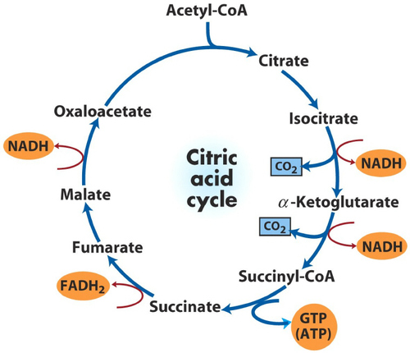
Citric Acid Cycle
1. Acetyl group combines with a C4 molecule to produce citrate
5. Additional oxidation reactions produce FADH2, and another NADH + H+
2. Oxidation reactions produce two
NADH + H+
3. The loss of two CO2 results in a new C4 molecule
4. One ATP is produced

Slide 23
Electron Transport/ATP Synthesis
The ETC is located in the cristae of the mitochondria, it is a series of carriers that pass electrons from one to the other.
NADH and FADH2 each gives up two electrons to the chain.
As the electrons pass from one carrier to the next, energy that will be used to produce ATP is captured and stored as a hydrogen ion.

Slide 24
Fig 6.9 Electron Transport Chain

Slide 25
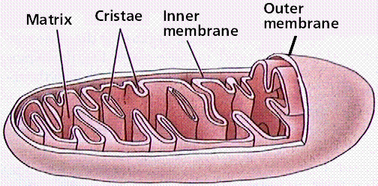
Organization of Cristae
The ETC is located within the cristae of the mitochondria.
Cristae increase the surface area, which increases the surface are devoted to ATP formation.
The excess H+ ions formed during the ETC are pumped into the intermembrane space making it more acidic and positively charged.

Slide 26
The cristae contain an ATP synthase complex, the H+ ions flow through this complex.
This changes the shape of the complex which causes the enzyme to synthesize ATP from ADP and Pi.
Mitochondria produce ATP through chemiosmosis.

