Slide 1
9 – Worms & Mollusks
Ms. Martel

Slide 2
9.1 - FLATWORMS
How is their body shape beneficial to worms?
A long, slender body allows them to move more quickly than radially symmetrical bodies.
The mouth, sense organs, and brain are located at the anterior end, or head, of the body.
This allows them to locate food and respond to stimuli as they move.
There are segmented worms and unsegmented worms.
Unsegmented worms include flatworms and roundworms.

Slide 3
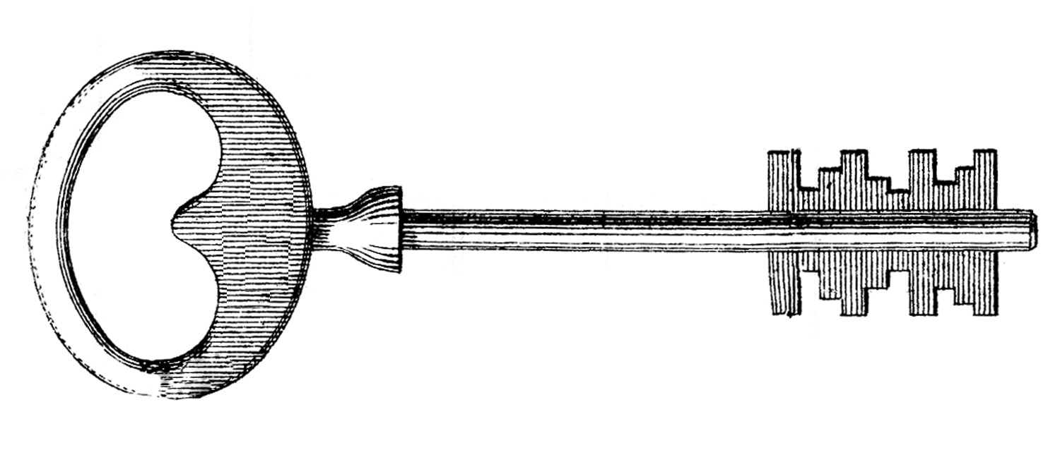
What Is a Flatworm?
The phylum Platyhelminthes consists of flatworms.
Flatworms are soft, flattened worms that have tissues and internal organ systems. They are the simplest animals to have three embryonic germ layers, bilateral symmetry and cephalization.

Slide 4
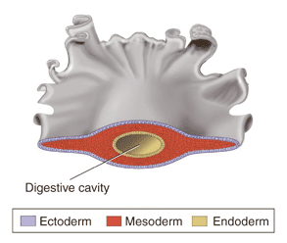
Flatworms are known as acoelomates, meaning “without a coelom.”
A coelom is a fluid-filled body cavity that is lined with tissue derived from mesoderm.
No coelom forms between the tissues of flatworms.
Most flatworms have enough cephalization to have what is called a head.

Slide 5
Form & Function in Flatworms
Flatworms are thin, most of their cells are close to the external environment.
This allows materials to pass easily into and out of their bodies.
All flatworms rely on diffusion for some essential body functions.
Free-living flatworms have organ systems for digestion, excretion, response, and reproduction.
Parasitic flatworms have less internal organ structures because they rely on their host(s) to conduct some of their essential life functions.

Slide 6
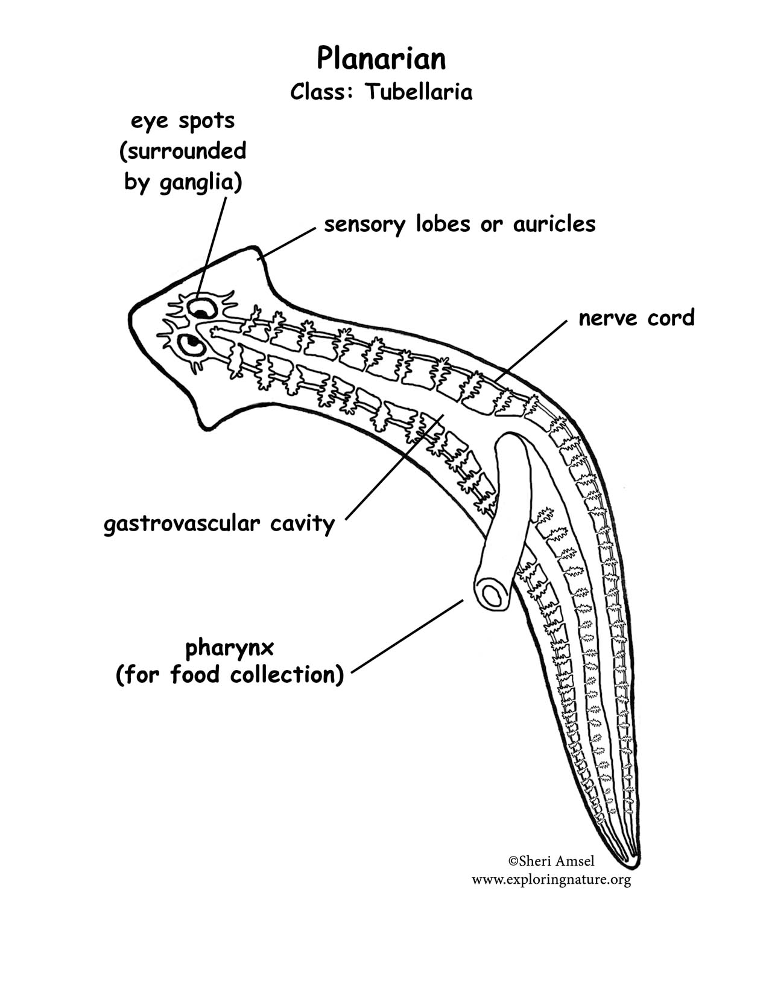
Feeding
Free-living flatworms can be carnivores or scavengers.
They have a single opening, or mouth, where food and wastes pass.
The pharynx structures extends out of the mouth, and pumps food into the digestive cavity.
Food is then digested by cells of the gut, and nutrients diffuse to other cells in the body.

Slide 7
Parasitic worms feed on blood, tissue fluids, or pieces of cells in the host’s body.
Because they consume food that’s already been digested, they do not need to possess complex digestive systems.

Slide 8
Respiration, Circulation, & Excretion
Their bodies are so flat and thin, many do not need a circulatory system to transport materials.
Instead they rely on diffusion to transport nutrients and wastes.
They have no gills, heart, blood vessels or blood.
Some flatworms have flame cells that function in excretion, and help remove excess water from the body.

Slide 9
Response
Most flatworms have more complex structures for detecting and responding to stimuli than cnidarians or sponges.
In free-living flatworms, a head encloses several ganglia, that control the nervous system.
Two long nerve cords run from ganglia along both sides of the body.
Parasitic flatworms interact little with their external environment, and have a less complex nervous system than free-living flatworms.

Slide 10
Many free-living flatworms have what look like eyes near the anterior end of their bodies.
These are actually “eyespots”, or a group of cells that can detect changes in the amount of light in their environment.
They also have specialized cells that detect chemicals found in food, or the direction in which water is flowing.
They use this information to locate food, and find dark hiding places.

Slide 11
Movement
Free-living flatworms typically move in two ways.
1) Cilia on their epidermal cells help them glide through water.
2) Muscle cells controlled by the nervous system allow them to twist and turn so they can react rapidly to environmental stimuli.

Slide 12
Reproduction
Most free-living flatworms are hermaphrodites that reproduce sexually.
Hermaphrodites have both male and female reproductive organs.
During sexual reproduction, two worms join in a pair, then deliver sperm to each other. The eggs are then laid in clusters, and hatch in a few weeks.
Asexual reproduction is also common in free-living flatworms, and takes place by fission.
This is when an organism splits in two.
Parasitic flatworms have complex life cycles that involve both sexual and asexual reproduction and multiple hosts.

Slide 13
Groups of Flatworms
There are three main groups of flatworms:
1. Turbellarians
2. Flukes
3. Tapeworms
Most turbellarians are free-living.
Most other flatworms are parasitic.

Slide 14
Turbellarians
Turbellarians are free-living flatworms. Most live in marine or fresh water.
Most are bottom dwellers, living in sand or mud under stones and shells.
The most familiar are the planarians.
Turbellarians can vary greatly in color, form, and size.

Slide 15
Flukes
Members of the class Trematoda, are known as flukes.
Flukes are parasitic flatworms. Most flukes infect the internal organs of their host.
Some flukes, are external parasites that live on the skin, mouth, gills, or other outside parts of a host.

Slide 16
Flukes live in multiple hosts.
It’s primary host where it reproduces sexually is a human.
Blood flukes infect humans by burrowing through exposed skin. Once inside, they care carried to the intestines.
Here they feed and reproduce sexually, and the embryos are passed out of the feces.
If the embryos reach water, they develop into larva and infect snails.
Larva develop inside the snail, are released and the cycle repeats.

Slide 17
Tapeworms
Members of the class Cestoda are called tapeworms
Tapeworms are long, flat, parasitic worms that are adapted to life inside the intestines of their hosts.
They are surrounded by food that has already been digested, so it can be absorbed directly through their body walls.

Slide 18
The head of the adult tapeworm, called a scolex, is a structure that can contain suckers or hooks.
It uses this to attach to the intestinal wall of its host to absorb nutrients.
Next are proglottids that make up most of the worms body.
Mature proglottids contain both male and female reproductive organs.
After the eggs are fertilized, proglottids break off and burst to release more worms.

Slide 19
9.2 - ROUNDWORMS
Members of the phylum Nematoda are among the most numerous of all animals.
A single rotting apple can contain as many as 90,000 roundworms.

Slide 20
What is a Roundworm?
They are unsegmented worms that range in size from microscopic to a meter in length.
Most are free-living, inhabiting soil, salt flats, aquatic sediments, and water.
Many others are parasitic and live in hosts that include almost any kind of plant and animal.

Slide 21
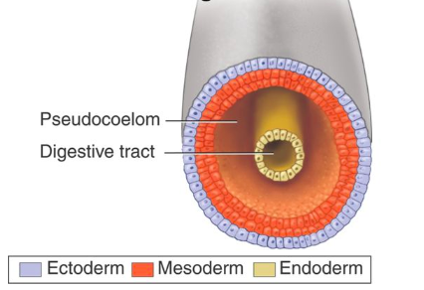
Like flatworms, roundworms develop from three germ layers.
However, roundworms have a body cavity between the endoderm and mesoderm tissues.
This is called a pseudocoelom, aka “false coelom,” because the cavity is lined only partially with tissues derived from the mesoderm

Slide 22
Roundworms are the first organisms to have a digestive tract with two openings.
This makes digestion in roundworms very different from that in flatworms because food moves in one direction.
Anything that cannot be digested leaves through the anus.
Roundworms are unsegmented worms that have pseudocoeloms and digestive systems with two openings – a mouth and an anus.

Slide 23
Form & Function in Roundworms
Roundworms have specialized tissues and organ systems that carry out essential physiological functions.
The body systems of free-living roundworms are typically more complex than those of parasitic ones.

Slide 24
Feeding
Many free-living roundworms are predators that use grasping mouthparts to catch and eat other small animals.
Some soil-dwelling and aquatic forms eat algae, fungi, or pieces of decaying organic matter.

Slide 25
Respiration, Circulation & Excretion
Roundworms exchange gases and excrete metabolic waste through their body walls.
They depend on diffusion to carry nutrients and waste through their bodies

Slide 26
Response
Roundworms have simple nervous systems consisting of several ganglia.
Nerves run down the length of their bodies, and transmit sensory information and control movement.
They also have sense organs that can detect chemicals given off by prey or hosts.

Slide 27
Movement
Their muscles extend the length of their bodies.
Together with the fluid in the pseudocoelom, these muscles function as a hydrostatic skeleton.
Aquatic roundworms move like snakes through the water
Soil-dwelling roundworms push their way through the soil by thrashing around.

Slide 28
Reproduction
Roundworms reproduce sexually, and most species have separate sexes – ie. Male and female.
They reproduce using internal fertilization.
The male deposits sperm inside the female’s reproductive tract.
Parasitic roundworms have life cycles that involve two or three different hosts.

Slide 29
Roundworms & Human Disease
Most roundworms are free-living, but parasites tend to get most of the attention.
Parasitic roundworms have been evolving relationships with other organisms for hundreds of millions of years.
This process has produced worms that can cause a great deal of pain and suffering in humans.
Parasitic roundworms include trichinosis-causing worms, filarial worms, ascarid worms, and hookworms

Slide 30
Trichinosis-Causing Worms
Adult worms live and mate in the intestines of their hosts.
Female worms release larvae in the intestines of their hosts.
The larvae then travel through the blood-stream and burrow into organs and tissues.
Cysts form in the host’s muscle tissue.
Human’s become infected usually by eating infected pork meat.

Slide 31
Filarial Worms
These are found primarily in tropical regions of Asia. They are threadlike worms that live in the blood and lymph vessels of birds and mammals.
They are transmitted from one host to another, usually through insects like mosquitos.
In severe infections, the worms may block the passage of lymph fluids.
This causes severe swelling known as elephantiasis.

Slide 32
Ascarid Worms
This is a serious parasite of humans and many other vertebrate animals.
It causes malnutrition in more than 1 billion people worldwide.
It does this by absorbing digested food from the host’s small intestine.
The disease is spread by eating vegetables and other foods that are not washed properly.
Inside the hosts intestine they can grow to 50cm in length.
Puppies are wormed to rid them of ascaris worms

Slide 33
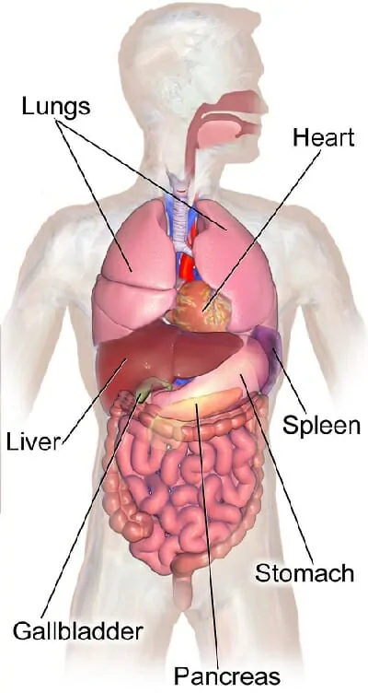
1) Human ingests food or water containing Ascaris eggs.
3) Larvae enter blood vessels and are carried to the lungs
4) Larvae are coughed up and swallowed. They then travel to the small intestine where they develop to maturity.
2) The eggs travel to the small intestine and develop into larvae.
5) Eggs are released and leave the host in feces

Slide 34
Hookworms
As many as 25% of the worlds population are infected with hookworms.
The eggs hatch outside of the body of the host and develop in soil.
If an unprotected foot steps on them, their hooks burrow into the skin and enter the bloodstream.
They travel through the blood to the intestines, suck the host’s blood and cause weakness and poor growth.

Slide 35
9.3 - ANNELIDS
The phylum Annelida includes earthworms, exotic seafloor worms, and parasitic leeches.
Because they are long and narrow, some annelids look a bit like flatworms or roundworms.
They are in reality more closely related to clams and snails because they share a similar larval stage.

Slide 36
What Is an Annelid?
The body of an annelid is divided into segments that are separated by septa.
Septa are internal walls between each segment.
Most segments are similar to one another, although they can be modified to perform special functions.
Some segments may be specialized for sensory receptors, other may specialize in respiration.
In many annelids, bristles called seta are attached to each segment.

Slide 37
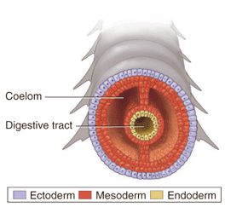
Annelids are worms with segmented bodies. They have a true coelom that is lined with tissue derived from mesoderm.
Like roundworms, annelids have a tube-within-a-tube digestive tract that food passes through from mouth to the anus.

Slide 38
Form & Function in Annelids
Annelids have complex organ systems.
Many of these systems are unique because of the segmented body plan of this group.

Slide 39
Feeding & Digestion
Annelids range from filter feeders to predators.
Many get their food using their pharynx.
The worm collects its food by extending its pharynx and pressing it against the surrounding sediments.
Others are filter feeders.

Slide 40
In earthworms, the pharynx pumps food and soil into a tube called the esophagus.
The food then moves to the crop where it can be stored
And then through the gizzard, where it is ground into smaller pieces.
The food is absorbed farther along in the digestive tract in the intestine.

Slide 41
Circulation
Annelids typically have a closed circulatory system – blood is contained in a network of blood vessels.
An earthworms blood is circulated through two major vessels that run from head to tail.
The dorsal (top) vessel moves blood towards the head.
The ventral (bottom) vessel moves from head to tail.
The dorsal vessel functions like a heart as it contracts rhythmically to help pump blood.

Slide 42
Respiration
Aquatic annelids often breathe through gills.
A gill is a specialized organ that exchanges gases underwater.
Lands dwelling annelids, take-in oxygen and give off carbon dioxide through the moisture of their skin.
They secrete a protective coating of mucus to keep their skin moist.

Slide 43
Excretion
Annelids produce two kinds of waste.
Digestive waste passes through the anus at the end of the digestive tract.
Cellular waste containing nitrogen is eliminated by nephridia.
These are excretory organs that filter fluid in the coelom.

Slide 44
Response
Most annelids have a well-developed nervous system consisting of a brain and nerve cords.
The sense organs are best developed in free-living marine annelids.
Many species have a variety of adaptations for detecting stimuli such as: sensory tentacles, chemical receptors, statocysts to help detect gravity, and even eyes.

Slide 45
Movement
Annelids have two major groups of body muscles.
Longitudinal muscles run from the front to the rear and contract to make the worm shorter and fatter.
Circular muscles wrap around each body segment and make the worm longer and thinner.

Slide 46
Reproduction
Most annelids reproduce sexually.
Some use external fertilization, and have separate sexes. Other annelids are hermaphrodites.
Two worms will attach to each other, exchange sperm to fertilize each others eggs.
The clitellum then secretes a mucus ring, and slips off the body to form a protective cocoon around the fertilized eggs.

Slide 47
Groups of Annelids
Because of their their segmentation, all annelids show a basic similarity.
They are divided into three classes:
1) Oligochaetes
2) Leeches
3) Polychaetes

Slide 48
Oligochaetes
This class contains earthworms and their relatives.
Oligochaetes are annelids that typically have stream-lined bodies and relatively few setae compared to polychaetes. Most live in soil or freshwater.
Earthworms are long pinkish-brown worms that are common in woods, fields, and gardens.
Tubifex worms, are red, threadlike aquatic worms that are sol in pet stores as food for tropical fish.

Slide 49
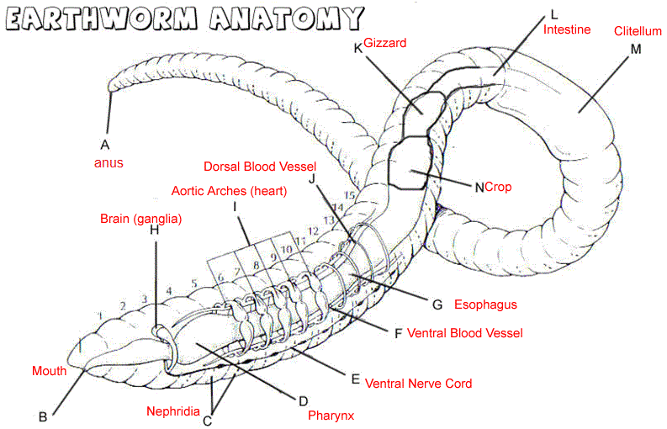

Slide 50
Leeches
Class Hirudinea contains leeches.
Leeches are typically external parasites that suck the blood and body fluids of their host.
Roughly 25% of all leeches are carnivores that feed on soft-bodied invertebrates.
They have powerful suckers at both ends of their bodies that help them cling to hosts.
The leech uses its pharynx to suck blood from their host, and sometimes releases a substance that anesthetizes the wound.
Leeches were once commonly used in medicine.
Today some surgeons use them after reattaching a limb to help reduce swelling.

Slide 51
Polychaetes
The class Polychaeta contains sandworms, bloodworms, and their relatives.
Polychaetes are marine annelids that have paired, paddlelike appendages tipped with setae.
They live in cracks and crevices in coral reefs; in sand, mud, and piles of rocks.

Slide 52
Ecology of Annelids
Earthworms burrow through soil, aerating it, and provide passageways for plant roots and water.
They are also an important part of the diets of birds, moles, skunks, snakes, and toads.
In the sea, they are also an important part of the food chain.

Slide 53
9.4 - MOLLUSKS
Mollusks are one of the oldest and most diverse phyla.
They differ widely in terms of size, shape, and forms, however there are a few characteristics that unify them under the same phylum.

Slide 54
What Is a Mollusk?
Mollusks are soft-bodied animals that usually have an internal or external shell.
They include snails, slugs, clams, squids, and octopi.
These animals are so different from one another, how are they placed in the same phylum?
Many mollusks share similar developmental stages
Many aquatic mollusks have a larval stage called a trochophore.
This larva is also a characteristic of annelids, which suggest that they are closely related.

Slide 55
Form & Function in Mollusks
Like annelids, mollusks have true coeloms surrounded by mesoderm tissue.
They also have complex, interrelated organ systems that function together to maintain the body as a whole.

Slide 56
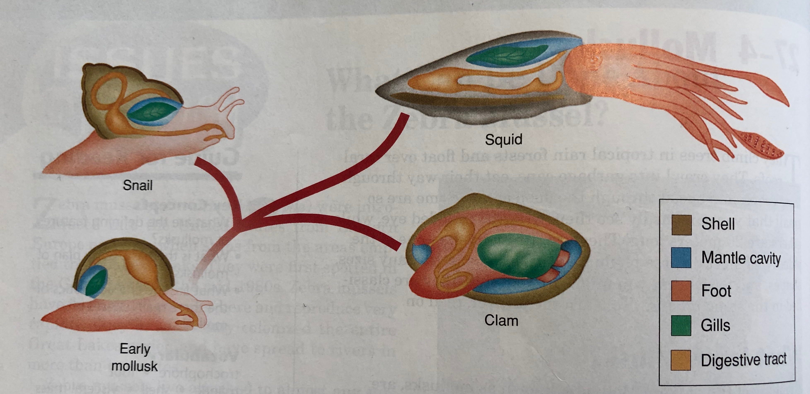
Body Plan
The body plan of most mollusks has four parts: foot, mantle, shell, and visceral mass.

Slide 57
The muscular foot takes many forms, including flat structures for crawling, spade structures for burrowing, and tentacles for capturing prey.
The mantle is a thin tissue layer that covers most of the mollusks body like a cloak.
The shell has been reduced or lost in slugs and some other mollusk groups.
Beneath the mantle is the visceral mass, which consists of internal organs.

Slide 58
Feeding
Mollusks can be herbivores, carnivores, filter feeders, detritivores, or parasites.
Snails and slugs feed using a flexible, tongue-shaped structure called a radula.
Herbivore mollusks use this to scrape off algae from rocks.
Carnivorous mollusks use their radula to drill through shells of other animals.

Slide 59
Octopi and certain sea slugs use their sharp jaws to eat their prey.
Clams, oysters, and scallops lead a quieter existence by filter feeding using gills.
Food is carried by water and enters the incurrent siphon.
The water flows over the gills, and leaves the excurrent siphon.
The plankton that sticks to the gills is moved to the mouth using cilia.

Slide 60
Respiration
Aquatic mollusks such as snails, clams, and octopi typically breathe using gills inside their mantle cavity.
Land snails and slugs do not have gills
Instead they breathe using a mantle cavity that is lined with blood vessels.
In order for gases to be exchanged, these animals need to stay moist.

Slide 61
Circulation
Oxygen and nutrients are carried around mollusks body using a circulatory system.
This system can either be open or closed.
In an open circulatory system, blood is pumped through vessels by a simple heart.
Blood eventually leaves vessels and moves through different sinuses, which are large saclike spaces.
Blood then moves to the gills and then back to the heart.

Slide 62
Open circulatory systems work well for slow-moving animals.
Faster moving mollusks like octopi and squid have a closed circulatory system.
This allows the blood to transport a lot more quickly than an open circulatory system.

Slide 63
Excretion
Cells of the body release nitrogen-containing waste into the blood in the form of ammonia.
The nephridia remove ammonia from the blood and release it outside of the body.

Slide 64
Response
The complexity of the nervous system varies greatly among this phylum.
Clams and other two-shelled mollusks have a simple nervous system consisting of ganglia, a few nerve cords, and simple sense organs such as chemical receptors and eyespots.

Slide 65
In contrast, octopi and their relatives are active intelligent predators that have the most highly developed nervous system of all invertebrates.
They can remember things for long periods, and may be more intelligent than some vertebrates.
Octopi are capable of complex tasks like opening jars, and have been trained to perform different tasks to avoid punishment.

Slide 66
Movement
Mollusks move in many different ways.
Snails secrete mucus along the base of the foot, and then move over surfaces using a rippling motion of the foot.
Octopuses and squids use a form of jet propulsion.
It draws water into the mantle cavity and then forces water out of the siphon propelling it in the opposite direction.

Slide 67
Reproduction
Many snails and two-shelled mollusks reproduce sexually by external fertilization.
They release enormous numbers of eggs and sperm into the open water.
In tentacled mollusks and certain snails, fertilization takes place inside the body of the female.
Some are also hermaphrodites, having both male and female reproductive organs.

Slide 68
Groups of Mollusks
Mollusks are divided into several classes according to characteristics of the foot and the shell.
The three major classes of mollusks are:
1) Gastropods
2) Bivalves
3) Cephalopods

Slide 69
Gastropods
Gastropods are shell-less or single-shelled mollusks that move by using a muscular foot located on the ventral side.
Many gastropods have a single shell that protects their bodies.
When threatened they pull completely into their coiled shells.

Slide 70
Land slugs and nudibranchs have no shells but protect themselves in other ways.
Most land slugs spend the daytime hiding under rocks from predators.
Some sea hares can squirt ink into the surrounding water producing a smoke screen to produce predators.
Some nudibranchs have chemicals in their bodies that are poisonous. Others can recycle nematocysts rom cnidarians they eat, and use them to sting predators.

Slide 71
Bivalves
Members of the class Bivalvia have two shells that are held together by one or two powerful muscles.
Common bivalves include clams, oysters, mussels, and scallops.
Most stay in one place for much of the time.
Clams burrow in mud or sand, mussels attach themselves to rocks.
However, scallops can move around quickly by flapping their shells when threatened.

Slide 72
Giant Clams
Pearls
Swimming Scallops

Slide 73
Cephalopods
Cephalopods are typically soft-bodied mollusks in which the head is attached to a single foot. The foot is divided into tentacles or arms.
Cephalopods have 8 or more tentacles equipped with sucking disks that grab and hold prey.
Most modern cephalopods have only small internal shells or no shells at all, except for nautiluses.
These animals control their depth in the water by regulating the amount of gas in their shells

Slide 74
Cuttlefishes have small shells inside their bodies. A squids internal shell has evolved into a thin supporting rod known as a pen. Octopi have lost their shells completely.
Cephalopods distinguish shapes by sight and texture by touch.
The eyes of many cephalopods are as complex as some vertebrates, and can be as large as dinner plates.

Slide 75
Ecology of Mollusks
Mollusks feed on plants, prey on animals, and “clean up” their surroundings by filtering algae out of the water.
Some are hosts to symbiotic algae or to parasites, others are parasites.
They are also an important source of food for many organisms.
More recently, scientists have been using bivalves to monitor water quality, because dangerous pollutants and microorganisms concentrate inside them through their filter feeding process.

