Slide 1
8 – Sponges & Cnidarians
Ms. Martel

Slide 2
8.1 – INTRODUCTION TO THE ANIMAL KINGDOM
The animal kingdom is the most diverse in appearance.
Each major group, or phylum, has it’s own typical body plan.

Slide 3
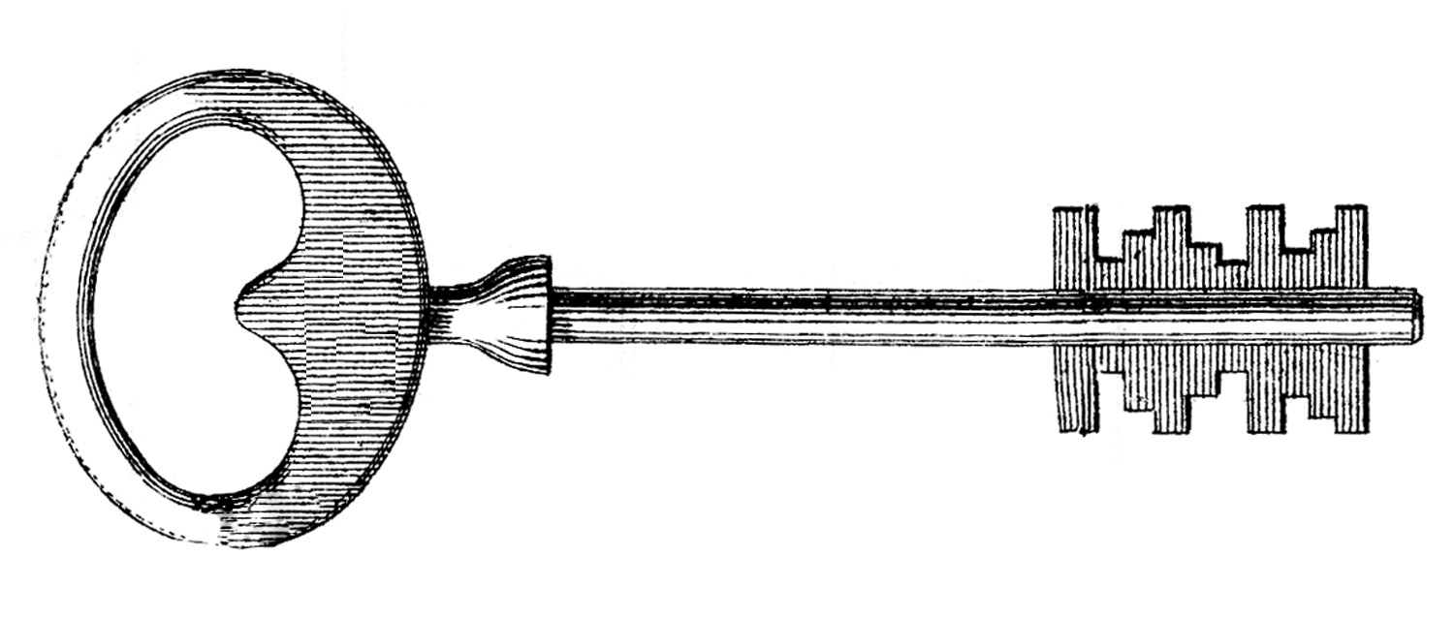
What Is an Animal?
All members of the animal kingdom share certain characteristics.
Animals, members of the kingdom Animalia, are multicellular, eukaryotic heterotrophs whose cells lack cell walls.
The bodies of most animals contain tissues.
Tissue is a group of cells that perform a similar function.
Animals have epithelial (skin), muscular, connective, and nervous tissues.

Slide 4
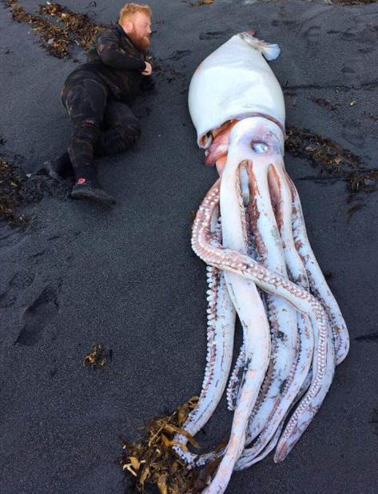
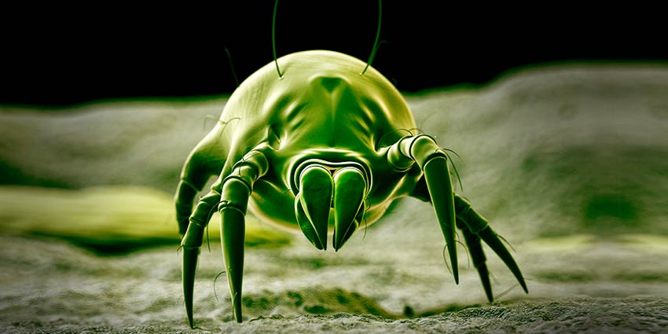
Over 95% of all animal species are often grouped in a single, informal category: invertebrates.
Invertebrates are animals that do not have a backbone, or vertebral column.
They range in size from microscopic dust mites, to the giant squid.
The other 5% of animals are called vertebrates because they have a backbone.

Slide 5
What Animals Do To Survive
Animals carry out the following essential functions; feeding, respiration, circulation, excretion, response, movement, and reproduction.
Many body functions help animals maintain homeostasis, or a stable internal environment.
Homeostasis is often maintained by internal feedback mechanisms.
Most of these mechanisms involve feedback inhibition, in which the product, or result of a process stops or limits the process.
For example, when your body sweats to release excess heat.

Slide 6
Feeding
Most animals cannot absorb food; instead, they ingest/eat it through the following mechanisms:
Herbivores eat plants
Carnivores eat other animals
Omnivores feed on plants and animals
Detritivores feed on decaying plant and animal material.
Filter feeders strain tiny floating organisms from water.
Parasites feed on hosts, harming them.

Slide 7
Respiration
Whether they live in water or on land, all animals respire, which means they take in oxygen and give off carbon dioxide.
Some animals can diffuse these gases through their skin
Most animals however, have evolved complex tissues and organ systems for respiration.

Slide 8
Circulation
Many small aquatic animals rely solely on diffusion to transport oxygen, nutrient molecules, and waste products among all their cells.
Larger animals have some kind of circulatory system to move materials around within their bodies.

Slide 9
Excretion
A primary waste product of cells is ammonia.
A buildup of ammonia and other waste products would kill an animal.
Most animals have an excretory system that either eliminated ammonia or converts it into a less toxic substance.
By eliminating metabolic wastes, excretory systems help maintain homeostasis.

Slide 10
Response
Animals respond to events in their environment using specialized cells called nerve cells.
In most animals, nerve cells hookup together to form a nervous system.
Some nerve cells respond to external stimuli, others process information and determines how the animal responds.

Slide 11
Movement
Some adult animals stay attached to a single spot.
However, most are motile, or can move.
But both usually have muscles or muscle-like tissues.
Muscle contraction enables motile animals to move around with skeletal support.
Muscles also help animals feed and pump water and fluids through their bodies.

Slide 12
Reproduction
Most animals reproduce sexually.
This helps to create and maintain genetic diversity in populations.
Many can also reproduce asexually. This allows them to increase their numbers rapidly.

Slide 13
Trends in Animal Evolution
Our survey of the animal kingdom will begin with simple forms and move through more complicated ones.
Complex animals tend to have high levels of cell specialization and internal body organization, bilateral body symmetry, a front end or head with sense organs, and body cavity.
Embryos of complex animals develop in layers.

Slide 14
Cell Specialization & Levels of Organization
As animals have evolved, their cells have become specialized to carry out different functions, such as movement and response.
Each cell type has a structure and chemical composition that enable it to perform a specialized function.
Groups of specialized cells form tissues
Tissues join together to form organs and organ systems.

Slide 15
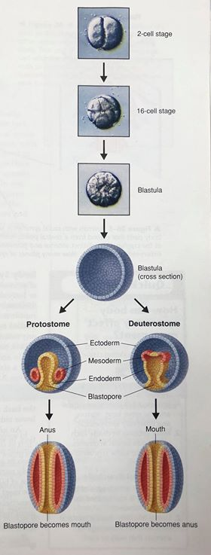
Early Development
Animals that reproduce sexually begin life as a zygote, or fertilized egg.
The zygote undergoes a series of divisions to form a blastula.
A blastula is a hollow ball of cells.
The blastula fold in on itself, forming an opening called a blastophore.
From here, a blastophore can go one of two directions, it will either become a protostome or deuterostome

Slide 16
A protostome is an animal whose mouth is formed from the blastopore. (ie. most invertebrates).
A deuterostome is an animal whose anus is formed from the blastopore. (ie. echinoderms and vertebrates are deuterostomes).
This suggests that vertebrates are most closely related to echinoderms

Slide 17
The cells of most animal embryos differentiate into three layers called germ layers.
1)Endoderm develops into the lining of the digestive tract and respiratory system.
2) Mesoderm gives rise to muscles, circulatory, reproductive organs, and kidneys.
3) Ectoderm, gives rise to sensory organs including nerves and skin.
Development Diagram

Slide 18
Body Symmetry
With the exception of sponges, every kind of animal exhibits some type of body symmetry.
Many simple animals, like sea anemone, exhibit radial symmetry.
Most animals exhibit bilateral symmetry, meaning they have a left and right sides, as well as anterior and posterior ends.
Bilateral symmetry allows for segmentation

Slide 19
Cephalization
Animals with bilateral symmetry usually exhibit cephalization.
Cephalization is the concentration of sense organs and nerve cells at the front end of the body.
These animals can respond to the environment more quickly and in more complex ways than simpler animals can.
In general, the more complex the animal, the more pronounced their cephalization.

Slide 20
Body Cavity Formation
Most animals have a body cavity – a fluid-filled space that lies between the digestive tract and the body wall.
This provides a space where internal organs can be suspended so they are not pressed on by muscles, or twist out of shape by body movements.
In some animals, body cavities contain fluids involved in circulation, feeding, and excretion.

Slide 21
8.2 - SPONGES
Sponges are the simplest and probably the most unusual animals.
Living on Earth for at least 540 million years, they are the most ancient animals.
They can be found in any ocean on the planet, at any depth.

Slide 22
What Is a Sponge?
Sponges encompass the phylum Porifera, “pore-bearers.”
Sponges are sessile, meaning they live their entire adult life attached to a single spot.
Sponges are classified as animals because they are multicellular; heterotrophic, have no cell walls, and contain a few specialized cells.

Slide 23
Form and Function in Sponges
Sponges have nothing resembling a mouth or gut, and they have no tissues or organ systems.
Simple physiological processes are carried out by a few specialized cells.

Slide 24
Body
Sponges are asymmetrical; they have no front or back ends, and no left or right sides.
We can think of sponges as large ,cylindrical water pumps.
The body forms a wall around a large central cavity through which water is circulated continually.

Slide 25
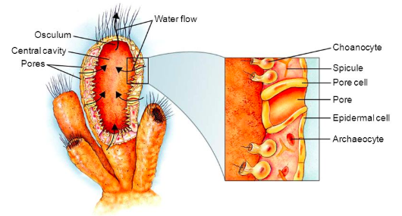
Choanocytes are specialized cells that use flagella to move a steady current of water through the sponge.
This water enters through pores located in the body wall.
Water then leaves through the osculum, a large hole at the top of the sponge.

Slide 26
The movement of water through the sponge provides a simple mechanism for feeding, respiration, circulation, and excretion.
Sponges have a simple skeleton made of spiny spicules.
A spicule is a spike-shaped structure made of calcium carbonate or silica

Slide 27
Spicules are made by archaeocytes, which are specialized cells that move around within the walls of the sponge.
Softer sponges have an internal skeleton made of spongin.
These sponges are used as natural bath sponges.

Slide 28
Feeding
Sponges are filter feeders that sift microscopic food particles from the water.
Digestion takes place inside the cells.
As water moves through the sponge, food particles are trapped and engulfed by choanocytes.
The particles are then passed onto to archaeocytes, that transport digested food throughout the sponge.

Slide 29
Respiration, Circulation, & Excretion
Sponges rely on the movement of water through their bodies to carry out body functions.
As water moves throughout the body cavity, oxygen diffuses into the surrounding cells.
Carbon dioxide, ammonia and other wastes are carried away at the same time.

Slide 30
Response
Sponges do not have nervous systems that allow them to respond to changes in their environment.
However, many can produce toxins, that make them poisonous to potential predators.

Slide 31
Reproduction
Sponges can reproduce either sexually or asexually.
In most sponge species, a single sponge forms both the eggs and sperm.
The eggs are fertilized inside in sponges body. This is called internal fertilization.
Sperm are released from one sponge, and are carried through water currents until they enter the pores of another sponge.
Archaeocytes carry the sperm to the egg.
Sponges Reproductive Cycle

Slide 32
Sponges can reproduce asexually by budding or by producing gemmules.
In budding, part of a sponge break off the parent sponge, settles on the sea floor, and grows into a new sponge.
When conditions are harsh, some sponges produce gemmules, which are group of archaeocytes surrounded by a tough layer of spicules.
This allows the sponge to survive freezing and drought

Slide 33
Ecology of Sponges
Sponges are important in aquatic ecology.
They provide habitats for marine animals.
Sponges also form partnerships with photosynthetic bacteria, algae, and plantlike protists.
These organisms provide food and oxygen for the sponge, and the sponge provides them with protection.

Slide 35
8.3 - CNIDARIANS
Cnidaria are a group of organisms that include hydras, jellyfish, sea anemones, and corals.
They are found in waters all over the world.
Some live as individuals
Others live in colonies composed of dozens or even thousands of connected individuals.

Slide 36
What Is A Cnidarian?
Cnidarians are soft-bodied, carnivorous animals that have stinging tentacles arranged in circles around their mouths. They are the simplest animals to have body symmetry and specialized tissues.

Slide 37
They get their name from the cnidocytes, or stinging cells, that are located along their tentacles.
They are used for defense and to capture prey.
Nematocysts are a poison-filled, stinging structure that contains a tightly coiled dart within each cnidocyte.

Slide 38
Form & Function in Cnidarians
Cnidarians are only a few cells thick and have simple body systems.
Most of their responses to the environment are carried out by specialized cells and tissues.
These tissues function in physiological processes such as feeding and movement.

Slide 39
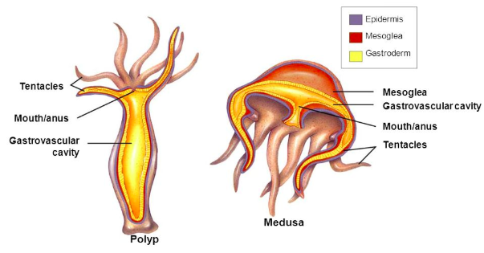
Body Plan
Cnidarians have radial symmetry.
They have a central mouth surrounded by numerous tentacles that extend outward from the body.
Cnidarians typically have a life cycle that includes two different stages: a polyp and medusa.

Slide 40
A polyp is a cylindrical body with armlike tentacles.
In a polyp, the mouth points upward. They are usually sessile.
A medusa has a motile, bell-shaped body with the mouth on the bottom.
They each have a body wall that surrounds an internal space called a gastrovascular cavity, where digestion takes place.

Slide 41
Feeding
After paralyzing its prey, a cnidarian pulls the prey through its mouth and into its gastrovascular cavity.
Food enters, and waste leaves through the same opening.
Food is partially digested in the gastrovascular cavity. It is then absorbed by the gastroderm, can digestion is completed here.

Slide 42
Respiration, Circulation, & Excretion
Following digestion, nutrients are usually transported throughout the body by diffusion.
Cnidarians respire and eliminate the wastes of cellular metabolism by diffusion through their body walls.

Slide 43
Response
Cnidarians gather information from their environment using specialized sensory cells.
A nerve net is a loosely organized network or nerve cells that allow cnidarians to detect stimuli such as touch.
They also have statocysts, which are groups of sensory cells that help determine the direction of gravity.
Ocelli are eyespots that can detect light.

Slide 44
Movement
Cnidarians move in different ways.
Sea anemones have a hydrostatic skeleton, which consists of a layer of circular muscles and a layer of longitudinal muscles that enable them to move.
Medusas move by jet propulsion. Muscle contractions cause their bodies to fold like umbrella’s, this pushes water out of the bell moving it forward.

Slide 45
Reproduction
Most cnidarians reproduce both sexually and asexually.
Polyps can reproduce asexually by budding
In most cnidarians, sexual reproduction takes place with external fertilization in water.
This takes place outside of the female body.
The female will release the eggs into the water, and the male releases the sperm in the water.
Jellyfish Reproduction Cycle Diagram

Slide 46
Groups of Cnidarians
Here we will learn about three classes of Cnidarians.
1) Class Scyphozoa – Jellyfish
2) Class Hydrozoa – Hydras
3) Class Anthozoa – Sea Anemones & Corals
All cnidarians live under water, and nearly all live in the ocean.
Cnidarians include jellyfishes, hydras and their relatives, and sea anemones and corals.

Slide 47
Jellyfishes
The class Scyphozoa contains jellyfishes.
Scyphozoans, which means “cup animals,” live their lives primarily as medusas.
The polyp form of jellyfishes is restricted to a small larval stage.
The largest jellyfish ever found was almost 4 meters in diameter, and the tentacles were more than 30 meters long
They reproduce sexually.

Slide 48
Hydras & Their Relatives
The polyps of most hydras grow in branching colonies that sometimes extend more than a meter.
Within the colony, polyps are specialized to perform different functions.
The most common freshwater hydrozoans are hydras. Hydras lack a medusa stage.
Hydras reproduce asexually by budding, or sexually.
Many get their nutrition from capturing, stinging, and digesting small prey.

Slide 49
Sea Anemones and Corals
Members of this group live their entire lives in the polyp stage.
They all have a central body surrounded by tentacles. Their namesake anthozoa means: “flower animal.”
Many species are colonial
Sea anemones are solitary polyps that live at all depths of the ocean.
Using nematocysts, they catch a variety of marine organisms.

Slide 50
Individual coral polyps look like minature sea anemones
Most corals are colonial, and their polyps grow together in large numbers.
New polyps are produced using budding, as they grow they secrete a skeleton of calcium carbonate
These grow slowly and can live for hundreds, or thousands of years.
They reproduce sexually by producing eggs and sperm that release into the water.

Slide 51
Ecology of Corals
The distribution of corals is determined by temperature, water depth, and light intensity.
The stony, or “hard” corals require high levels of light.
Light is necessary because corals rely on algae to capture solar energy, and recycle nutrients.
This allows them to live in water that carries few nutrients.

Slide 52
Many coral reefs are suffering from human activity.
Recreational divers sometimes damage coral reefs.
Silt and other sediments from logging, farming, and mining can wash onto reefs and smother corals.
Chemical fertilizers, insecticides, and pollutants can poison corals.
Overfishing can upset the ecological balance of reefs.
Coral bleaching has become common
High temperatures can kill algae that live in corals
Over the last 20 years, bleaching has become more common and severe, causing the death of many reefs.

Slide 53
