Slide 1
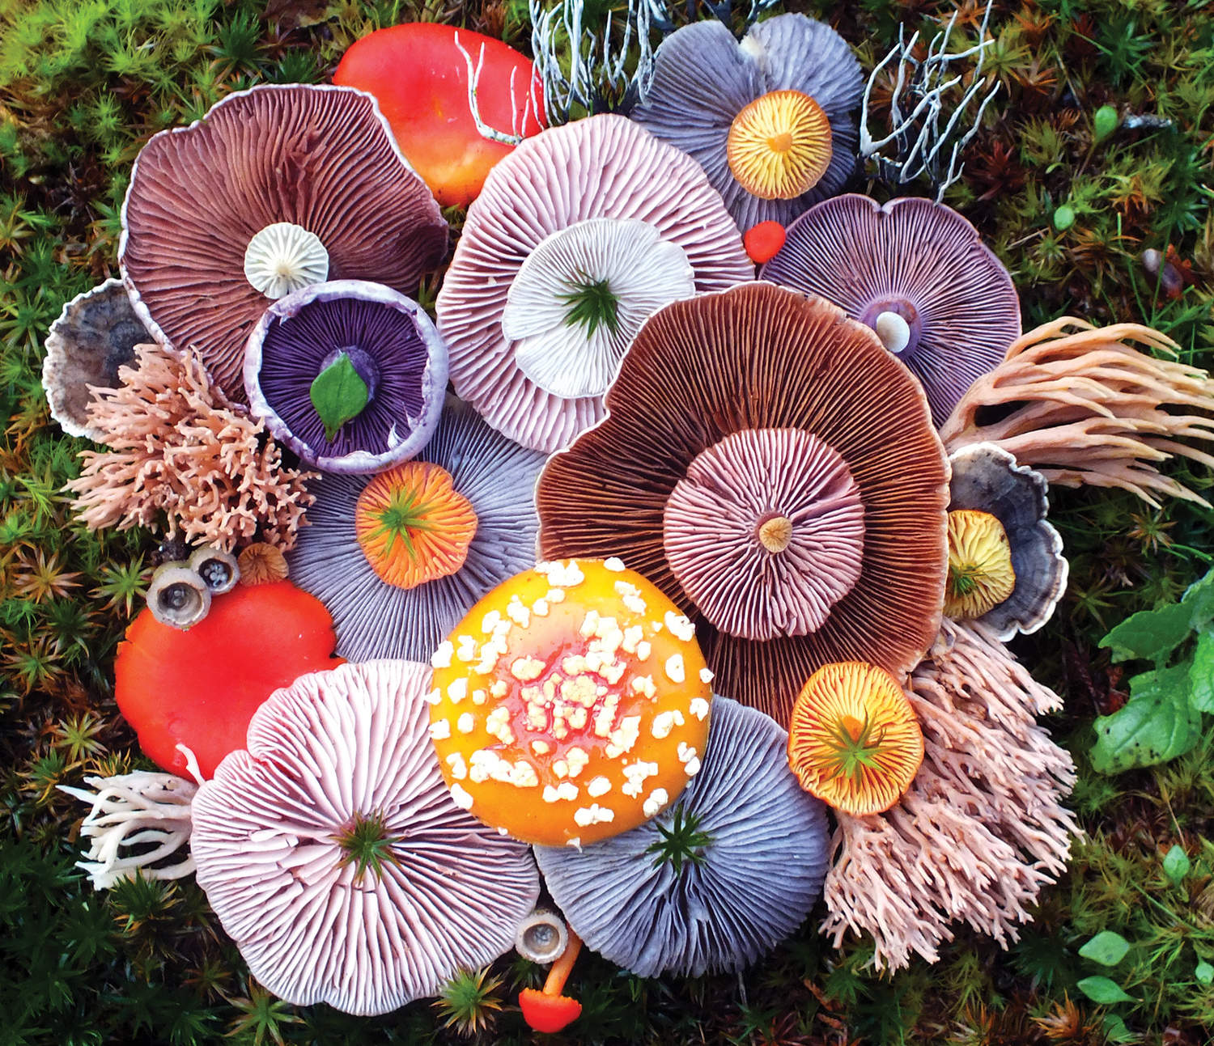
7 - Fungi
Ms. Martel

Slide 2
Looking At Fungi Intro Activity
What are mushrooms made of?
Examine a mushroom without damaging it. Record your observations, and include a sketch.
Carefully separate the stalk and cap of the mushroom. Try to break the stalk across and lengthwise.
Crumble a piece of the stalk. Describe the shape of the parts that make up the stalk.
Break the cap in two, and examine the thin sheets on the underside of the cap. Record your observations

Slide 3
Think About It…
Observing: Was the stalk made up of parts with specific shapes? If so, what are the shapes of those parts?
Comparing and Contrasting: Compare a mushroom to a plant. How are they similar? Different?

Slide 4
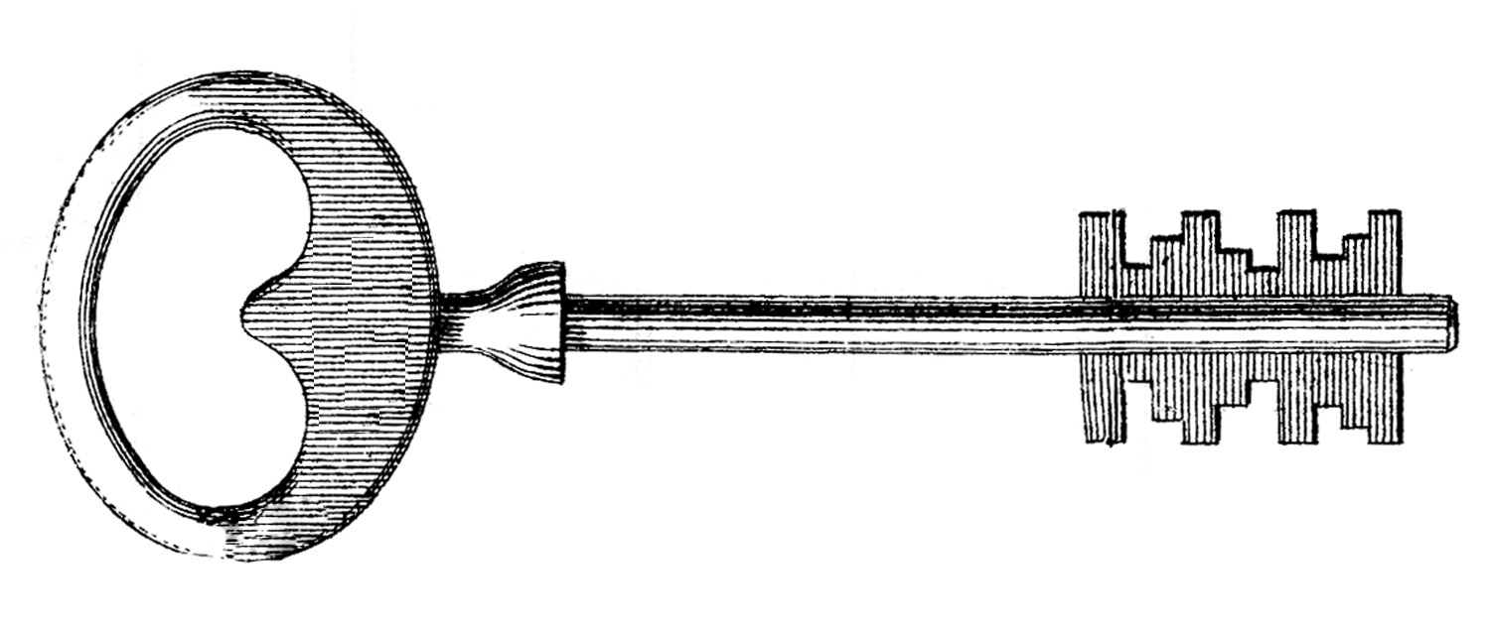
7.1 – THE KINGDOM FUNGI
Fungi are eukaryotic heterotrophs that have cell walls.
The cell walls of fungi are made up of chitin.
Unlike animals, fungi do not ingest their food. Instead they digest food outside of their bodies and then absorb it.

Slide 5
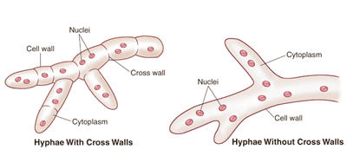
Structure & Function of Fungi
Except for yeasts, all fungi are multicellular.
Multicellular fungi are composed of thin filaments called hyphae; that are only one cell layer thick.
Some hyphae have cross walls that help separate the nuclei while others do not.

Slide 6
Fungus Structure
The bodies of multicellular fungi are composed of many hyphae tangled together into a thick mass called a mycelium.
The mycelium has a large surface area, which makes it well suited to absorb food.
The fruiting body is a reproductive structure growing from the mycelium in the soil.

Slide 7
Reproduction in Fungi
Most fungi reproduce both asexually and sexually.
Asexual reproduction takes place when cells or hyphae break off and begin to grow on their own.
Some also produce spores, which scatter and grow into new organisms.
In some fungi, spores are produced in structures called sporangia.
These are found at the tips of specialized hyphae called sporangiophores.

Slide 8
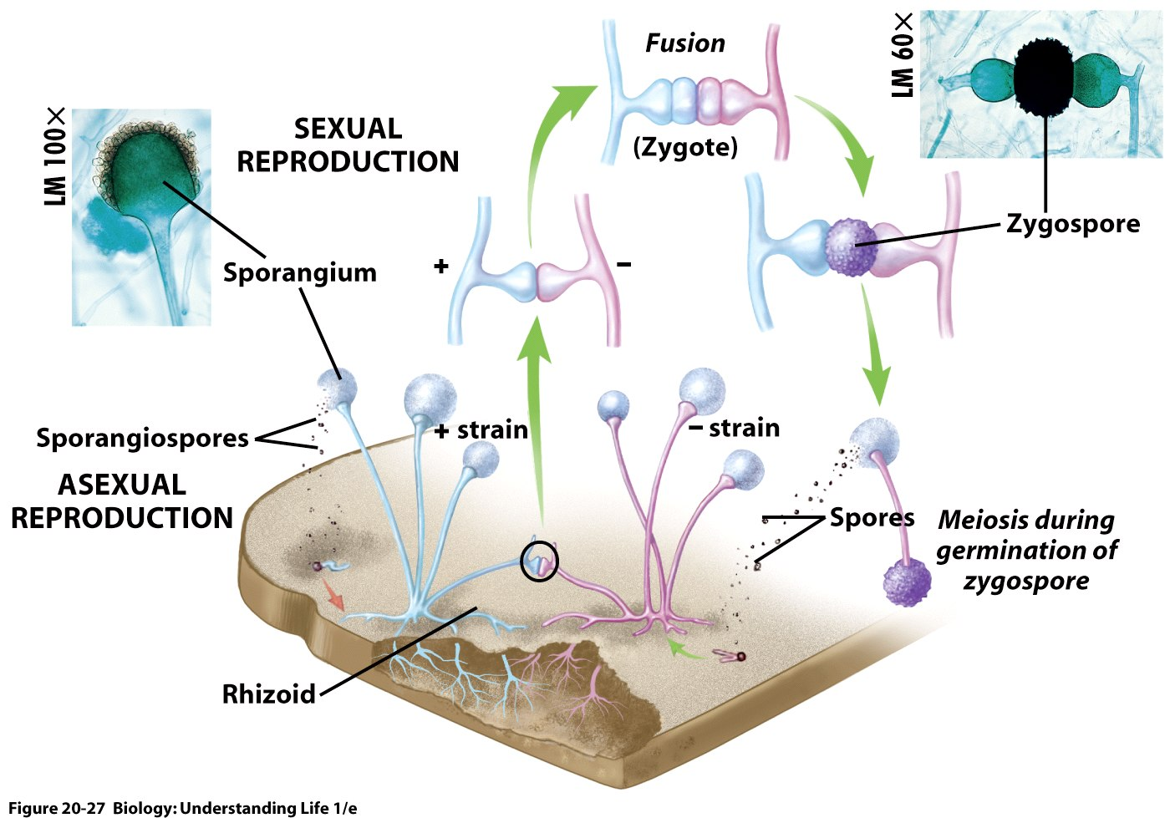
Sexual reproduction usually involves two different mating types.
These are called “+” (plus) and the other “-” (minus).
When the hyphae of opposite mating types meet, they fuse into the same cell.
They then produce spores that are capable of growing.

Slide 9
How Fungi Spread
Many fungi produce dry, almost weightless spores that scatter easily in the wind.
In order for these spores to germinate, there must be a proper combination of temperature, moisture, and food.
Other fungi specialize in luring animals, that help disperse spores over long distances. Ex) insects.

Slide 10
7.2 – CLASSIFICATION OF FUNGI
The kingdom Fungi has over 100,000 species.
They are classified according to their structure and method of reproduction.
Their methods of reproduction are unlike those of any other kingdom.
The four main groups of fungi are:
1) the common mold (Zygomycota)
2) the sac fungi (Ascomycota)
3) the club fungi (Basidiomycota)
4) the imperfect fungi (Deuteromycota)

Slide 11
1) The Common Molds
The familiar molds that grow on meat cheese, and bread are members of this phylum.
Zycomycetes have life cycles that include a zygospore.
A zygospore is a resting spore that contains zygotes formed during the sexual phase of the mold’s life cycle.

Slide 12
Structure & Function of Bread Mold
Black bread mold is a familiar zygomycete.
With a hand lens you can see delicate hyphae on moldy bread.
There are two different kinds of hyphae:
1) The rootlike hyphae that penetrate the bread’s surface are rhyzoids. They anchor fungus to the bread, release digestive enzymes, and absorb digested organic material.
2) The stemlike hyphae that run along the surface of the bread are stolons.

Slide 13
QUICKLAB: What is the structure of bread mold?
Materials: transparent tape, moldy bread, hand lens, microscope slide, compound microscope.
1) Obtain a piece of moldy bread, and examine the mold using a handlens. Sketch what you see.
2) The touch the sticky side of a piece of tape to the black “fuzzy” area of a bread mold.
3) Gently stick the tape to a glass slide. Observe the slide under a compound microscope. Sketch your observations.

Slide 14
Analyze & Conclude
1) Observing: Describe the structures you observed in the bread mold.
2) Formulating Hypotheses: What do you think the function of the round structures is? Why might it be advantageous for a single mass of bread mold to produce so many of the round structures?
3) Inferring: How can your observations help explain the ability of molds to appear on foods even in very clean kitchens?

Slide 15
2) The Sac Fungi
The phylum Ascomycota is named for the ascus, a reproductive structure that contains spores.
There are more than 30, 000 species of ascomycetes, making it the largest phylum of the kingdom Fungi.
Some are large enough to be visible when they grow above ground, others such as yeast are microscopic.

Slide 16
Life Cycle of Sac Fungi
The life cycle of an ascomycete typically includes both sexual and asexual reproduction.
In asexual reproduction, tiny spores called conidia are formed at the tips of specialized hyphae called conidiophores. In suitable environments they grow.

Slide 17
Sexual reproduction occurs when the haploid hyphae of two different mating types grow close together.
The hyphae form a fruiting body.
The ascus forms within the fruiting body

Slide 18
Yeasts
Yeasts are unicellular fungi.
The yeasts used by humans for baking and brewing are classified as ascomycetes because they form asci with ascospores during the sexual phase of their life cyle.
The dry granules of yeast contain ascospores, which become active in moist environments
This process of asexual reproduction is called budding.

Slide 19
3) The Club Fungi
The phylum Basidiomycota, or club fungi, gets its name from a specialized reproductive structure that resembles a club.
The spore bearing structure is called the basidium, which are found on the gills that grow on the underside of a mushroom cap.

Slide 20
Life Cycle of Club Fungi
This group undergoes the most elaborate life cycle of all the fungi.
When the right combination of moisture and nutrients occurs, spore-producing fruiting bodies push above the ground.
You will recognize these fruiting bodies as mushrooms
When the mushroom cap opens, it exposes hundreds of tiny gills on its underside, each lined with basidia.
The fusion of two basidia produces basidiospores, which then scatter.

Slide 21
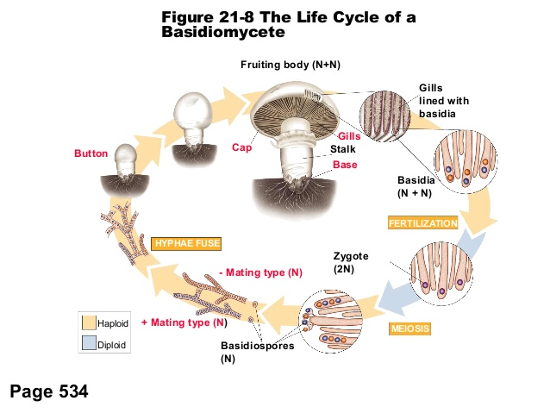

Slide 22
Diversity of Club Fungi
In addition to mushrooms, this group includes shelf fungi, which grow near the surface of decaying trees.
Puffballs, earthstars, jelly fungi, and plant parasites known as rusts are other examples.

Slide 23
Edible and Inedible Mushrooms
Many types of fungi have long been considered delicacies, and several different species of mushrooms are cultivated for food.
For example, regular mushrooms, portobello, and shiitake.
Wild mushrooms are a different story.
Some are edible, however many are poisonous. The poisonous ones can look identical to edible mushrooms.
The result of eating a poisonous mushroom can be severe illness or even death.

Slide 24
4) The Imperfect Fungi
Deuteromycota are fungi that cannot be placed in other phyla because researchers have not been able to observe a sexual phase in their life cycles.
One of the best known imperfect fungi is Penicillium, this mold frequently grows on fruit and is the source of the antibiotic penicillin.

Slide 25
7.3 – ECOLOGY OF FUNGI
Paleontologists think that fungi helped early plants to obtain nutrients from the ground.
Their earliest appearance suggests that fungi may have been essential to plants’ successful colonization of land.
Over time, fungi have become an important part of virtually all ecosystems.

Slide 26
All Fungi Are Heterotrophs
Fungi must rely on other organisms for their energy.
Many fungi are saprobes, this means they obtain food from decaying organic matter.
Others are parasites, and others are symbionts.
Although most fungi feed on decaying matter, a few feed by capturing live animals.

Slide 27
Fungi as Decomposers
Fungi play an essential role in maintaining equilibrium in nearly every ecosystem, where they recycle nutrients by breaking down the bodies and wastes of other organisms.
Many feed by releasing digestive enzymes that break down organic material into simple molecules.
These molecules then diffuse into the fungus.
Mycelia of fungus produce the enzymes that help speed up the breakdown of wastes and dead organisms

Slide 28
Fungi as Parasites
As useful as fungi are, others can infect both animals and plants, disrupting their internal equilibrium and causing disease.
Parasitic fungi cause serious plant and animal diseases. A few cause diseases in humans.

Slide 29
Plant Diseases
Fungal diseases are responsible for the loss of approximately 15% of crops grown in temperate regions of the world.
Fungi are in direct competition with humans for food
Wheat rust affects one of the most important crops in North America.

Slide 30
Human Diseases
Fungal parasites can also infect humans.
Athletes foot is a fungus that forms a mycelium directly within the outer layers of the skin.
This produces a red, inflamed sore from which the spores can easily spread from person to person.
When the same fungus infects the scalp, it produces a red scaling sore known as ringworm.

Slide 31
Other Animal Diseases
As problematic as human fungal diseases can be, few fungal diseases are as deadly as the infection by Cordyceps.
Microscopic spores become lodged in various insects.
The spores multiply inside their bodies, digesting all its cells and tissues until the insect dies.
Then hyphae develop to spread infection to other members of the same species.

Slide 32
Symbiotic Relationships
Some fungi form symbiotic relationships in which both partners benefit. Two such mutualistic associations, lichens and mycorrhizae, are essentially to many ecosystems.

Slide 33
Lichens
Lichens are not single organisms, they are symbiotic associations between a fungus and a photosynthetic organism.
Lichens are extremely resistant to drought and cold.
They can survive these harsh environments because of the relationship between two partner organisms.

Slide 34
Bacteria carry out photosynthesis, providing the fungus with a source of energy.
The fungus in turn provides the bacteria with water and minerals.
Lichens are the first to enter barren environments, and help soil formation.
They are also very sensitive to air pollution, and are among the first organisms to be affected when air quality deteriorates.

Slide 35
Mycorrhizae
Fungi also form mutualistic relationships with plants.
Almost half of the tissues of trees are hidden beneath the ground in masses of tangled roots.
These associations of plant roots and fungi are mycorrhizae.
The tiny hyphae of the fungi aid plants in absorbing water and minerals.
The plants in turn provide the fungi with the products of photosynthesis.

Slide 36
The partnership between plant and fungus does not end with a single plant.
The roots of each are plugged into mycorrhizal networks that connect many plants.
The networks also appear to connect plants of different species.
Experiments show that carbon atoms from one tree often end up in another nearby tree.

