Slide 1
6 - Protists
Ms. Martel

Slide 2
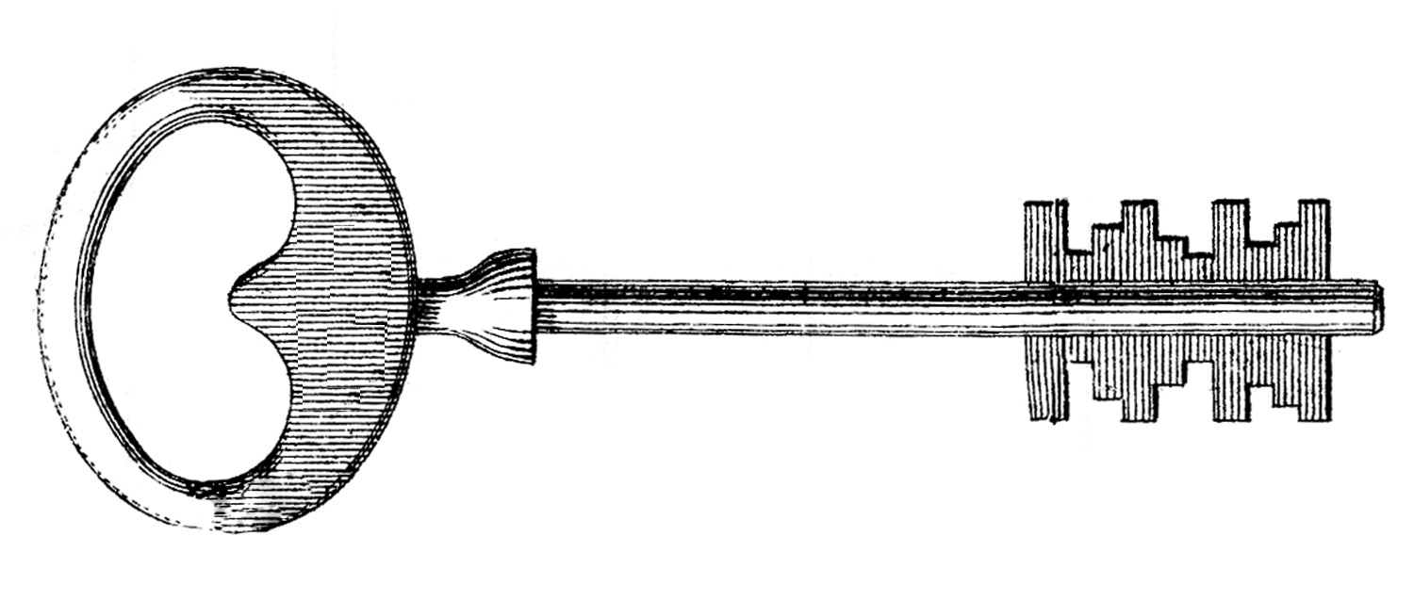
6.1 – THE KINGDOM PROTISTA
What Is a Protist?
This is a very diverse group that may include more than 200, 000 species.
Protists are very controversial in how they are defined, and are more accurately categorized in what they are NOT.
Protists are eukaryotes that are NOT members of the kingdoms Plantae, Animalia, or Fungi.

Slide 3
Recall that eukaryotes have a nucleus and other organelles.
Most protists are unicellular, however, some are multicellular.

Slide 4
Evolution of Protists
Protists are members of a kingdom whose formal name, Protista, comes from the Greek words meaning “the very first.”
The first eukaryotic organisms on Earth, 1.5 bya, were protists.
Scientists believe that the endosymbiotic theory can explain the evolution of these organisms.

Slide 5
Classification of Protists
One way to classify protists is according to how they obtain nutrition.
1) Protists that are heterotrophs are called animal-like protists.
2) Protists that produce their own food by photosynthesis are called plant-like protists.
3) Protists that obatin their food by external digestion – ie) decomposers or parasites – are called fungus-like protists.

Slide 6
6.2 – ANIMAL-LIKE PROTISTS: PROTOZOANS
Protozoa means “first animals”, this group of protists are heterotrophic.
There are four phyla of animal-like protists, and are distinguished from one another by means of how they move:
1) zooflagellates
2) sarcodines
3) ciliates
4) sporozoans

Slide 7
1)Zooflagellates
Many protists move through water by their flagella.
Flagella are long-whiplike projections that allow a cell to move.
Animal-like protists that swim using flagella are classified in the phylum Zoomastigina and are often referred to as zooflagellates.

Slide 8
Zooflagellates are generally able to absorb food through their cell membranes.
Many live in lakes or streams, and absorb nutrients from decaying organic material.
Most reproduce asexually by mitosis and cytokinesis, however, some can reproduce sexually.

Slide 9
2) Sarcodines
Sarcodines are animal-like protists that use pseudopods for feeding and movement.
The best known sarcodines are amoebas.
Amoebas can capture and digest particles of food and even other cells.
They do this by surrounding their meal, then taking it inside themselves and forming a food vacuole.
Amoebas reproduce by mitosis and cytokinesis.

Slide 10
Other members of sarcodina include Foraminiferans and Heliozoans.
Foraminiferans are found in the ocean and secrete calcium carbonate, as they die, their shells accumulate on the ocean floor.
Heliozoans look like little sunrays.

Slide 11
3) Ciliates
Members of the phylum Cioliophora, known as ciliates, use cilia for feeding and movement.
Ciliates are found in both fresh and salt water.
Most are free-living, meaning they are not parasites or symbionts

Slide 12
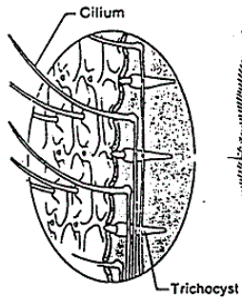
Internal Anatomy
Paramecium are the best known ciliates.
The cell membrane is highly structured and has trichocysts just below the surface used as defense

Slide 13
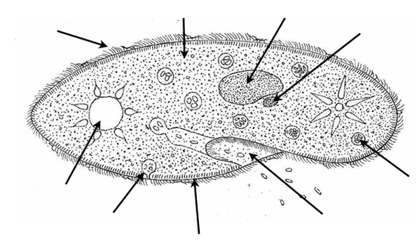
MACRONUCLEUS
MICRONUCLEUS
TRICHOCYST
Paramecium have two types of nuclei.
1) macronucleus keeps multiple copies of most of the genes that the cells need in day-to-day existence.
2) micronucleus keeps a “reserve copy” of all of the cell’s genes.

Slide 14
GULLET
ANAL PORE
Ciliates obtain food by using cilia to sweep food particles into the gullet.
These particles are forced into food vacuoles to be digested.
Waste material is emptied into the anal pore to be expelled outside of the cell.

Slide 15
CONTRACTILE VACUOLE
Water may move into paramecium by osmosis.
This excess water is collected in vacuoles, and emptied into the contractile vacuoles.
These are specialized to pump water out of the organism when they are full.

Slide 16
Conjugation
Ciliates typically reproduce asexually.
When placed under stress, they may undergo conjugation.
This begins when two paramecia attach themselves to each other.
They exchange micronuclei.
The macronucleus disintegrates, and a new one forms through the fusion of the micronuclei.
This helps to maintain genetic diversity.
Refer to Conjugation image in notes

Slide 17
4) Sporozoans
Members of the phylum Sporozoa do not move on their own and are parasitic.
Many have complex life cycles that involve more than one host.
They reproduce by sporozoites.

Slide 18
Animallike Protists and Disease
Some animallike protists cause serious diseases, including malaria and African sleeping sickness.

Slide 19
Malaria
The sporozoan Plasmodium, which causes malaria, is carried by the female Anopheles mosquito.
Once an infected mosquito enters the human blood stream, the protist infects liver cells and then red blood cells.

Slide 20
Other Protistan Diseases
African sleeping sickness – caused by a zooflagellate.
Spread from person to person by the bite of a tsetse fly.
They destroy red blood cells, and invade the nervous system, causing the infected person to lose consciousness, and may lead to a fatal sleep.
Amebic dysentery – the entamoeba lives in the intestines of the host, and attack the intestinal walls.
They are passed out through the feces and is spread easily in places with poor sanitation.

Slide 21
Ecology of Animallike Protists
Many play essential roles in the living world.
Some live symbiotically within other organisms.
Others recycle nutrients by breaking down dead organic matter.
Many live in seas and lakes, where they are eaten by tiny animals. Which in turn serves as food for larger animals.

Slide 22
6.3 – PLANTLIKE PROTISTS: UNICELLULAR ALGAE
Many protists contain the green pigment chlorophyll and carry out photosynthesis.
Plantlike protists are commonly called algae.
There are seven major phyla of algae classified according to cellular characteristics
The first four phyla are discussed in this section:
1) euglenophytes
2) chrysophytes
3) diatoms
4) dinoflagellates

Slide 23
Chlorophyll & Accessory Pigments
A key trait used to classify algae is the type of photosynthetic pigments they contain.
A shortage of light poses major difficulties for deep water algae.
In adapting to conditions of limited light, various groups of algae have evolved different forms of chlorophyll.
Chlorophyll a, chlorophyll b, and chlorophyll c absorb different wavelengths of light.
Chlorophyll and accessory pigments allow algae to harvest and use energy from sunlight.

Slide 24
1) Euglenophytes
Euglenophytes are plantlike protists that have two flagella but no cell wall.
Euglenas are found in ponds and lakes around the world, and they are excellent swimmers.

Slide 25
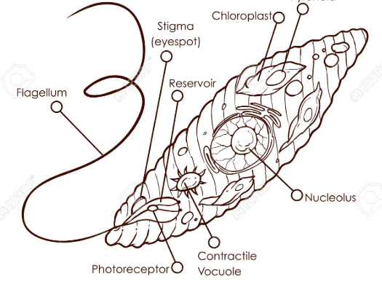
Near the gullet, there is a cluster of reddish pigment known as the eyespot, which helps it to find sunlight.
Euglenas to not have a cell wall, but have an intricate cell membrane called a pellicle.
They reproduce asexually through binary fission.

Slide 26
2) Chrysophytes
This phylum includes the yellow-green algae, and golden-brown algae.
Members of the phylum Chrysophyta are a diverse group of plantlike protists that have gold-coloured chloroplasts.
They reproduce both asexually and sexually.

Slide 27
3) Diatoms
Members of phylum Bacillariophyta, or diatoms, are among the most abundant and beautiful organisms on Earth.
Diatoms produce thin, delicate cell walls rich in silicon – the main component of glass.

Slide 28
4) Dinoflagellates
These are members of the phylum Pyrrophyta.
About half of the dinoflagellates are photosynthetic; the other half live as heterotrophs.
They generally have two flagella, and most reproduce asexually through binary fission.
Many species are luminescent, and give off light when agitated in the water.

Slide 29
Ecology of Unicellular Algae
Plantlike protists are common in both fresh and salt water, and are important in those respective ecosystems.
They are important organisms whose position at the base of the food chain makes much of the diversity of aquatic life possible
They make up a considerable part of phytoplankton.

Slide 30
Phytoplankton are photosynthetic organisms found near the surface of the ocean.
About half of the photosynthesis that occurs on Earth is carried out by phytoplankton.
As phytoplankton is the foundation of the marine food chain, they impact every other multicellular organism on Earth.

Slide 31
Algal Blooms: many protists grow rapidly where sewage is discharged. They help to recycle waste.
When waste is excessive, algae may grow into enormous masses known as algal blooms.
These blooms deplete the water of nutrients and oxygen, and cells die in great numbers.

Slide 32
6.4 – PLANTLIKE PROTISTS: RED, BROWN, AND GREEN ALGAE
Most of the algae in this section are multicellular.
Some of their most notable similarities to plants include their reproductive cycles, cell walls, and photosynthetic pigments.
The three phyla of algae include:
1) red algae
2) brown algae
3) green algae

Slide 33
1) Red Algae
Red algae are members of the phylum Rhodophyta.
Red algae are able to live at great depths due to their efficiency in harvesting light energy. Red algae contain chlorophyll a and reddish accessory pigments called phycobilins
Red algae lack flagella and centrioles, and play an important role in the formation of coral reefs.

Slide 34
2) Brown Algae
Brown algae belong to the phylum Phaeophyta.
Brown algae contain chlorophyll a and c, as well as brown accessory pigment fucoxanthin.
Brown algae are the largest and most complex of the algae.

Slide 35
The largest known algae is the giant kelp that can grow more than 60 meters in length.
The body of the alga consists of flattened stemlike structures called stipes, leaflike structures called blades, and gas-filled swellings called bladders, which help it to float

Slide 36
3) Green Algae
Green algae are members of the phylum Chlorophyta.
Green algae share many characteristics with plants, including their photosynthetic pigments and cell wall composition.
Green algae have cellulose in their cell walls, and contain chlorophyll a and b.
Many scientists believe that green algae are the ancestors of modern land plants.

Slide 37
Unicellular Green Algae
Chlamydomonas, a typical single-celled green algae, grows in ponds, ditches, and wet soil.
They are small and egg shaped, and have two small contractile vacuoles

Slide 38
Colonial Green Algae
Several species live in multicellular colonies.
The freshwater Spirogyra, form long threadlike colonies called filaments.
The cells in a Volvox colony are arranged to form hollow spheres.

Slide 39
Multicellular Green Algae
Ulva, or “sea lettuce” is a bright-green marine algae that is commonly found along rocky seacoasts.
The body is only two cell layers thick.

Slide 40
Human Uses of Algae
Algae are a major food source for life in the oceans.
They also produce much of Earth’s oxygen through photosynthesis.
Some species are used in medicine to help treat ulcers, high blood pressure, arthritis, and other health problems.
We use it in food production, for example, seaweed used in sushi. It can also be found in ice cream, salad dressing, candy bars, syrup, and eggnog.
Industry also uses it to make plastics, waxes, deodorants, and paints.

Slide 41
6.5 – FUNGUSLIKE PROTISTS
Funguslike protists grow in damp, nutrient rich environments and absorb food through their cell membranes.
Like fungi, the funguslike protists are heterotrophs that absorb nutrients from dead or decaying organic matter. But unlike most true fungi, funguslike protists have centrioles. They also lack chitin cell walls of true fungi.

Slide 42
Slime Molds
Slime mold are found in places that are damp and rich in organic matter, like the forest floor, or compost.
Slime molds are funguslike protists that play key roles in recycling organic material.
There are two broad categories of slime molds, cellular clime molds and acellular slime molds.

Slide 43
Cellular Slime Molds
These belong to the phylum Acrasiomycota.
They spend most of their lives as unicellular organisms that look and behave like animallike protists.
However, during adverse conditions, they act like multicellular organisms that aggregate to form a fruiting body to reproduce sexually.

Slide 44
Acellular Slime Molds
These belong to the phylum Myxomycota.
They also spend most of their lives as individual amoeba-like cells, however when they aggregate, their cells fuse and produce structures with many nuclei called a plasmodia
These can grow several meters in diameter

Slide 45
Water Molds
Water molds are members of the phylum Oomycota.
Oomycetes thrive on dead or decaying organic matter in water and some are plant parasites on land.
They produce thin filaments known as hyphae.
They display both sexual and asexual reproduction in their life cycle.

Slide 46
Ecology of Funguslike Protists
Slime molds and water molds are important recyclers of organic material.
AKA they help things rot.
However, some can harm living things.
They can cause plants diseases in grapes, tomatoes, and potatoes for example.

Slide 47
Water Molds and the Potato Famine
In 1846, a protist that produces airborne spores, that destroys all parts of the potato plant, lead to the death and starvation of at least 1 million Irish.
To escape the famine, over 1 million Irish emigrated to the US and other countries.

