Slide 1
Warm up:
What is the difference between a tumor and cancer?
What does metastasis mean?
Name 2 things that cause cancer, and 2 things that can help prevent cancer

Slide 2
5.2 Asexual Reproduction
Science 9
Biology Unit

Slide 3
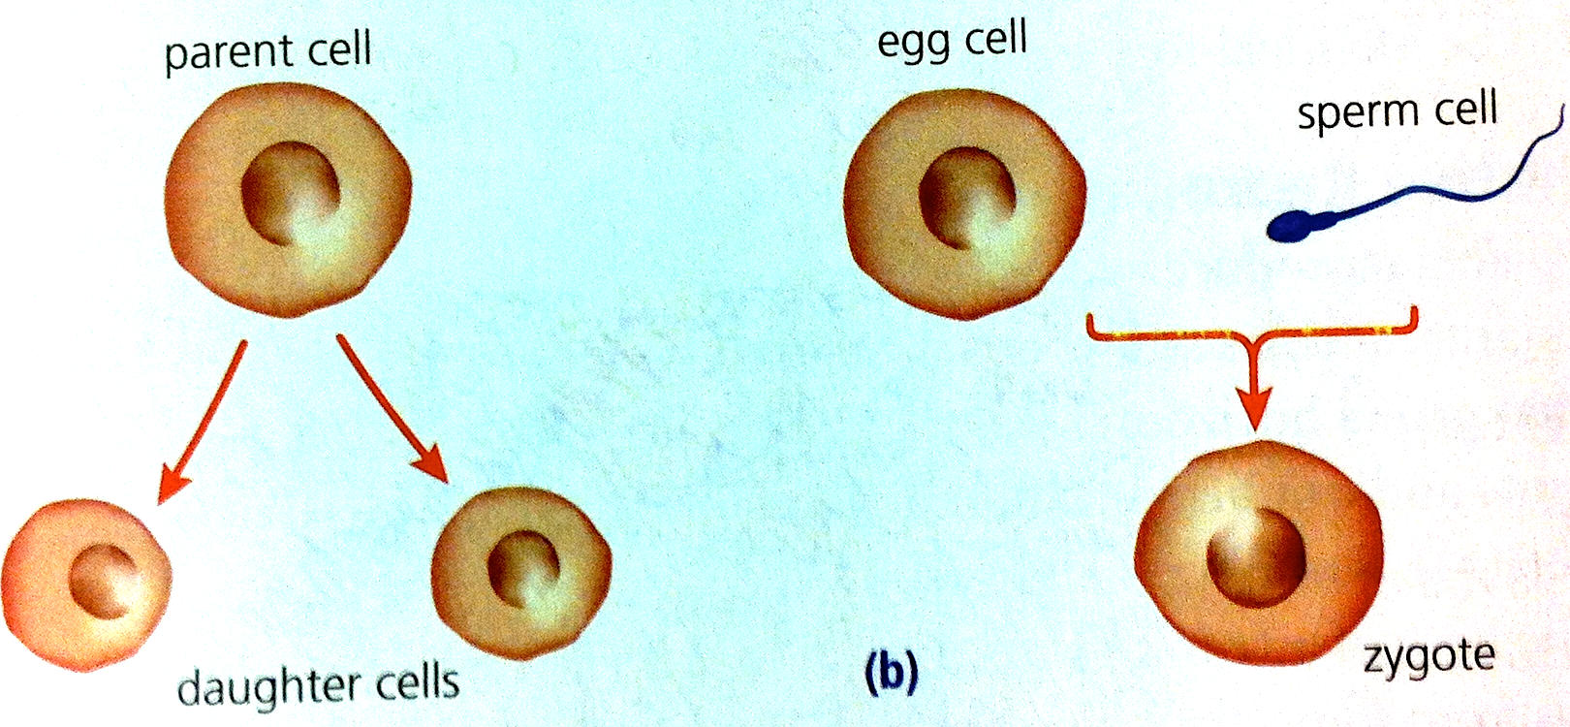
Reproduction:
Two types of reproduction: Sexual & Asexual
In Sexual Reproduction, two separate organisms (parents) contribute genetic information, usually specialized sex cells (egg cell and sperm cell)
Same DNA
Mix DNA

Slide 4
Reproduction:
Two types of reproduction: Sexual & Asexual
In Asexual Reproduction, only 1 parent cell is needed. All the offspring that are produced are identical to parent.
Offspring produced are clones containing identical DNA of the parent (cell division)
Same DNA
Mix DNA

Slide 5
5 TYPES OF aSEXUAL REPRODUCTION
binary fission
budding
fragmentation
vegetative reproduction
spore formation

Slide 6
gROUP ACTIVITY
Your group will be assigned one method of asexual reproduction. You will have 30 mins to read through the material in the textbook and become experts on your method.
Each group is responsible for teaching the class about their method of asexual reproduction through a 2 min presentation/skit/poem/song/comic strip.

Slide 7
gROUP ACTIVITY
During each presentation the rest of the class will take notes on the material presented and fill it in their chart. MAKE SURE YOU SPEAK CLEAR AND SLOW so they can write down the info.

Slide 8
Guidelines for Presentations
You must clearly state which method of asexual reproduction you have
Explain exactly how this method produces a new organism
Give an example organism that uses this method of reproduction
Explain the advantages of this method
In addition, the presentation should be interesting and fun to watch
After your presentation you must answer any questions the teacher or the students have about the material presented

Slide 9
Marking Scheme
Your group will be given a mark out of 15 for your presentation.
Including all the necessary information (6 marks)
Creativity (2 marks)
How well your group works together (2 marks)
Effectiveness of the presentation (3 marks)
Listening during other groups presentations (2 marks)

Slide 12
Planarians

Slide 13
Characteristics of asexual reproduction
What are some common things between all of these 5 types of asexual reproduction?
Advantages/Disadvantages of asexual reproduction?

Slide 14
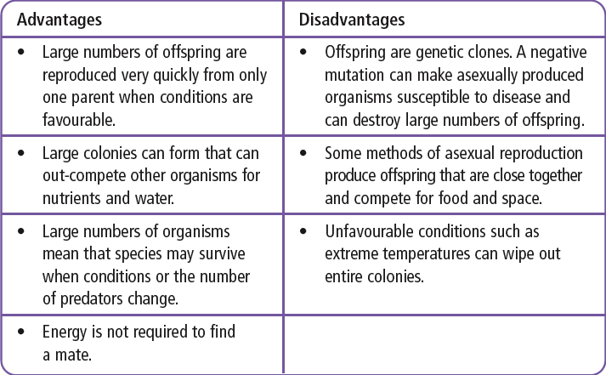
Characteristics of asexual reproduction
Different types of asexual reproduction, all have three characteristics in common:
Only one organism is needed to reproduce
All the offspring are genetically identical to each other and to the parent organism
A single organism can produce large numbers of offspring

Slide 15
Homework
Finish 5.2 Worksheet

