Slide 1
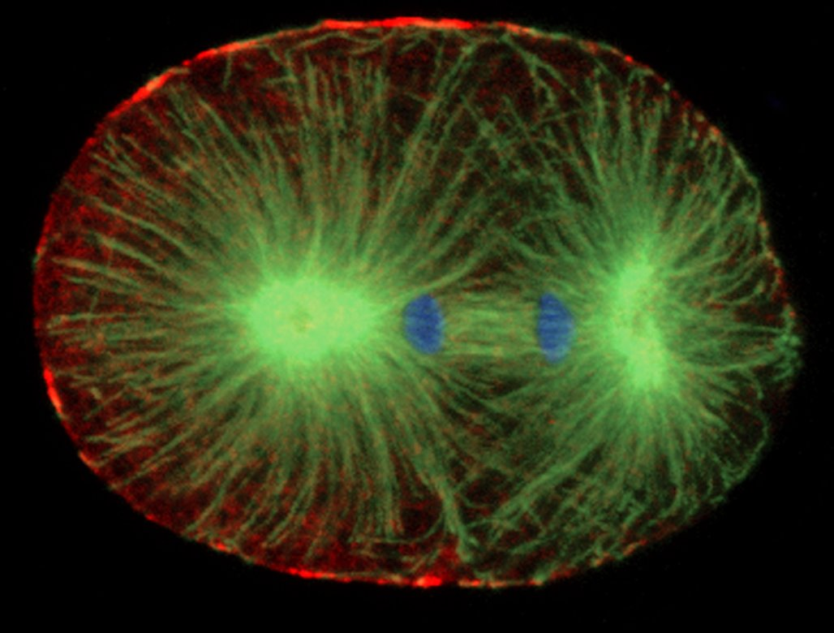
5.1 THE CELL CYCLE
Mitosis
Science 9

Slide 2
Biology is about the very small….
sometimes we learn about things that we can’t see or
don’t think about
But biology is about understanding about what our body is doing
without you even knowing about it…..
Nature also has come up with some pretty weird things…..

Slide 3
Weirdest Living things on Earth

Slide 4
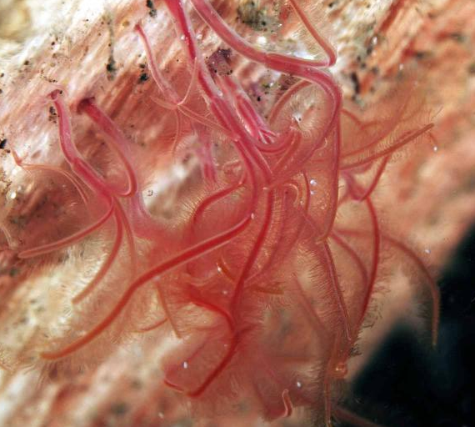
Zombie Worms
Zombie worms feed off the bones of whales and other dead sea creatures…but they don’t have a mouth
Scientists have discovered they excrete acid that breaks down the bone.

Slide 5
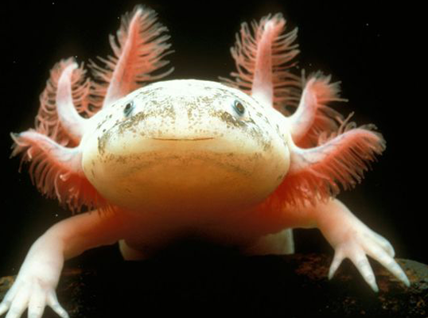
Axolotl
Mexican mole salamander that lived in the water

Slide 6
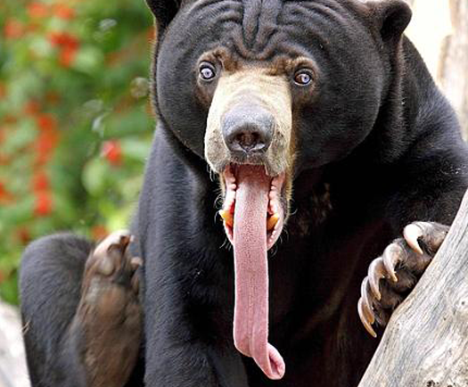
Sun Bear
Also known as a “dog bear” due to its small size and large tongue. They are found in Southeast Asia.

Slide 7
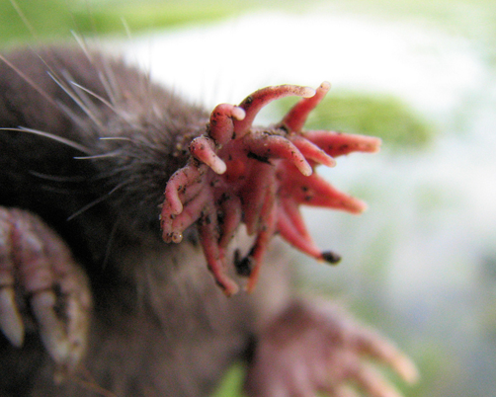
Star Nosed Mole
They live in Canada and the US. They have 22 tentacles that helps that find food.

Slide 8
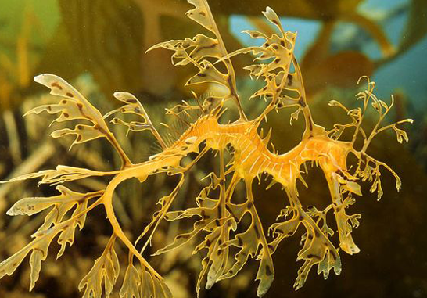
Leafy Seadragon
It lives in Australia and looks like seaweed. It is camouflaged very well.

Slide 9
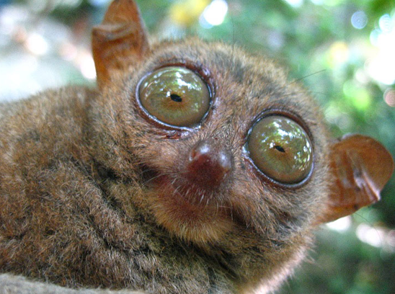
Tarsier
These guys perform ninja moves to catch birds in mid flight while leaping from tree to tree.

Slide 10
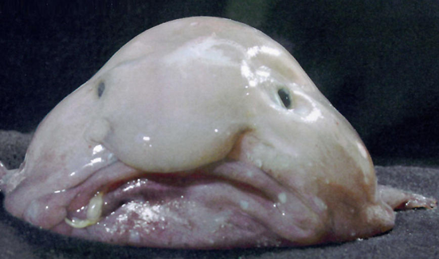
Blobfish
Live in deep water in Australia and they are adapted to living at extreme pressures.

Slide 11
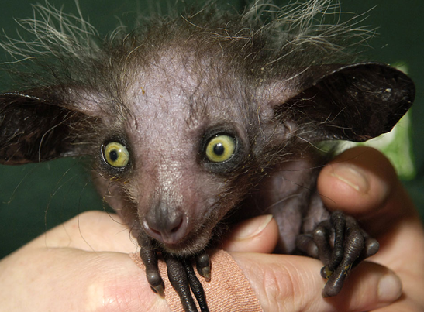
Aye-aye
They live in Madagascar and they are the world’s largest nocturnal primate.

Slide 12
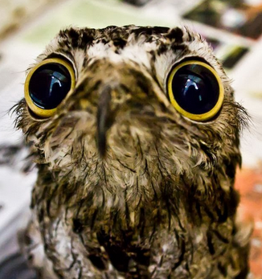
Potoo Bird

Slide 13
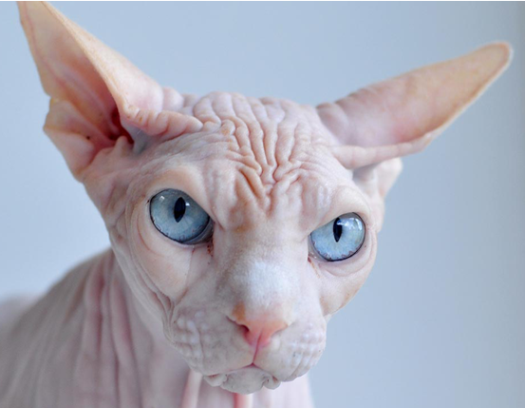
Sphynx cat
Breed for its lack of hair and extroverted behavior.

Slide 14
Strongest living thing on Earth
Rhinoceros beetle

Slide 17
5.1 THE CELL CYCLE
Mitosis
Science 9

Slide 18
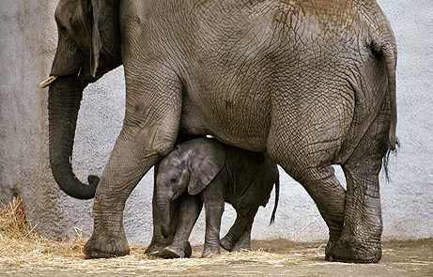
Introduction: How do little elephants grow up to be BIG elephants?

Slide 19
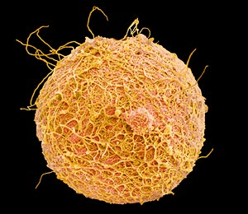
Asexual Reproduction
The process of asexual reproduction begins after a sperm fertilizes an egg.

Slide 20
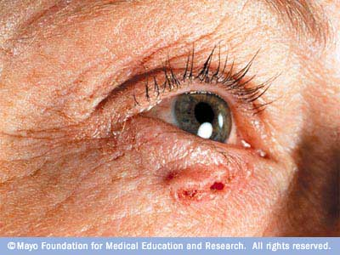
Three reasons why cells reproduce by asexual reproduction: 1. Growth 2. Repair 3. Replacement

Slide 21
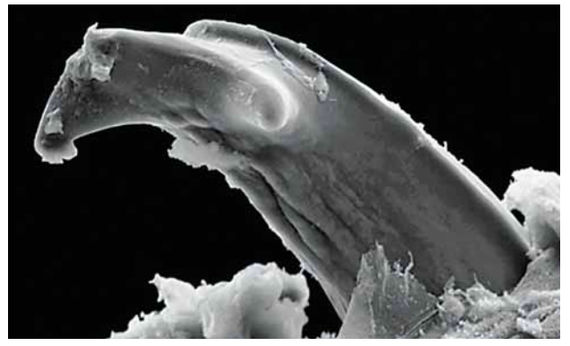
^{B. taitanus}

Slide 23
Cell Cycle
The cell cycle has three stages
Interphase
Mitosis
Cytokinesis

Slide 24
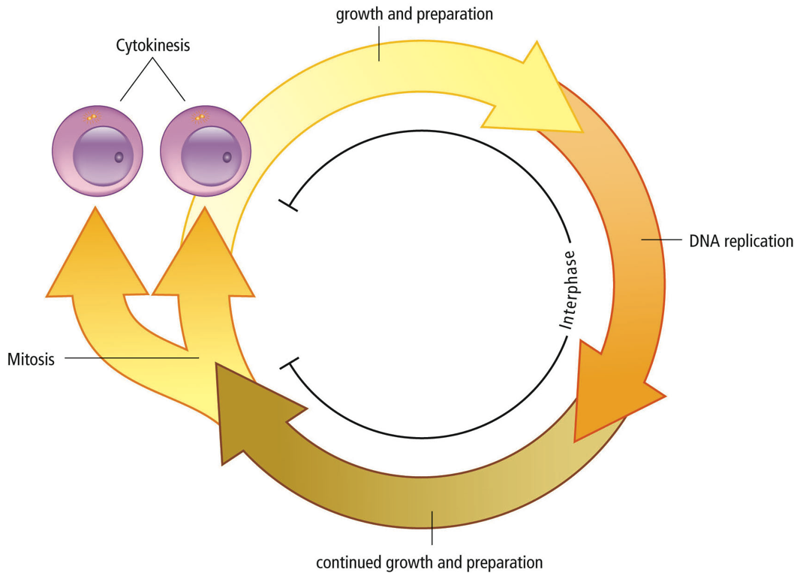
The Cell Cycle
CYTOKINESIS
- Split into 2 cells
INTERPHASE
MITOSIS
-divide up cell contents

Slide 25
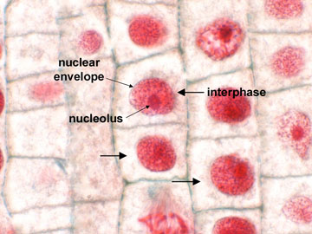
1. INTERPHASE
Longest stage where the cell carries the normal function within the organisms.
(e.g. Nerve cells transfer electrical signals, stomach cells release enzymes for digestion)
Growth and preparation
Cell increases in size
Cell makes proteins for regular function
Some organelles begin to duplicate

Slide 26
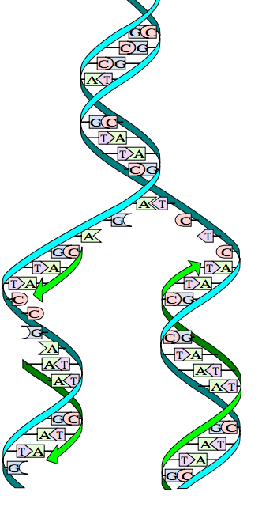
1. INTERPHASE
B) DNA replication
1. DNA unwinds and unzips, separating the ladder at the bases.
2. New nucleotides floating around the cells come in and pair with the original DNA. (A←→T; G←→C)
3. Two identical DNA molecules, each with one old and one new strand

Slide 27
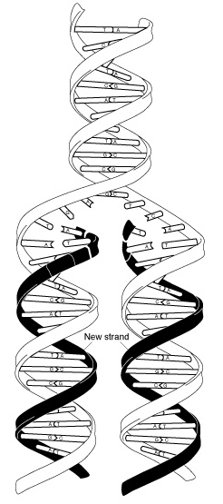

Slide 28
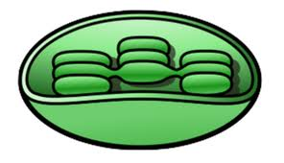
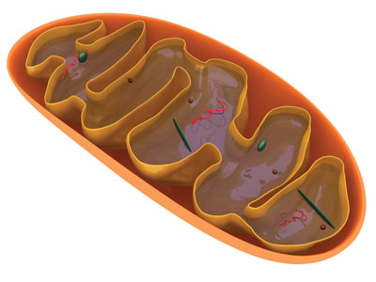
1. INTERPHASE
C) Continued growth & preparation
Grow and make protein for cell division
Mitochondria and chloroplasts duplicate

Slide 29
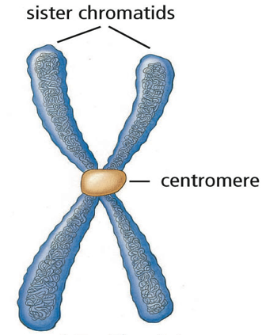
2. MITOSIS
Shortest stage
The goal is to get 2 daughter nuclei (plural of nucleus)
The two molecules of DNA from replication coil up into sister chromatids and are joined in the middle by a centromere

Slide 30
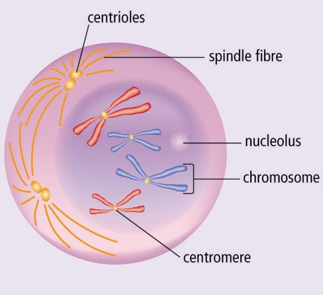
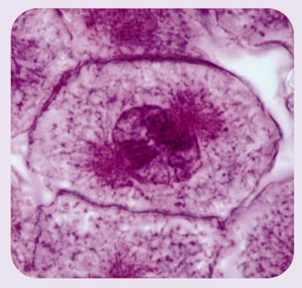
Early Prophase
Chromosome coiled into X-shape
Nucleolus disappears
Nuclear membrane breaks down
Centrioles move to opposite ends
Spindle fibres start to form

Slide 31
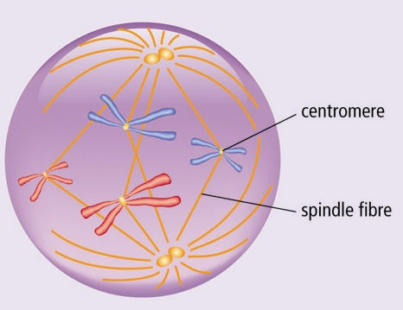
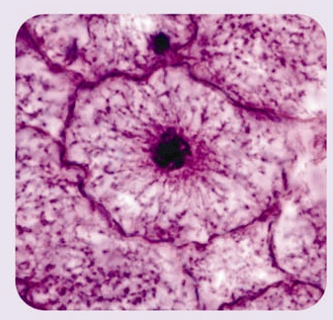
Late Prophase
Spindle fibres completely formed
Nuclear membrane disappears
Chromosomes attach to spindle fibres at centromeres

Slide 32
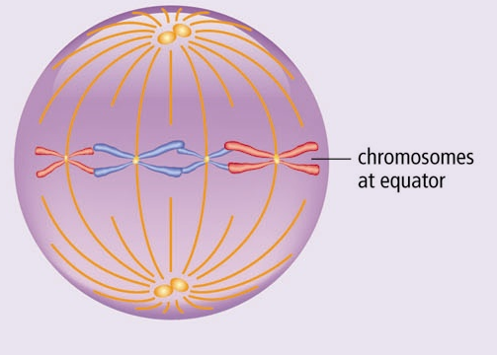
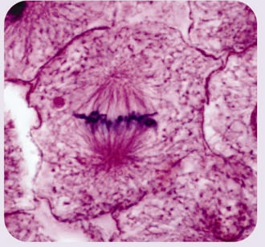
Metaphase
Chromosomes line up at equator of cell

Slide 33
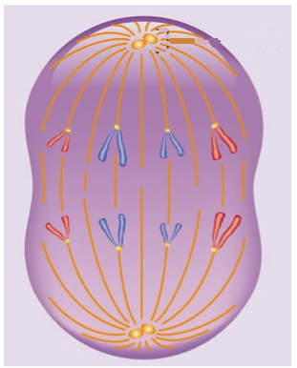
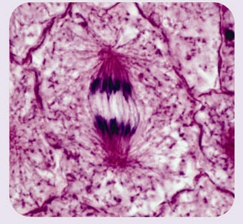
Anaphase
Spindle fibres contract and pull chromosomes apart into halves (sister chromatids)

Slide 34
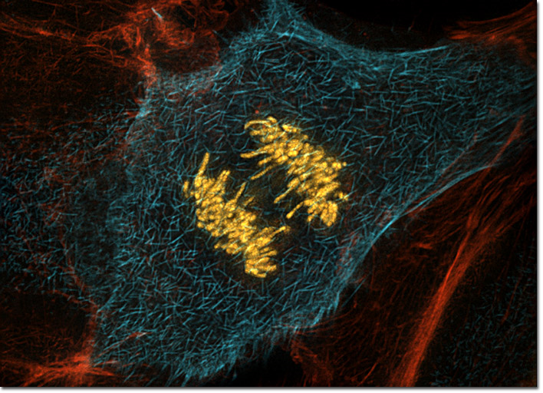

Slide 35
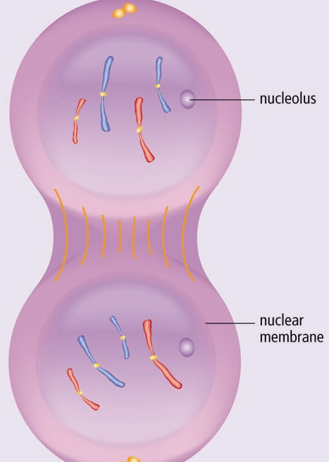
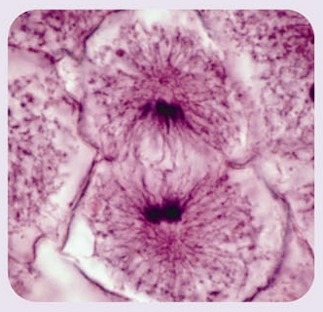
Telophase
Complete set of chromosomes is at each end of cell
Spindle fibres disappear
2 nuclear membranes form
2 nucleoli appear in each nucleus
Ready for Cytokinesis (separation)!

Slide 36
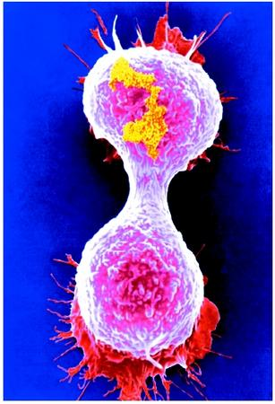
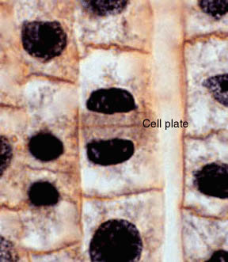
Cytokinesis
Final stage of cell cycle
Separate two nuclei into two DAUGHTER CELLS (identical to parent)
In plants, a cell plate is formed and it becomes the new cell wall and cell membrane

Slide 37
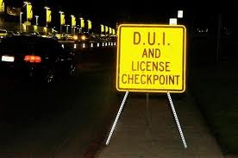
Checkpoints in Cell Cycle
Special proteins monitor cell activities during various stages in the cell cycle
Send instructions to nucleus to tell cell NOT to divide if:
-Not enough nutrients for growth
-DNA not replicated
-DNA is damaged (e.g. chromosomes did not attach to spindle fibres, chromosome did not move to poles)

Slide 38
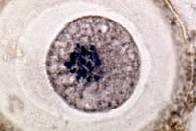
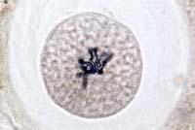
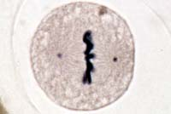
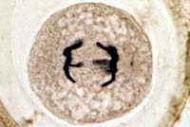
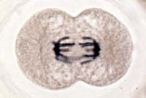
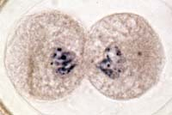
Animal Mitosis -- Review
Interphase | Prophase
Metaphase | Anaphase
Telophase | Cytokinesis

Slide 41
Now please complete the worksheet in your notes for review.

