Slide 1
5.1 Understanding Cancer
Notes:
Heart disease is the leading cause of death in the US.
Cancer is the 2nd leading cause of death in the US.
Lifetime risk of developing cancer for men is 1 in 2, for women it is 1 in 3 according to the CDC.
One doesn’t think about it until it affects you or someone you know.

Slide 2
Intro
Hand in onion root lab.
Notes:
We use the term “cancer” to refer to a group of almost 200 different diseases. Our bodies are made up of about 30 trillion cells. The cells group together to form tissues and organs. Cancer can arise in any of those cells.
For example, stomach cancer is a different disease than breast cancer. It has different treatments, etc. There are even different types of breast cancer and skin cancer, etc.

Slide 3
IMPMATC

Slide 4
What are check points?
In the cell cycle there are a few check points. Why do you think there are checkpoints?
Notes:
We use the term “cancer” to refer to a group of almost 200 different diseases. Our bodies are made up of about 30 trillion cells. The cells group together to form tissues and organs. Cancer can arise in any of those cells.
For example, stomach cancer is a different disease than breast cancer. It has different treatments, etc. There are even different types of breast cancer and skin cancer, etc.

Slide 5
Cell Cycle Checkpoints
Three checkpoints in cell cycle
After DNA has been replicated
Before mitosis starts
After mitosis ends
*
Notes:
*

Slide 6
What happens if checkpoints aren’t working?
Cancer…..
Notes:
We use the term “cancer” to refer to a group of almost 200 different diseases. Our bodies are made up of about 30 trillion cells. The cells group together to form tissues and organs. Cancer can arise in any of those cells.
For example, stomach cancer is a different disease than breast cancer. It has different treatments, etc. There are even different types of breast cancer and skin cancer, etc.

Slide 7
What Is Cancer?
Cancer is a large group of diseases (over 200) characterized by uncontrolled growth and spread of abnormal cells.
Do you know someone that has had cancer?
Notes:
We use the term “cancer” to refer to a group of almost 200 different diseases. Our bodies are made up of about 30 trillion cells. The cells group together to form tissues and organs. Cancer can arise in any of those cells.
For example, stomach cancer is a different disease than breast cancer. It has different treatments, etc. There are even different types of breast cancer and skin cancer, etc.

Slide 8
What Is the Difference between Cancer and a tumor?
Two types of tumors:
Benign (non-cancerous) – this is not cancer!
Does not spread; it can eventually become malignant in some cases.
Malignant (cancerous) – this is cancer!
Has the potential to spread to other parts of body.

Slide 9
Overall Cancer Incidence and Mortality Trends in U.S.
*
Notes:
*

Slide 10
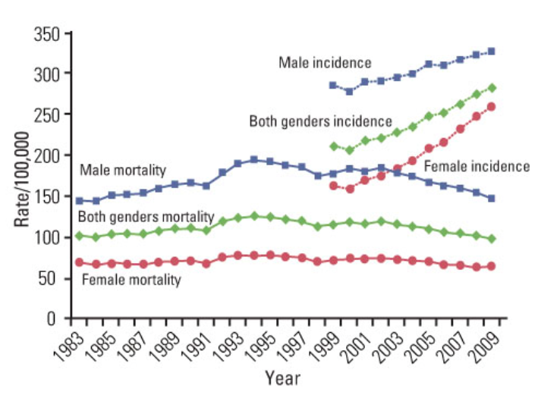
Overall Cancer Incidence and Mortality Trends in Korea
*
Notes:
*

Slide 11
Normal Cells Vs. Cancer Cells
Cancer cells:
Lose control over growth and multiplication
Do not self-destruct when they become worn out or damaged
Crowd out healthy cells

Slide 12
Growth of Cancer Cells
Cancer cells reproduce every 2-6 weeks.
2-6 weeks
Size of cancer cells:
One million cancer cells = head of a pin
One billion cancer cells = a small grape
2³⁰ = 1,073,741,824 = 1 billion cells
2-6 weeks
2-6 weeks
Notes:
If cancer cells divide every month, it would be 2 1/2 years before one cancer cell grows into a small grape-sized tumor.
A person has usually had cancer for several years before it is detected and/or causes side effects.

Slide 13
Signs and Symptoms of Cancer
Change in bowel habits or bladder functions
Sores that do not heal
Unusual bleeding or discharge
Lumps or thickening of breast or other parts of the body
Indigestion or difficulty swallowing
Recent change in wart or mole
Persistent coughing or hoarseness
Notes:
Not having symptoms does not mean there is no cancer.
A change in bowel habits or bladder function. Chronic constipation, diarrhea, or a change in the size of the stool may indicate colon cancer. Pain with urination, blood in the urine, or change in bladder function could be related to bladder or prostate cancer. Any changes in bladder or bowel function should be reported to your doctor.
Sores that do not heal. Skin cancers may bleed and resemble sores that do not heal. A persistent sore in the mouth could be an oral cancer and should be dealt with promptly, especially for patients who smoke, chew tobacco, or frequently drink alcohol. Sores anywhere on the body should not be overlooked.
Unusual bleeding or discharge including discolorations such as black, brown or red. Unusual bleeding can occur in early or advanced cancer. Coughing up blood is a sign of lung cancer. Blood in the stool could be a sign of colon or rectal cancer. Cancer of the lining of the uterus (eudiometrical cancer) or cervix can cause vaginal bleeding. Blood in the urine is a sign of possible bladder or kidney cancer. A bloody discharge from the nipple may be a sign of breast cancer.
Thickening or lump in breast or other parts of the body. Many cancers can be felt through the skin, particularly in the breast, testicle, lymph nodes (glands), and the soft tissues of the body. A lump or thickening may be an early or late sign of cancer. Any lump or thickening should be reported to your doctor. You may be feeling a lump that is an early cancer that could be treated successfully.
Indigestion or difficulty swallowing. These symptoms may indicate cancer of the esophagus, stomach, or pharynx (throat).
Recent change in a wart or mole. A change in color, loss of definite borders, or an increase in size should be reported to your doctor without delay. The skin lesion may be a melanoma which, if diagnosed early, can be treated successfully.
A nagging cough or hoarseness. A persistent cough that does not go away is a sign of lung cancer. Hoarseness can be a sign of cancer of the larynx (voice box) or thyroid. These are often late signs of cancer.
Additional general symptoms
Unexplained weight loss
Fever
Fatigue
Pain

Slide 14
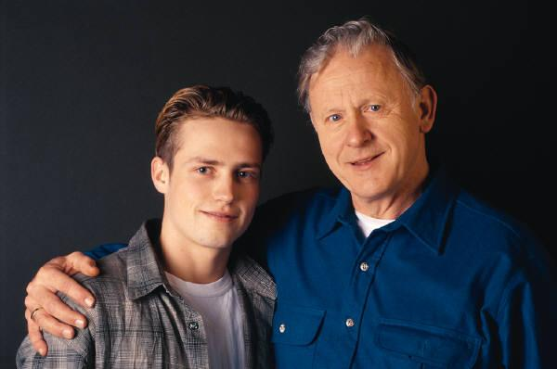
What Causes Cancer?
Family History
Lifestyle
Environment
Notes:
We know that there are three major contributing/risk factors for cancer. (Read slide)

Slide 15
Lifestyle Risks
Smoking
Diet high fat and low in fruits and vegetables
Lack of exercise
Unprotected exposure to the sun, (UV) rays
Obesity
Notes:
Two-thirds (67%) of all cancers are caused by the way we live.
Obesity is a lifestyle risk for developing cancer. In Utah 18% of adults are obese.

Slide 16
Environmental Risks
Second hand smoke
Air pollution
Industrial pollution
Chemical exposures
Notes:
Researchers have estimated that between 2 and 8 percent of cancers can be attributed to workplace exposures. In the United States, this would represent between 24,500 and 98,000 new cases of cancer each year.
Diesel exhaust and other pollutants are linked to lung cancer, but unless you have had prolonged exposure, your risk is low. The Environmental Protection Agency regulates diesel exhaust emissions from motor vehicles under the Clean Air Act. For more information go to www.EPA.gov.
Smokers have 10 times the risk of getting lung cancer than a non-smoker.

Slide 17
Inherited Risks
Not a hereditary disease – we do not pass on cancer to offspring.
We can inherit dispositions (susceptibility) to cancer.
Notes:
Remember to stress that only 15% are inherited. Everyone is at risk for cancer!

Slide 18
From Benign to Malignant
Cancer cells divide too quickly and can leave the original site and enter the blood, lymph, or tissues.
Most cells divide a set number (60-70) of times, then they stop dividing.
This usually limits benign tumors to small sizes.
Cancer cells can divide forever.
*

Slide 19
http://science.education.nih.gov/supplements/nih1/cancer/activities/activity2_animations.htm
(Animation #1)
Metastasis – When the bad cells have moved to other organs in your body and started to form tumors.
*
Notes:
*

Slide 20
Treatment options
If surgery cannot remove the tumor, what are other options?
Radiation - Uses high-energy rays to kill cancer cells. A large machine directs radiation at the body.
Chemotherapy - Uses anticancer drugs to kill cancer cells.
*
Notes:
*

Slide 21
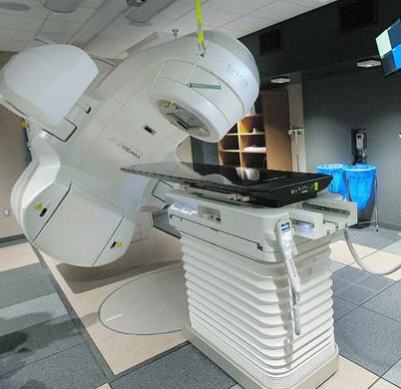
*
Notes:
*

Slide 22
Cancer Treatments
One common chemotherapy for ovarian cancer is Taxol.
Taxol blocks a cell's ability to break down the spindle fibres during mitosis. With the spindle fibres still in place, the cell can't divide into daughter cells and therefore the cancer can’t grow.
Taxus Brevifolia
*

Slide 23
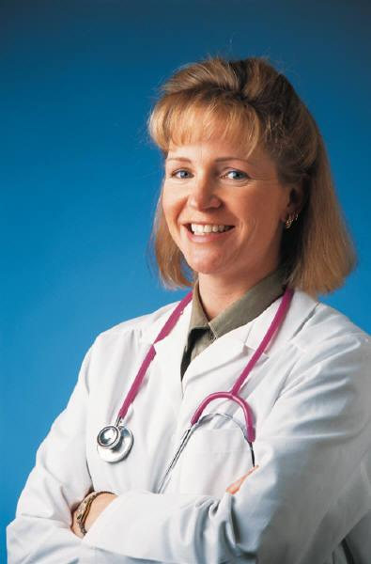
Why Screening Tests?
The treatment of cancer is most successful when the cancer is detected as early as possible, often before symptoms occur.
Notes:
Sometimes cancers form in locations where symptoms may not be produced until the cancer has grown quite large. The treatment of cancer is most successful when the cancer is detected as early as possible. It is possible to detect some cancers before symptoms occur. The American Cancer Society, and other organizations, encourage the early detection of certain cancers before symptoms occur by recommending a cancer-related checkup and specific early detection tests for people who do not have any symptoms.

Slide 24
Good News!
Other Ways to Reduce the Risks of Developing Cancer…

Slide 25
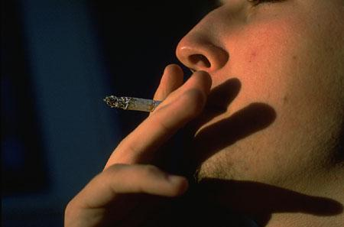
Avoid Smoking or Chewing Tobacco
Cigarette smoking is the leading cause of preventable death in the US
Second hand smoke affects everyone
Notes:
More than 400,000 people die of tobacco-related causes each year, killing more people than homicides, drugs, AIDS, and car accidents combined.
One out of 3 smokers die from smoking & many more become very sick.
Cigarettes & other forms of tobacco are linked to stroke, heart disease, and cancers of the lung, pancreas, mouth, throat, esophagus, larynx, bladder, and cervix.
Tobacco smoke contains at least 43 cancer-causing substances. Tobacco companies add ingredients to make their product as addictive as possible.
Most smokers begin smoking before the age of 18 and become addicted.
Tobacco companies target youth to replace smokers who either quit or die from their habit.
Secondhand smoke can be harmful in many ways. In the United States alone, each year it is responsible for:
An estimated 35,000 to 40,000 deaths from heart disease in people who are not current smokers
About 3,000 lung cancer deaths in nonsmoking adults
Other respiratory problems in nonsmokers, including coughing, phlegm, chest discomfort, and reduced lung function
150,000 to 300,000 lower respiratory tract infections (such as pneumonia and bronchitis) in children younger than 18 months of age, which result in 7,500 to 15,000 hospitalizations
Increases in the number and severity of asthma attacks in about 200,000 to 1 million asthmatic children
Increase in the number of cases of inflammation of the middle ear and build up of fluid in the ear in young children of smokers.

Slide 26
Fruits and Vegetables Decrease Cancer Risks
Cancer rates could decline by up to 20% if everyone consumed 5 fruits and vegetables a day!*
Cancer fighting substances:
Antioxidants
Dietary fiber
Carotenoids
Flavenoids
*American Institute for Cancer Research, 1998.
Notes:
*if everyone consumed 5 or more servings of fruits & vegetables each day
Additionally
Eat more high-fiber foods: whole grains, cereals, beans, and vegetables.
Eat fewer high-fat foods and watch your weight. Cut down on butter, margarine, fried foods, and rich desserts.

Slide 27
Limit Alcohol to No More Than
Men – 2 drinks per day
Women - 1 drink per day
Notes:
Alcohol increases the risk of cancers of the mouth, pharynx, larynx, esophagus, liver, and breast.
A drink is defined as 12 ounces of beer, 5 ounces of wine, or 1.5 ounces of 80 proof distilled spirits.
The combination of alcohol and tobacco increases the risk of cancer far more than the effect of either drinking or smoking.
Regular consumption of even a few drinks per week is associated with an increased risk of breast cancer in women. Women at high risk of breast cancer may want to consider not drinking any alcohol.

Slide 28
Reduce Your Skin Exposure to the Sun
Limit time outside, between 10 a.m. & 4 p.m.
Wear protective clothing. Use wide-brimmed hats and sunglasses.
Prevent sunburns, especially for children under 18. Use waterproof sunscreen of SPF 15 or higher. Reapply as directed.
Avoid tanning beds.
Notes:
You are 66 times more likely to sunburn while hiking Mt. Timpanogos than while sunbathing in Los Angeles.(we need reference for this)
Tanning beds, once thought to be safer than the sun, may be associated with a nearly two-fold increase in the likelihood of developing the potentially deadly skin cancer melanoma, according to a Swedish study published in the British Journal of Cancer (Vol. 82, No. 9). People 35 or younger who used the beds regularly had a melanoma risk eight-fold higher than people who never used tanning beds. Even occasional use among that age group almost tripled the chances of developing melanoma.

Slide 29
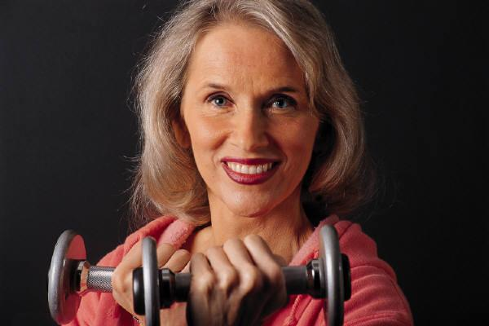
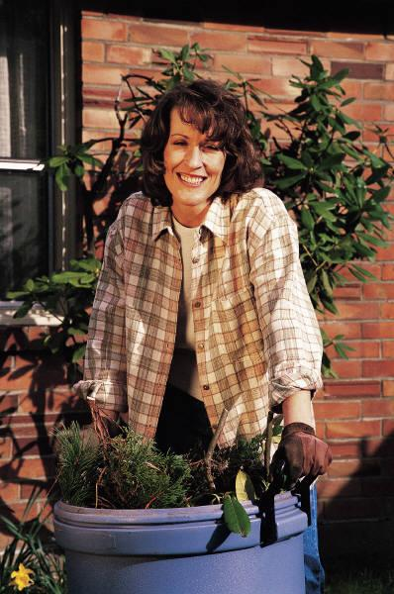
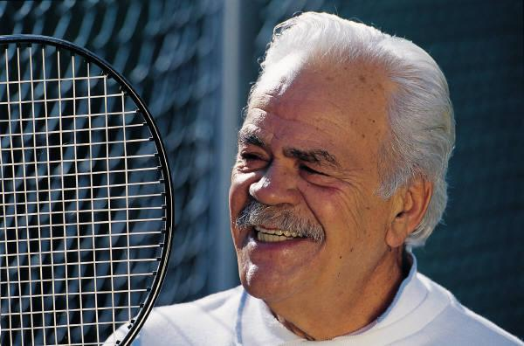
Be Active…Often
Exercise for 30 minutes or more at least 4 days a week.

Slide 30
186,550
The number of lives that could be saved each year if we ate a healthy diet and exercised regularly
186,550
The number of lives that could be saved each year with no tobacco
American Cancer Society
Notes:
You may wonder what this number represents.
This is the number of lives we could save each year from cancer deaths if people would follow ACS nutrition and physical activity guidelines.
One third of the approximately 500,000 cancer deaths that occur each year in this country are due to diet and activity habits.

Slide 31
Notes:
You may wonder what this number represents.
This is the number of lives we could save each year from cancer deaths if people would follow ACS nutrition and physical activity guidelines.
One third of the approximately 500,000 cancer deaths that occur each year in this country are due to diet and activity habits.

Slide 32
Review questions
Complete review questions 1-5 in your notes.
Notes:
Alcohol increases the risk of cancers of the mouth, pharynx, larynx, esophagus, liver, and breast.
A drink is defined as 12 ounces of beer, 5 ounces of wine, or 1.5 ounces of 80 proof distilled spirits.
The combination of alcohol and tobacco increases the risk of cancer far more than the effect of either drinking or smoking.
Regular consumption of even a few drinks per week is associated with an increased risk of breast cancer in women. Women at high risk of breast cancer may want to consider not drinking any alcohol.

