Slide 1
The Cell/Bacteria & Viruses
Ms. Martel

Slide 2
5-1 – LIFE IS CELLULAR
The Discovery of the Cell
Without the instruments to make them visible, cells remained out of sight for most of human history.
All of this changed with the invention of the microscope

Slide 3
Early Microscopes
In the mid 1600’s, scientists began to use microscopes to observe living things.
In 1665 Robert Hooke used an early compound microscope to look at plant material.
He noted that the material seemed to be made of thousands of tiny empty chambers that he later called cells.
Around the same time Anton van Leeuwenhoek observed tiny living microorganisms in pond water using a single-lens microscope

Slide 4
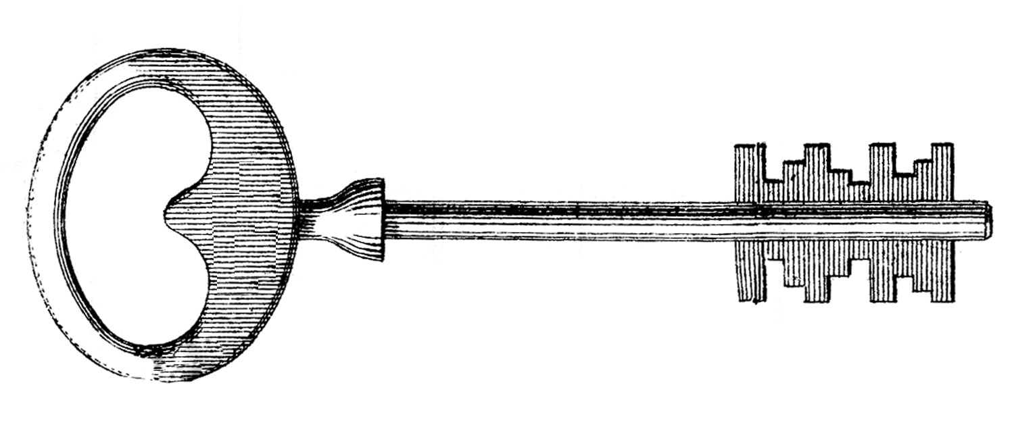
The Cell Theory
Soon, numerous observations made it clear that cells were the basic units of life.
The cell theory states:
All living things are composed of cells
Cells are the basic units of structure and function in living things
New cells are produced from existing cells

Slide 5
Exploring the Cell
Modern day biologists have new sophisticated technology that allows them to explore the intricacies and depths of cells.
Fluorescent labels and light microscopy allows them to follow molecules moving through the cell

Slide 6
Confocal light microscopy, which scans cells with a laser beam, makes it possible to build 3-D images of cells and their parts.
High resolution video technology makes it easy to produce movies of cells as they grow, divide, and develop

Slide 7
Prokaryotes & Eukaryotes
Cells can range in size from only 0.2 micrometers – 1000 micrometers in diameter.
Despite their differences they have two characteristics in common.
1) They are surrounded by a barrier called a cell membrane.
2) At some point in their lives, they contain the molecule that carries biological information – DNA

Slide 8
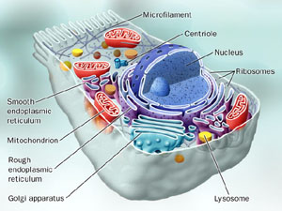
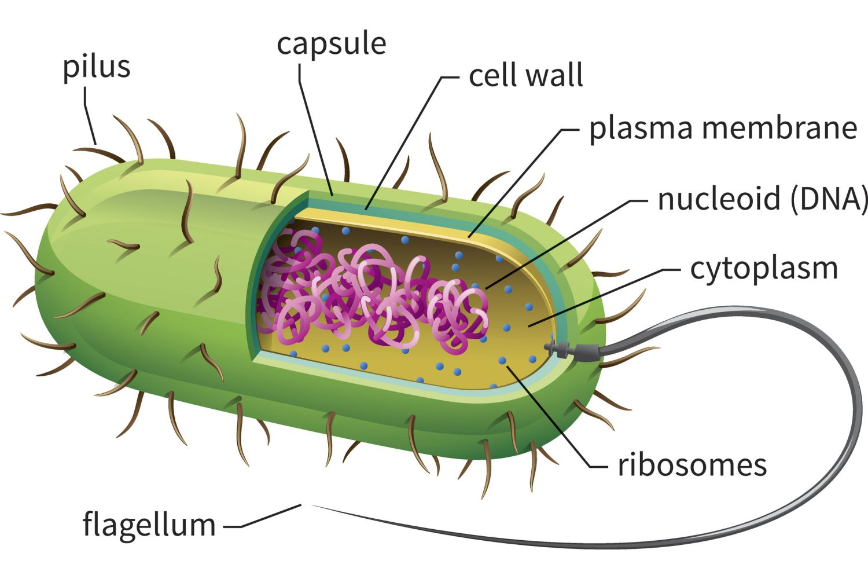
Cells fall into two broad categories, depending on whether they contain a nucleus.
The nucleus is a large membrane-enclosed structure that contains the cell’s genetic material in the form of DNA
The nucleus controls many of the cells activities.
Eukaryotic cells contain a nucleus, prokaryotic cells do not contain a nucleus.

Slide 9
Prokaryotes
Prokaryotic cells are generally smaller and simpler than eukaryotic cells.
Prokaryotic cells have genetic material that is not contained in a nucleus.
Despite their simplicity, prokaryotes carry out every activity associated with living things.
They grow, reproduce, respond to the environment, and some can even move.
Bacteria are examples of prokaryotes

Slide 10
Eukaryotes
Eukaryotic cells are generally larger and more complex than prokaryotic cells.
They generally contain dozens of structures and internal membranes that are highly specialized.
Eukaryotic cells contain a nucleus in which their genetic material is separated from the rest of the cell.
Some live out solitary lives as single celled organisms, others form large multicellular organisms such as plants, animals, fungi, and protists.

Slide 11
5.2 – EUKARYOTIC CELL STRUCTURE
Eukaryotic cell’s have structures that exhibit patterns. These structures act as if they are specialized organs, these are known as organelles.
Cell biologists divide the eukaryotic cell into two major parts: the nucleus and the cytoplasm.
The cytoplasm is the portion of the cell outside the nucleus.
The cytoplasm and nucleus work together to carry out the business of life.

Slide 12
Nucleus
The nucleus contains nearly all the cell’s DNA and with it the coded instructions for making proteins and other important molecules.

Slide 13
Ribosomes
Ribosomes are small particles of RNA and protein found throughout the cell that assemble proteins to be used around the body.

Slide 14
Endoplasmic Reticulum
This is the site where lipid components of the cell membrane are assembled, along with proteins and other materials that are exported from the cell.

Slide 15
Golgi Apparatus
The function of the Golgi apparatus is to modify, sort, and package proteins and other materials from the endoplasmic reticulum for the storage in the cell or secretion outside the cell.

Slide 16
Lysosomes
Small organelles filled with enzymes, that digest, or breakdown lipids, carbohydrates, and proteins into small molecules that can be reused.
They also breakdown organelles that no longer function properly anymore.

Slide 17
Vacuoles
Vacuoles store materials such as water, salts, proteins, and carbohydrates.
In plant cells there is a large central vacuole filled with water.

Slide 18
Mitochondria
Mitochondria convert chemical energy stored in food into compounds that are more convenient for the cell to use, AKA ATP.

Slide 19
Chloroplasts
Chloroplasts are organelles that capture the energy from sunlight and convert it into chemical energy in a process called photosynthesis.

Slide 20
Cytoskeleton
The cytoskeleton is a network of protein filaments that helps the cell to maintain its shape. The cytoskeleton is also involved in movement

Slide 21
5.3 - BACTERIA
Microscopic life covers nearly every square centimeter of Earth.
The smallest, most common microorganisms are prokaryotes – unicellular organisms that lack a nucleus.

Slide 22
Classifying Prokaryotes
Until fairly recently, all prokaryotes were placed in a single kingdom – Monera.
Scientists now divide them into two groups: eubacteria and archaebacteria.

Slide 23
Eubacteria
This is the larger of the two kingdoms.
It is so large in fact that biologists do not agree on exactly how many phyla are needed to classify this group
Eubacteria are usually surrounded by a cell wall that protects the cell from injury.

Slide 24
Archaebacteria
Archaebacteria look very similar to eubacteria, but chemically they are very different.
Archaebacteria lack the peptidoglycan of eubacteria and also have different membrane lipids. Also, the DNA sequences of key archaebacterial genes are more similar to eukaryotes.
Scientists reason that archaebacteria may be the ancestors of eukaryotes.

Slide 25
Identifying Prokaryotes
Because prokaryotes are so small, it may seem difficult to tell one type of prokaryote from another.
Prokaryotes are identified by characteristics such as shape, the chemical nature of their cell walls, the way they move, and the way they obtain energy.

Slide 26
Shapes
Rod-shaped prokaryotes are called bacilli.
Spherical prokaryotes are called cocci.
Spiral and corkscrew-shaped prokaryotes are called spirilla

Slide 27
Cell Walls
Two different types of cell walls are found in eubacteria.
Gram staining is used to tell them apart, which consists of two dyes.
The primary stain is violet, and the counterstain is red.
Gram-positive bacteria, whom have much thicker peptidoglycan walls, stain violet.
Gram-negative bacteria have very thin walls, and stain red.

Slide 28
Movement
You can also identify them by whether they move and how they move.
Some do not move at all.
Other are propelled by flagella, cilia, or glide slowly along a layer of slime-like material they secrete.

Slide 29
Metabolic Diversity
Depending on their source of energy and whether or not they use oxygen for cellular respiration, prokaryotes can be divided into two main groups.
Most are heterotrophs that consume organic molecules to get their energy.
Others are autotrophs that make their own food from inorganic molecules.

Slide 30
Heterotrophs
Chemoheterotrophs take in organic molecules for both energy and a supply of carbon.
Animals and humans fall into this category as well.
Photoheterotrophs are photosynthetic, but also need to take-in organic compounds as a carbon source.

Slide 31
Autotrophs
Photoautotrophs use light energy to convert a carbon dioxide and water to carbon compounds and oxygen similar to photosynthesis.
Chemoautotrophs perform chemosynthesis and make organic carbon molecules from carbon dioxide.
However, they do not require light energy to do so.

Slide 32
Releasing Energy
Like all organisms, bacteria need a constant supply of energy. This energy is released by either cellular respiration or fermentation.
Obligate aerobes – organisms that require a constant supply of oxygen in order to live
Obligate anaerobes – organisms that cannot survive in the presence of oxygen.
Facultative anaerobes – organisms that are able to survive with or without oxygen.

Slide 33
Growth & Reproduction
When conditions are favourable, bacteria can grow and divide at astonishing rates.
In nature, growth is held in check by the availability of food and the production of waste products.

Slide 34
Binary Fission
When a bacterium has grown to nearly double it’s size, it replicates it’s DNA and divides in half, producing two identical “daughter” cells.
This is an asexual form of reproduction.

Slide 35
Conjugation
Many bacteria are able to exchange genetic information by conjugation.
A hollow bridge forms between two bacteria cells.
Genes move from one cell to the other.
This increases genetic diversity.

Slide 36
Spore Formation
When growth conditions become unfavourable, many bacteria form spores.
One example is the endospore, formed when a bacterium produces a thick internal wall that encloses its DNA and a portion of its cytoplasm.
Spores can remain dormant for months or even years sometimes.

Slide 37
Importance of Bacteria
Bacteria are vital to maintaining the living world. Some are producers that capture energy by photosynthesis. Others are decomposers that break down the nutrients in dead matter and the atmosphere. Others live inside humans as well.

Slide 38
Decomposers
Every living thing depends directly or indirectly on a supply of raw materials.
As decomposers, bacteria help the ecosystem recycle nutrients, therefore maintaining equilibrium in the environment.

Slide 39
Nitrogen Fixers
Plants and animals depend on bacteria for nitrogen.
Our atmosphere is 80% Nitrogen gas, but plants and animals cannot use this nitrogen directly, and rely on bacteria to convert it into a useable form through nitrogen fixation.

Slide 40
Human Uses of Bacteria
Bacteria are use for food and beverage production.
It is used in industry.
Some bacteria can digest petroleum, which makes it useful in oil spills.
Others remove waste and poison from water.
Others are used to synthesize drugs and chemicals through genetic engineering techniques.
A strain of E. coli bacteria live in our intestines and help us to break down products our bodies cannot.

Slide 41
5.4 - VIRUSES
What Is a Virus?
Viruses are particles of nucleic acid, protein, and in some cases lipids.
Viruses can reproduce only by infecting living cells.
Viruses differ widely in size and structure.
However, viruses all have one thing in common: they enter living cells and, once inside, use the machinery of the infected cell to produce more viruses.

Slide 42
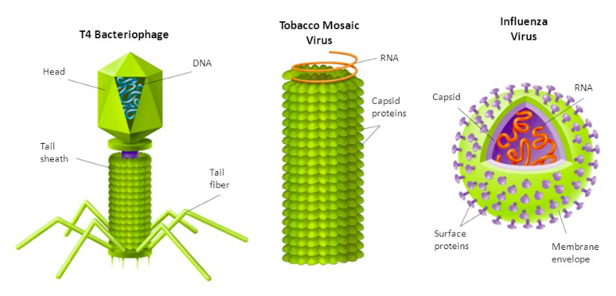
Most are so small they can be seen only with the aid of a powerful electron microscope.
A typical virus is composed of a core of DNA or RNA surrounded by a protein coat.

Slide 43
A virus’s protein coat is called its capsid.
This includes proteins that enable a virus to enter a host cell.
These proteins bind to a receptor on the surface of a cell and “trick” the cell into allowing it inside.
Once inside, the viral genes are expressed.
Often, these genes cause the host cell to make copies of the virus, in the process the host cell is destroyed.

Slide 44
Most viruses are highly specific to the cells they infect.
Plant viruses infect plant cells; most animal viruses infect only certain related species of animals.
And bacteria viruses only infect certain types of bacteria. These viruses are called bacteriophages.

Slide 45
Viral Infection
Once the virus is inside the host cell, two different processes may occur.
Some replicate themselves immediately, killing the host cell.
Others replicate themselves in a way that doesn’t kill the host cell immediately.

Slide 46
Lytic Infection
In this process, a virus injects it’s genetic information into a host cell.
Once inside, the host cannot tell the difference between the viral genetic material and it’s own because it exhibits similar characteristics.
The host cell is then “tricked” into making hundreds of new viral cells.
The infected cell then bursts, releasing the new viral cells to infect other hosts.
In a lytic infection, a virus enters a cell, makes copies of itself, and causes the cell to burst.

Slide 47
Lysogenic Infection
Other viruses cause lysogenic infections, in which a host cell makes copies of the virus indefinitely.
In a lysogenic infection, a virus integrates its DNA into the DNA of the host cell, and the viral genetic information integrates along with the host cell’s DNA
Unlike lytic viruses, lysogenic viruses do not lyse the host cell right away, instead they remain inactive for a period of time.

Slide 49
Retroviruses
Some contain RNA as their genetic information and are called retroviruses.
When retroviruses infect a cell, they produce a DNA copy of their RNA.
The DNA is then inserted into the host cell, where it may remain dormant for varying lengths of time.
They get their name from the fact that their genetic information is copied backward – that is from RNA to DNA. An example of a retrovirus is HIV.

Slide 50
Viruses and Living Cells
Viruses must infect a living cell in order to grow and reproduce.
This means viruses could be considered parasites. A parasite depends entirely upon another living organism for its existence, harming that organism in the process.
But are viruses truly alive?
If living things are required to be made up of a cell and to live independently, then no viruses are not alive.
Yet, they have many of the characteristics of living things; such as reproducing with the help of a host, regulating gene expression, and even evolve.

Slide 51
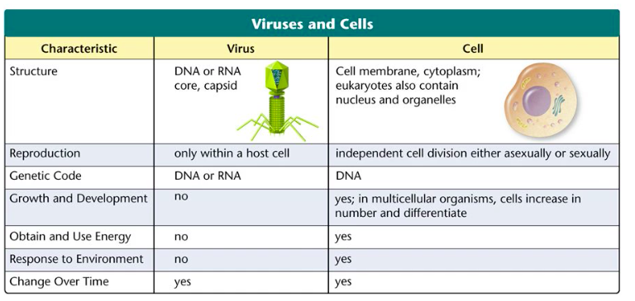

Slide 52
5.5 – DISEASES CAUSED BY BACTERIA AND VIRUSES
Bacteria and viruses are everywhere in nature, but only a few cause disease.
However, these pathogens, or disease-causing agents, get all the attention.
All viruses reproduce by infecting living cells, and disease results when the infection causes harm to the host.
Disease results when bacteria interfere with the host’s ability to obtain enough of those elements to function properly

Slide 53
Bacterial Disease in Humans
The growth of pathogenic bacteria disrupts the body’s equilibrium by interfering with its normal activities and producing disease.
Bacteria produce disease in one of two general ways. Some damage the cells and tissues of the infected organism directly by breaking down the cells for food. Other bacteria release toxins that travel throughout the body interfering with the normal activity of the host

Slide 54
Using Cells for Food
The bacterium Mycobacterium tuberculosis, which causes tuberculosis, is inhaled into the lungs and destroys lung tissue.
It may also enter a blood vessel and travel to new sites in the body where it destroys more tissue

Slide 55
Releasing Toxins
Streptococcus bacterium that causes strep throat can release toxins into the blood stream.
These toxins can cause scarlet fever.
The bacteria that causes diphtheria also releases toxins into the bloodstream, which can lead to breathing problems, heart failure, paralysis and death

Slide 56
Preventing Bacterial Disease
Many bacterial diseases can be prevented by stimulating the body’s immune system with vaccines.
A vaccine is a preparation of weakened or killed pathogens.
When injected, the vaccine sometimes prompts the ability to destroy new pathogens.

Slide 57
If a bacterial infection does occur, a number of drugs can be used to attack and destroy the invading bacteria.
Antibiotics are compounds that block the growth and reproduction of bacteria.
One of the major reasons for the dramatic increase in human life expectancy during the past two centuries, is an increased understanding of how to prevent bacterial infections

Slide 58
Bacterial Disease in Animals
Animals are also affected by bacterial diseases, requiring farmers and ranchers to take precautions to protect their livestock from infection.
Some bacteria can infect both humans and animals, such as Bacillus anthracis.
Anthrax infections can be found in sheep, and can spread to farmers and wool workers who have contact with the animals.
Anthrax can be fatal to both humans and animals.

Slide 59
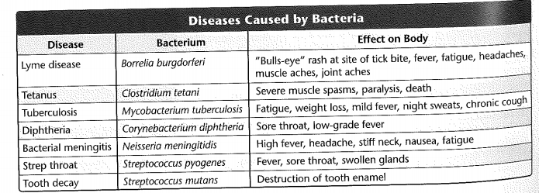
Diseases Caused by Bacteria

Slide 60
Controlling Bacteria
Although most bacteria are harmless, and many beneficial, the risk of infection is enough to warrant efforts to control bacterial growth.
There are various methods used to control bacterial growth, including sterilization, disinfectants, and food processing.

Slide 61
Sterilization by Heat
Sterilization destroys all bacteria by subjecting them to great heat.
Most bacteria cannot survive high temperatures for a long time, so most can be killed by exposure to heat.

Slide 62
Disinfectants
Another method to control bacteria growth, is to use disinfectants. These are used in homes to clean bathrooms, and kitchens etc.
Proper hand washing methods are a good way to remove bacteria.
Overuse of antibacterial compounds increases likelihood that common bacteria will eventually develop resistance.

Slide 63
Food Storage and Processing
Bacteria can cause food to spoil.
One method of preventing this is by storing it in a refrigerator.
Low temperatures cause bacteria to reproduce more slowly.
In addition, boiling, frying, or steaming can sterilize many kinds of food.

Slide 64
Viral Disease in Humans
Like bacteria, viruses produce disease by disrupting the body’s normal equilibrium.
In many viral infections, viruses attack and destroy certain cells in the body, causing the symptoms of the disease.
Ex. poliovirus infects and kills cells of the nervous system, producing paralysis.

Slide 65
Unlike bacterial diseases, viral diseases cannot be treated with antibiotics.
The best way to protect against most viral disease lies in vaccines.
Most vaccines provide protection only if they are used before an infection begins.
Once a viral disease has been contracted, it may be too late to control the infection.
However, sometimes the symptoms of infection can be treated.

Slide 66
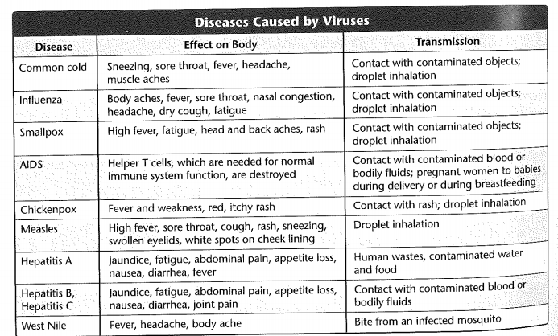
Diseases Caused By Viruses

Slide 67
Viral Disease in Animals
Viruses produce serious animal diseases as well.
Some animal viruses can even cause cancer.
Scientists have learned a great deal about cancer by studying the genes of these oncogenic viruses, which disrupt normal controls over cell growth and division.

Slide 68
Viral Disease in Plants
Many viruses infect plants.
These viruses pose a serious threat to many agricultural crops.
Like other viruses, most plant viruses have a difficult time entering the cells they infect.
Partly due to the fact that plants have a thick cell wall.
Many plant viruses are spread by insects.
Once inside the plant, many viruses spread rapidly, causing severe tissue damage, sometimes killing the plant

Slide 69
Viroids and Prions
These are virus-like particles that also cause disease.
Viroids cause disease in plants.
They are single-stranded RNA molecules that have no surrounding capsids.
They disrupt metabolism of plant cell by infecting the cell and forcing synthesis of new viroids.
Prions cause disease in animals.
Prions contain only proteins, not DNA or RNA, so they are not technically viruses.
It is thought that they cause disease by forming protein clumps. These clumps induce normal protein molecules to become prions.
Eventually there are so many prions, the cells become damaged

Slide 70
TED Talk
Evolution of Antibiotic Resistance

