Slide 1
CLASSIFICATION
Ms. Martel

Slide 2
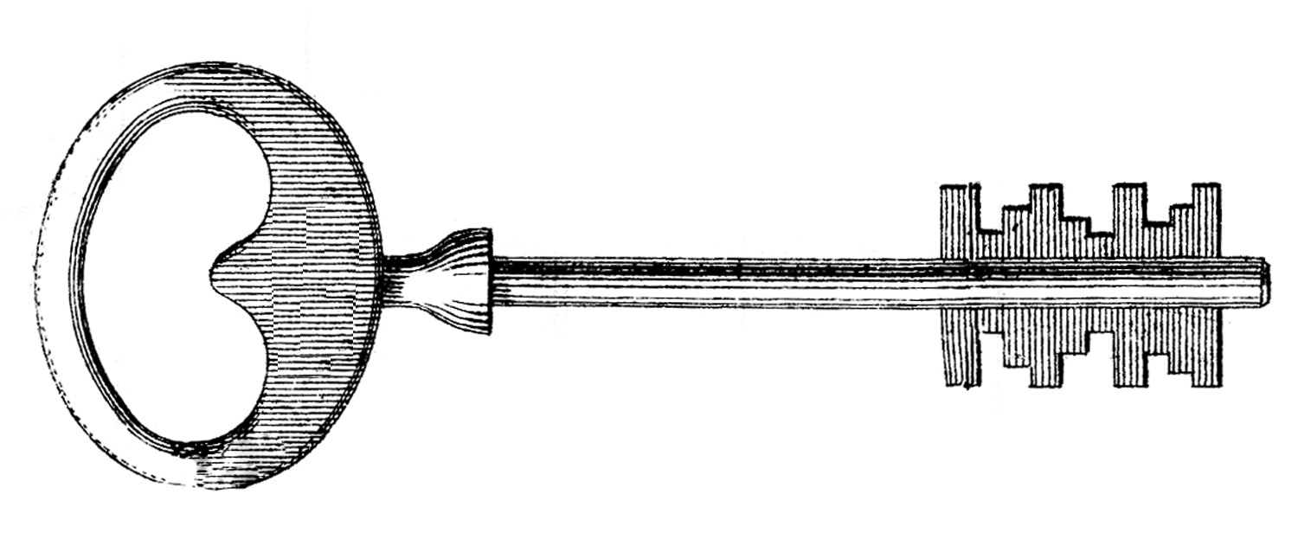
4.1 – FINDING ORDER IN DIVERSITY
Why Classify?
In order to study the diversity among organisms, biologists must give organisms names and then organize living things into groups that have biological meaning.
To study the diversity of life, biologists use a classification system to name organisms and group them in a logical manner.

Slide 3
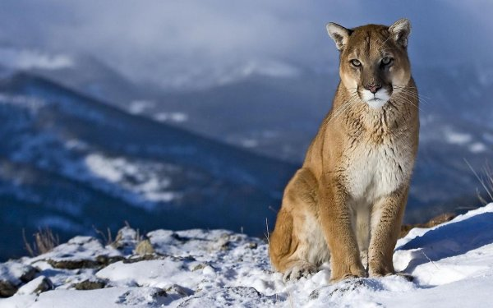
In the discipline known as taxonomy, scientists classify organisms and assign each organism to a universally accepted name.
Depending on where you live you may recognize this as a mountain lion, a puma, a cougar, or a panther.
The scientific name for this animal is Felis concolor.
To avoid the confusion caused by regional names, biologists use a classification system to group organisms in a logical manner and to assign names.

Slide 4
Assigning Scientific Names
Early Efforts at Naming Organisms
The first attempts at standard scientific names often described the physical characteristics of a species in detail.
As a result, these names could be twenty words long!
This system had another major drawback, it was difficult to standardize the names as different scientists described different characteristics.

Slide 5
Binomial Nomenclature
Carolus Linnaeus developed a two-word naming system called binomial nomenclature.
In binomial nomenclature, each species is assigned a two-part scientific name.
The scientific name is always written in italics, the first word capitalized and second is lowercase.

Slide 6
For example, the grizzly bear is called Ursus arctos. The first part of the scientific name Ursus, is the genus to which the organism belongs to.
A genus is a group of closely related species.
The second part of a scientific name, is unique to each species within the genus. Often this part of the name is a Latinized description of some important trait, or indication of where the organism lives.

Slide 7
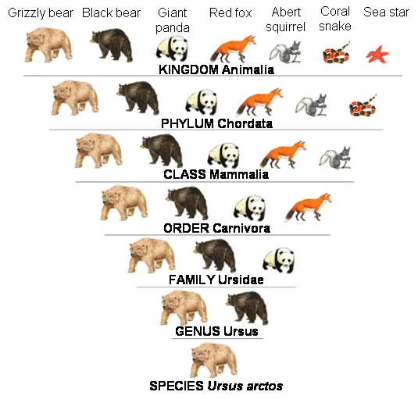
Linnaeus’s System of Classification
Linnaeus’s hierarchical system of classification includes seven levels. They are from smallest to largest – species, genus, family, order, class, phylum, and kingdom.

Slide 8
In taxonomic nomenclature, or naming system, each level is called a taxon, or taxonomic category.
The two smallest categories are species, and genus.
Genera that share many characteristics are grouped in a larger category, the family.
An order is a broad taxonomic category composed of similar families.
The next larger category, the class, is composed of similar orders.
Several different classes make up a phylum.
The kingdom is the largest, and most inclusive of Linnaeus’s categories and initially only had two categories: Animalia and Plantae

Slide 9
4.2 – MODERN EVOLUTIONARY CLASSIFICATION
Linnaeus and other taxonomists have always tried to group organisms according to biologically important characteristics.
Like any taxonomic system, Linnaeus’s system had limitations and problems.

Slide 10
Which Similarities Are Most Important?
Linnaeus grouped species into larger taxa, such as genus and family, mainly according to visible similarities and differences.
But which similarities and differences are most important?
If you lived in Linnaeus’s time, how would you have classified dolphins?
Would you have called them fishes because they live in water and have finlike limbs?
Or would you call them mammals because they breathe air and feed their young with milk?

Slide 11
Evolutionary Classification
Darwin’s ideas about descent with modification have given rise to the study of phylogeny, or evolutionary relationships among organisms.
Biologists now group organisms into categories that represent line of evolutionary descent, or phylogeny, not just physical similarities.

Slide 12
Species within a genus are more closely related to each other than to species in another genus.
According to evolutionary classification that is because all members of a genus share a recent common ancestor.
The higher the level of the taxon, the farther back in time the common ancestor of all the organisms in the taxon.

Slide 13
Classification Using Cladograms
To refine the process of evolutionary classification, many biologists now prefer a method called cladistic analysis.
This identifies and considers only those characteristics of organisms that are evolutionary innovations – new characteristics that arise as lineages evolve over time.
Characteristics that appear in recent parts of a lineage but not in its older members are called derived characters.

Slide 14
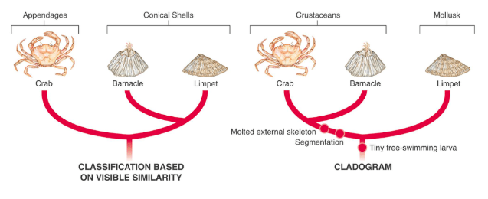
Derived characters can be used to construct a cladogram, a diagram that shows the evolutionary relationships among a group of organisms.
In the diagram above, notice how characteristics such as, “free-swimming larva” and “segmentation” appear at certain locations along the branches of the cladogram.
These locations are the points at which these characteristics first arose.

Slide 15
Cladograms are useful tools that help scientists understand how one lineage branched from another in the course of evolution.
Just as a family tree shows the relationship among different lineages within a family, a cladogram represents a type of evolutionary tree, showing evolutionary relationships among a group of organisms

Slide 16
How is a cladogram constructed?
Derived Characters in Organisms
Organism | Derived Character
 | Backbone | Legs | Hair
Earthworm | Absent | Absent | Absent
Trout | Present | Absent | Absent
Lizard | Present | Present | Absent
Human | Present | Present | Present
Procedure:
1. Identify the organism in the table that is least closely related to the others.
2. Use the information in the table to construct a cladogram of these animals.

Slide 17
Analyze & Conclude
1. Using Tables & Graphs- what trait separates the least closely related organism from the other animals?
2. Classifying – list the animals in your cladogram in order of distance from the least closely related organism.
3. Drawing Conclusions – does your cladogram indicate that lizards and humans share a more recent common ancestor than either does with an earthworm? Explain.
4. Inferring – where would you insert a frog is you added it to the cladogram? Explain your answer.

Slide 18
Linking Classification & Phylogeny
A phylogenic tree represents a hypothesis about evolutionary relationships.
These are often depicted as a series of dichotomies, or two way branch points.
Each branch point repxresents the divergence of two evolutionary lineages from a common ancestor.

Slide 19
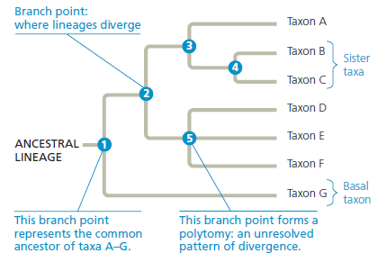
Branch 3 represents the common ancestor of taxa A, B, and C.
The position of branch point 4 to the right of 3 indicated that taxa B and C diverged after their shared lineage split from that of taxon A.
Taxa B and C are sister taxa, groups of organisms that share an immediate common ancestor (branch point 4)

Slide 20
This tree is rooted, which means that a branch point within the tree represents the most recent common ancestor.
The term basal taxon refers to a lineage that diverges early in the history of a group.
Ex. taxon G lies on a branch that originated near the common ancestor of the group.
The lineage leading to taxa D-F includes polytomy, a branch point from which more than two descendant groups emerge.

Slide 21
What We Can and Cannot Learn from Phylogenetic Trees
First, they are intended to show patterns of descent, not phenotypic similarity.
Second, the sequence of branching in a tree does not necessarily indicate the actual ages of the particular species.
Third, we should not assume that a taxon on a phylogenetic tree evolved from the taxon next to it.

Slide 22
Cladistics
In the approach to systematics called cladistics, common ancestry is the primary criterion used to classify organisms.
Using this methodology, biologists attempt to place species into groups called clades, each of which includes an ancestral species and all of its descendants.

Slide 23
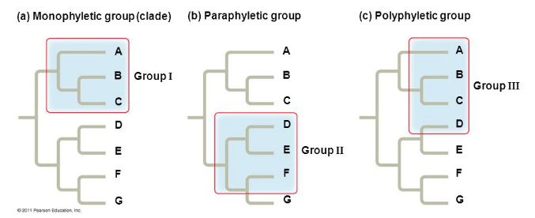
Clades are nested within larger clades.
A taxon is equivalent to clade only if it is monophyletic. Signifying that it consists of an ancestral species and all of it’s descendants
A paraphyletic group consists of an ancestral species and some, but not all of its descendants.
A polyphyletic group includes taxa with different ancestors.

Slide 24
Similarities in DNA and RNA
All of the classification methods discussed so far are based primarily on physical similarities and differences.
But even organisms with very different anatomies have common traits.
All organisms use DNA and RNA to pass on information and to control growth and development.
The genes of many organisms show important similarities at the molecular level. Similarities in DNA can be used to help determine classification and evolutionary relationships.

Slide 25
Similar Genes
Even humans and yeasts show surprising similarities.
Both organisms have a gene that codes for the protein myosin that enables human muscles to contract, and for yeast enables internal cell parts to move.
This is a strong indicator that humans and yeast share common ancestry.

Slide 26
DNA Evidence
DNA evidence can also help show the evolutionary relationships of species and how species have changed.
The more similar the DNA sequence of two species, the more recently they shared a common ancestor, and the more closely related they are.
The more two species have diverged from one another, or changed in comparison to one another, the less similar their DNA will be.

Slide 27
Molecular Clocks
Comparisons of DNA can also be used to mark the passage of evolutionary time.
A model known as a molecular clock uses DNA comparisons to estimate the length of time that two species have been evolving independently.

Slide 28
Simple mutations occur all the time, causing slight changes in the structure of DNA.
Some have a major positive or negative effect on an organism’s phenotype.
Others have no effect on phenotype.
A comparison of such DNA sequences in two species can reveal how dissimilar the genes are.
This is turn indicated how long ago the two species shared a common ancestor.

Slide 29
4.3 – KINGDOMS AND DOMAINS
As in all areas of science, systems of classification adapt to new discoveries.
Ideas and models change as new information arises.
Early attempts at drawing life’s universal tree were based on some misguided assumptions.
Some older models represented vertebrates as the most important and abundant animals.
This is just one example from many that biologists now know to be incorrect.

Slide 30
The Tree of Life Evolves
The scientific view of life was simpler in Linnaeus’s time.
The only known differences among living things were the fundamental traits that separated plants from animals.

Slide 31
Five Kingdoms
Biologists soon realized that two kingdoms were not enough to represent all living things on the planet.
A third kingdom was soon accepted as kingdom Protista, which included microorganisms such as protists and bacteria.
Subsequently a fourth kingdom known as Fungi, was accepted and included mushrooms, yeast and molds.
Later kingdom Monera was recognized as a fifth kingdom because bacteria lacked nuclei and organelles

Slide 32
Six Kingdoms
As evidence about microorganisms continued to accumulate, biologists came to recognize that Monera were composed of two distinct groups.
Some biologists consider these differences to be as great as those between animals and plants.
As a result, Monera have been separated into two kingdoms, Eubacteria and Archaebacteria.

Slide 33
Changing Number of Kingdoms
First Introduced | Names of Kingdoms
1700’s | Plantae |  |  |  |  | Animalia
Late 1800’s | Protista |  |  | Plantae |  | Animalia
1950’s | Monera |  | Protista | Fungi | Plantae | Animalia
1990’s | Eu-bacteria | Archae-bacteria | Protista | Fungi | Plantae | Animalia

Slide 34
The Three-Domain System
Molecular analyses have given rise to a new taxonomic category that is recognized by many scientists.
The domain is a more inclusive category than any other – larger than a kingdom.
The three domains are the domain Eukarya, which is composed of protists, fungi, plants, and animals; the domain Eubacteria; and the domain Archaea, which corresponds to the kingdom Archaebacteria.

Slide 35
Classification of Living Things
DOMAIN | Bacteria | Archaea | Eukarya
KINGDOM | Eu-bacteria | Archae - bacteria | Protista | Fungi | Plantae | Animalia
CELL TYPE | Pro-karyote | Pro-karyote | Eukaryote | Eukaryote | Eukaryote | Eukaryote
CELL STRUCTURE | Cell walls with peptido-glycan | Cell walls without peptido-glycan | Cell walls of cellulose in some | Cell wall of chitin | Cell walls of cellulose | No cell walls
NUMBER OF CELLS | Uni-cellular | Uni-cellular | Most unicellular; some colonial and multi-cellular | Most multi- cellular; some uni-cellular | Multi-cellular | Multi-cellular
MODE OF NUTRITION | Auto or hetero- troph | Auto or hetero- troph | Auto or hetero- troph | Hetero-troph | Auto-troph | Hetero-troph

Slide 36
Domain Bacteria
Members of the domain Bacteria are unicellular and prokaryotic.
Have thick cell walls containing a substance called peptidoglycan.
These bacteria are ecologically diverse, ranging from free-living soil organisms to deadly parasites.
Some photosynthesize, some need oxygen to survive while others are killed by oxygen.

Slide 37
Domain Archaea
Members of the domain Archaea are unicellular and prokaryotic.
They live in some of the most extreme environments on the planet – volcanic hot springs, brine pools, and black organic mud devoid of oxygen.
Their cell walls lack peptidoglycan, and their membranes contain unusual lipids that are not found in any other organism.

Slide 38
Domain Eukarya
This domain consists of all organisms that have a nucleus.
It is organized into the four remaining kingdoms of the six-kingdom system: Protista, Fungi, Plantae, and Animalia

Slide 39
Protista
Kingdom Protista is composed of eukaryotic organisms that cannot be classified as animals, plants, or fungi.
Members of this kingdom display the greatest variety
Most are unicellular, but some are multicellular.
Some are photosynthetic, while others are heterotrophic.
Some share characteristics with plants, others with fungi, and others with animals.

Slide 40
Fungi
Fungi are heterotrophs, most feed on dead or decaying organic matter.
Fungi secrete digestive enzymes into their food source.
They then absorb smaller food molecules into their bodies. Examples include mushrooms and yeast.

Slide 41
Plantae
These are multicellular organisms that are photosynthetic autotrophs.
They are non-motile, and have cell walls that contain cellulose.
This kingdom includes cone-bearing and flowering plants as well as mosses and ferns.

Slide 42
Animalia
These are multicellular and heterotrophic organisms.
Their cells do not have a cell wall. Most animals are motile.
There is incredible diversity within this kingdom, and many species exist in almost every part of the planet.

