Slide 1
4.4 – How do geological features and processes affect where and how we live?
Ms. Martel

Slide 2
The geological history of British Columbia helps shape our lives
CONCEPT 1
Plate tectonics explains British Columbia’s geological processes.
Specific features of the landscape such as soil quality, salmon spawning areas, river deltas, mineral deposits, and hot springs have influenced the patterns of settlement.

Slide 3
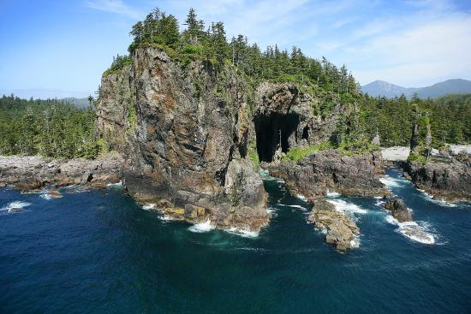
The Coast
Includes the Coast and Cascade Mountains, Haida Gwaii, Vancouver Island, and the Gulf Islands.
Much of this region experiences earthquake activity.
There are mountains of dormant volcanoes

Slide 4
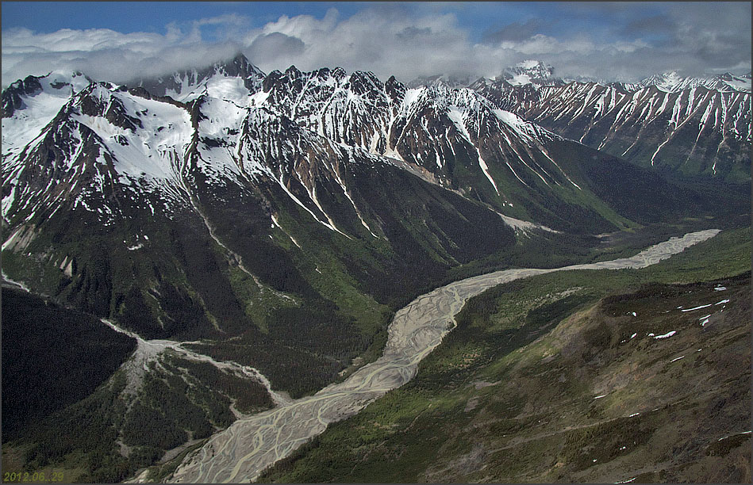
The Northern Interior
Includes Cassiar Mountains.
Glaciers from the last Ice Age have carved out the many lakes that dot the landscape and have left behind nutrient-rich soils for farming
These mountains have rock from ancient ocean crust that collided with the North American plate more than 200 million years ago.

Slide 5
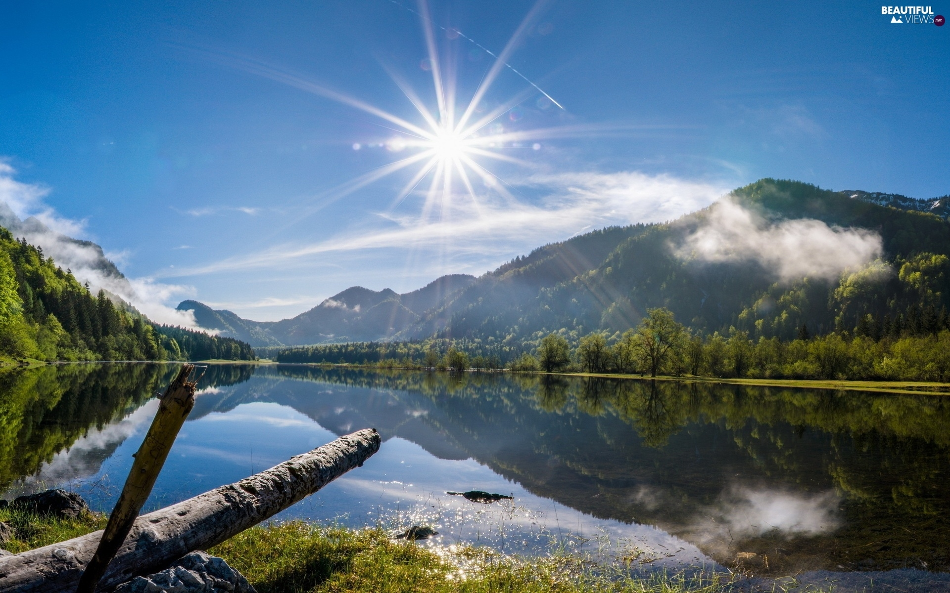
The Northeast
Includes the Peace River Region
Its soils, so rich for farming, were once the bottom of an ancient glacial lake.
The area also has deposits of natural gas, oil, and coal.
In addition to waterfalls, and caves, Tumbler Ridge also boasts fossils of marine fish and reptiles that date back over 200 million years ago.
Nine of the fourteen known tyrannosaur tracks in the world are found here.

Slide 6
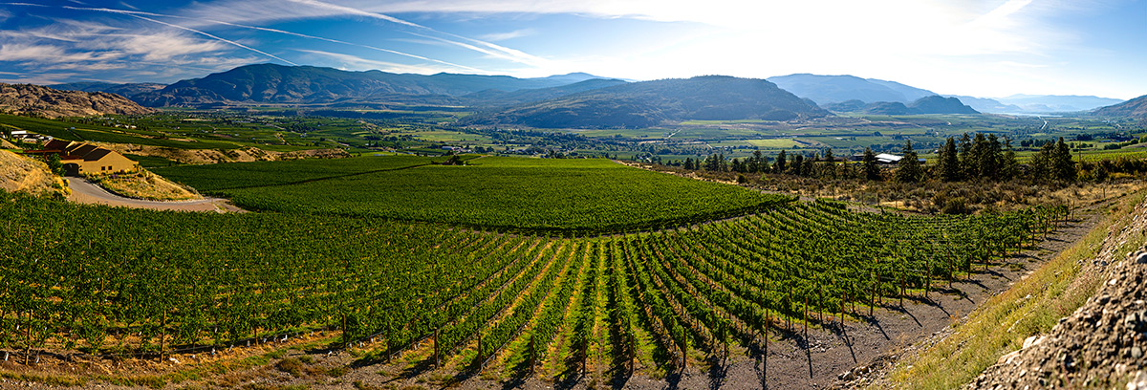
The Southern Interior
Includes steep-walled canyons with flowing rivers.
Near Lillooet, the Bridge River and Fraser River meet to create an important fishing site for the St’at’imc First Nations
The Okanagan Valley is most known for its lakes and agriculture.
The architecture of many towns reflects the wealth that came from silver, gold, and copper mines.

Slide 7
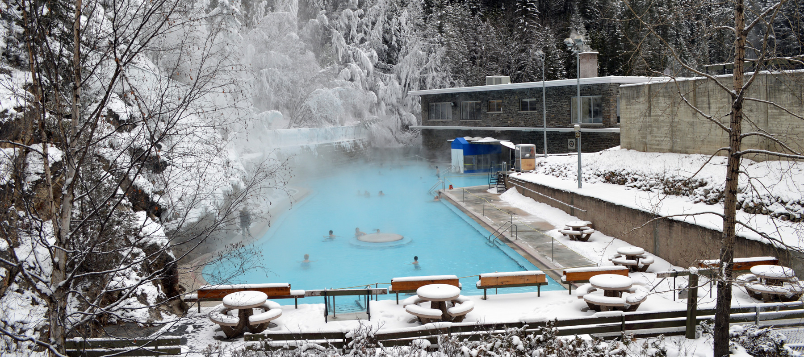
The Rocky Mountains
The Rocky Mountains run through the southeast and extend toward the north end of the province.
The Rocky Mountain Trench, North America’s longest mountain valley, runs along the west side of the Rockies.
Water rises at faults in Earth’s crust in this valley, producing world-famous hot springs such as those at Radium

Slide 8
We use our knowledge of geological processes to help keep us safe.
CONCEPT 2
Millions of people all over the world live in places that can experience natural hazards such as earthquakes and landslides.
These are examples of geohazards, which are destructive events that result from geological processes.
Many factors combine to make British Columbia vulnerable to geohazards.
These factors include the substantial amounts of rain and snow that fall each year, its geological makeup, and large amounts of sediments laid down by glaciers.
The province is also located in an active tectonic region

