Slide 1
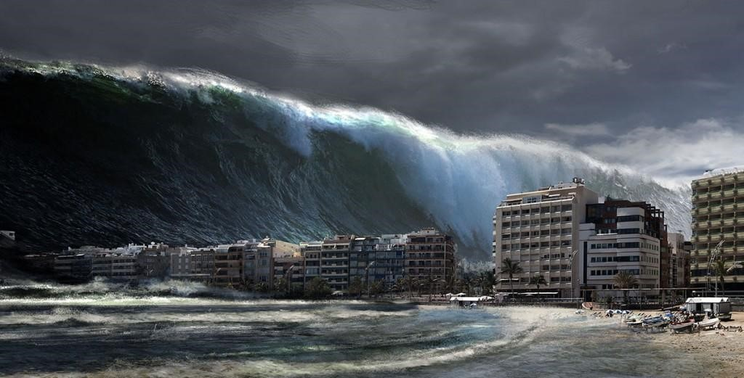
4.3 – How does the theory of plate tectonics explain Earth’s geological processes?
Ms. Martel

Slide 2
Most earthquakes occur near tectonic plate boundaries
CONCEPT 1
Almost all earthquakes occur along plate boundaries.
Tectonic plate boundaries are where there is greatest stress on the rock in Earth’s crust.
Movements in Earth’s crust can squeeze, stretch, or twist the rock.
This applies pressure to the rock.

Slide 3
Earthquakes Happen at Faults
Earthquake – ground shaking release of energy when a break in the crust occurs.
Usually occur when rocks suddenly shift along a break in the rock, releasing built-up pressure.
The break where movement happens is called a fault.
During an earthquake, one block of rock slides against or alongside another block of rock at a fault.
A fault line is the line along the surface of the ground where the break in the rock happens.

Slide 4
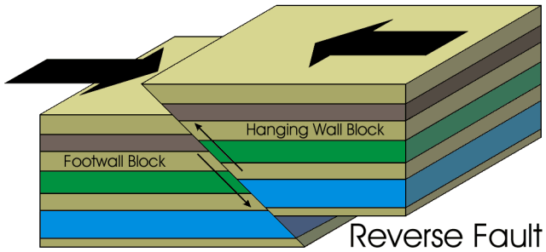
Types of Faults
Reverse – when rock is squeezed together and one block rides up to overlap the other block, a reverse fault forms.
The crust is shortened, horizontally.

Slide 5
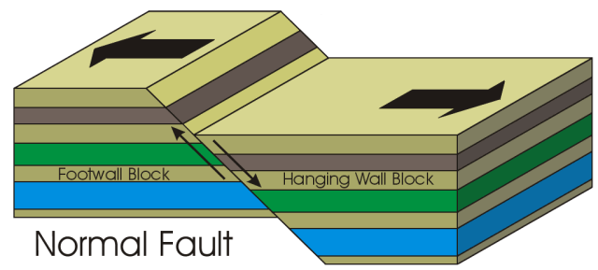
Types of Faults
Normal – when rock is pulled apart and one block slips downward, a normal fault forms.
The crust is lengthened

Slide 6
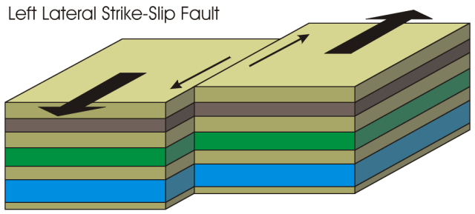
Types of Faults
Strike-slip – when block of rock move past each other horizontally, a strike-sip fault forms.

Slide 7
Movement along faults produces seismic waves.
CONCEPT 2
Activity – Seismic Slinky Waves
Model the different types of waves using a Slinky.
What do you need to do with the Slinky to generate P waves? S waves? L waves?
Describe the movement of each type of wave that you generated using the Slinky.

Slide 8
An earthquake starts at a location called the focus.
This is the point where breakage of rock first happens.
This is usually several km below the surface of the Earth.
Rocks along a fault move into a new position and the ground feels like it is vibrating.
Vibrations are seismic waves.
A earthquake’s epicentre is the point on the surface of Earth that is directly above the focus.
When people describe where an earthquake has occurred, they are referring to the epicentre.

Slide 9
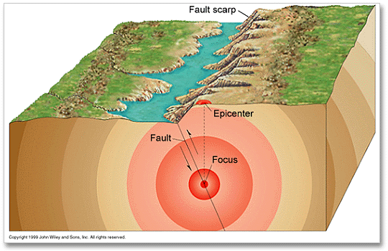
The focus is the point where breakage of rock inside Earth first happens.
Location where earthquake starts.
A

Slide 10
As an earthquake occurs, seismic waves leave the focus in all directions.
B

Slide 11
An earthquake’s epicentre is the point on the surface of Earth that is directly above the focus.
C

Slide 12
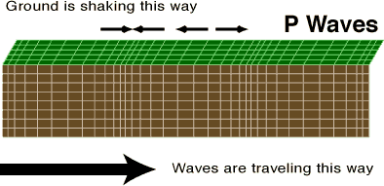
Types of Seismic Waves
Wave Type | Characteristics | Effect on Rock Particles | Where They Travel
Primary Waves (P waves) | Move the fastest Are the first ones detected in an earthquake | Cause rock particles to move forward and backward | Can travel through both solids and liquids

Slide 13
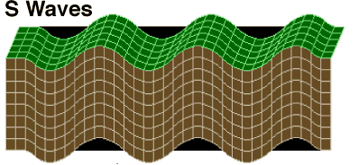
Types of Seismic Waves
Wave Type | Characteristics | Effect on Rock Particles | Where They Travel
Secondary waves (S waves) | Move slower than P waves | Cause rock particles to move up and down | Can only travel through solids

Slide 14
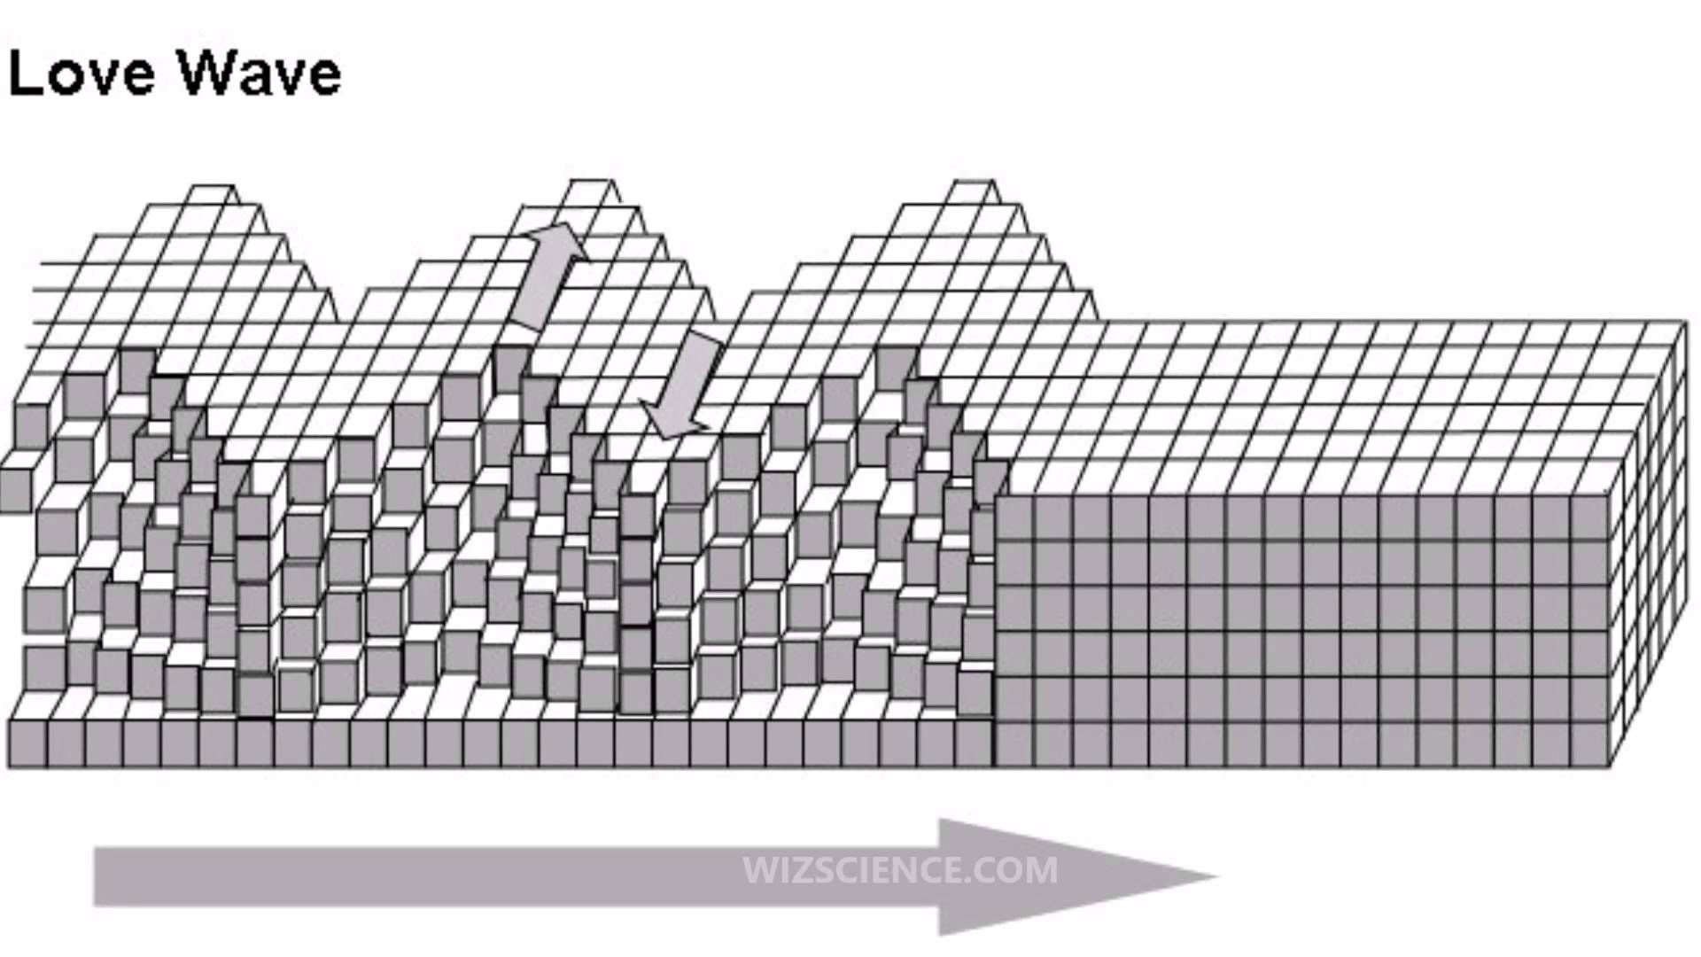
Types of Seismic Waves
Wave Type | Characteristics | Effect on Rock Particles | Where They Travel
Surface waves (L waves) | Are the slowest of the three waves Are on the surface and often cause the greatest damage | Cause rock particles to move both up and down and side to side | Can travel along the surface of Earth and not through Earth’s interior

Slide 15
How Earthquakes Are Measured
Seismic waves are detected and recorded by scientific instruments called seismographs.
It includes a seismometer, which detects ground motion, and a device that amplifies and records the signal.
When an earthquake occurs, seismic data from instruments at different stations are uploaded to computers that process the information and determine the strength and location of the earthquake

Slide 16
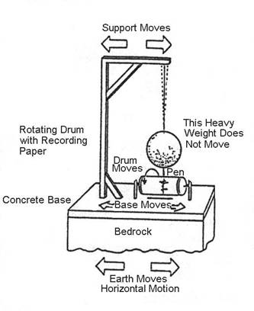
Historic Seismograph
This device only records ground movement parallel to the arrows. So, it only records a single direction.

Slide 17
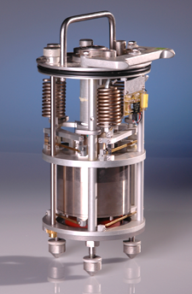
Modern Seismograph
This device records north-south, east-west, and up-down motion using three seismometers.

Slide 18
The magnitude of an earthquake refers to how strong the earthquake is.
The Richter scale is based on the size of the largest seismic waves that are formed.
The higher the number the stronger the earthquake.
In general, earthquakes that are magnitude 4 or less do not cause damage.
The world’s strongest recorded earthquake was a magnitude 9.5, in Chile in 1960.

Slide 19
Most volcanoes occur where oceanic crust collides with another plate
CONCEPT 3
Mount St Helens

Slide 20
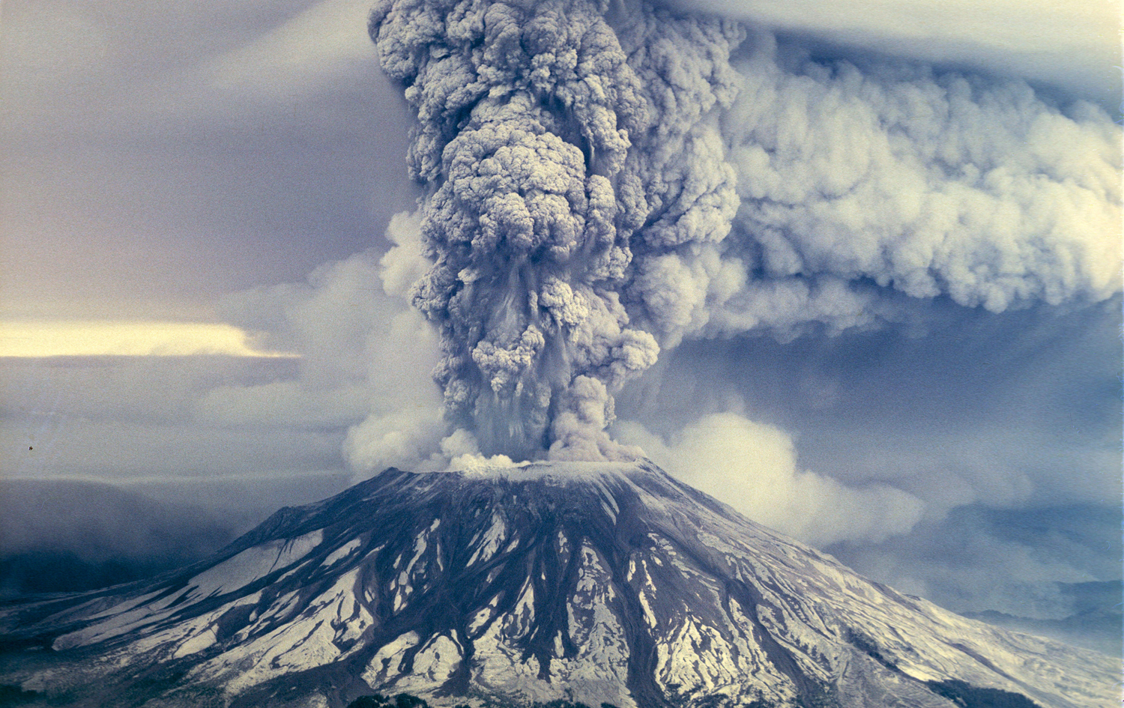
Anywhere that magma from the mantle reaches Earth’s surface can be called a volcano.
Magma that has been released onto Earth’s surface is called lava.
Volcanic eruptions can send hot gases and volcanic ash flying high into the air.
An eruption can also cause dangerous landslides that produce massive paths of destruction.

Slide 21
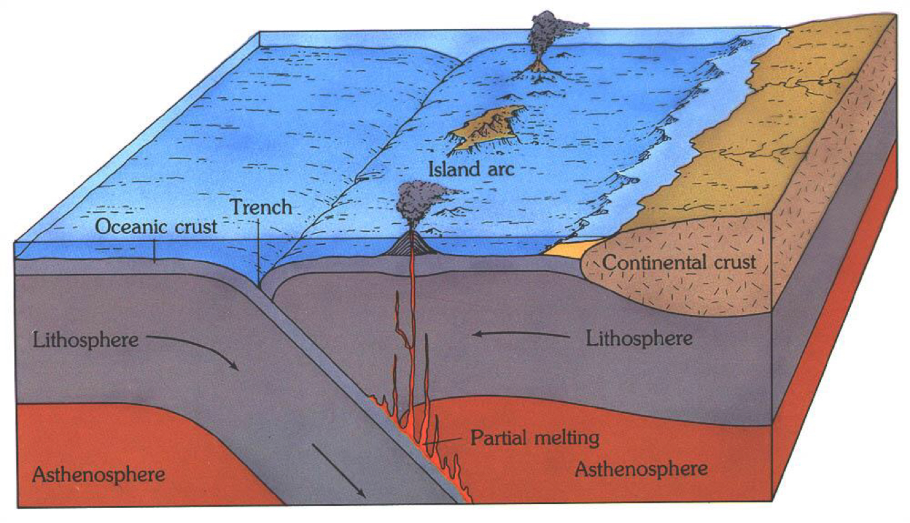
How Volcanoes Form at Plate Boundaries
Many volcanoes occur at convergent boundaries.
An oceanic trench is formed where one plate subducts beneath another.
Magma rises into the upper plate and some is released onto the surface.
Over time, the erupted lava builds up and forms a group of volcanic islands

Slide 22
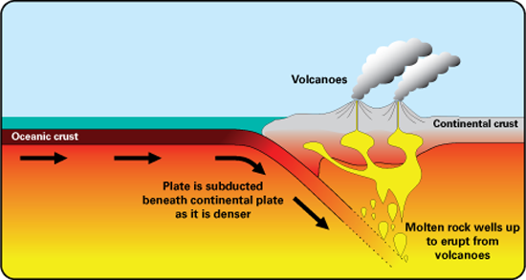
This is what happens when oceanic crust collides with continental crust.
Volcanoes form on the surface of the continental crust.
Magma can rise to the surface and cause an eruption
Pressures produced cause squeezing of the crust for hundreds of km.
This causes the crust to fold and crumple, producing high mountain ranges.

Slide 23
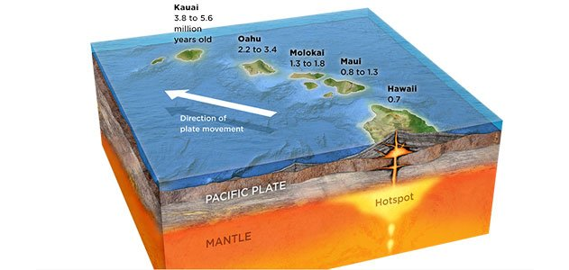
Hot Spot Volcanoes
Hot spots are defined as unusually hot regions of Earth’s mantle where magma rises to the surface by breaking through weak parts of the lithosphere.
An example is the Hawaiian Islands.

Slide 24
Mountain ranges can also form when continental crust collides
CONCEPT 4
Activity – Investigating B.C.’s Mountain Ranges
Using the topographic map, answer the following questions.
How many mountain ranges are there, where are they located?
Which ones include volcanoes?
What are the names and elevations of the tallest peaks in each range?
What patterns do you notice about the directions that mountain ranges run?

Slide 25
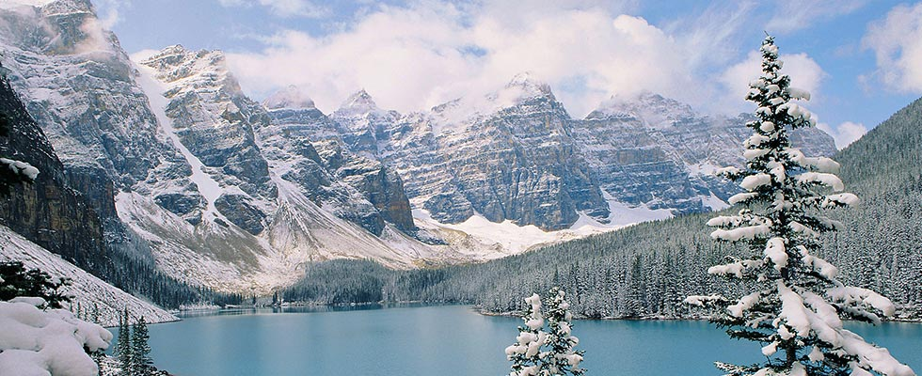
The rocky mountains are 4800 km long and run from BC to New Mexico in the US.
Mountain ranges contain many peaks grouped together in a continuous line.
Their locations are not random, these structures hold detailed information about Earth’s history and the role that plate tectonics may have played in their formation.

Slide 26
Continental Crust Collisions
Unlike when oceanic crust collides, continental crust is not easily subducted beneath the other plate.
Instead, one plate is shoved beneath the edge of the other.
The impact causes a large area to be pushed up forming mountains.
The plates are under an enormous amount of pressure producing faults and causes rocks to be deformed.

Slide 27
