Slide 1
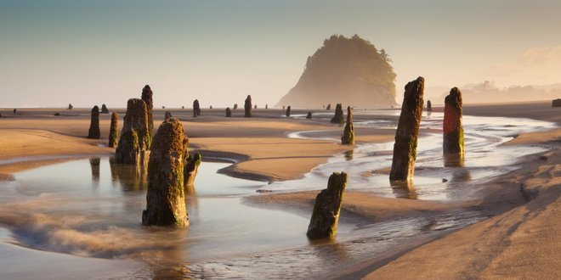
4.1 – What ideas, observations, and evidence led to the theory of plate tectonics?
Ms. Martel

Slide 2
ACTIVITY – Looking at Maps
Look at the maps from different time periods in history.
What does the oldest known map show?
What do maps from the 16th century show?
How do they differ from maps from the 19th century?
What observations can you make about the position and shape of continents from modern-day maps?

Slide 3
Scientists debated how to interpret the shapes and positions of Earth’s continents
CONCEPT 1
Most of the Earth’s surface appears to remain unchanged during the course of a human lifetime.
On a geologic time scale, Earth’s surface has changed dramatically.
Early mapmakers in the 1500’s were the first to suggest that edges of continents who share the Atlantic Ocean seemed to fit together.

Slide 4
Fixism – the idea that continents have been in the same locations since Earth first formed.
This idea was prevalent until the mid 1900’s
Alfred Wegnener was a German scientist that wondered if Earth’s continents were once joined together.
He collected rock, climate, and fossil information from around the world to see if he could find evidence to support the idea that continents moved.

Slide 5
The Continental Drift Hypothesis
Based on his collected evidence, Wegener proposed his continental drift hypothesis.
He suggested that 200 million years ago, all the continents were connected as a single supercontinent called Pangea.
He hypothesized that over time, the continents slowly moved apart until they reached their current positions.

Slide 6
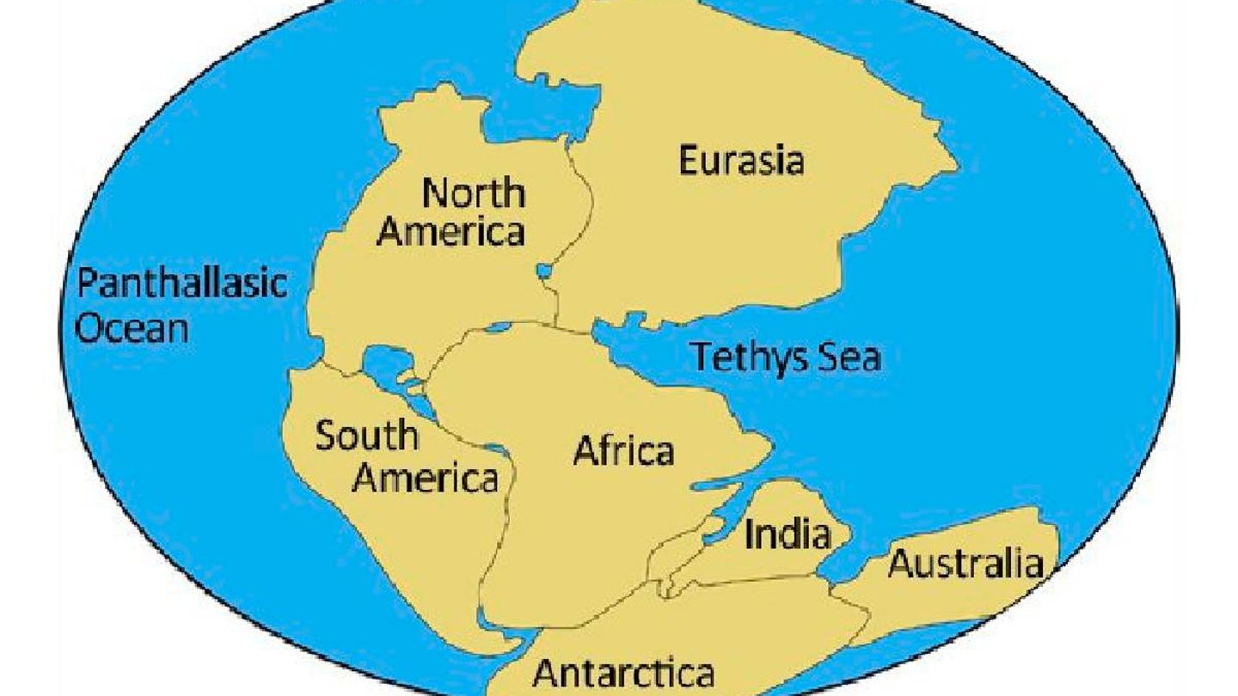

Slide 7
Wegener’s Hypothesis is Rejected
Even though Wegener had a lot of evidence supporting his hypothesis, most scientists strongly rejected it.
Wegener could not explain how continents could move.
Scientists could not imagine what forces could be large enough to make a continent move.
Decades later, discoveries about the ocean floor provided information that supported the idea that continents move.
His hypothesis is now seen as the start of the development of the theory of plate tectonics.

Slide 8
Technology helps scientists make inferences about the different layers of Earth
CONCEPT 2
Earth is about 12 700 km in diameter.
There is approximately 6350 km between you and the centre.
There are no tools that can probe that deep, so scientists must use indirect evidence to model Earth’s structure.
One way is to study energy waves that travel through the interior during earthquakes.
A waves speed and behaviour are affected by the material they pass through.
Because of this, scientists can infer Earth’s structure and composition.

Slide 9
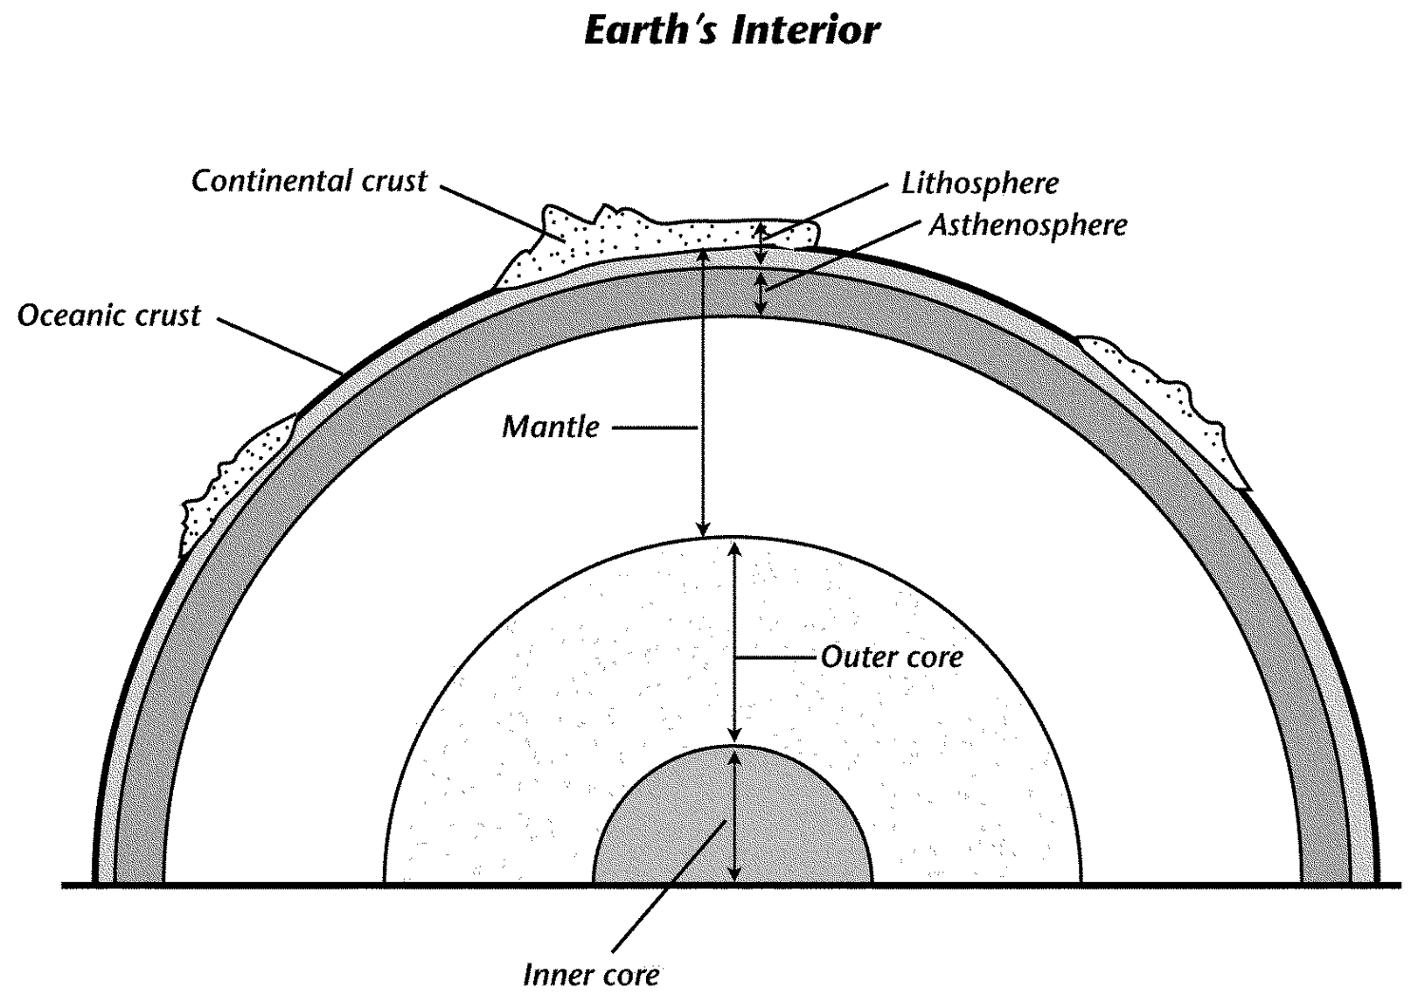
Crust – thin layer of solid rock surrounding Earth. Crust is thinner under oceans.
Oceanic crust is mostly basalt
Continental crust is mostly granite
Mantle – there is an upper and lower mantle. The top part of the upper mantle is solid.
A part just below this is made of rock that is soft like taffy so it can flow slowly.
The rest of the upper and lower mantle are made of denser, more solid material.

Slide 10
Outer Core –this is the only layer that is liquid
Star t at 2:28-4:41
Inner Core – Earth’s deepest layer is also the hottest at more than 5000° C.
It is solid because the dense material is under extreme pressure.

Slide 11
Studies of the ocean floor revealed where new rock is made
CONCEPT 3

Slide 12
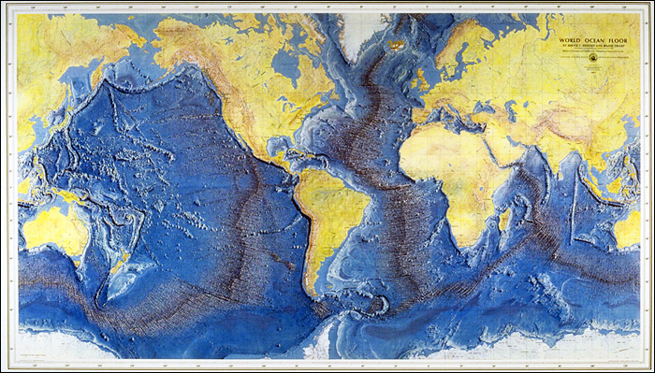
Mountains and Trenches of the Ocean Floor
By the 1870’s, scientists had begun to study and map the ocean floor using weighted ropes dragged by ships.
When contact was made with objects below the surface, the length of the rope was recorded.
In the 1920’s, ropes were replaced with sonar.
This helped scientists discover and detail vast mountain ranges and deep valleys

Slide 13
Mid-ocean ridge – mountain ridges along the ocean floor
Trenches – deep valleys in the ocean floor
Mid-ocean ridges circle Earth and are nearly 60,000 km long.
The mid-Atlantic ridge, at 16,000 km long, is longer than any mountain range on land.
Earthquakes and volcanic eruptions are common along mid-ocean ridges.

Slide 14
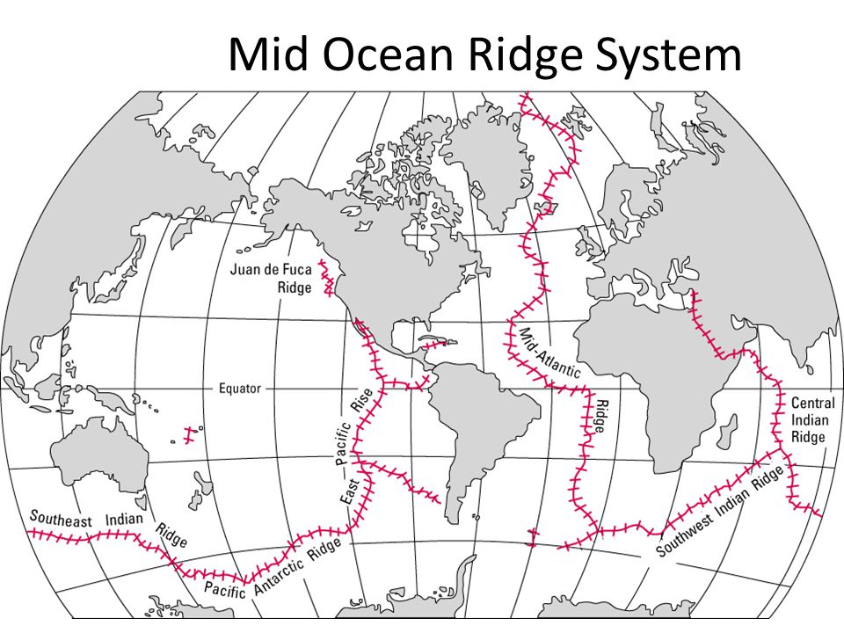

Slide 15
Deep sea trenches can be 1000’s of km long and many km deep.
The Mariana’s Trench is more than 11 km deep. The following diagram compares it’s size to that of Mt. Everest, the world’s tallest mountain.

Slide 16
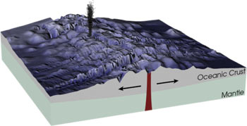
Making New Rock on the Ocean Floor
In general, ocean rocks are much younger than land rocks.
The ocean floor near mid-ocean ridges is younger than ocean floor farther away from the ridges.

Slide 17
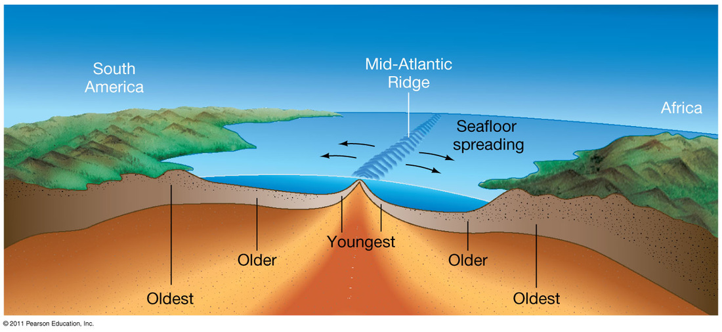
The layer of sediment that covers the ocean floor gets thicker as you move farther away from the ridge.
This suggests the ocean floor is younger closer to the mid-ocean ridge.
Ocean rocks closer to a mid-ocean ridge are younger than ocean rocks farther from a ridge.

Slide 18
In 1962, Harry Hess proposed that new ocean crust is made at mid-ocean ridges.
This process is called sea-floor spreading.
This discovery was important to understanding how continents could move.
Molten rock from a rift in a mid-ocean ridge cools, hardens, and continuously pushes older rock aside in the opposite direction.
Continents are carried by the widening ocean floor.

Slide 19
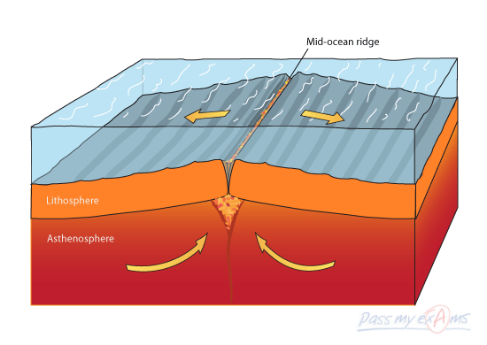
Mid-ocean ridges are higher than surrounding areas.
Rift: The valley at the centre of the ridge has a crack, or rift, in the Earth’s crust. At this rift, molten rock, or magma, from deep inside Earth rises to fill the crack.
Magma erupts on the ocean floor and creates new rock.
This process is repeated over millions of years, new rock pushes older rock away from the ridge.

Slide 20
The theory of plate tectonics provides a unified explanation for geological features and processes.
CONCEPT 4
In the 1970’s, research submarines were taking photos of the ocean floor.
This allowed scientists to make direct observations of mid-ocean ridges and trenches.
Eventually, scientists understood that Earth’s surface is made up of huge slabs of rock called tectonic plates.
There are 12 major plates and many smaller ones, that all fit together.

Slide 21
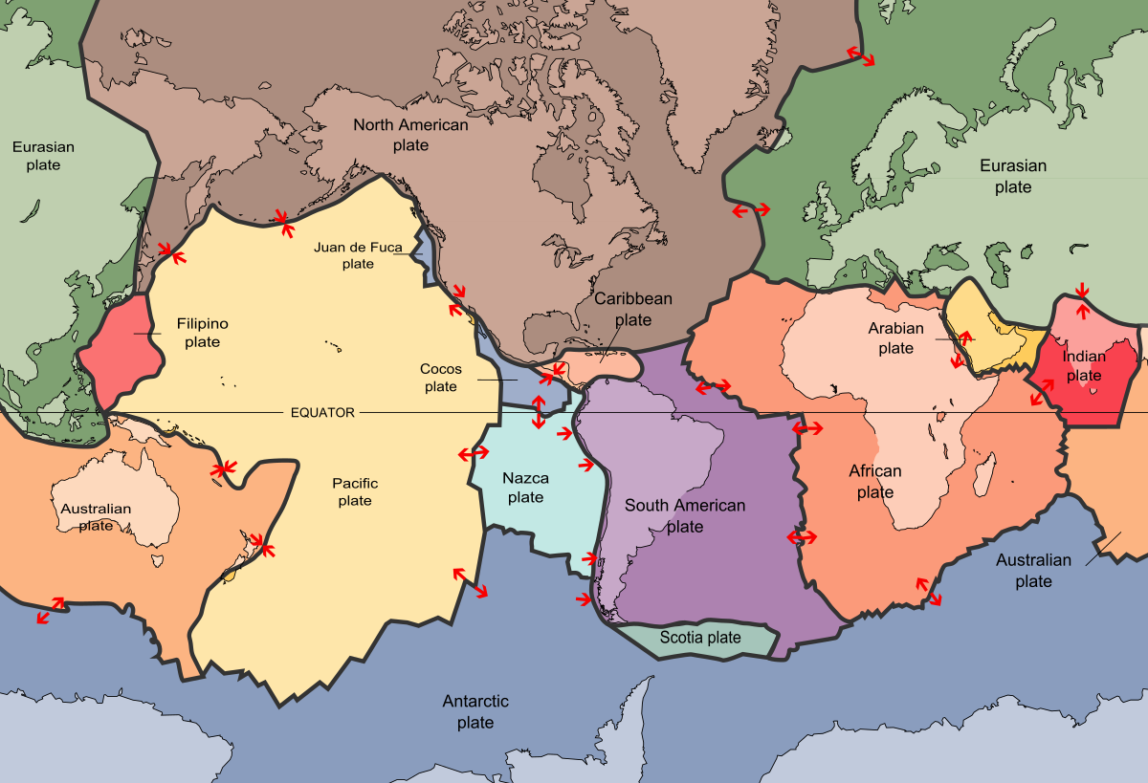
Earth’s tectonic plates move very slowly – about 10 cm per year. This is about the same rate that your fingernails grow.

Slide 22
Plate Tectonics – A Unifying Theory
Theory of plate tectonics – the lithosphere is broken into large plates that interact and cause geologic activities.
It explains how and why the continents move;
How and why sea floor spreading occurs;
And how, why, and where earthquakes, volcanoes, and formation of mountains occur.
It is a unifying theory because it brings together ideas and explanations from a wide array of sciences.

