Slide 1
The Origin of Species/The History of Life
Ms. Martel

Slide 2
3.1 – THE FOSSIL RECORD
Studying life’s history is on of the most fascinating and challenging parts of biology, researchers go about it in several ways.
One technique is to read the pieces of the story that are “written” in ancient rocks, in petrified sap of ancient trees, in peat bogs and tar pits, and in polar glaciers.

Slide 3
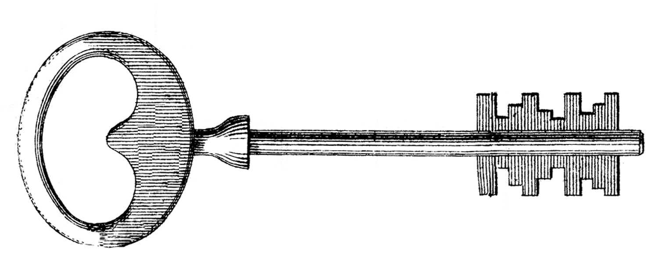
Fossils and Ancient Life
Paleontologists use fossils to infer what past life forms were like.
ie) structure of organism, what they ate, what ate them, environment they lived in etc.
Paleontologists group similar organisms together and arrange them in the order in which they lived – from oldest to most recent. This is called the fossil record.
The fossil record provided evidence about the history of life on Earth. It also shows how different groups of organisms have changed over time.

Slide 4
How Fossils Form
The formation of any fossil depends on a precise combination of conditions.
Because of this the fossil record is incomplete.
Most fossils are formed in sedimentary rock.
Sedimentary rock is formed when exposure to rain, heat, wind, and cold breaks down existing rock into small particles.

Slide 5
These particles are carried by streams and rivers into lakes or seas, and eventually settle to the bottom.
Sediment builds up over time and dead organisms may also sink to the bottom and become buried.
If conditions are right, remains may be kept intact and free from decay.
The weight of the sediment compresses the lower layers, and along with chemical activity, turns them into rock.

Slide 6
The quality of fossil preservation varies.
Sometimes, small particles of rock surrounding the remains preserve an imprint of the soft parts.
In other cases, the hard parts are preserved when saturated or replaced with mineral compounds.

Slide 7
Interpreting Fossil Evidence
When paleontologists study a fossil, they look for anatomical similarities – and differences – between the fossil and living organisms.
Paleontologists determine the age of fossils using two techniques: relative dating and radioactive dating.

Slide 8
Relative Dating
Two centuries ago, geologists noted that rock layers containing certain fossils consistently appeared in the same vertical order no matter where they were found.
In relative dating, the age of a fossil is determined by comparing its placement with that of fossils in other layers of rock.
The oldest rock layers are on the bottom, more recent layers are closer to Earth’s surface.
Scientists use index fossils to compare the relative age of fossils.

Slide 9
To be used as an index fossil, a species must be easily recognized and must have existed for a short period and have a wide geographic range.
Relative dating allows paleontologists to estimate a fossil’s age compared with that of other fossils.
It provides no information about its absolute age, or age in years.

Slide 10
Radioactive Dating
Scientists use radioactive decay to assign absolute ages to rocks.
Radioactive elements in rocks decay into nonradioactive elements at a steady rate, which is measured as a half-life.
A half-life is the length of time required for half of the radioactive atoms in a sample to decay.
In radioactive dating, scientists calculate the age of a sample based on the amount of remaining radioactive isotopes it contains.

Slide 11
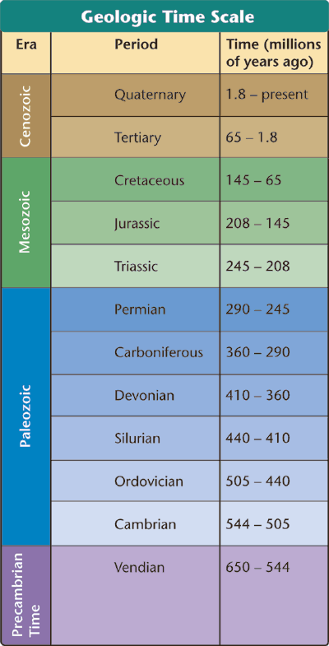
Geologic Time Scale
Paleontologists use divisions of the geologic time scale to represent evolutionary time.
After Precambrian Time, the basic divisions of the geologic time scale are eras and periods.

Slide 12
Eras
Geologists divide the time between the Precambrian and the present into three eras.
1. The Paleozoic Era - many vertebrates and invertebrates lived during this time.
2. The Mesozoic Era – the age of the dinosaurs, mammals began to evolve during this time as well
3. The Cenozoic Era – the age of the mammals as they have become common during this time.

Slide 13
Periods
Eras are subdivided into periods, which range in length from tens of millions of years to less than two million years.
Many periods are named for places around the world where geologists first described the rocks and fossils of that period.

Slide 14
3.2 – EARTH’S EARLY HISTORY
If life comes only from life, then how did life on Earth first begin?
This section presents the current scientific view of event on the early Earth.
Furthermore, there is only a small amount of evidence to support this hypotheses, which makes it likely that scientific ideas around this will change.

Slide 15
Formation of Earth
Geologic evidence shows that the following events likely occurred during Earth’s formation approximately 4.6 billion years ago.
Pieces of cosmic debris were attracted to one another.
The planet was then struck by one or more objects which produced enough heat to melt the entire globe.

Slide 16
Once melted, it’s elements rearranged themselves according to density.
The most dense elements formed the planet’s core.
The least dense elements formed the first atmosphere.
Earth’s early atmosphere probably contained hydrogen cyanide, carbon dioxide, carbon monoxide, nitrogen, hydrogen sulfide, and water.

Slide 17
About 4 billion years ago, Earth cooled enough for solid rocks to form.
Oceans did not exist because volcanic activity shook Earth’s crust, and comets and asteroids bombarded the surface making it too hot for water to form.
About 3.8 billion years ago, Earth’s surface cooled enough for water to remain liquid.
Thunderstorms drenched the planet, and oceans covered most of the surface.
Oceans were brown because an excess of dissolved iron.

Slide 18
The First Organic Molecules
In the 1950’s Stanley Miller and Harold Urey tried to simulate conditions on the early Earth in a laboratory.
They filled a flask with hydrogen, methane, ammonia, and water to represent the atmosphere.
They made certain no microorganisms could contaminate the simulation, and then passed electric sparks to simulate lightening.

Slide 19
Over a few days, several amino acids – the building blocks of proteins – began to accumulate.
Miller and Urey’s experiments suggested how mixtures of the organic compounds necessary for life could have arisen from simpler compounds present on a primitive Earth.

Slide 21
The Puzzle of Life’s Origins
A stew of organic molecules is a long way from a living cell.
Geological evidence suggests that about 200-300 million years after Earth cooled enough to carry liquid water, cells similar to modern bacteria were common.

Slide 22
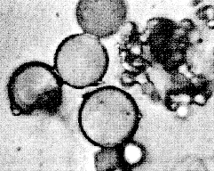
Formation of Microspheres
Under certain conditions, large organic molecules can form tiny bubbles called proteinoid microspheres.
These have characteristics of living cells such as selectively permeable membranes, and a simple means of storing and releasing energy.
Scientists believe that these could have evolved into the first living cells.

Slide 23
Free Oxygen
Microscopic fossils, or microfossils, of single-celled prokaryotic organisms that resemble modern bacteria have been found in rocks more than 3.5 billion years old.
The first life forms must have evolved in the absences of oxygen because Earth’s first atmosphere contained very little of it.
Overtime, photosynthetic bacteria became common in the Precambrian seas.
This means more oxygen was being produced, and was accumulating in the atmosphere.

Slide 24
To the first cells, this increase in oxygen was the cause of their demise.
The rise of oxygen in the atmosphere drove some life forms to extinction, while other life forms evolved new, more efficient metabolic pathways that used oxygen for respiration.

Slide 25
Origin of Eukaryotic Cells
About 2 billion years ago, prokaryotic cells – cells without nuclei – began evolving internal cell membranes.
The result was the ancestor of all eukaryotic cells.

Slide 26
The Endosymbiotic Theory
Scientists believe that some prokaryotic organisms entered an ancestral eukaryote.
This was not a parasitic relationship rather a symbiotic relationship where both organisms benefitted from this new relationship.
Some of these new relationships included the following:
One group of prokaryotes had the ability to use oxygen to generate ATP (our energy molecule). These evolved into our mitochondria.
Other prokaryotes that carried out photosynthesis evolved into the chloroplasts of plants and algae.

Slide 27
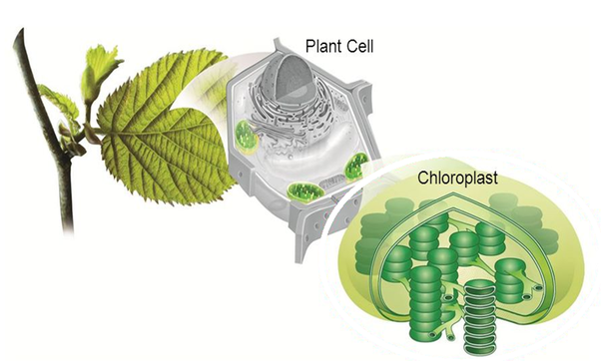
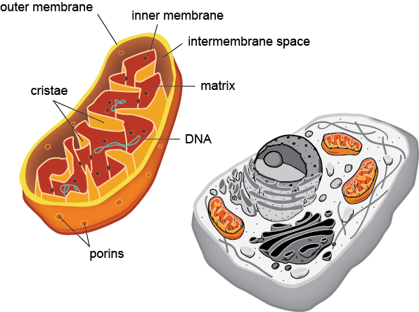

Slide 28
The endosymbiotic theory proposes that eukaryotic cells arose from living communities formed by prokaryotic organisms.

Slide 29
The Evidence
1) mitochondria and chloroplasts contain DNA similar to bacterial DNA.
2) mitochondria and chloroplasts have ribosomes whose size and structure resemble those of bacteria.
3) like bacteria, mitochondria and chloroplasts reproduce by binary fission.
These similarities provide strong evidence of a common ancestry between free-living bacteria and the organelles of living eukaryotic cells.

Slide 30
Sexual Reproduction and Multicellularity
Most prokaryotes reproduce asexually.
Meaning they duplicate their genetic material, and divide into two identical cells.
This restricts genetic variation to mutations in DNA.
Sexual reproduction shuffles and reshuffles genes. Therefore, the offspring never resemble their parents exactly.
This increases the probability that favourable combinations will be produced, increasing the chance of evolutionary change.
A few hundred million years after the evolution of sexual reproduction, multicellular organisms developed

Slide 31
3.3 – EVOLUTION OF MULTICELLULAR LIFE
The fossil record indicates that major changes occurred in Earth’s climate, geography, and life forms.
The following section is an overview of how multicellular life evolved from its earliest forms to is present-day diversity.

Slide 32
Precambrian Time
Almost 90% of Earth’s history occurred during the Precambrian time.
Simple anaerobic forms of life appeared and were followed by photosynthetic forms, which added oxygen to the atmosphere.
Eukaryotes appeared, some gave rise to multicellular organisms, that continued to increase in complexity.
Life existed only in the sea, and few fossils exist form this time as all the animals were soft-bodied.

Slide 33
Paleozoic Era
Rich fossil evidence shows that early in the Paleozoic Era, there was a diversity of marine life.
This era included many kinds of invertebrate animals.

Slide 34
Cambrian Period- the first known animals evolved here, invertebrates such as jellyfish, trilobites, worms etc.
Ordovician & Siliurian Periods- arthropods evolved here, as well as the first vertebrates (jawless fishes). The first land plants and insects developed in these periods too.
Devonian Period- fish developed jaws here as well as bony skeletons. Vertebrates began to invade the land, such as amphibian-like creatures.
Carboniferous & Permian Periods – reptiles evolved during this time, and swampy forests also

Slide 35
A mass extinction happened at the end of the Paleozoic era.
The mass extinction at the end of the Paleozoic affected both plants and animals on land and in the seas. As much as 95% of life in the oceans disappeared.

Slide 36
Mesozoic Era
Events during the Mesozoic included the increasing dominance of dinosaurs. Is also marked by the appearance of flowering plants.

Slide 37
Triassic Period- organisms that survived the Permian mass extinction became the main forms of life during this period. We call this period the Age of Reptiles, the first mammals also evolved here.
Jurassic Period- dinosaurs became the dominant animals on land. One of the first birds appeared during this time.
Cretaceous Period- this period was still dominated by dinosaurs, but brought about new forms of plant life such as leafy trees, shrubs, and small flowering plants. The end of this period is famously marked by a meteor striking Earth.

Slide 38
Cenozoic Era
The extinction of dinosaurs at the end of the Mesozoic, made room for mammals to take over.
During the Cenozoic, mammals evolved adaptations that allowed them to live in various environments – on land water and air.

Slide 39
Tertiary Period – in the oceans, marine mammals such as whales and dolphins evolved. On land, flowering plants and insects flourished.
Quaternary Period- Earth’s climate cooled causing a series of ice ages. So much of Earth’s water froze the ocean levels dropped by more than 100 meters!!!
Fossil records indicate that our early ancestors appeared 4.5 mya, but did not look entirely human. Homo sapiens may have appeared as early as 200, 000 years ago in Africa.

Slide 40
3.4 – PATTERNS OF EVOLUTION
Biologists use the term macroevolution to refer to large-scale evolutionary patterns and processes.
Six important topics in macroevolution are extinction, adaptive radiation, convergent evolution, coevolution, punctuated equilibrium, and changes in developmental genes.

Slide 41
Extinction
More than 99% of all species that have ever lived are now extinct.
Sometimes extinction occurs because species are unable to adapt and compete for resources.
Several times in Earth’s history, mass extinctions wiped out entire ecosystems.
Most mass extinctions are caused by several factors which can include: many large volcanic eruptions, continents moving, sea levels changing, changes in O2 and CO2 levels etc.
With each disappearance of so many species, it provides ecological opportunities for other species to adapt and thrive.

Slide 42
Adaptive Radiation
This is process by which a single species or small group of species evolves into several different forms that live in different ways.
Ex) the disappearance of dinosaurs cleared the way for the great adaptive radiation of mammals.

Slide 43
Convergent Evolution
Process by which unrelated organisms independently evolve similarities when adapting to similar environments.
Ex) Shark and dolphins fins. They look similar and have similar functions but evolved separately from each other on different evolutionary branches.

Slide 44
Coevolution
The process by which two species evolve in response to changes in each other over time.
Ex) many flowering plants can reproduce only if the shape, colour, and odor of their flowers attracts a specific type of pollinator.

Slide 45
Punctuated Equilibrium
Pattern of evolution in which long stable periods are interrupted by brief periods of more rapid change.
This can happen for several reasons:
When a small group migrates to a new environment.

Slide 46
When a small population becomes isolated from a larger one, the small one can evolve more rapidly because genetics can spread more quickly among fewer individuals.

Slide 47
Developmental Genes and Body Plans
Changes in the genes for growth and differentiation during embryological development can produce transformations in body shape and size
Changes in the expression of developmental genes may explain how these differences evolved.

Slide 48
3.5 – THE BIOLOGICAL SPECIES CONCEPT
According to this concept, a species is a group of population whose members have the potential to interbreed in nature and produce viable, fertile offspring.

Slide 49
Reproductive Isolation
Mechanisms of reproductive isolation can be broken down in to two categories:
1) Prezygotic (before the zygote) barriers. These mechanisms either impede members of different species from attempting to mate, prevent an attempted mating by being completed successfully, or by hindering fertilization if mating is completed successfully.
2) Postzygotic (after the zygote) barriers. These mechanisms can include developmental errors that reduce survival among hybrid embryos, or problems after birth may cause hybrids to be infertile.

Slide 50
1) Prezygotic Barriers
A) Habitat Isolation: two species that occupy different habitats within the same area may encounter each other rarely.
B) Temporal Isolation: species that breed during different times of the day or year.
C)Behavioural Isolation: members of the population are able to interbreed but different courtship rituals prevent them from doing so

Slide 51
D) Mechanical Isolation: mating is attempted, but morphological differences prevent its successful completion.
E) Gametic Isolation: sperm of one species may not be able to fertilize the eggs of another species.

Slide 52
2) Postzygotic Barriers
A) Reduced Hybrid Viability: the genes of different parent species may interact in ways that impair the hybrid’s development or survival
B) Reduced Hybrid Fertility: even if hybrids are vigorous, they may be sterile.
C) Hybrid Breakdown: some first-generation hybrids are viable and fertile, but when they mate with one another or with either parent species, the next generation are feeble or sterile

Slide 53
Limitations of the Biological Species Concept
There is no way to evaluate reproductive isolation of fossils
Does not apply to organisms that reproduce asexually all or most of the time.
Here species are designated by gene flow, but there are many species that are morphologically and ecologically distinct, yet gene flow occurs between them. Ex) Grolar bear.

Slide 54
Other Definitions of Species
A) Morphological Species Concept
Characterizes a species by body shape and other structural features. Can be applied to asexual and sexual organisms.
B) Ecological Species Concept
Views a species in terms of its ecological niche, the sum of how members of the species interact with the nonliving and living parts of their environment.
C) Phylogenetic Species Concept
Defines a species as the smallest group of individuals that share a common ancestor, forming the branch on the tree of life.

Slide 55
3.6 – SPECIATION CAN TAKE PLACE WITH OR WITHOUT GEOGRAPHIC ISOLATION
Speciation can occur in two main ways, depending oh how gene flow is interrupted between population of the existing species.

Slide 56
Allopatric Speciation
Here, gene flow is interrupted when a population is divided into geographically isolated subpopulations.

Slide 57
The Process of Allopatric Speciation
Once geographic separation has occurred, the separated gene pools may diverge.
Different mutations arise, and natural selection and genetic drift may alter allele frequencies.
Reproductive isolation may then arise as a by-product of selection or drift.

Slide 58
Sympatric (“Same Country”) Speciation
Sympatric speciation occurs in population that live in the same geographic area.
Can occur if gene flow is reduced by factors such as polyploidy, habitat differentiation, and sexual selection.

Slide 59
Polyploidy
Is when a species originates from an accident during cell division that results in extra sets of chromosomes.
There are two distinct forms:
An autopolyploid is an individual that has more than two chromosome sets that are all derived from a single species.
An allopolyploid is a fertile individual that has more than two chromosome sets as a result of two different species interbreeding.

Slide 60
Habitat Differentiation
Sympatric speciation can also occur when genetic factors enable a subpopulation to exploit a habitat of resource not used by the parent population.

Slide 61
Sexual Selection
This typically occurs due to females selecting males based on their appearance, or based on their possession of favourable traits.

