Slide 1
Descent with Modification: A Darwinian View of Life
Ms. Martel

Slide 2
KAHOOT

Slide 3
Do Lima Beans Show Variation?
1. Count out 10 lima beans and measure the length of each in millimeters. Record your results.
2. Combine your data with the data of two/three other classmates. Place all the data on one graph paper between the three of you. Plot the length on the x-axis, and the number of beans of each length on the y-axis.
Calculate the average length of the beans. Are most lima beans close to the average length? Would your graph look the same if you collected the entire classes data?

Slide 4
1.1 – THE PUZZLE OF LIFE’S DIVERSITY
Think-Pair-Share: What is EVOLUTION?
Evolution – the process by which modern organisms have descended from ancient organisms.
Think-Pair-Share: What is a THEORY?
Theory – is a well supported testable explanation of phenomena that have occurred in the natural world

Slide 5
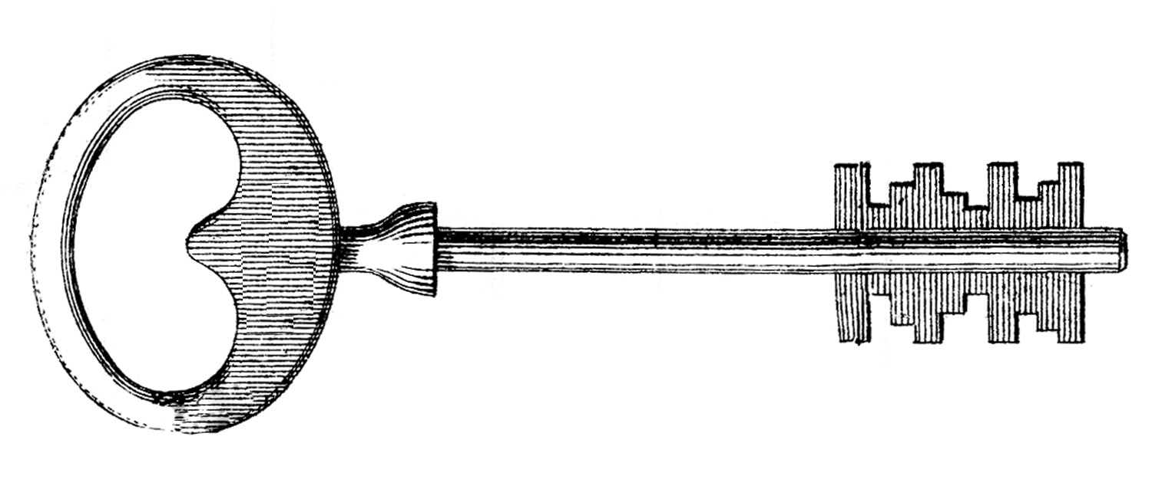
Voyage of the Beagle
The individual who contributed more to our understanding of evolution than anyone was Charles Darwin.
In 1831 he set sail for a voyage around the world on the H.M.S. Beagle.
During his travels, Darwin made numerous observations and collected evidence that led him to propose a revolutionary hypothesis about the way life changes over time.

Slide 6
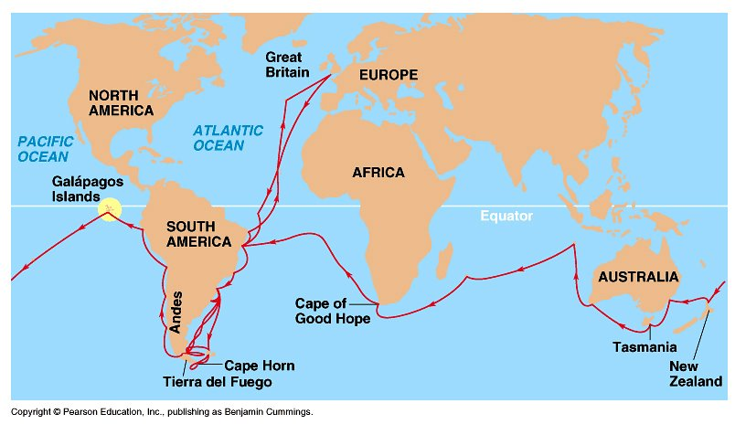

Slide 7
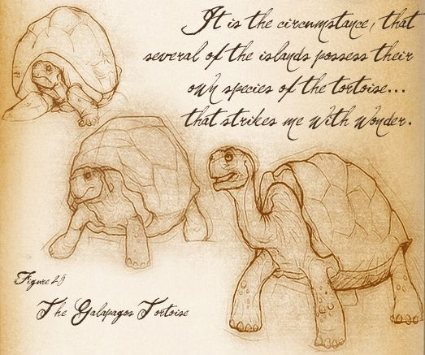
Darwin collected plant and animal specimens wherever the ship anchored, and would then study them while at sea.
He filled many notebooks with his observations and thoughts.
Eventually coming up with a scientific explanation for the diversity of life on this planet.

Slide 8
Darwin’s Observations
1) Patterns of Diversity: Darwin noted how so many plants and animals seemed so well suited to whatever environment they inhabited.
He was impressed by the many ways in which organisms survived and produced offspring.
He was also puzzled by where different species lived, and did not live.
Ex. why were there no rabbits in Australia, despite the presence of habitats that seemed perfect for them? Similarly, why were there no kangaroos in England?

Slide 9
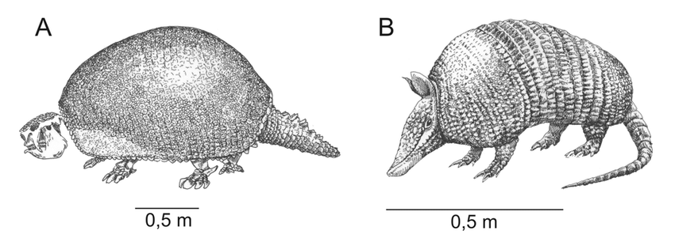
2) Living Organisms & Fossils: Darwin soon realized that living animals represented just part of the puzzle.
Darwin collected the preserved remains of ancient organisms called fossils.
Some resembled organisms still alive today, while others were unlike any other creature he had ever seen.
Why had so many of these species disappeared?
How were they related to living species?

Slide 10
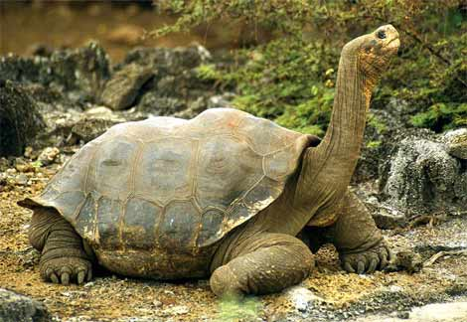
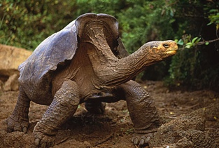
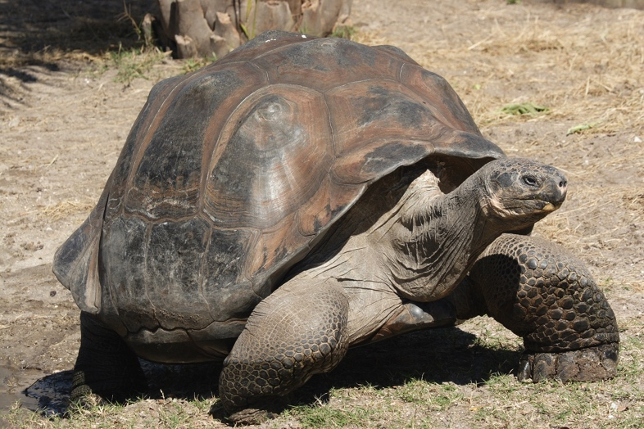
3) The Galapagos Islands: the most influential stop on Darwin’s voyage.
Darwin noted that although they were close together they had very different climates.
He was fascinated by the land tortoises, marine iguanas, and finches that varied in predictable ways from one island to another.

Slide 11
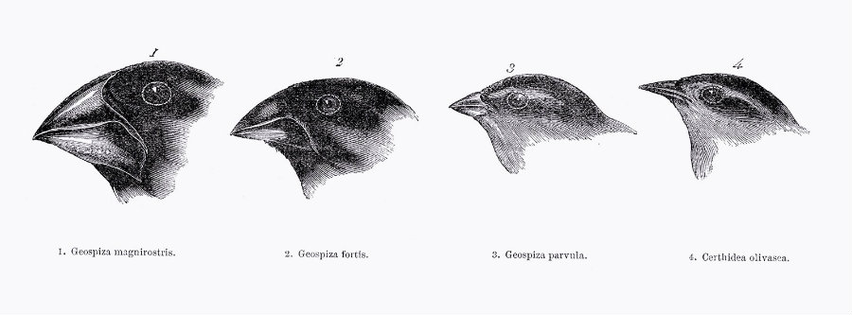
He noted that the shape of tortoise’s shell could be used to identify which island it inhabited.
He also collected an assortment of birds that had differently shaped beaks. At first he thought they were wrens, finches, warblers, and blackbirds.

Slide 12
The Journey Home
Darwin observed that the characteristics of many animals and plants varied noticeably among the different islands of the Galapagos.
He began to wonder if animals living on different islands had once been members of the same species.

Slide 13
1.2 – IDEAS THAT SHAPED DARWIN’S THINKING
Darwin’s voyage came during one of the most exciting periods in the history of Western science.
During this time a rich fossil record was challenging the traditional view that Earth had been created only a few thousand years ago.
Darwin began to realize that what he was observing did not fit into this view of unchanging life.

Slide 14
An Ancient, Changing Earth
During the 18th and 19th centuries, scientists gathered information suggesting that Earth was very old and had changed slowly over time.
Hutton and Lyell helped scientists recognize that Earth is many millions of years old, and the processes that changed Earth in the past are the same that operate in the present.

Slide 15
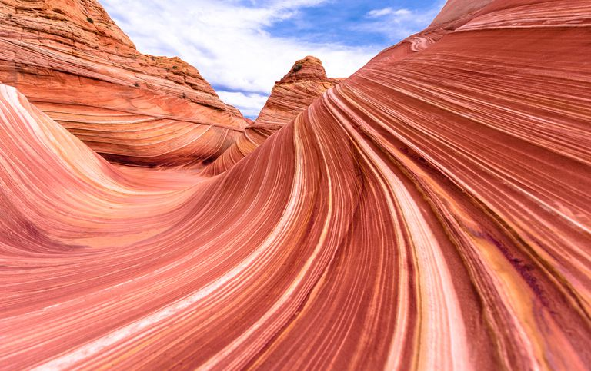
Hutton and Geological Change
In 1795, James Hutton proposed that layers of rock form very slowly.
Also that some rocks are moved up by forces beneath Earth’s surface.
And that rocks, mountains, and valleys are shaped by natural forces including rain, wind, heat, and cold temperatures.
Hutton proposed that these processes occur very slowly over millions of years.

Slide 16
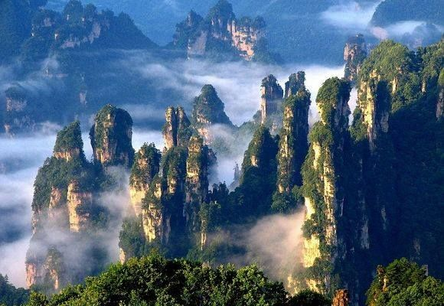
Lyell’s Principles of Geology
Lyell stressed that scientists must explain past events in terms of processes that they can observe such as volcanic eruptions and erosion.
His work explained how geological features could be built up or torn down over long periods of time.

Slide 17
This understanding of geology influenced Darwin in two ways.
1. If Earth could change over time, might life change as well?
2. He realized that it would have taken many years for life to change in the way he suggested. This would have been possible only if Earth were extremely old.

Slide 18
Lamarck’s Evolution Hypotheses
Jean-Baptiste Lamarck was among the first scientists to recognize that living things have changed over time.
He also realized that organisms were somehow adapted to their environments.
Lamarck proposed that by selective use or disuse of organs, organisms acquired or lost certain traits during their lifetime. These traits could then be passed on to their offspring. Over time, this process led to change in a species.

Slide 19
A) Tendency Toward Perfection: he proposed organisms change and acquire features that help them live successfully in their environments.
B) Use and Disuse: he proposed organisms could alter the size or shape of particular organs by using their bodies in new ways.
C) Inheritance of Acquired Traits: Lamarck thought that acquired characteristics could be inherited. Ex. if a giraffe elongated it’s neck to reach higher trees, it’s offspring would inherit the elongated neck.

Slide 20
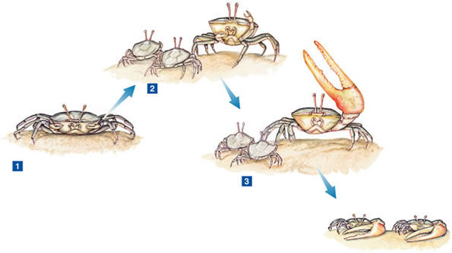

Slide 21
Evaluating Lamarck’s Hypotheses
Lamarck’s hypotheses was incorrect in several ways.
Lamarck like Darwin did not know how traits are inherited.
He did not know that an organism’s behaviour has no effect on it’s heritable characteristics.
However, he was the first to develop a hypotheses of evolution and to realize that organisms adapt to their environment.

Slide 22
Population Growth
Another important influence on Darwin came from economist Thomas Malthus.
In 1798, Malthus noted that babies were being born faster than people were dying.
Malthus reasoned that if the human population continued to grow unchecked, sooner or later there would be insufficient living space and food for everyone.
Darwin developed questions around this proposal that became central to his explanation of evolutionary change, such as…
What factors determine which offspring survive and reproduce?

Slide 23
1785 – James Hutton
Proposed Earth is shaped by geological forces that took place over extremely long periods of time. Estimates Earth to be millions of years old.
1809 – Jean – Baptiste Lamarck
Lamarck publishes his hypotheses of inheritance of acquired traits. The ideas are flawed, but is the first to propose a mechanism of evolution
1750
1800
1798 – Thomas Malthus
Malthus predicts that the human population will grow faster than the space and food supplies needed to sustain it.

Slide 24
1833 – Charles Lyell
In the second volume of Principles of Geology, he explains that processes occurring now have shaped Earth’s geological features over long periods of time
1858 – Alfred Wallace
Wallace writes to Darwin, speculating on evolution by natural selection, based on his studies of the distribution of plants and animals
1850
1900
1831 – Charles Darwin
Sets sail on the H.M.S. Beagle
1859 – Charles Darwin
Publishes On the Origin of Species

Slide 25
1.3 – DARWIN PRESENTS HIS CASE
When Darwin returned to England in 1836, he made some remarkable discoveries.
The birds he collected turned out to be different species of finches, all of whom migrated over from South America, and subsequently became different species specialized to the island they inhabited.
The tortoises and marine iguana’s had a similar story.

Slide 26
Publication of On the Origin of Species
Darwin filled notebooks with his ideas about species diversity and the process that would later be called evolution.
He did not rush to publish his thoughts as they would challenge fundamental scientific beliefs and spent 25 years gathering as much evidence as he could.
In 1858 he received a short essay from Alfred Wallace, that summarized the same thoughts on evolutionary change Darwin had.
At a scientific meeting later that year, Wallace’s essay was presented together with some of Darwin’s work.

Slide 27
Inherited Variation and Artificial Selection
Darwin’s conversations with plant and animal breeders lead him to believe that there was heritable variation within an organism – differences that are passed from parents to offspring.
Darwin termed the process of selective breeding of plants and animals artificial selection.
In artificial selection, nature provided the variation, and humans selected those variations that they found useful.

Slide 28
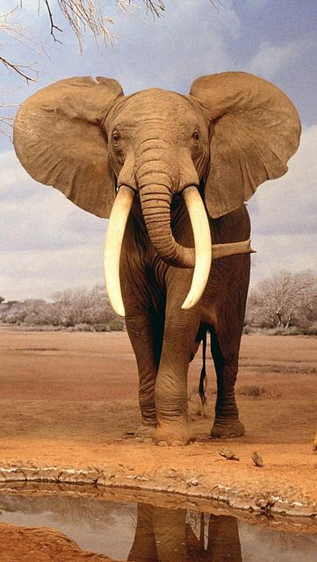
Evolution by Natural Selection
Darwin’s next insight was to compare in nature to artificial selection.
He developed a scientific hypothesis to explain how evolution occurs.
This is where he made his greatest contribution – and his strongest break with the past.

Slide 29
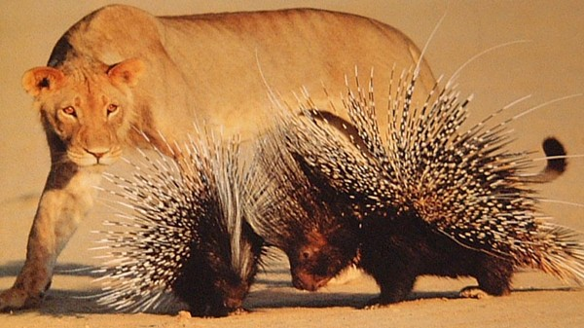
The Struggle for Existence
The struggle for existence means members of each species compete regularly to obtain food, living space, and other necessities of life.
In this struggle, the faster predators can catch more prey, and prey that are better camouflaged or have defenses can avoid being caught.

Slide 30
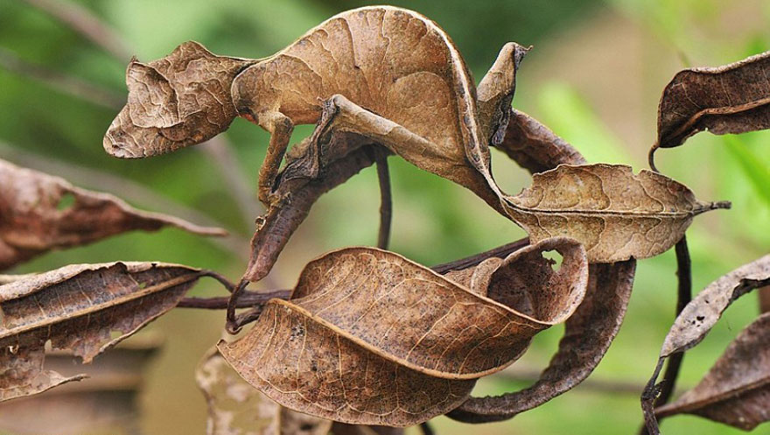
Survival of the Fittest
Darwin called the ability of an individual to survive and reproduce in its environment fitness.
He proposed fitness is a result of adaptations.
An adaptation is an inherited characteristic that increases an organisms chance of survival.
Adaptations can include anything from anatomical/structural characteristics, physiological processes or functions, and behaviour.

Slide 31
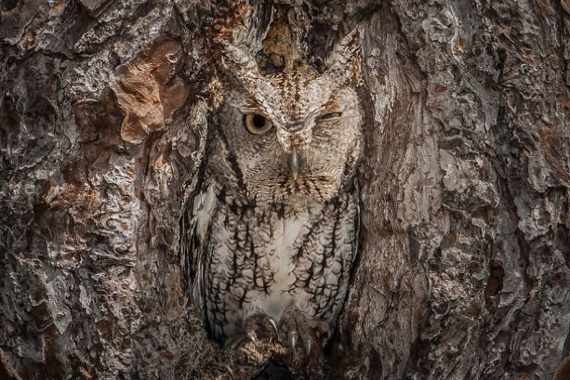
The concept of fitness is central to the process of evolution.
Generation after generation, individuals compete to survive and produce offspring.
Individuals that are better suited to their environment – with adaptations that enable fitness – survive and reproduce most successfully.
Darwin called this process survival of the fittest.

Slide 32
Because of its similarities to artificial selection, Darwin referred to survival of the fittest as natural selection.
In both artificial and natural selection, only certain individuals of a population produce new individuals.
Overtime natural selection results in changes in the inherited characteristics of a population. These changes increase a species’ fitness in it’s environment.
Natural selection cannot be seen directly, it can only be observed as changes in a population over many generations.

Slide 33
Descent With Modification
Each living species has descended, with changes, from other species over time.
He referred to this principle as descent with modification.
This implies that all living organisms are related to one another.
If we look far enough back, we could find the common ancestors of all living things.
This is the principle known as common descent.
All species – living and extinct – were derived from common ancestors.

Slide 34
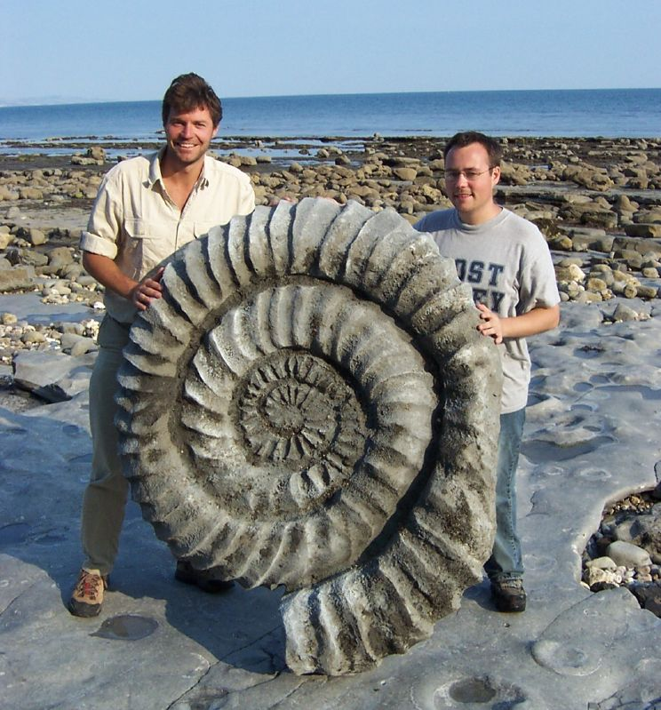
Evidence of Evolution
Darwin argued that living things have been evolving on Earth for millions of years. Evidence for this process could be found in the fossil record, geographical distribution of living species, homologous structures, and embryology.

Slide 35
1. The Fossil Record
By comparing fossils from older rock layers with fossils from younger layers, scientists could document the fact the life on Earth has changed over time.
Researchers have discovered many transitional fossils that document various intermediate stages in the evolution of modern species from organisms that are now extinct.
Gaps remain in the record of many species, and these gaps are important as they point out uncertainties in our understanding of exactly how some species evolved.

Slide 36
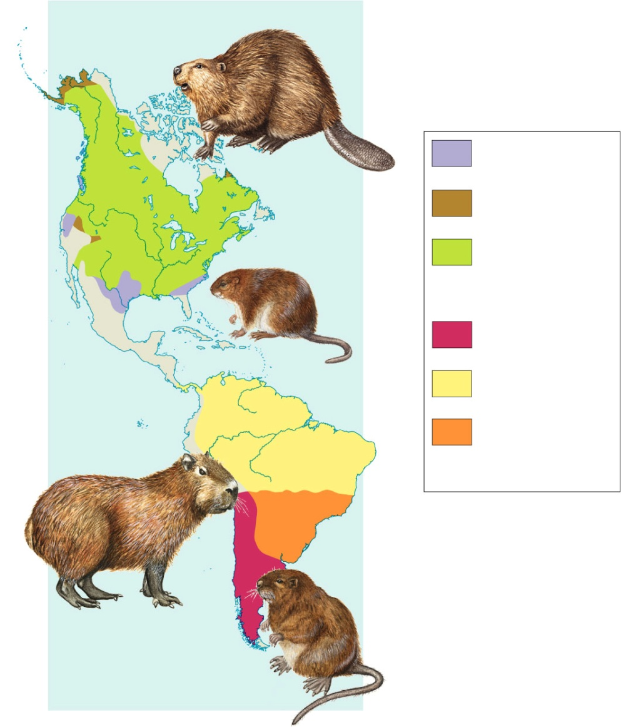
2. Geographic Distribution of Living Species
Darwin noted two observations with regards to geography.
Some species modified to their different environments from a single common ancestor.
While others who lived on different continents, yet had similar ecological conditions, evolved striking features in common despite having different ancestors.

Slide 37
3. Homologous Body Structures
Structures that have different mature forms but develop from the same embryonic tissues are called homologous structures.
Provides strong evidence that all four-limbed vertebrates have descended, with modifications, from common ancestors.
Not all homologous structures serve important functions, some are merely traces of homologous organs.
These vestigial organs may resemble miniature legs, tails, or other structures.

Slide 39
Similarities in Embryology
The early stages, or embryos, of many animals with backbones are very similar.
What do these similarities mean?
Same groups of embryonic cells develop in the same order and in similar patterns or produce the tissues and organs of all vertebrates.
These common cells and tissues, growing in similar ways, produce the homologous structures discussed earlier.

Slide 40
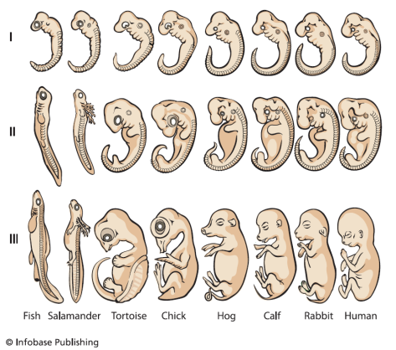

Slide 41
Summary of Darwin’s Theory
Individual organisms differ, and some of this variation is heritable.
Organisms produce more offspring than can survive, and many that do, do not reproduce.
Organisms compete for limited resources.
Each individual organism has advantages and disadvantages. Individuals best suited survive and reproduce, and pass on their traits to their offspring. This causes species to change over time.
Species alive today are descended with modification from ancestral species in the past. This unites all organisms on Earth into a single tree of life.

