Slide 1
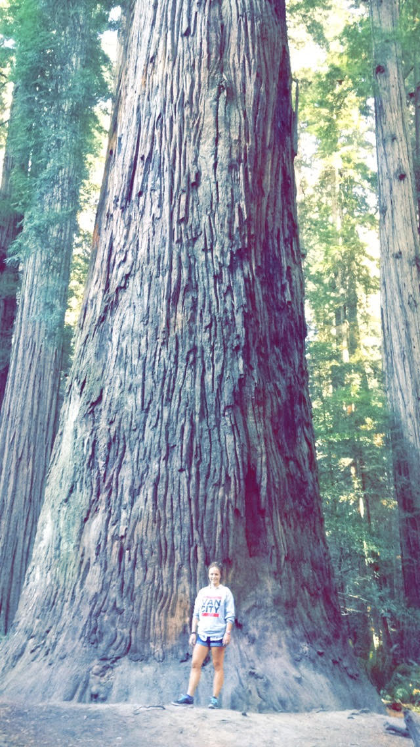
12 - Plant Diversity
Ms. Martel

Slide 2
Are All Plants The Same?
1. Obtain three plants, a metric ruler, and a hand lens.
2. Make a table to record your data.
3. Identify three major parts of each plant. Measure the heights of the plants and the sizes of their parts.
4. Use the hand lens to examine the plants. Record your observations.

Slide 3
Think About It…
Comparing & Contrasting: How are the three plants alike? How are they different?
Inferring: What are the functions of the major parts of each plant?
Classifying: Use your observations to classify the three plants into groups. Explain your reasons for classifying them in these groups.

Slide 4
12.1 – INTRODUCTION TO PLANTS
Where plants are plentiful, other organisms such as animals, fungi, and microorganisms, take hold and thrive.
Plants provide the base for food chains on land.
They provide shade, shelter, and oxygen for animals of every size and kind.
The oldest fossil evidence of plants is 470 myo.

Slide 5
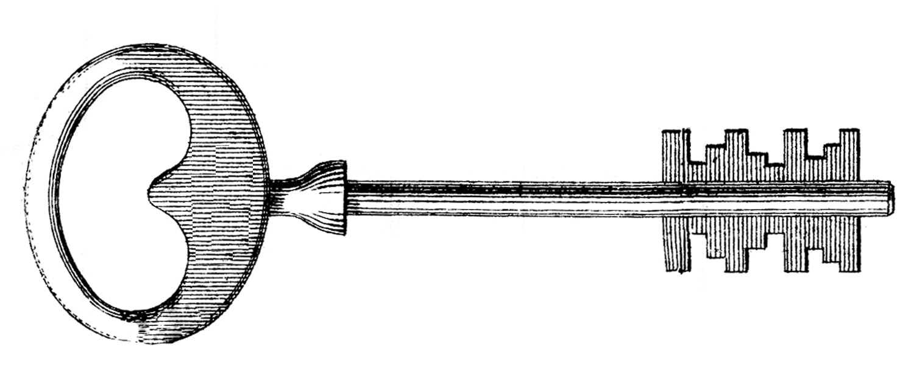
What Is A Plant?
Plants are multicellular eukaryotes that have cell walls made of cellulose. They develop from multicellular embryos, and carry out photosynthesis using green pigments chlorophyll a & b.
Plants include tree, shrubs, and grasses, as well as other organisms, such as mosses and ferns.
Most are autotrophs, although a few are parasites or saprobes.

Slide 6
With a few exceptions, plants do not gather food nor do they move about or struggle directly with their predators.
They cannot run away from danger.
So how are plants so successful?
It’s helpful to think of plants as stationary animals that eat sunlight.

Slide 7
The Plant Life Cycle
Plant life cycle have two alternating phases, a diploid phase and a haploid phase.
This is known as alternation of generations
During the two phases, mitosis and meiosis alternate to produce the two types of reproductive gametes and spores.
The diploid phases is known as the sporophyte, or spore-producing plant.
The haploid phase is known as the gametophyte, or gamete-producing plant.

Slide 8
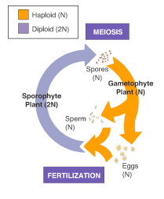

Slide 9
The earliest plants, mosses and ferns, require water to reproduce.
Seed plants have reproductive cycle that can be carried out without water.

Slide 10
What Plants Need to Survive
Surviving as stationary organisms on land is a difficult task, but plants have developed a number of adaptations that enable them to succeed.
The lives of plants center on the need for sunlight, water and minerals, gas exchange, and the transport of water and nutrients throughout the plant body.

Slide 11
Sunlight
Plants use energy from sunlight to carry out photosynthesis.
Every plant displays adaptations shaped by the need to gather sunlight.
Photosynthetic organs such as leaves are arranged on the stem to maximize light absorption.

Slide 12
Water & Minerals
All cells require a constant supply of water.
Plants must obtain and deliver water to all of their cells.
Water is a raw material of photosynthesis, it is used up quickly when the sun is shining.
Sunny conditions can cause living tissues to dry out
Thus, plants have developed structures that limit water loss.
As they absorb water, plants also absorb minerals.

Slide 13
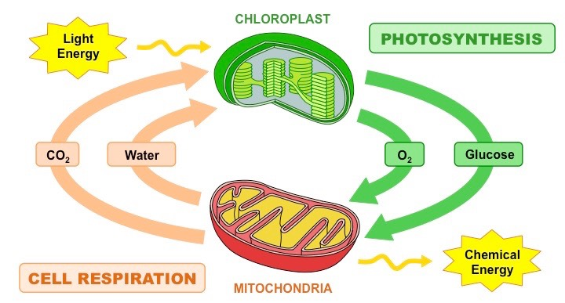
Gas Exchange
Plants require oxygen to support cellular respiration, as well as carbon dioxide to carry out photosynthesis.
They must exchange these gases with the atmosphere without losing excessive amounts of water through evaporation.

Slide 14
Movement of Water & Nutrients
Plants take up water & minerals through their roots but make food in their leaves.
Most plants have specialized tissues that carry water & nutrients upward from the soil and distribute the products of photosynthesis throughout the plant body.
Simpler plants carry out these functions by diffusion

Slide 15
Early Plants
For most of Earth’s history, plants did not exist.
Life was concentrated in the oceans, lakes, and streams.
Algae and photosynthetic prokaryotes added oxygen to the planets atmosphere.
As plants colonized land, they changed the environment in ways that made it possible for other organisms to develop.
How plants evolved structures that acquire transport, and conserve water is the key to answering this question.

Slide 16
Origins in the Water
The first plants evolved from an organism much like multicellular green algae living today.
Multicellular green algae have the same size, colour, and appearance of plants.
They also have similar reproductive cycles, and identical cell walls and photosynthetic pigments.

Slide 17
The First Plants
The first true plants were dependent on water to complete their life cycles.
Over time, the demands of life on land favoured the evolution of plants more resistant to the drying rays of the sun.
From here, several major groups of plants evolved.
One group developed into mosses and their relatives
Another lineage gave rise to ferns, cone-bearing plants, and flowering plants.

Slide 18
Overview of the Plant Kingdom
Botanists divide the plant kingdom into four groups based on three important features:
Water conducting tissues
Seeds
Flowers
Today, plant scientists can classify plants more precisely by comparing the DNA sequences of various species.

Slide 19
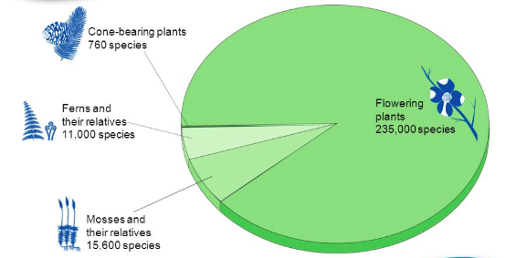

Slide 20
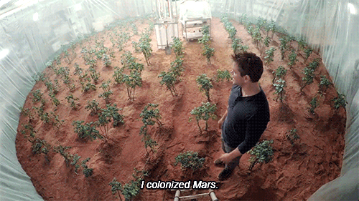
“Plantastic” Voyage

Slide 21
12.2 - BRYOPHYTES
Mosses and their relatives are called bryophytes, or nonvascular plants.
Unlike all other plants, they do not have specialized tissues that move water and nutrients (vascular tissue).
Bryophytes have life cycles that depend on water for reproduction. Lacking vascular tissue, these plants can draw up water by osmosis only a few centimeters above the ground

Slide 22
Groups of Bryophytes
The most recognizable feature of bryophytes is that they are low-growing plants that can be found in moist, shaded areas.
Bryophytes include mosses, liverworts, and hornworts.

Slide 23
Mosses
The most common bryophytes are mosses, which are members of the phylum Bryophyta.
They grow in swamps and bogs, near streams, and in rain forests.
Many can tolerate low temperatures, allowing them to grow in harsh environments.
They’re actually the most abundant plant in polar regions.
Each moss plant has a thin, upright shoot that looks like a stem with tiny leaves.
When they reproduce, they produce thin stalks containing a capsule. This is the sporophyte stage.

Slide 24
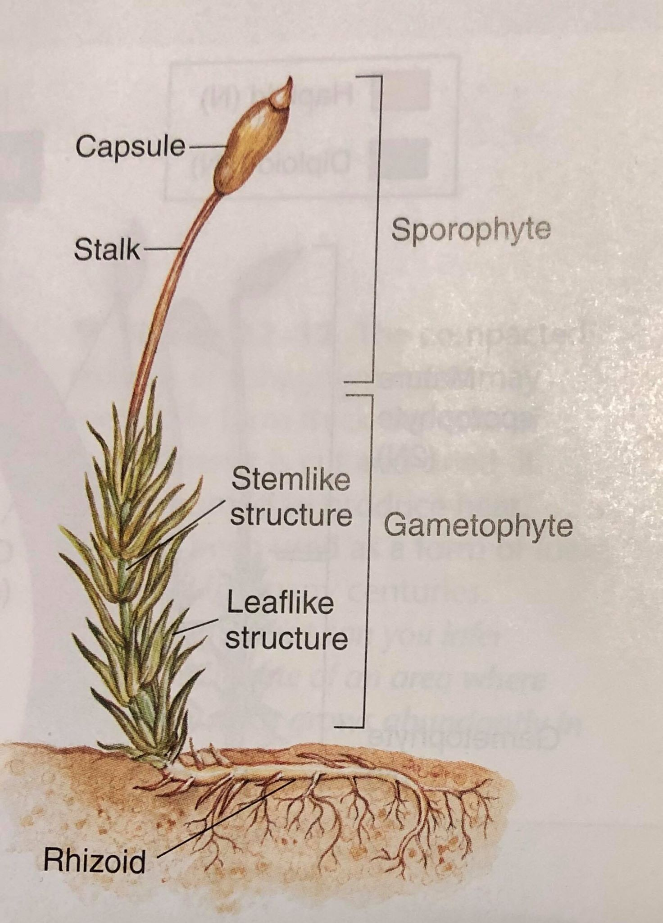
Because the “leaves” of mosses are only one cell thick, these plants lose water quickly.
They do not have true roots, instead they have rhizoids, which are long thin cells that anchor them in the ground and absorb water and minerals from the soil.

Slide 25
Liverworts
These plants belong to the phylum Hepaticophyta
The liverworts gametophytes form broad and thin structures that draw up moisture directly from the surface of the soil.
When mature, the gametophytes produce structures that look like umbrellas which carried the structures that produce eggs and sperm.
Some liverworts can reproduce asexually by means of gemmae.
Gemmae can divide by mitosis to produce a new individual.

Slide 26
Hornworts
Hornworts are members of the phylum Anthocerophyta.
They are found only in soil that is damp nearly all year round.
The hornworts sporophyte looks like a tiny green horn.

Slide 27
Human Use of Mosses
Sphagnum mosses are a group of mosses that thrive in the acidic water of bogs.
They can absorb many times their own weight, and act as a natural sponge.
In certain environments, the dead remains accumulate and form peat.
Peat can be cut from the ground and burned as fuel.
Peat moss is also used in gardening to help the soil retain water.

Slide 28
12.3 – SEEDLESS VASCULAR PLANTS
Bryophytes have only one way to transport water – from cell to cell.
This limits their height to just a few centimeters.
Fossil evidence shows that the evolution of vascular tissue, which is specialized to conduct water and nutrients throughout the plant is what allowed plants to grow to new heights.

Slide 29
Evolution of Vascular Tissue: A Transport System
Both forms of vascular tissue – xylem and phloem – can move fluids through the plant body, even against the force of gravity.
Xylem: a transport subsystem that carries water upward from the roots to every part of a plant.
Phloem: transports solutions of nutrients and carbohydrates produced by photosynthesis.
Lignin: is a substance that make the cell walls rigid, enabling vascular plants to grow very tall.

Slide 30
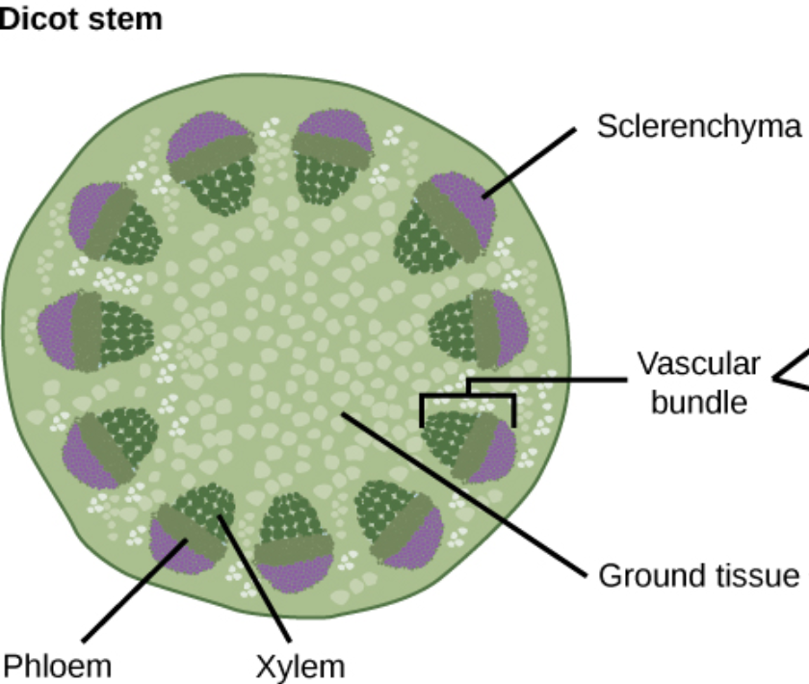

Slide 31
Ferns & Their Relatives
Seedless vascular plants include club mosses, horsetails, and ferns.
The most numerous phylum of these is the ferns. Ferns have true roots, leaves, and stems.
Roots are underground organs that absorb water and minerals
Leaves are photosynthetic organs that contain one or more bundles of vascular tissue.
The vascular tissue is gathered into veins made of xylem and phloem.
Stems are supporting structures that connect roots and leaves, shuttling water and nutrients between them.

Slide 32
Club Mosses
Today, club mosses are small plants that live in moist woodlands. They look like miniature pine trees.
Ancient club mosses grew into huge trees, and produced some of Earth’s first forests.

Slide 33
Horsetails
The only living genus of Arthrophyta is the horsetail.
They have true leaves, stems, and roots.
During colonial times, horsetails were commonly used to scour pots and pans.

Slide 34
Ferns
Ferns are members of phylum Pterophyta.
More than 11, 000 species of ferns are living today.
Ferns have true vascular tissues, strong roots, creeping or underground stems called rhizomes, and large leaves called fronds.
They are often found living in the shadows of forest trees, where direct sunlight hardly penetrates.

Slide 35
12.4 – SEED PLANTS
Seed plants are divided into two groups: gymnosperms and angiosperms.
Gymnosperms bear their seeds directly on the surfaces of the cones.
Angiosperms, aka flowering plants, bear their seeds within a layer of tissue that protects the seed.

Slide 36
Reproduction Free From Water
Unlike mosses and ferns, seed plants do not require water for fertilization of gametes.
Because of this, seed plants can live almost anywhere.
Adaptations that allow seed plants to reproduce without water include flowers or cones, the transfer of sperm by pollination, and the protection of embryos in seeds.

Slide 37
Cones & Flowers
Cones are the seed bearing structure of gymnosperms.
Flowers are the seed bearing structure of angiosperms.

Slide 38
Pollen
A pollen grain is where the male gamete is in seed plants.
Sperm produced is carried to the female reproductive structure by wind, insects, or small animals.
The transfer of pollen is called pollination.

Slide 39
Seeds
A seed is an embryo of a plant that is encased in a protective covering and surrounded by a food supply.
An embryo is an organism in its early stages of development.
The seed coat surrounds and protects the embryo and keeps the contents of the seed from drying out.

Slide 40
Seeds may also have special tissues or structures that aid in their dispersal to other habitats.
For example, some are textured so they stick to animals.
Seeds can survive long periods of bitter cold, extreme heat, or drought – beginning to grow only when conditions are once again right.

Slide 41
QUICK LAB: How do seeds differ from spores?
Materials: Fern, microscope, microscope slide, eyedropper, sunflower seeds in shells, brown paper bag, hand lens.
Procedure:
1. Scrape the sporangia from the underside of a fern onto a microscope slide. Add a drop of water and a coverslip and examine the slide under low power. Sketch a few spores.
2. Open a sunflower seed. With a hand lens, examine the nutlike kernel of the seed and sketch the embryo.
3. Rub the seed on a brown paper bag and hold it to the light, a bright spot indicates lipids.

Slide 42
Analyze & Conclude
1. Observing: What evidence do you have that nutrients are stored in sunflower seeds?
2. Predicting: A spore and a seed are deposited in an area where the soil is poor in nutrients. Which is more likely to survive in a nutrient-poor environment? Explain?
3. Formulating Hypotheses: Consider two populations of ferns and seed plants. How might their reproductive strategies, or methods of reproduction, have an impact on their survival? Over time, how might these events affect the overall diversity of plants?

Slide 43
Gymnosperms – Cone Bearers
The most ancient surviving seed plants are the gymnosperms.
Gymnosperms include gnetophytes, cycads, ginkgoes, and conifers.
These plants all reproduce with seeds that are exposed – gymnosperm means “naked seed”

Slide 44
Gnetophytes
The reproductive scales of these plants are clustered into cones.
Welwitschia is found in the Namibian desert, and is one of the most remarkable species of this group.
It’s leathery leaves grow continuously and spread across the ground.

Slide 45
Cycads
Cycads are beautiful palm-like plants that reproduce with large cones.
They can be found growing in tropical and subtropical places such as Mexico, the West Indies, Florida, and parts of Asia, Africa, and Australia.

Slide 46
Ginkgoes
Ginkgoes were common when dinosaurs were alive, but today there remains only one species.
They were carefully cultivated in China planted around temples.
They are now often planted in urban settings in the US, as they are resistant to air pollution and provide a lot of shade.

Slide 47
Conifers
By far the most common gymnosperm with over 500 known species.
Includes pines, spruces, firs, cedars, sequoias, redwoods, junipers, and yews.
Some conifers can live for more than 4000 years.
Other species like the redwood can grow more than 100 meters in height.

Slide 48
Ecology of Conifers
Today, conifers thrive in a wide variety of habitats in several different biomes.
Conifer leaves have specific adaptations to dry conditions.
For example, pine needles reduce the surface area from which water can be lost by evaporation.
They also have a thick, waxy layer that covers conifer leaves.
Most conifers are evergreens, meaning they retain their leaves throughout the year.

Slide 49
12.5 – ANGIOSPERMS – FLOWERING PLANTS
Flowering plants originated on land and soon came to dominate Earth’s plant life.
The vast majority of species have a method of reproduction and development involving flowers and fruits.

Slide 50
Flowers & Fruits
Angiosperms develop unique reproductive organs known as flowers.
Flowers are an advantage because they attract animals such as bees, moths, or hummingbirds, which transport pollen.
This is much more efficient than wind.

Slide 51
Fruits contain ovaries, which surround and protect the seeds.
The presence of an ovary gives angiosperms their name: angiosperm means “enclosed seed.”
After pollination the ovary develops into a fruit.
When an animal eats a fruit, and then pass the seeds through their bodies at a secondary location, this increases their habitat range.

Slide 52
Diversity of Angiosperms
The angiosperms are incredibly diverse.
There are many different ways to categorize them.
The categories can overlap, but provide a way of organizing the diversity of angiosperms.

Slide 53
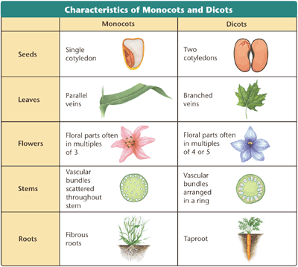

Slide 54
Monocots & Dicots
There are two classes within the angiosperms: monocots and dicots.
Monocots and dicots are named for the number of seed leaves, or cotyledons, in the plant embryo. Monocots have one seed leaf, and dicots have two.
Monocots include corn, wheat, lilies, orchids, and palms.
Dicots include roses, clover, tomatoes, oaks, and daisies.

Slide 55
Woody & Herbaceous Plants
Flowering plants can be subdivided into various groups according to the characteristics of their stems.
Woody plants are made primarily of cells with thick cell walls.
These include trees, shrubs, and vines.
Plant stems that are smooth and nonwoody are characteristic of herbaceous plants.
Examples include dandelions, and sunflowers.

Slide 56
Annuals, Biennials, and Perennials
The life span of plants is determined by a combination of genetic and environmental factors.
There are three categories of plant life spans: annual, biennial, and perennial.

Slide 57
Some plants grow from seed to maturity, flower, produce seeds, and die all in the course of one growing season.
These are annuals.
This group includes many garden plants such as marigolds, petunias, zinnias, as well as wheat and cucumber.

Slide 58
Angiosperms that complete their life cycle in two years are called biennials.
In the first year they germinate, grow roots, very short stems, and sometimes leaves.
The second year, they grow new stems, leaves, and produce flowers and seeds.
Evening primrose, parsley, celery, and foxglove are biennials.

Slide 59
Flowering plants that live for more than two years are called perennials.
Some such as peonies, asparagus, and many grasses, have herbaceous stems that die each winter and are replaced in the spring.
Most have woody stems.
Palm trees, sagebrush, maple trees, and honeysuckle are all examples.

