Slide 1
Welcome to Chemistry 11
Learn to use the technology to help you excel in chemistry
Msdmartel.weebly.com
Use for notes and to evaluate the workbook

Slide 2
Never attempt Unauthorized Experiments
in the Lab!
Follow the Approved Procedure for the Experiment!

Slide 3
1. Follow all instructions carefully. Use special care when you see the word CAUTION.
2. Never do laboratory work unless your teacher is supervising you.
3. Always follow the directions given by your lab manual or by your teacher.
4. Know the location of ALL safety equipment in the laboratory.
5. Always wear protective eyewear and clothing when instructed to by your teacher.

Slide 4
NEVER run, push, or engage in horseplay of any kind in the laboratory.
Never eat or drink in the laboratory.
Report any accident, spill, or breakage to you teacher immediately.
Always clean your work area and equipment at the end of the lab period.
Dress properly for the laboratory. a. Roll long sleeves above the wrist b. Don’t wear loose-fitting sleeves or bulky outerwear. c. Tie back long hair.
d. No sandals or open-toed shoes

Slide 5
11. Use care with electricity.
a. Electrical cords are kept away from the edge of the table where people passing by can catch them.
b. Always make sure that your hands are dry before you handle any electrical equipment.
c. Always use electrical equipment in a completely dry area.

Slide 6
12. Be careful with laboratory glassware.
a. Always check glassware before you use it. Never use glassware that is chipped or cracked. Show this glassware to your teacher.
b. Never use your bare hands to clean up broken glassware.
c. Always be careful when carrying glassware to and from you work area.

Slide 7
Be very careful with heat or fire.
a. Always use tongs to handle hot containers, objects, or materials.
b. Always heat liquids slowly and point open test tubes away from others in the lab.
c. Always turn burners and hotplates off when they are not in use.
d. Never allow flammable materials such as alcohol near an open flame.
e. Notify your teacher in the case of a burn. Minor burns should be soaked immediately in cold running water.

Slide 8
Use extreme care when working with chemicals.
a. Always treat the chemicals in the laboratory as hazardous.
b. Never taste substances in the laboratory.
c. Wear goggles whenever you are heating chemicals.
d. If you spill any chemicals on your skin, wash your skin with running water.
e. If chemicals splash in your eyes, use an eyewash.
f. Notify your teacher immediately of any chemical spills or accidents.

Slide 9
15. Disposal of chemicals.
a. Chemicals that are indentified as safe by your teacher can be poured down the sink and rinsed with water.
b. Toxic or poisonous chemicals must be poured into the toxic waste container.
c. Left over chemicals are never poured back into the stock container where they came from.
You should not wear contact lens during laboratory experiments
because volatile chemicals can get trapped under them.
16. You should know the basic WHIMIS symbols.

Slide 10
Compressed Gas

Slide 11
Flammable & Combustible Material

Slide 12
Oxidizing Material

Slide 13
Immediate & Serious Toxic Effects
A material that will quickly cause injury, illness, or death.

Slide 14
Other Toxic Effects
A material that can cause serious illness over a long period of time, or less serious in a short time

Slide 15
Biohazard Infectious Material

Slide 16
Corrosive Material

Slide 17
Dangerously Reactive Material

Slide 19
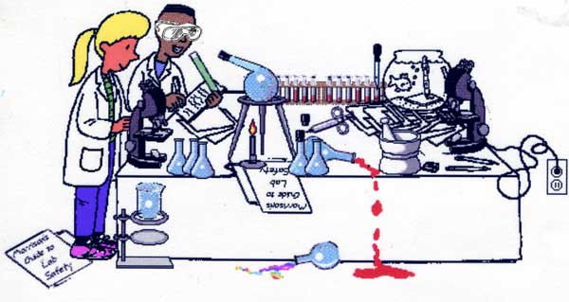
Wear safety googles
Don’t heat closed containers
Point them in a safe direction
Clean up spills
electrical cords kept away from the edge of the table

Slide 20
Use Accepted Techniques for Checking Odors
I like to snort the chemical!
It’s safer to fan or waft the chemical to your nose! chemical to your nose!

