Slide 1
1.6 – What medicines help protect us from microbes that make us sick?
Ms. Martel

Slide 2
Concept 1 – Traditional First Peoples medicines & treatments come from resources in nature
First Peoples in BC have a strong tradition of using resources from nature for medicinal purposes.
For generations, they’ve relied on plants, animals, and even clay deposits to treat various illnesses and conditions.
Here are some examples:

Slide 3
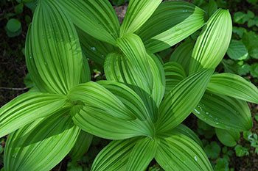
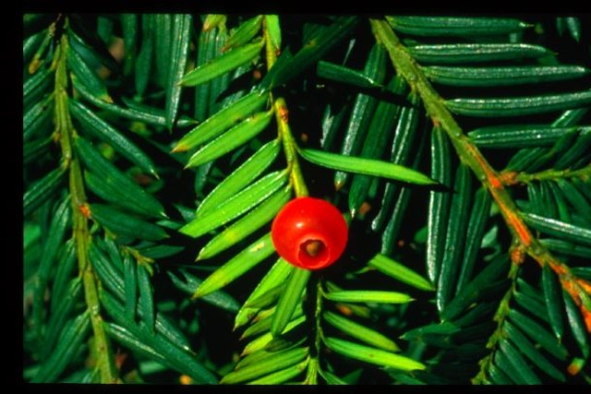
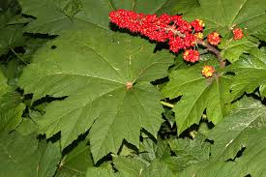
Devil’s club is used to treat breathing and digestive disorders, as well as arthritis and diabetes
Indian hellebore is used to treat skin and scalp conditions. When its burned the smoke is used as a decongestant
Pacific yew is used to treat pain and internal injuries. The bark also has cancer fighting chemicals

Slide 4
Concept 2 – Vaccines can help us prevent infections.
Think-Pair-Share
Many babies get vaccines to protect them against diseases such as tetanus, whooping cough, measles, hepatitis B, and chicken pox.
What do you know about vaccines?
What questions do you have about vaccines?
Share & discuss your ideas.

Slide 5
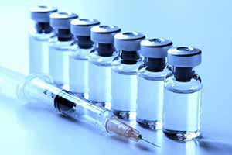
A vaccine is a substance that is given to a person or animal to protect against a specific disease.
Vaccines may be injected or taken orally.
Vaccines cause an immune response from the body
The immune system then “remembers” the exposure to the pathogen.

Slide 6
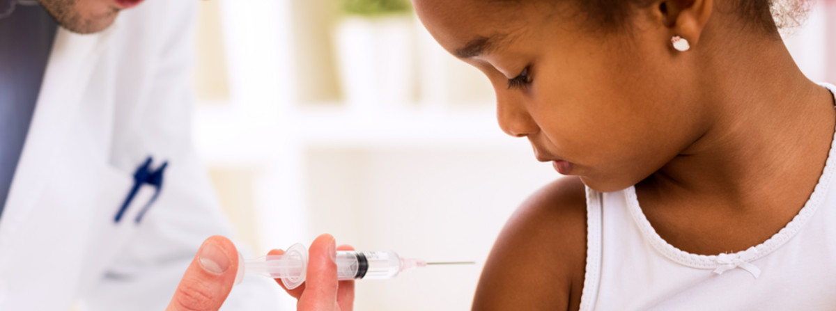
If the person is exposed to the same pathogen after being vaccinated,
The immune system will “recognize” it and begin to defend the body against it.
A vaccinated person is said to be immune against the disease.

Slide 7
TABLE 1.5 Types of Vaccines
Type of Vaccine | How It Works | Example
Live, attenuated vaccine | Contains living microbes that have been weakened so they cannot cause disease. Immune system responds strongly, giving lifelong immunity | Mumps, chickenpox, yellow fever
Inactive vaccines | Contains microbes that have been killed by heat, radiation, etc. Immune system responds weakly. To keep immunity, person has to get boosters periodically | Rabies, whooping cough
Subunit vaccines | Only pieces of microbes are used for vaccine. Immunity is provided after several doses. | Hepatitis B, Hib
Toxoid vaccines | Made using toxins that some types of bacteria produce. Booster shots are usually needed to keep immunity | Diphtheria, tetanus

Slide 8
Vaccines & Public Health
Many health agencies in Canada make strong arguments in favour of people getting vaccines.
Help protect people against diseases that can cause permanent damage such as:
Blindness
Muscles paralysis
Heart damage
And infertility to name a few.
The more people who get vaccinated, the less the disease can spread.

Slide 9
Table 1.6 Effectiveness of Certain Vaccines
Vaccines can help stop an outbreak from turning into an epidemic or pandemic.
Disease | # of reported cases, 1980 | # of reported cases, 2014 | % decrease in cases
Diphtheria | 97 774 | 7321 | 92.5
Measles | 4 211 431 | 267 582 | 93.6
Polio | 57 795 | 371 | 99.4
Tetanus | 114 248 | 11 392 | 90.0
Whooping cough | 1 982 384 | 220 504 | 88.9

Slide 10
Concept 3 – Antibiotics can treat bacterial infections
Think-Pair Share
Have you ever taken an antibiotic?
Can you explain how it helped you?
If not, how could you find the answer to this question?
What other questions do you have about antibiotics?
Share & discuss your ideas

Slide 11
Antibiotics – substances that fight infections by interfering with the life processes of bacteria.
Either they’re killed or prevented from reproducing.
Antibiotics are specific to a certain bacteria.
Cannot be used against viruses.

Slide 12
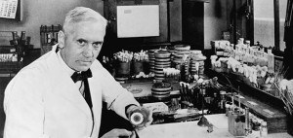
Penicillin – The first Antibiotic Available on a Global Scale
Penicillin was discovered in 1928 by accident when Alexander Fleming noticed that bacteria in his lab, would not grow around an accidental mould patch.
Penicillin is now a known antibiotic, and saved countless soldiers in WWII.
Development of other antibiotics soon followed.

Slide 13
The Development of Antibiotic-Resistant Bacteria
While the world has benefited from antibiotics, however, a serious problem has arisen from their overuse.
Many bacteria have become resistant to antibiotics, making diseases more difficult to treat.
As time passes, resistant bacteria will reproduce and become more common.
The antibiotic will no longer be effective.
A different antibiotic then needs to be used to fight the infection.
This is how “superbugs” develop.

Slide 14
