Slide 1
1.4 – What interactions occur between humans and micro-organisms?
Ms. Martel

Slide 2
Concept 1 – A micro-organism is an organism that can only be seen with a microscope
Micro-organisms are smaller than 1mm, so they can only be seen with a microscope.
Example, bacteria are approximately 1μm in length.
Thousands of them could fit in an area the size of the period at the end of this sentence.
Micro-organisms, or microbes for short, live in every place you can imagine.
From the air, water, sandy beaches, forests, mountains, grasslands, Arctic, deserts, - microbes are everywhere.

Slide 3
The Importance of Microbes
Microbes have many important roles in ecosystems such as:
1. Decomposers – they break down dead or waste materials. This returns nutrients to the soil. Plants then use these nutrients.
2. Nitrogen-fixing bacteria – these bacteria make nitrogen available to plants. They live on the roots and change nitrogen into a form plants can use.
3. Phytoplankton – are the main producers in oceans and lakes. They produce about 50% of the oxygen in the atmosphere.

Slide 4
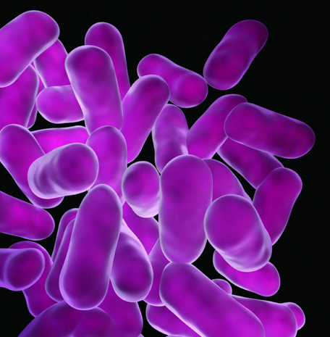
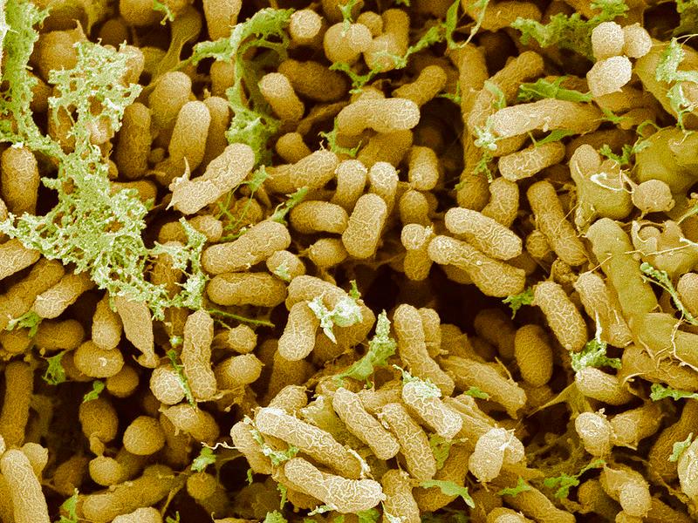
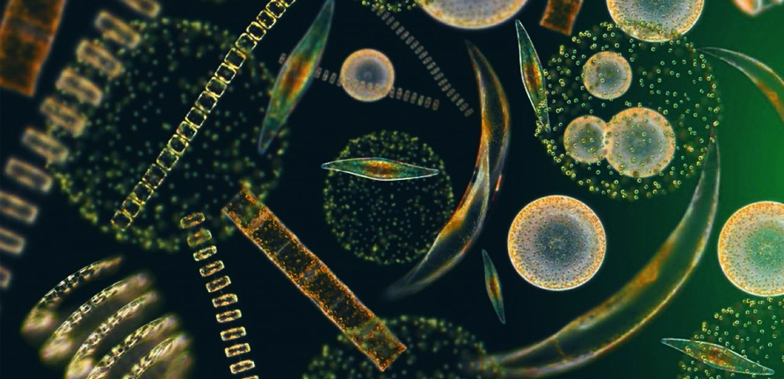

Slide 5
Concept 2 – Humans have both negative and positive interactions with microbes.
Negative Interactions with Microbes
Under certain conditions, phytoplankton can reproduce very quickly and form red-tide which is a toxin found in shellfish, that humans then eat.
This is an example of a pathogen, microbes that make people sick.
Other example include E. Coli and Botulism, which can cause food poisoning, vomiting, and fever.
Causing sickness is our only negative interaction with microbes.
Mould for example causes food to spoil and wood to rot, which can affect our homes.

Slide 6
Positive Interactions with Microbes
There are more than 400 types of bacteria in your intestine right now, but they a natural part of your GI tract and help keep you healthy.
Some help to digest food, others help prevent infection
Others help to absorb vitamin K which helps your bot clot properly.

Slide 7
Table 1.3 – Some Positive Interactions With Microbes
Interaction | Examples
Food production | Bacteria are used to make foods like cheese, yogurt, pickles, and even chocolate.
Medicine production | Bacteria are used to make antibiotics, and insulin that people with diabetes need.
Agricultural production | They’re also used to genetically modify crops to better protect them against insects or disease.
Waste management | More than 300 species are used in water treatment plants to decompose wastes.
Disaster recovery | Bacteria can be used to clean up oil spills, and areas contaminated by chemical spills etc.

