Slide 1
1.3 – How are cells different from one another?
Ms. Martel

Slide 2
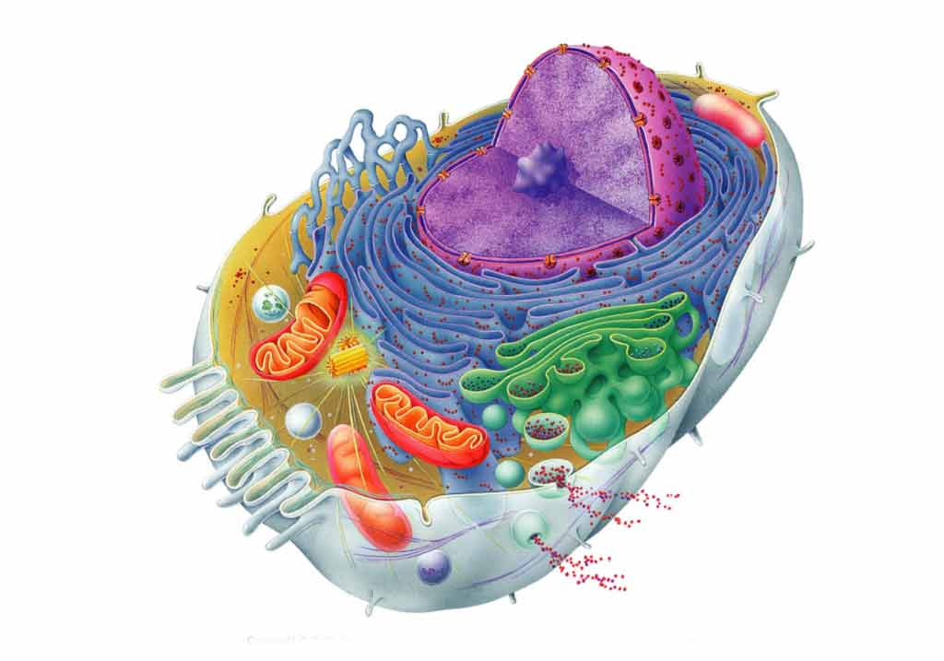
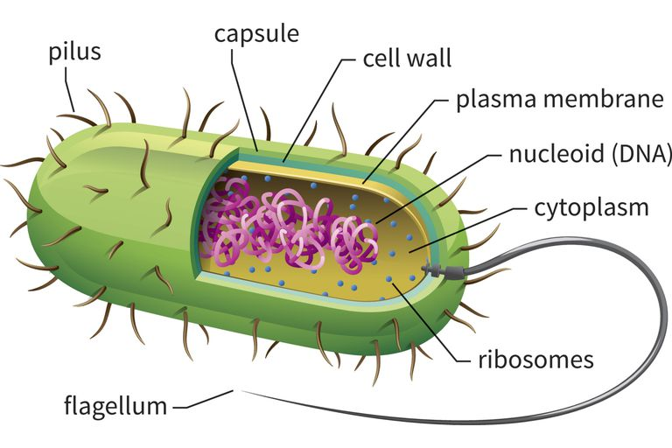
Concept 1 – Scientists classify cells into two types based on the presence or absence of a nucleus
As scientists have studied millions of cells, they have developed criteria that let them classify cells into two main types.
1. Prokaryotic cells
2. Eukaryotic cells

Slide 3
Prokaryotic Cells
A prokaryotic cell does not have a separate nucleus.
They are also simpler than the other types of cells.
They have fewer internal structures.

Slide 4
Eukaryotic Cells
A eukaryotic cell has a nucleus
This contains the genetic material. (example: DNA)
The nucleus is surrounded by a membrane.
Eukaryotic cells also contain other internal structures called organelles.
These carry out cell processes.

Slide 5
Table 1.2 – Comparing Prokaryotic and Eukaryotic Cells
Characteristic | Prokaryotic Cell | Eukaryotic Cell
Genetic material contained in nucleus surrounded by membrane | No | Yes
Organelles surrounded by membranes | No | Yes
Size and complexity | Smaller & less complex | About 10x larger & more complex
Can carry out all processes needed to stay alive. | Yes | Yes
Example | Bacteria | Plant & animal cells

Slide 6
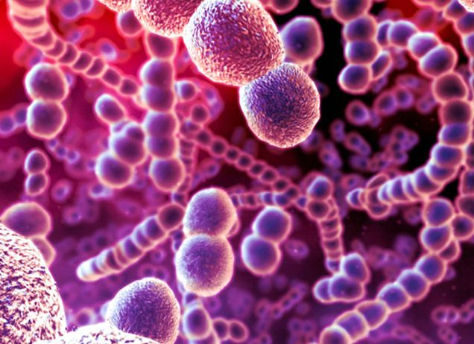
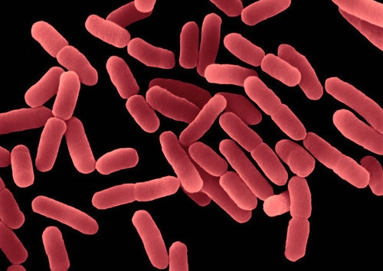
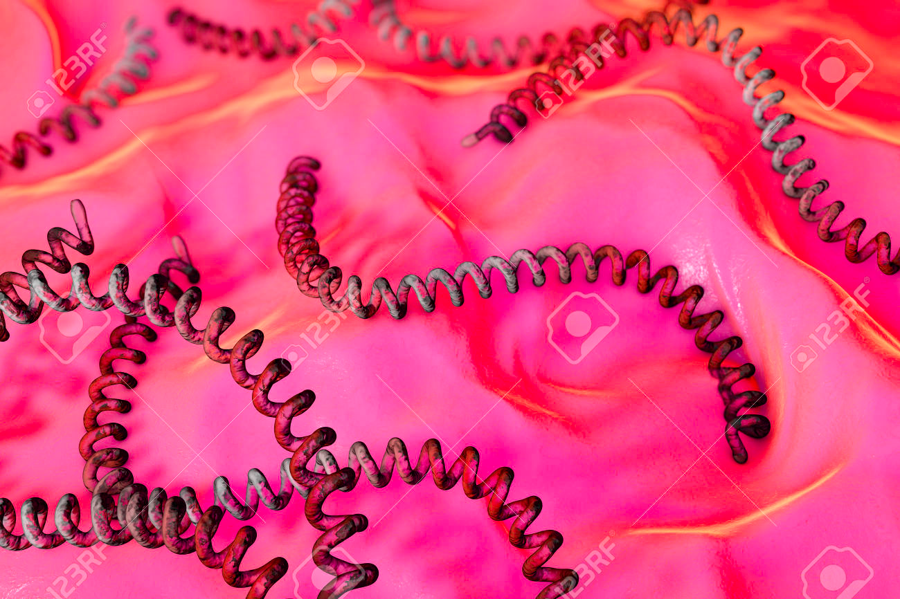
Concept 2 – Bacteria are prokaryotic cells
Describing Bacteria
Observe the different types of bacteria shown. How would you describe each cell? How are they similar/different?
Could you live in boiling water or super-salty lakes? You could if you belonged to archaea. They live in extreme environments.
You’re probably more familiar with the other group of prokaryotes: bacteria

Slide 7
Bacteria | Archaea
Lack a nucleus Has a cell wall Has a cell membrane that surrounds cytoplasm Genetic material, and protein-making structures called ribosomes float within the cytoplasm. Some have flagella for movement | Lack a nucleus Has a cell wall Has a cell membrane that surrounds cytoplasm Molecules found in archaea resemble molecules found in eukaryotes. Also have molecules that are not found in any other organism.

Slide 8
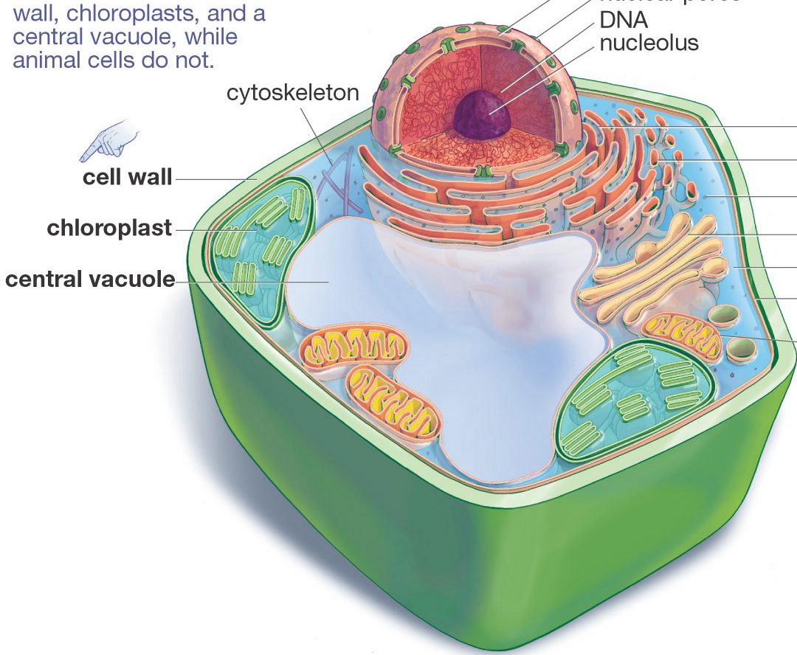
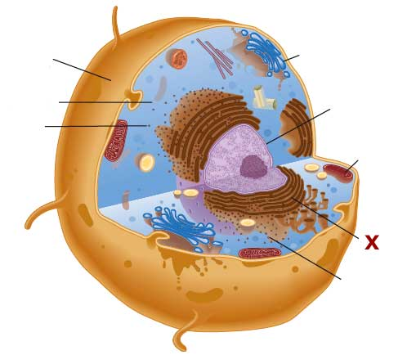
Concept 3 – Plant & animal cells are eukaryotic cells
Above is an example of a plant cell and animal cell.
Talk with a partner and discuss similarities and differences between the two.

Slide 9
A
B
Cell Organelles | Structure & Function
A. Cell Membrane | Surrounds & protects the contents of the cell. Helps control movement of food, wastes, & other substances in and out of the cell
B. Cytoplasm | Jelly-like fluid in which internal organelles float

Slide 10
D
D
C
Cell Organelles | Structure & Function
C. Cell Wall | Tough, rigid structure surrounding the cell membrane, giving plant cells a regular, box-like shape
D. Nucleus | Large, often round structure containing genetic material. Controls cell growth, reproduction, and other activities

Slide 11
F
E
F
Cell Organelles | Structure & Function
E. Vacuoles | Balloon-like spaces within the cytoplasm to store wastes, food etc. Smaller and more numerous in animal cells
F. Mitochondria | Bean-shaped structures that release energy from food molecules to power cell processes.

Slide 12
H
G
Cell Organelles | Structure & Function
G. Chloroplasts | Structures containing chlorophyll, which captures energy from the Sun to produce food in leaves of plants.
H. Vesicles | Small sacs that transport materials and sometimes help materials enter and leave the cell.

Slide 13
Plant Cells
Plant cells have organelles that carry out processes needed for plant to survive.
They also have some structures that animal cells don’t.
Cell wall: thick out structure to provide support
Large Vacuole: stores water and other substances
Chloroplasts: capture the energy in sunlight. This is also where photosynthesis happens.

Slide 14
Photosynthesis
Photosynthesis is a chemical reaction that uses the energy of sunlight to change carbon dioxide and water into sugar and oxygen.
Plants take CO2 from the air
And absorb water through their roots
Light energy comes from the Sun.
Plants need the sugar produced by photosynthesis for food.
Oxygen is also produced and released into the air.

Slide 15
Animal Cells
Animal cells have organelles that carry out life processes.
They have cell membranes that controls movement of substances into and out of the cell.
Vesicles break down waste material
Nucleus directs cells activities and contains genetic material.
Mitochondria plays a key role in cellular respiration

Slide 16
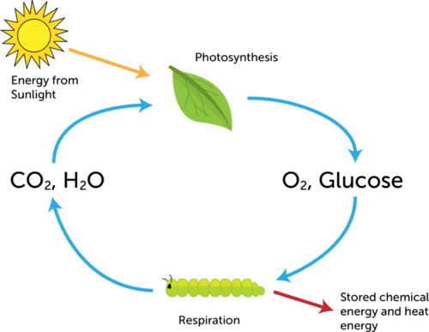
Photosynthesis & Cellular Respiration
This diagram shows the relationship between photosynthesis and cellular respiration.
They function together as an important cycle.
Most living things depend on this cycle to survive.

Slide 17
Cell Quiz Next Block!!!
Complete Worksheet to practice for cell quiz next class.

