Slide 1
1.2 – Where do living things come from?
Ms. Martel

Slide 2
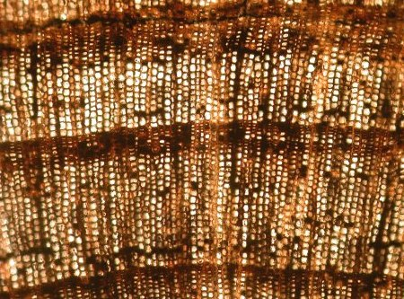
Concept 1 – Living things come only from other living things
Robert Hooke was a British scientist in the 17th century.
In the 1660’s, he created a microscope to observe tree bark.
He called the structures he saw cells, this term is still used today.
As technology for making microscopes improved, scientists were able to observe and learn more about different types of cells.

Slide 3
The Cell Theory
Scientists agree on three important statements about cells and their connection with living things.
Taken together, these statements about cells are called the cell theory.
1. All living things are made up of one or more cells.
2. All new cells come from pre-existing cells.
3. The cell is the basic unit of life.

Slide 4
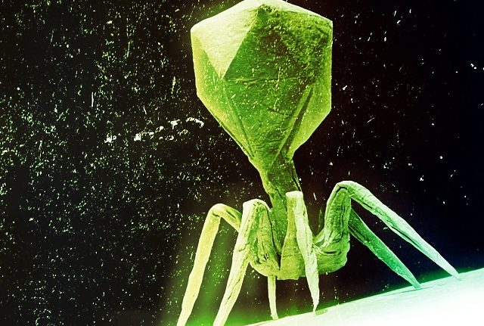
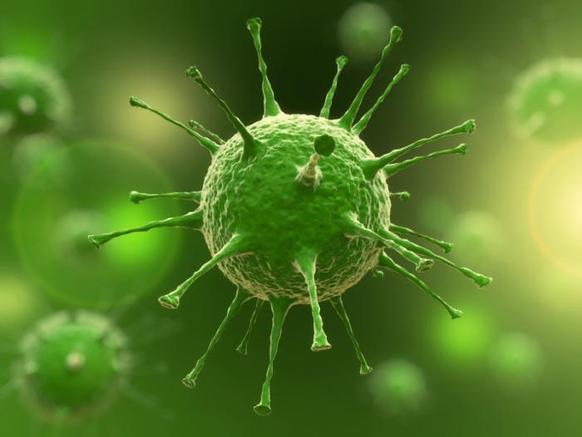
Concept 2 – Scientists debate about whether viruses are living things or not.
A virus is a strand of genetic material surrounded by a layer of protein that can infect and reproduce in a host cell.
Some viruses have a tail-like structure and fibers.
Others have a fatty membrane that surrounds the protein coat.

Slide 5
How Viruses Work
Viruses do not contain the cell parts that plant and animal cells do.
They cannot take in nutrients, use energy, produce wastes, or even reproduce on their own.
Viruses must be inside the cell of another organism, a host, to reproduce.
Viruses are dormant when they are not in a host, they are not capable of carrying out any life functions.
They can stay dormant for hours, days, or even months.
Once they reach a host, they use its cells to reproduce.
That is all viruses do inside the host: reproduce.

Slide 6
How Recent Evidence Has Changed How Scientists View Viruses
Most scientists do not consider viruses to be alive, because they do not have the characteristics of living things.
They cannot even reproduce without hijacking the structures and processes of host cells.
In the last few decades, there have been discoveries that support the notion that viruses can be considered living.

Slide 7
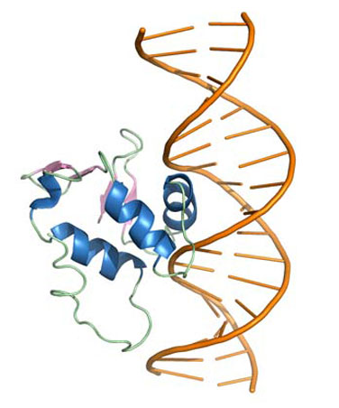
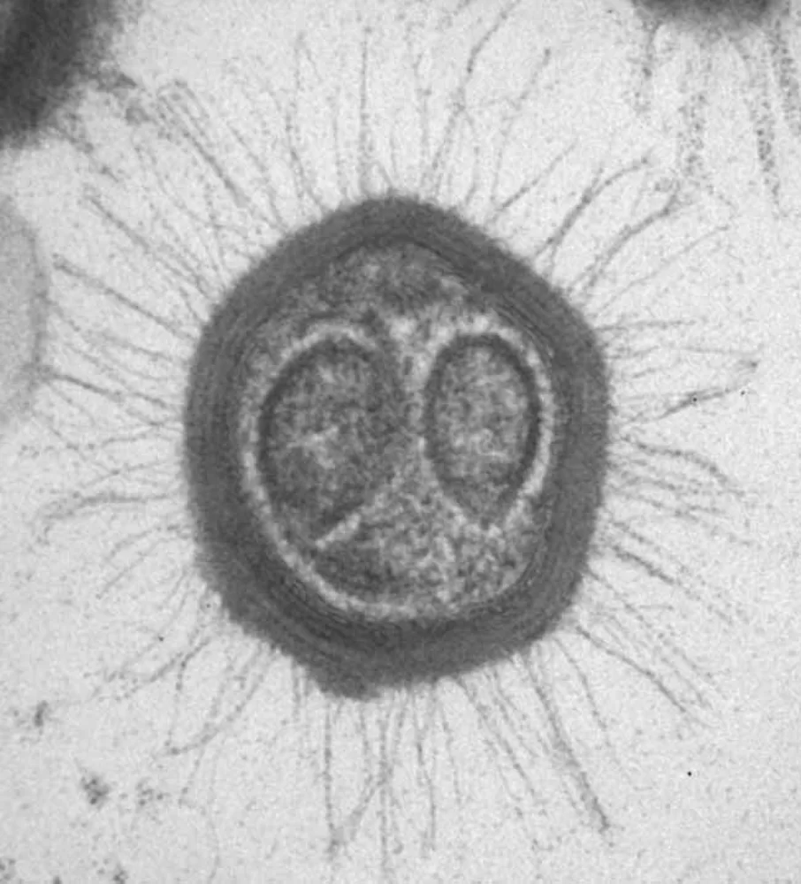
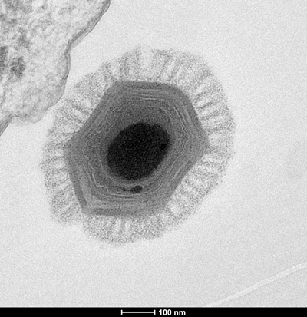
2011 – Scientists discover another large virus called the Megavirus. It has even more genetic material than the Mimivirus. Scientists believe they may have evolved from a common ancestor that was able to make its own proteins.
2015 – Scientists trace the evolutionary history of over 3000 viruses by comparing their proteins. Results showed that more than 400 proteins are shared between viruses, and 66 are unique to viruses. Scientists think this means that viruses used to have properties of cells, and then evolved as separate “organisms” at some later time.
1992-2008 – Scientists discover and research the largest and most complex virus to date: the Mimivirus. It has 5x as much genetic material as other viruses.
Some of the genetic material has never been seen before.

Slide 8
Debate – Are Viruses Alive?
With your assigned partner, choose which one of you will argue that viruses are alive, and the other will argue that they are not.
Conduct research and try to find 10 arguments to help support your stance.
Next class you will have a “mini-debate” with your partner.
Take a minute and try to find counter arguments for points your partner made.
Find someone else in the class to conduct another “mini-debate” with.
Repeat the debate another one or two times.
Debrief

