Slide 1
Observations

Slide 2
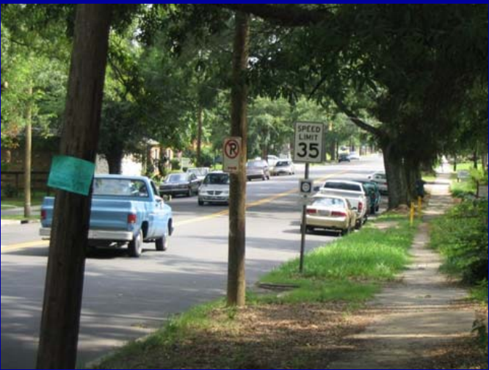
Take a good look at this picture

Slide 3
Question 1
Are there parked cars on the side of the road?

Slide 4
Question 2
What color is the pickup truck driving in the road?

Slide 5
Question 3
Are there any minivans around?

Slide 6
Question 4
What what the speed limit?

Slide 7
Question 5
Are there any people walking on the streets?

Slide 8
Take a good look at this picture

Slide 9
Answers
Yes
Blue
Yes
35
No

Slide 10
Observation Activity #2
For each group, there is one observer and one or two investigators.
Observer look at the picture for 30 seconds. The investigators should not look at the picture.
After 30 seconds, the investigators should begin questioning the observers. Each Investigator should question each observer. Then, the Investigators should attempt to reconstruct the scene based on the "eyewitness testimony"

Slide 11
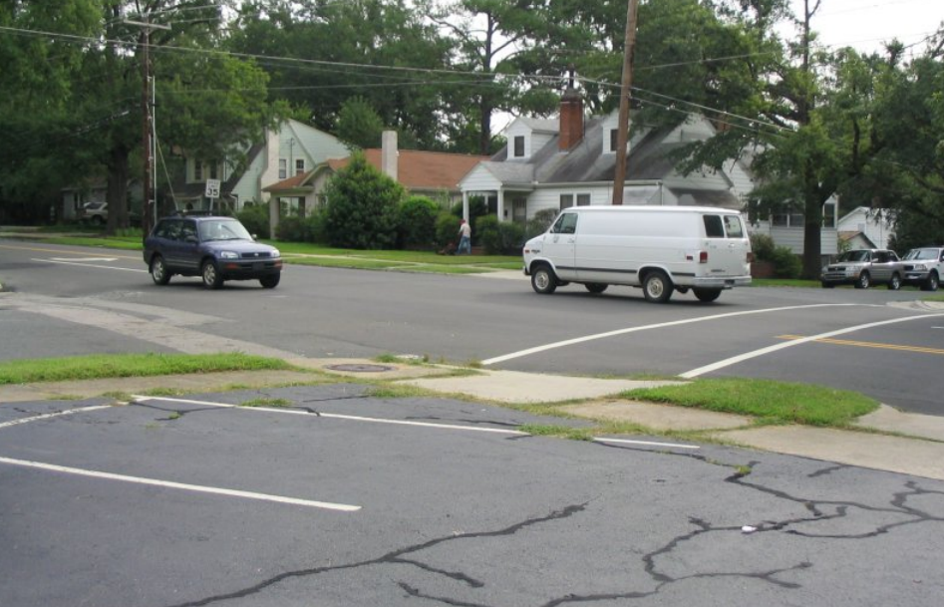

Slide 12
Potential questions
How many cars were in the intersection?
Across the street, are there any parked cars on the side?
Can you describe at least one of the cars driving through the intersection?
Are there any other potential witnesses? If they answer yes, ask the following question: What was this witness doing? Where was he?
They should have noticed a person mowing a lawn across the street.
What was the speed limit?
Was the there anyone parked in the first parking spot?

Slide 14
Weird things with observations…

Slide 15
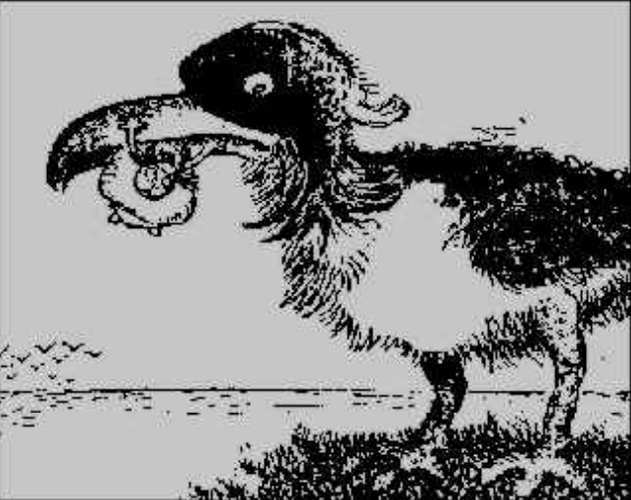
Compare this photo….

Slide 16
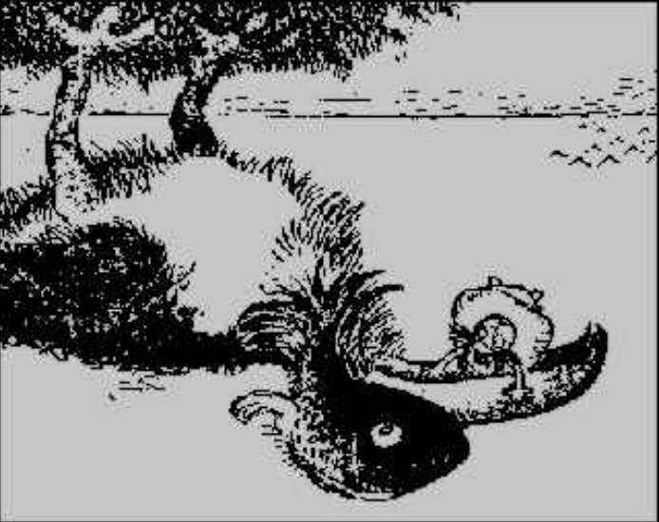
….to this one

Slide 17
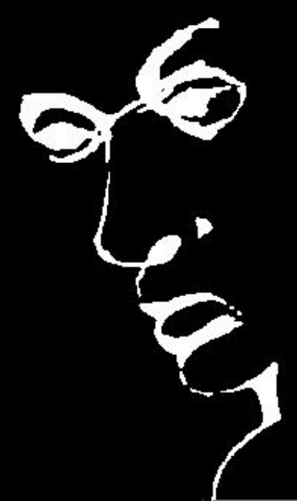
This image contains a picture and a word.
Do you see both of them?

Slide 18
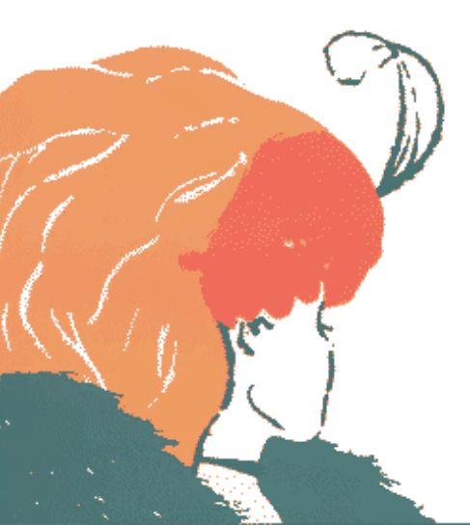
What do you observe?

Slide 19
Observation game
1. Each partner has 6 pieces of science lab equipment. You also need a divider.
2. Sit facing a partner, with the textbook/binder as a divider standing up in between.
3. Partner #1 should arrange their set of objects on their side of the divider any way they want, making sure that Partner #2 cannot see.
4. Next, Partner #1 should use words only to describe to Partner #2 how the objects are situated. No hand signals and no peeking allowed!! Try and use the observation words from the list.
5. Partner #2 follows the directions given by Partner #1 to repeat the arrangement using their own set of objects.
6. When finished, remove the folder to reveal the hidden arrangement. Do the objects match?
7. Repeat this game, and switch roles of Partner #1 and #2 this time

Slide 20
Lab Equipment
Match the pictures with the lab equipment and write their function

Slide 21
Homework
Finish lab equipment worksheet
Pick your favorite object and write at least 6 descriptive observations about it
Pick another 2 common objects and describe them so clearly that your friend could figure out what the object is. Next class we will see if your friends can figure out the objects

