Slide 1
Scientific Method
Miss Martel
Free Powerpoint Templates

Slide 2
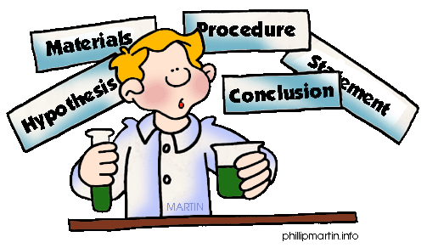
The Scientific Method

Slide 3
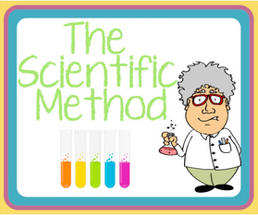
The Scientific Method
The scientific method is a way to ask and answer scientific questions by making observations and doing science experiments.
The steps of the scientific method includes:

Slide 4
The Scientific Method
Ask a Testable Question
Research
Develop a Hypothesis
Plan the Investigation
Experiment
Record Data and Observations
Write a Procedure
List the Materials
Analyze
Data
Draw a Conclusion

Slide 5
Problem/Question

The problem or question must be testable – can be answered by doing an experiment
You must be able to measure the results in some way.
Opinion questions or questions that can be answered by looking on the internet are not good scientific questions.
Notes:
Not every question is a good question that can be tested. In this class, we’re going to focus on “testable” questions, or questions that we can do experiments on. These are questions that can be answered by doing a laboratory investigation. They are NOT opinion questions or questions that can be answered by doing research in a book or on the internet. Developing a good question is important because it gives your experiment direction and lets other people know what question you are trying to answer in your experiment. It must be clear. A question such as “How do students learn best?” is not clear because there are too many different ways to test it. A better question might be, “Do students learn better before or after eating?” because it only tests one particular thing. TIP: YOU MUST BE ABLE TO MEASURE THE RESULTS IN SOME WAY FOR IT TO BE CONSIDERED A TESTABLE QUESTION.

Slide 6
Problem/Question
Are the following questions good or bad questions?
Why is Friends the best TV show ever?
How does the number of hours of sleep affect student’s work habits?
What is the effect of gender on favourite ice cream flavour?
✗
✓
✓

Slide 7
Research

Write down/use all the information that you already know about the topic.
Do research on the topic you are investigating to understand the basics.
Research is important because it helps form a hypothesis.
Notes:
Write down all information you already know
Do research in books on the topic you are investigating
Ask experts on the subject you are researching
If you find an answer to your problem/question you do not need to move on

Slide 8
The Scientific Method
Ask a Testable Question
Research
Develop a Hypothesis
Plan the Investigation
Experiment
Record Data and Observations
Write a Procedure
List the Materials
Analyze
Data
Draw a Conclusion

Slide 9
Hypothesis
Using your background research and current knowledge, make an educated guess that answers your question.
A hypothesis is a simple statement that expresses what you think will happen.
“If _____(cause)______, then _____(effect)_____.”
Notes:
A hypothesis is a special kind of prediction that forecasts (predicts) how changing one part of an experiment will affect the results. It is NOT a guess. It is an informed and well-thought out prediction that requires background information. You can also think of it as a cause-effect statement.
A hypothesis is best written in the “If ______________, then _____________.” format. After the “if” is the part the scientist will change on purpose. After the “then” is the result of the change.

Slide 10
Hypothesis
Question:
What type of pizza is preferred by eighth graders?
Hypothesis:
If eighth graders are questioned about pizza preference, then they will prefer pepperoni.
Question:
How does the internet affect a student’s daily life?
Hypothesis:
If the internet was not accessible, then students will engage in more sports.

Slide 11
The Scientific Method
Ask a Testable Question
Research
Develop a Hypothesis
Plan the Investigation
Experiment
Record Data and Observations
Write a Procedure
List the Materials
Analyze
Data
Draw a Conclusion

Slide 12
Investigation, Materials, Procedure and Experiment
Plan the Investigation
When the hypothesis is formed, follow the instructions of how the experiment will be carried out.
List the Materials
List all the materials used
Write a Procedure
Write down the steps you did to perform the experiment. The steps must be clear so that another person can reproduce the same experiment.
Experiment
Perform the experiment to test the hypothesis

Slide 13
The Scientific Method
Ask a Testable Question
Research
Develop a Hypothesis
Plan the Investigation
Experiment
Record Data and Observations
Write a Procedure
List the Materials
Draw a Conclusion
Analyze
Data

Slide 14
Observations
Describe any observations you made during the experiment. Include all information that could have affected your results such as errors or unexpected surprises.
The observations should be collected by using all 5 senses: sight, smell, touch, taste and sound

Slide 15
The Scientific Method
Ask a Testable Question
Research
Develop a Hypothesis
Plan the Investigation
Experiment
Record Data and Observations
Write a Procedure
List the Materials
Analyze
Data
Draw a Conclusion

Slide 16
Forming a Conclusion
Analyze the data you collected and summarize the results, this is called a conclusion
Use your analysis to answer your original question.
Do the results of your experiment support or oppose your original hypothesis?

Slide 17
How to Write a Conclusion
Restate the hypothesis of your experiment
Indicate if the results accept or reject the hypothesis
Explain your results

Slide 18
Look at these 2 sets of animal tracks.
List 3 observations and draw a conclusion for Frame 1

Slide 19
Now what do you think?
List 3 observations and draw a conclusion for Frame 2

Slide 20
What about now?
With more data and observations, you can draw a more accurate conclusion!
List 3 observations and draw a conclusion for Frame 3

Slide 21
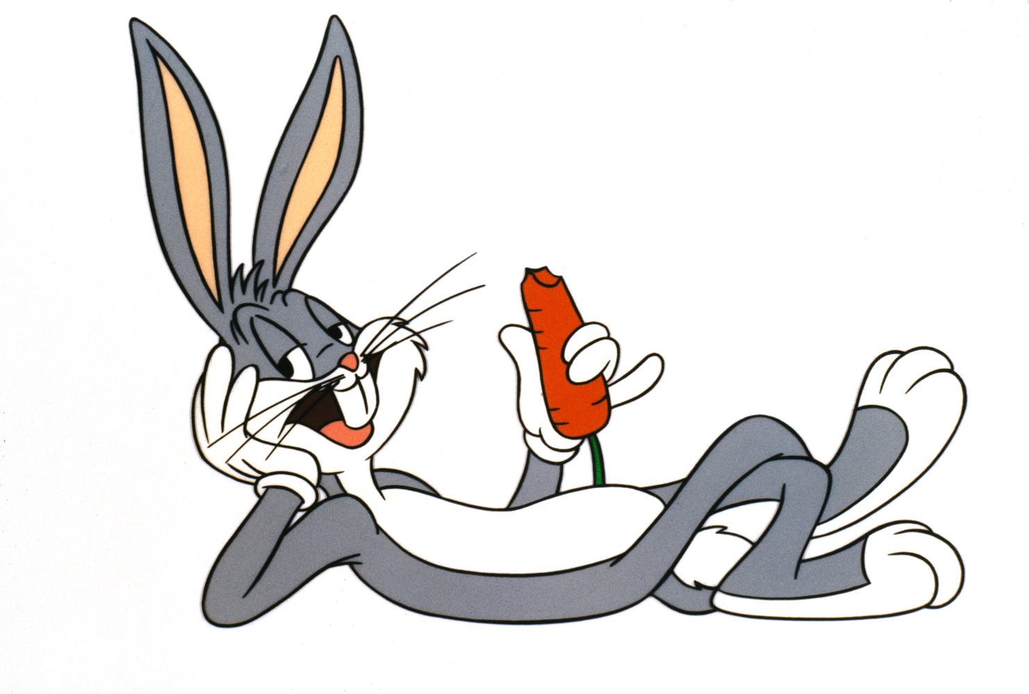
That’s all Folks!

