Slide 1
Safety in the classroom What is Science?

Slide 2
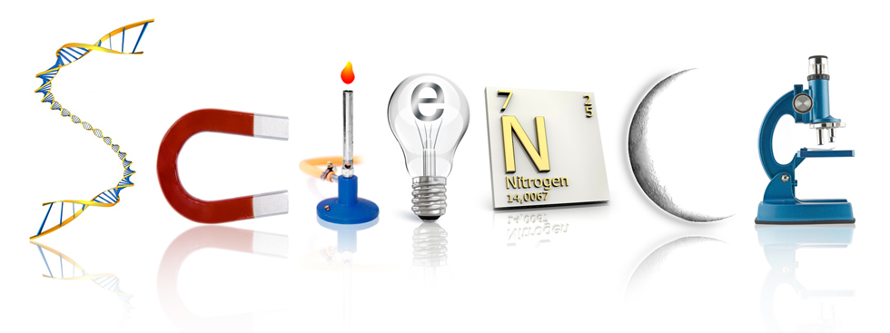
What is Science?

The word “science” comes from the Latin word scientia, meaning “knowledge” or “to know”.

Slide 3
What is Science?

Science is a particular way of knowing about the world.
Science is the search for natural explanations for natural phenomena (ex. earthquakes, plant growth).
Science gathers information about the physical and natural world through research and observations.

Slide 4
Branches of Science
Physical Science – Physics, Chemistry, Earth Science
Natural Science:
Life Science – Biology (Zoology, Human Biology, Botany)

Slide 5
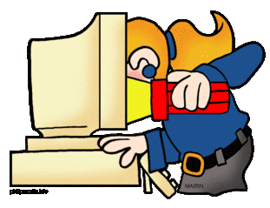
Branches of Science
Social Science:
Ex.) Sociology, Psychology, Geography
Formal Science:
Ex.) Math, Statistics
Applied Science:
Applying scientific knowledge to test models
Ex. Medicine, Technology Development

Slide 6
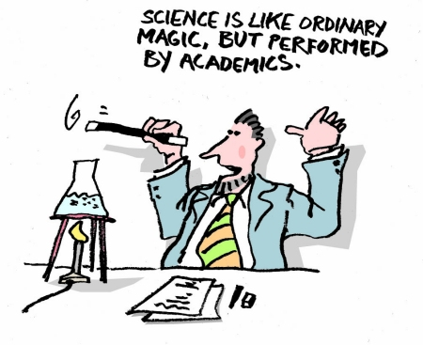
So… What is Science?

Slide 7
Working in the Science Lab
What is the first thing to be
done if there is any hazard
or injury in the lab?
Are eating or drinking permitted in the
science lab?
Tell the teacher
No, unless the drink is in a bottle

Slide 8
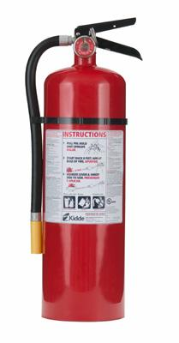
Safety Equipment in the Classroom

Where is the fire extinguisher in the classroom?
When do we use the fire extinguisher?
How far away from the fire are you when using the extinguisher?
Why do you avoid spraying it on a person?
By the right side door
On a small fire, not on a person
About 2.5 meters away
Could cause blindness, suffocate a person, since they cannot breathe

Slide 9
Safety Equipment in the Classroom

If a person is on fire, what do you try to get them to do?
Fire Triangle – Fuel, heat and oxygen are all required for a fire to start
.
STOP, DROP, and ROLL

Slide 10
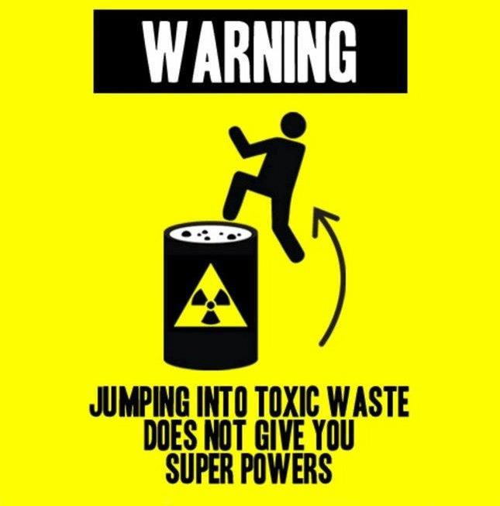

Slide 11
Emergency Procedures
When do you use the eyewash
bottle?
How do you use the eyewash bottle properly?
Chemicals get in your eyes
Keep eyes open, rinse

Slide 12
Emergency Procedures
Where is the emergency shower?
When do you use the emergency shower
When do you use the first aid kit?
What precautions are taken when helping someone who is bleeding?
Mr Jansen’s room. When chemicals spill on a large area of the body.
Small, minor cuts or scratches
Always wear gloves

Slide 13
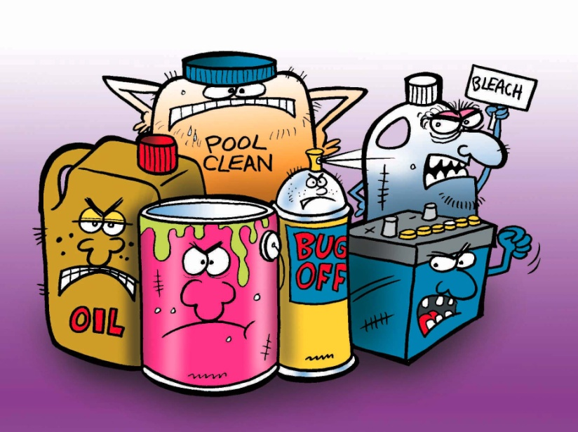
Working with Chemicals
How do you safely smell a
chemical?
If you break glassware what should you do?
How do you dispose of chemicals at the end
of a lab?
Waft (fan the smell)
Use a broom and dust pan and put in the broken glass container
As directed by the teacher, since it depends on the chemical
Notes:
Need to change on sheet

Slide 14
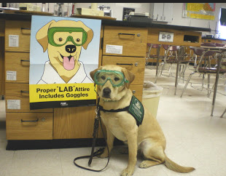
Appropriate Lab Attire
What does it mean to be dressed appropriately for a lab?
When using an open flame, long hair must be
_________.
Wear goggles
tied back

Slide 15
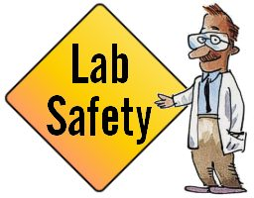
Appropriate Lab Attire
Why is wearing contact lenses not permitted during a lab?
Other than contact lenses, what else should you
avoid wearing?
Chemicals could stick to contacts
Open toed shoes and
loose fitting clothes

Slide 17
Pair Assignment
Get into groups of two, you will be given two safety scenarios.
For each scenarios, read carefully what is happening and look at the comic for extra help. Then…
Identify the hazards
Make a list of what you would do to address the situation and once the accident has occurred
Record carefully the order in which you would carry out each step

Slide 18
Hand in one sheet per group
Rubric:
Each scenarios is marked out of 4 points.
4 = everything identified
3 = one or two minor points missing
2 = one major point and/or many minor points missing
1 = more than one major point missing

